Slide 1
Building 3D Trusted Data Pipelines With Dagster, Dbt, and Duckdb
PyCon Australia 2023
Danh Phan
Adelaide, August 2023

Slide 2

About me
Danh Phan
Senior Data engineer at IDS, HESTA.
An open-source contributor & a camper
Ex. ML Researcher, Ex. Data analyst,
Ex. Web dev, Ex. Database designer.
https://danhphan.net
Views And Opinions Are My Own!

Slide 3
Overview
Context
Trusted data pipelines
Demo

Slide 4
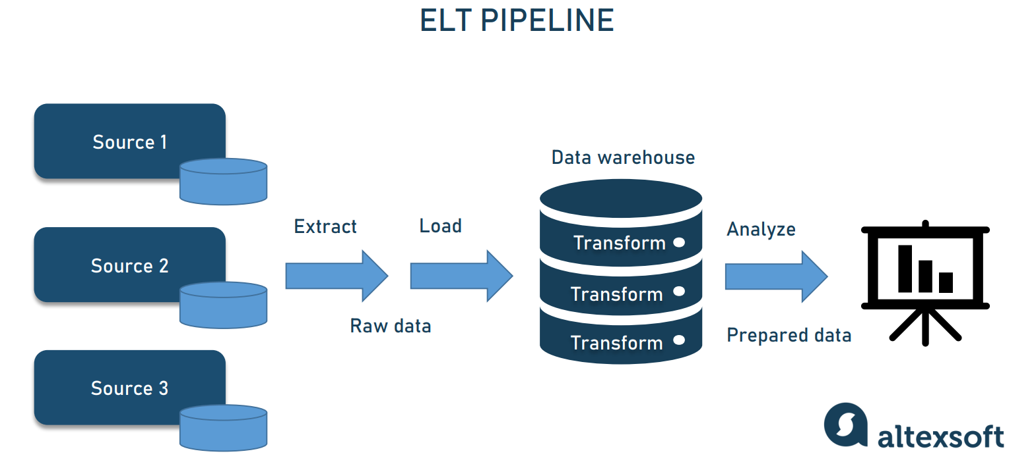

Slide 5
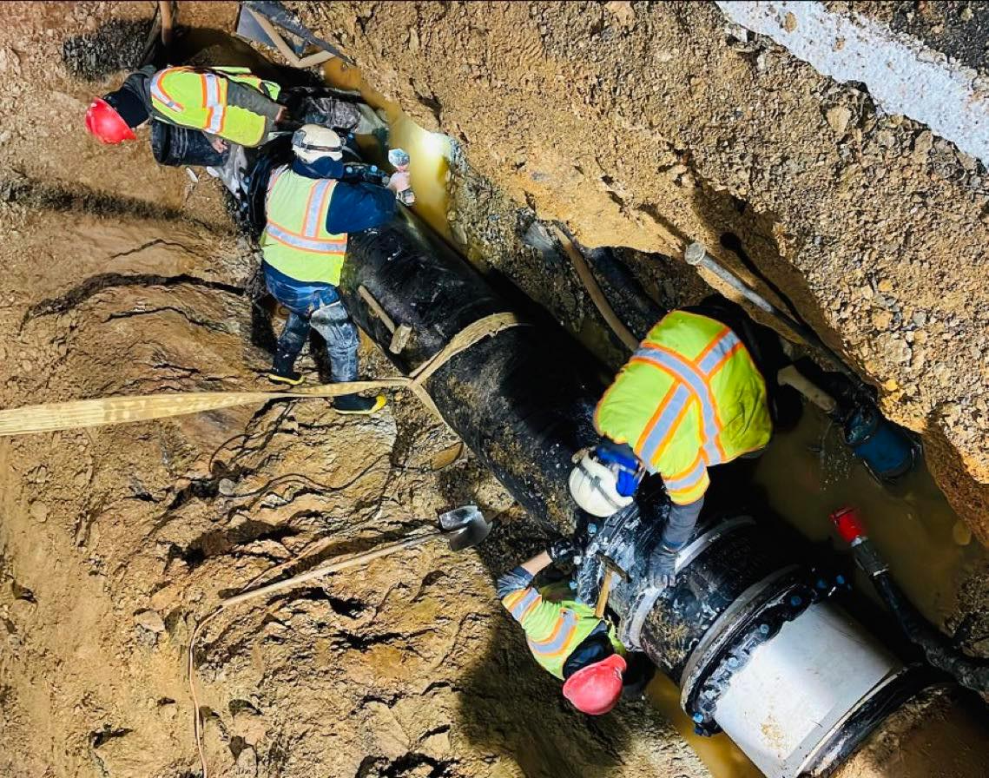



Slide 6
Need robust/reliable pipelines
Interesting talks on this topic
2022 Open Data Science, Sam Bail : Building a Robust Data Pipeline with the "dag Stack": dbt, Airflow, and Great Expectations
2021 Bigeye, Egor Gryaznov : Data Reliability Engineering—Reliable Data Pipelines 101
2021 DataEngBytes, Harmeet Sokhi : Shift-left testing : Building reliable Data Pipelines
2019 DataBricks, Steven Yu : Building Robust Production Data Pipelines with Databricks Delta
2017 DataBricks, Xiao Li : Building Robust ETL Pipelines with Apache Spark
2016 Jfokus, Lars Albertsson : Data pipelines from zero to solid
…

Slide 7
Lessons-learned
Testing data pipelines (***)
DevOps practice: code versioning, CI/CD
Infrastructure as code (Terraform , CloudFormation, …)
Container environment (Docker)
Data lineage and monitoring
Enhance data contracts from upstream
…

Slide 8
Robust is not enough!
Robust/reliable is not enough
We absolutely need it
But we also need to deliver the data quality to our data consumers (data analysts, BI developers, or Data scientists)
Trusted data pipelines also focus on data quality!

Slide 9


Robust pipeline vs. Trusted pipeline
Engineering focus
Data consumers’ focus
@istockphoto
@UNICEFNigeria/2020

Slide 10
Data quality questions?
Is that table the same compared to the upstream table?
This table needs to have these columns
Where this data come from?
Is the data arrived late?
Is the values of a numeric column in an expected range?
Is the summary stats make sense?
Seem to have outliers?
We expect the column to have no null value?
…
IN DATA
WE TRUST
It is critical to test and measure data quality!

Slide 11
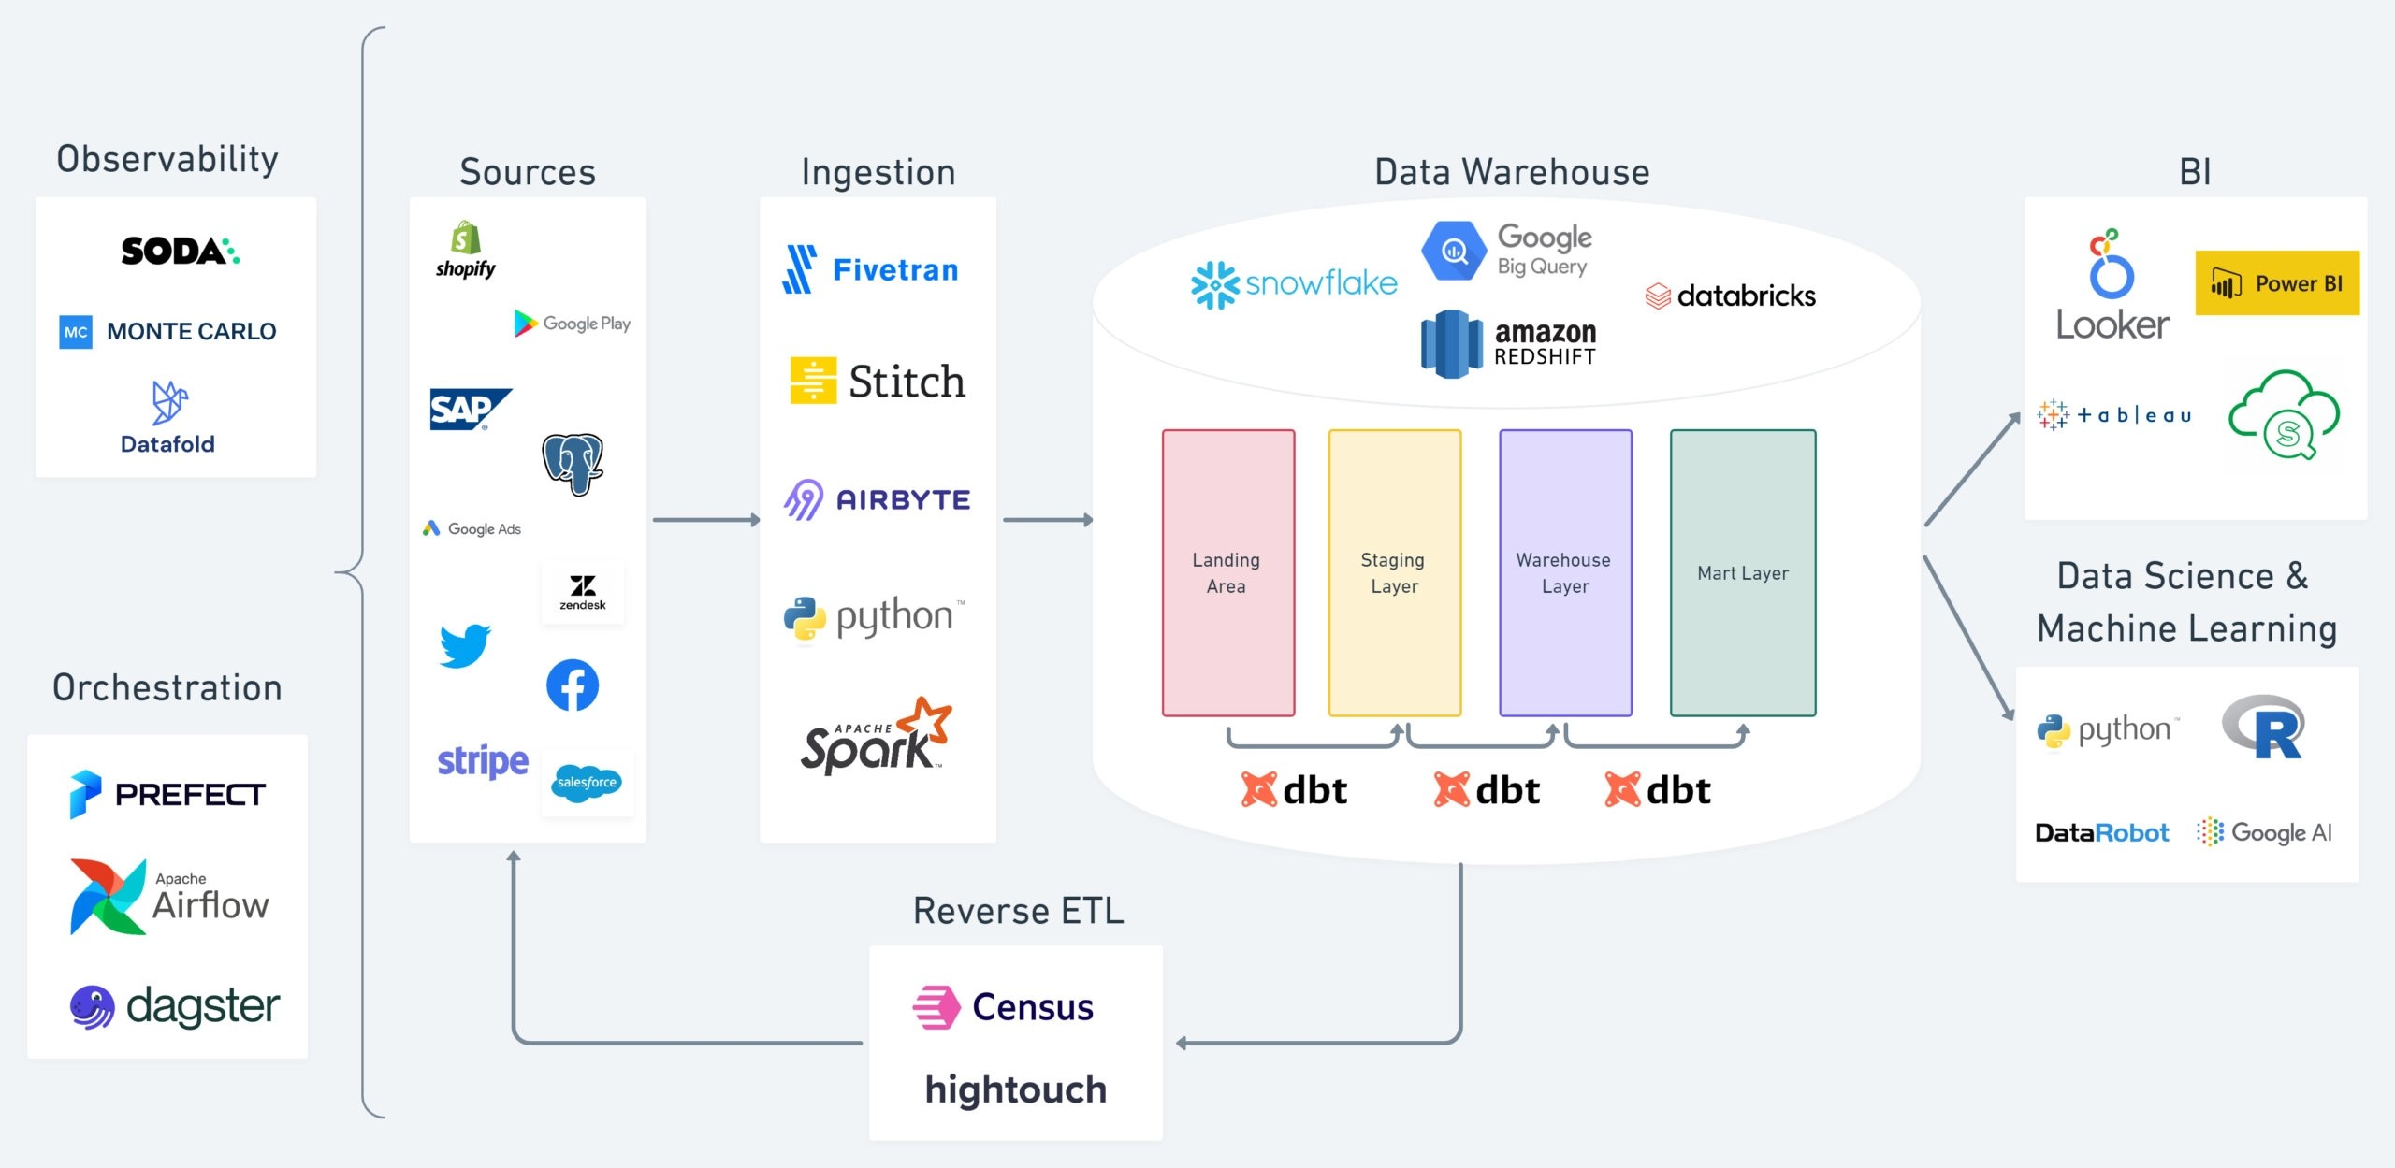
https://bitestreams.com/nl/blog/modern_data_stack/

Slide 12
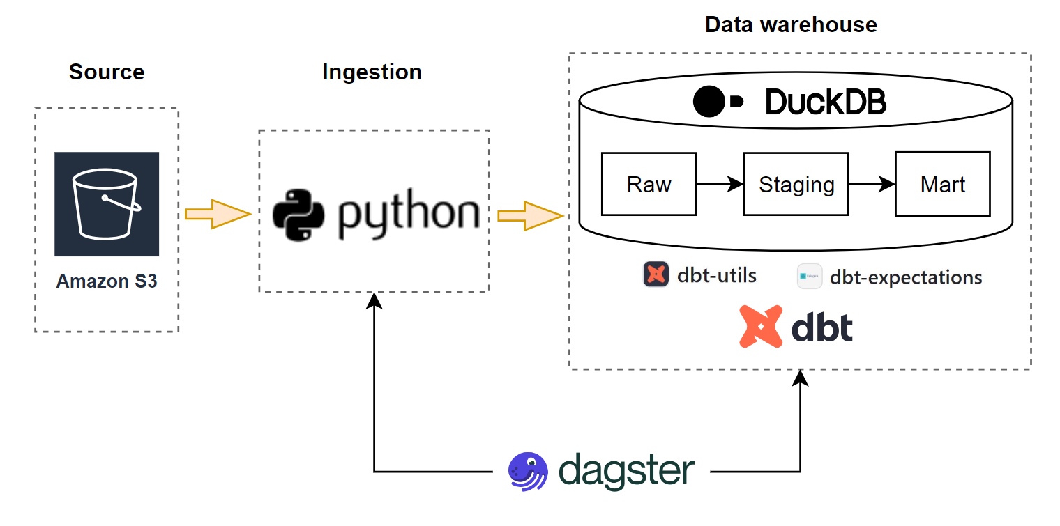
3D (Dagster, Dbt, and Duckdb) trusted pipeline

Slide 13
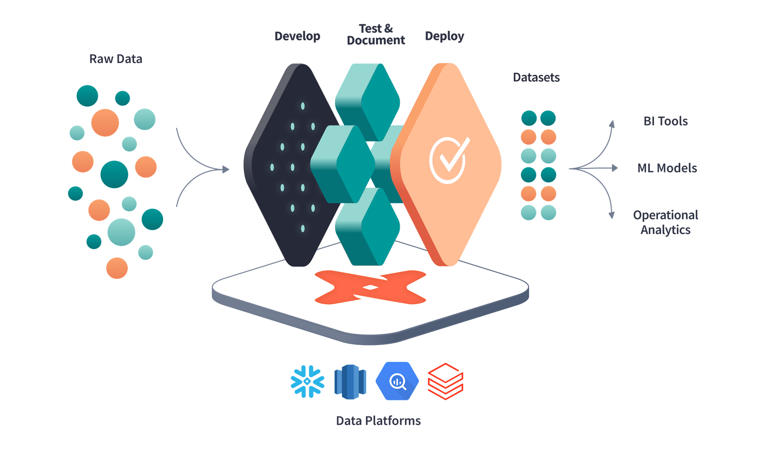
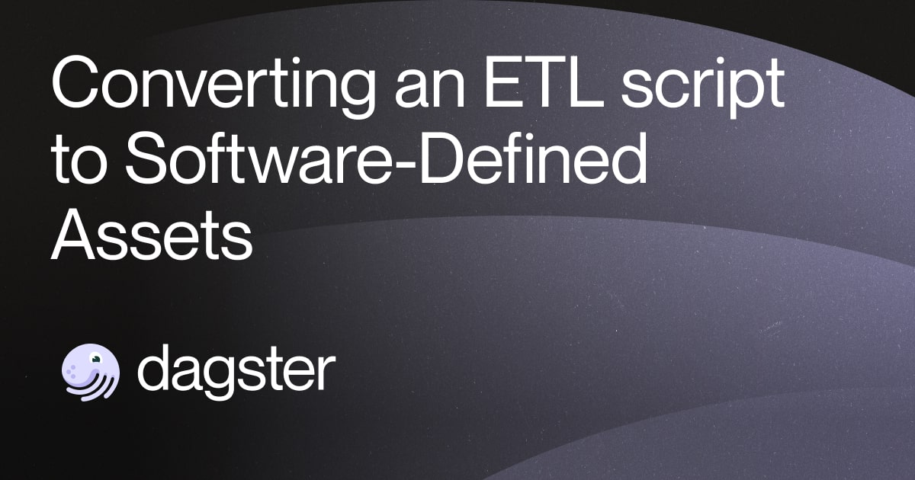
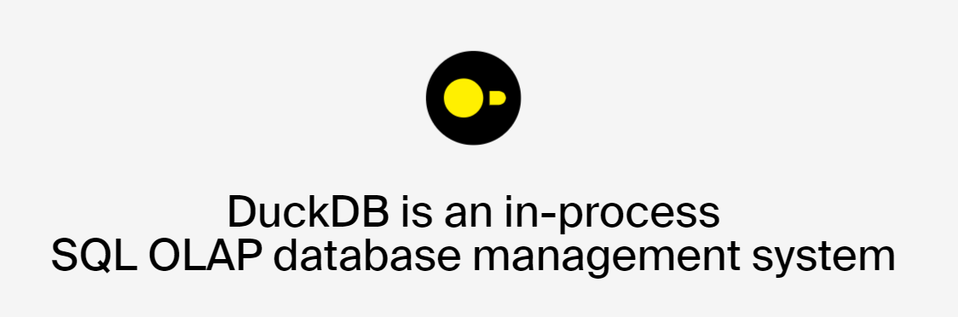
The 3Ds

Slide 14
Testing data quality
Between tables
Relationships
Raw (unprocessed) truth vs processed truth
In a table
Row counts
Column counts
Column exist
…
Column level:
Generic test:
Not null (with a threshold level)
Unique
Text data:
Following a pattern?
Accepted values?
Numeric data:
Min, max, mean, median
Outliers
Date:
Recency, range, latest, min, max

Slide 15
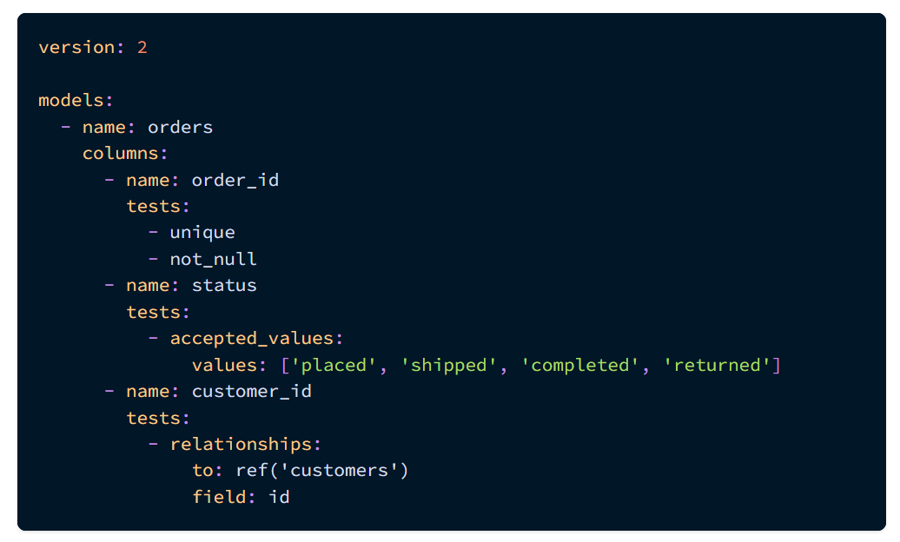
Testing data quality
Four generic tests already defined in Dbt:
unique,
not_null,
accepted_values
relationships.

Slide 16
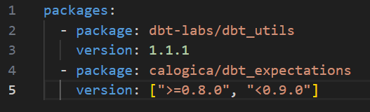
Testing data quality
Add testing packages into dbt packages.yml file:
Install dbt packages: dbt deps
Run test: dbt tests

Slide 17
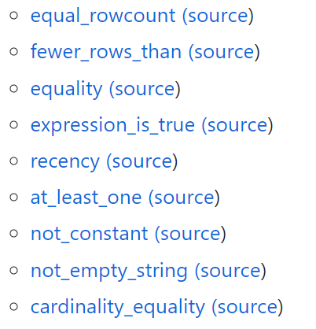
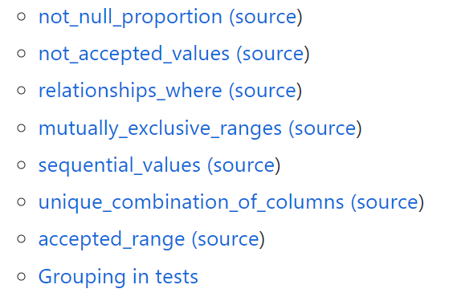
Testing data quality
https://github.com/dbt-labs/dbt-utils#generic-tests
Dbt-utils Generic Tests

Slide 18
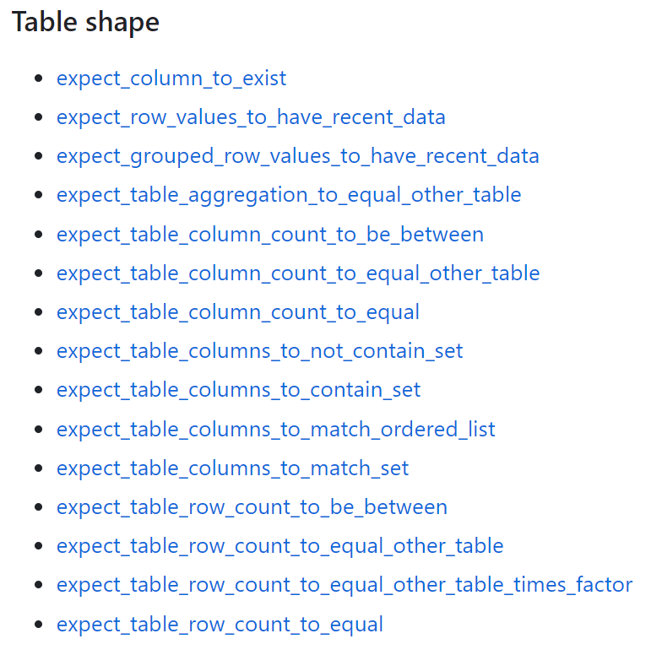
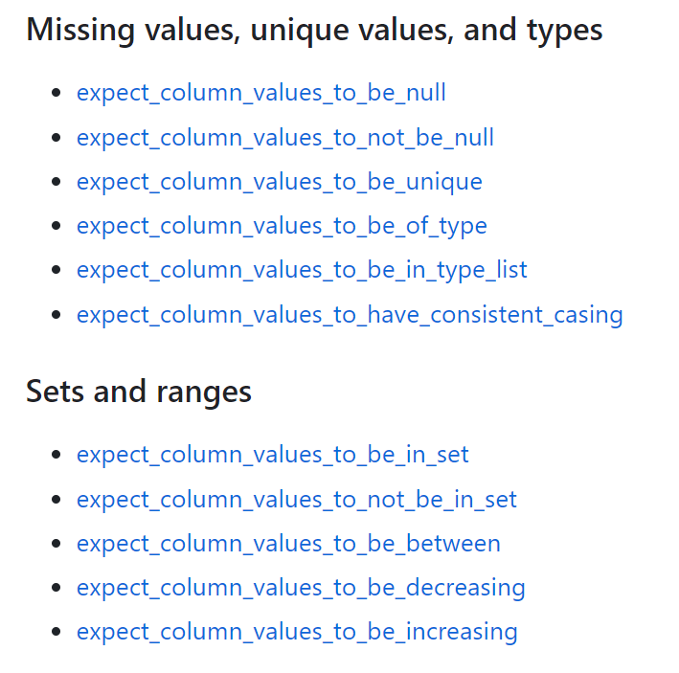
Testing data quality
Dbt-expectations
https://github.com/calogica/dbt-expectations

Slide 19
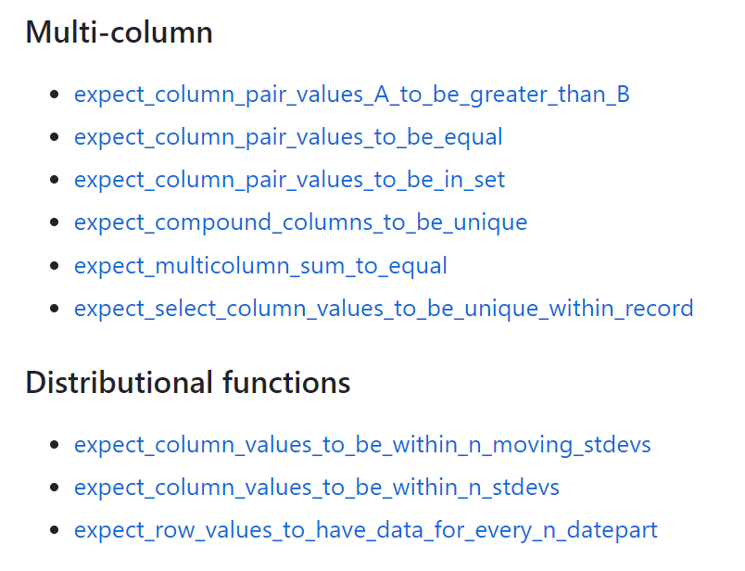
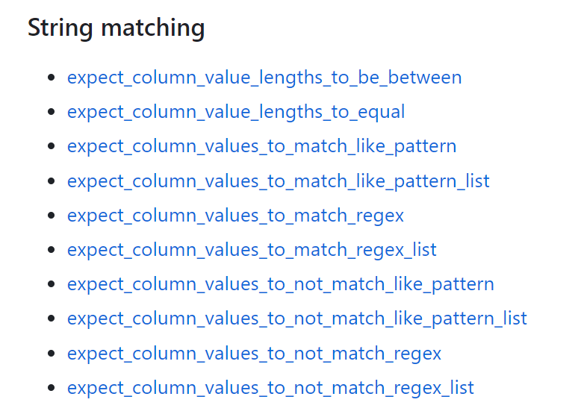
Testing data quality
Dbt-expectations
https://github.com/calogica/dbt-expectations

Slide 20
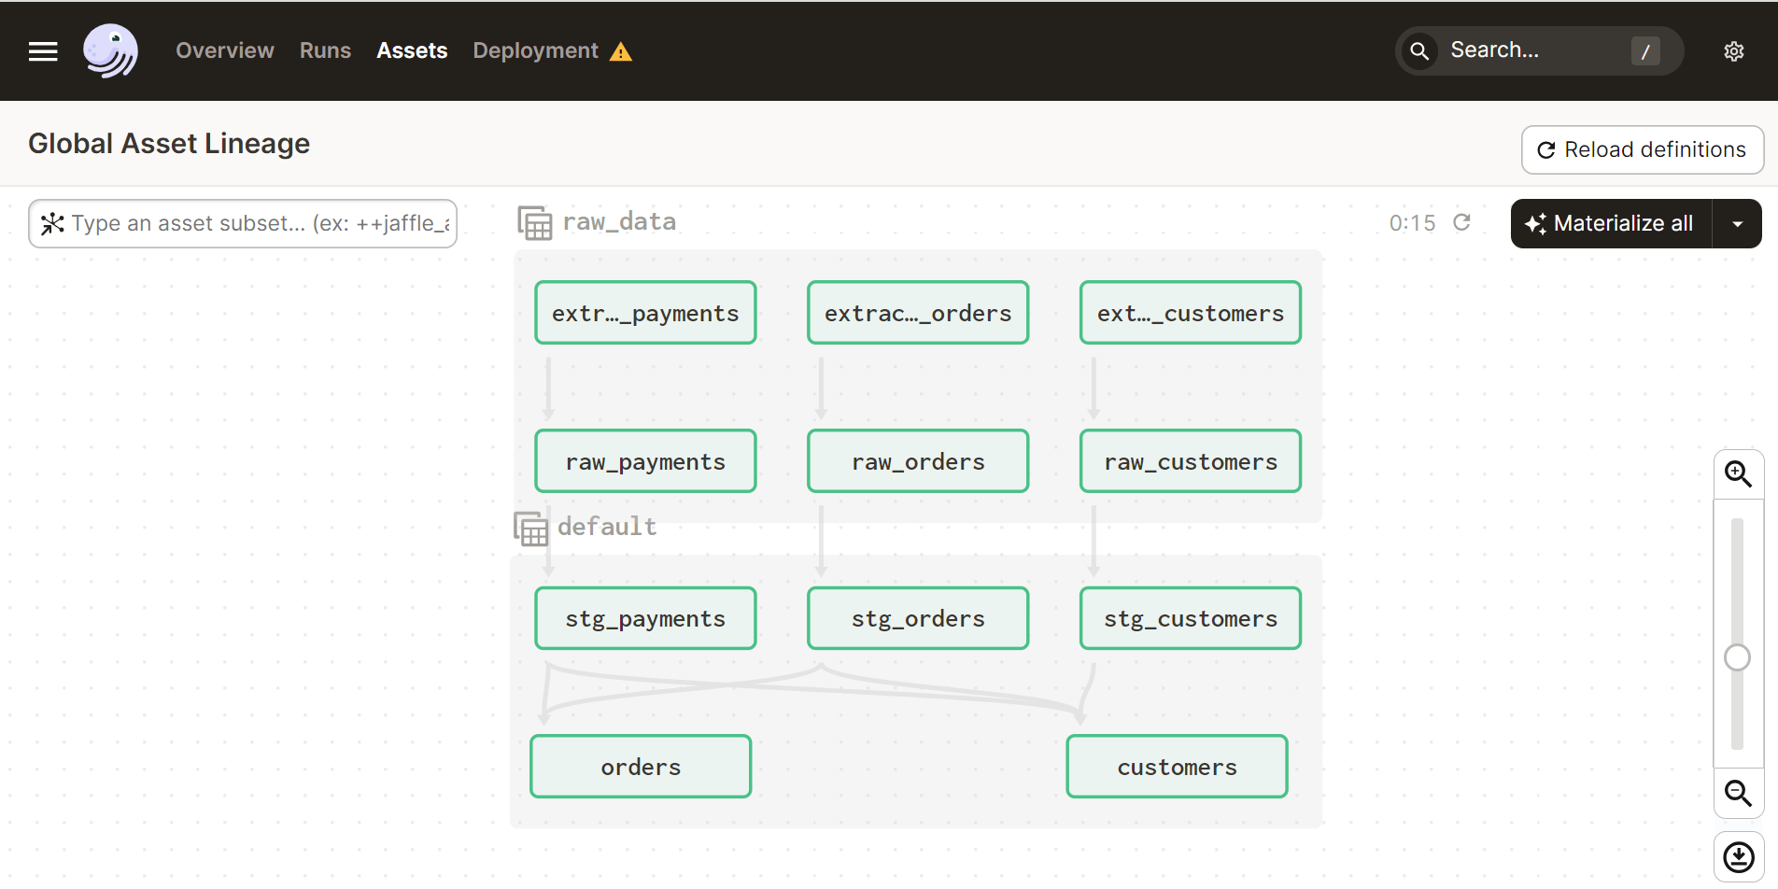

Slide 21
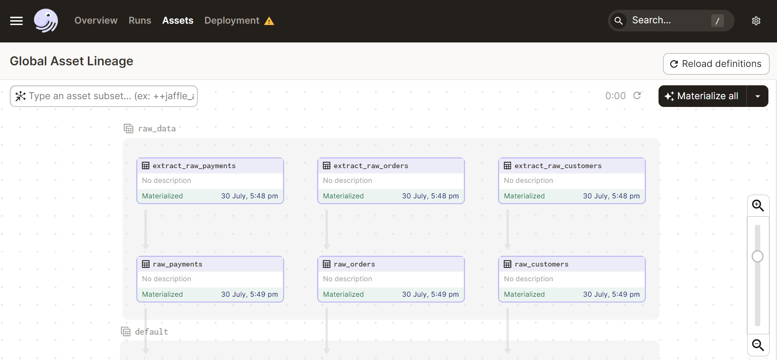

Slide 22
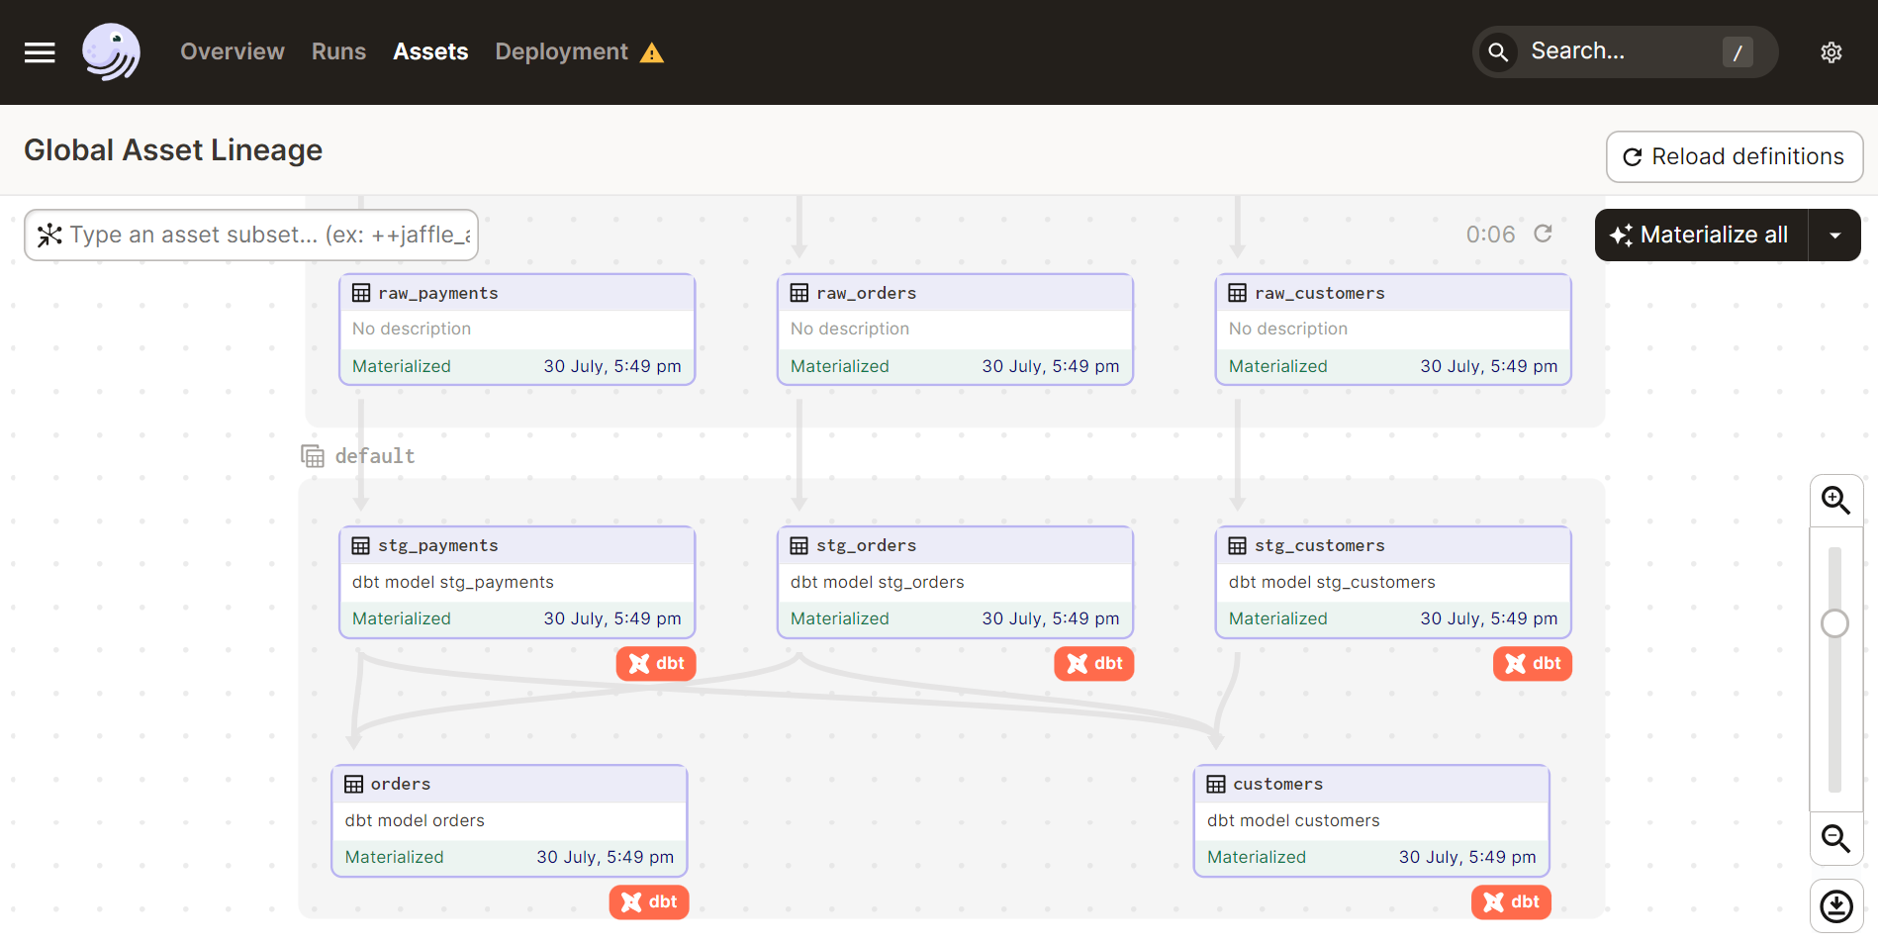

Slide 23
Demo

Slide 24
Building trust is a journey!
Building trusted data is a journey, which needs a good road map
And strong leaderships with a right data strategy
And buy-in of data stakeholders and data customers
Well designed data schema
Control data quality from upstream (data contract), on the way (data warehouse / data lake), and downstream

Slide 25
References
The Demo Project repo : https://github.com/danhphan/trusted-data-pipeline
Dbt tests: https://docs.getdbt.com/docs/build/tests
Dbt Workshop: Advanced Testing: https://www.youtube.com/watch?v=fo7lUn6vgtg
Build a poor man’s data lake from scratch with DuckDB : https://dagster.io/blog/duckdb-data-lake
Building a robust data pipeline with Dbt, Airflow, and Great Expectations: https://www.getdbt.com/coalesce-2020/building-a-robust-data-pipeline-with-dbt-airflow-and-great-expectations/
Dagster repo: https://github.com/dagster-io/dagster
Dbt repo: https://github.com/dbt-labs/dbt-core
Duckdb repo: https://github.com/duckdb/duckdb
Dbt-utils repo: https://github.com/dbt-labs/dbt-utils
Dbt-expectation repo: https://github.com/calogica/dbt-expectations

Slide 26
Thank you!

