Slide 1
An introduction to Multi-output Gaussian processes using PyMC
PyMCon Web Series
Danh Phan
Feb 2023

Slide 2
1. Why multi-output Gaussian Processes?
There are many cases where several outputs are affected by the same uncertainty.
For example:
The temperatures or wind speed in nearby locations
Stock prices of tech companies
The currency exchange with respect to USD dollars
The EEG recordings from human neonates on human brains
The spatial variability of over one risk factor for cancer across a geographical map.
the continuous-space multi-crime dataset
Spatial prediction of soil pollutants

Slide 3
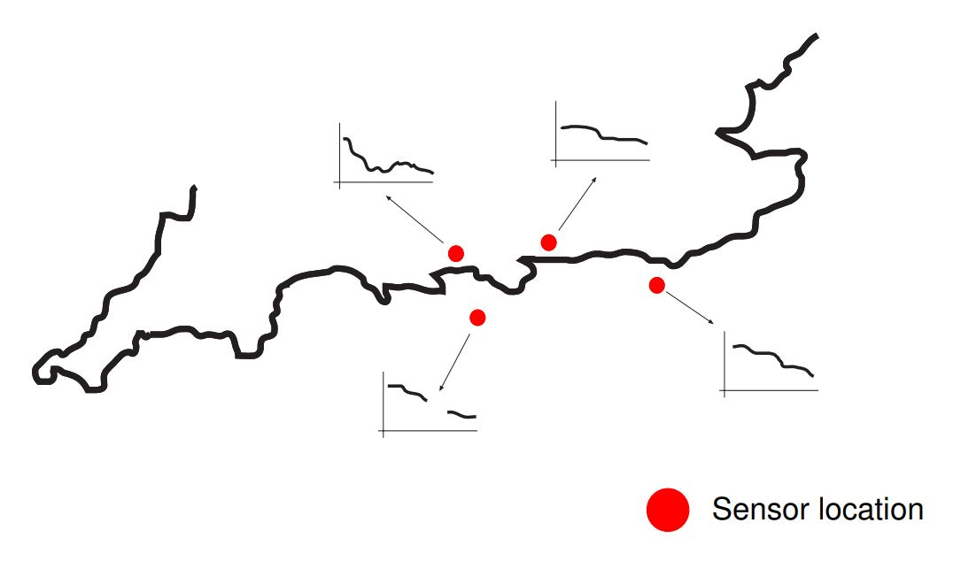
Example: The Sensor Network from South Coast of England

Slide 4
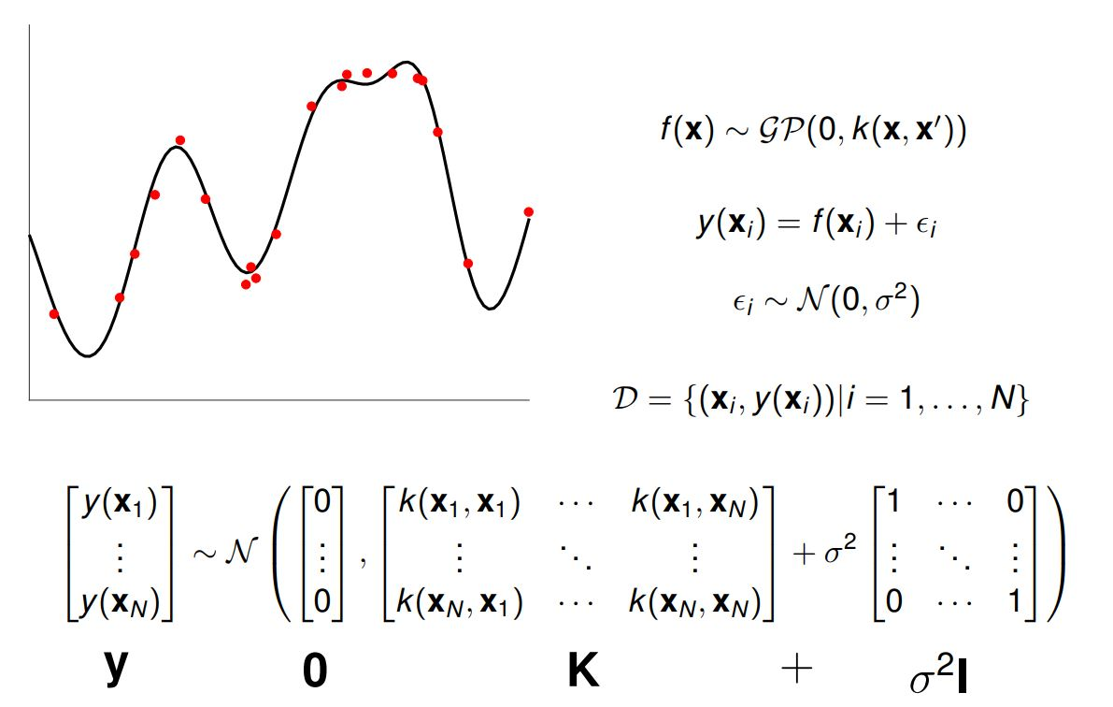
Single-output Gaussian Process

Slide 5
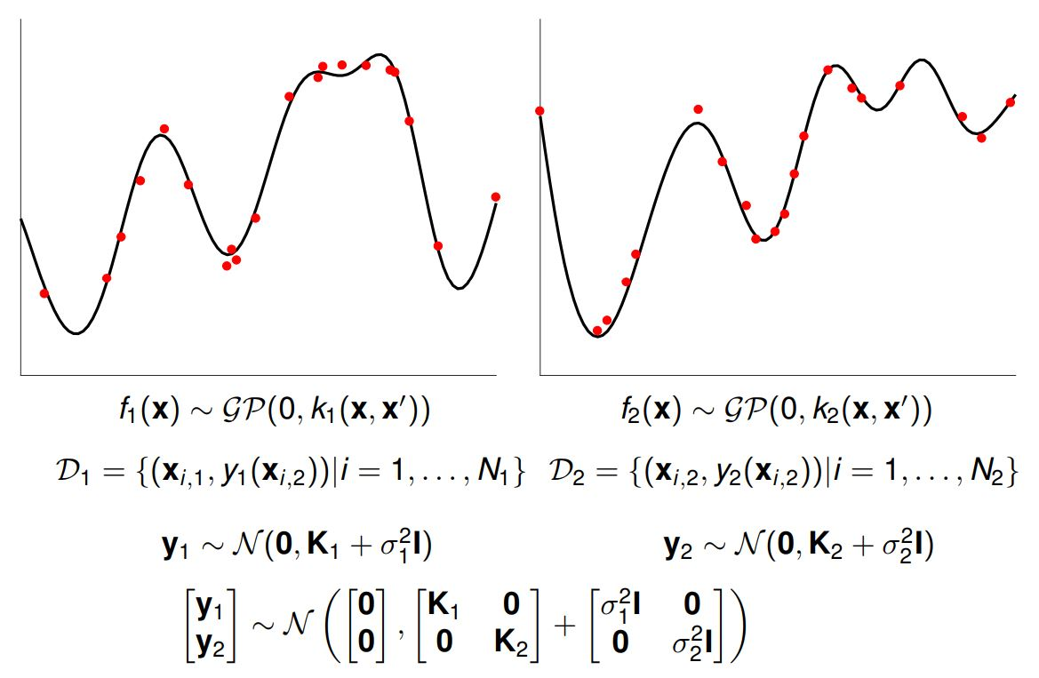
Multiple-output Gaussian process

Slide 6
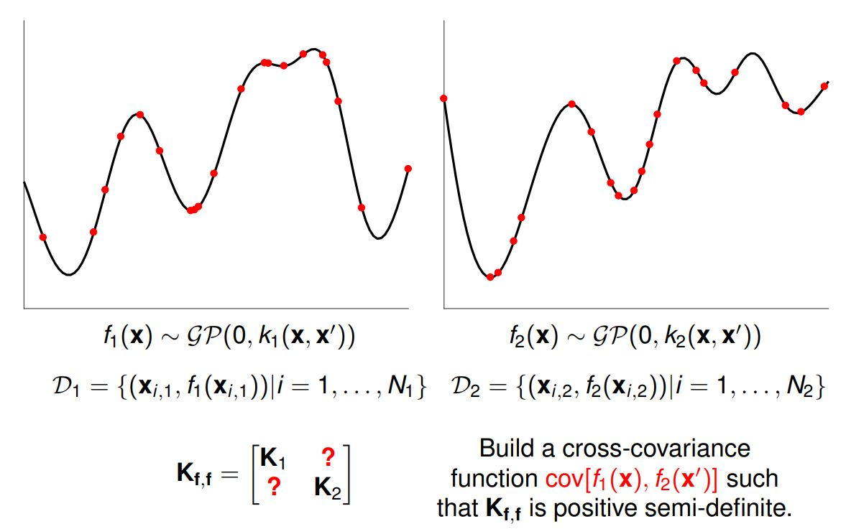
Multiple-output Gaussian process

Slide 7
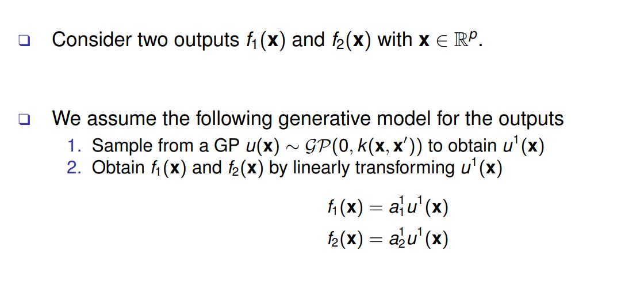
2. Intrinsic coregionalization model (ICM)
Two outputs and one latent sample

Slide 8
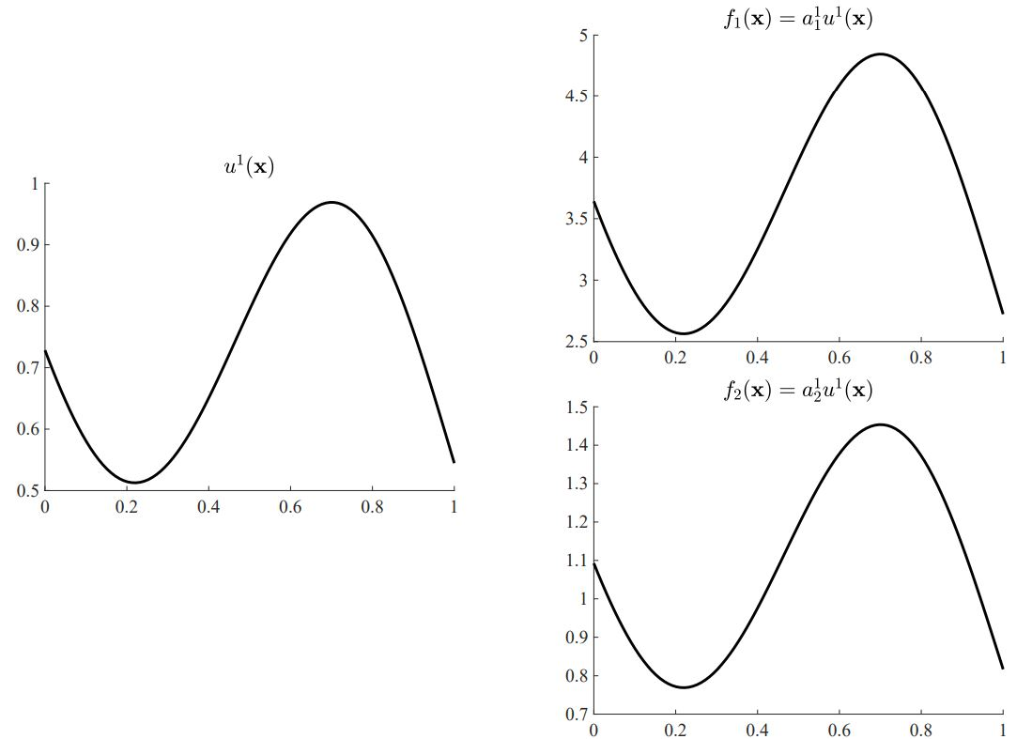
ICM: samples

Slide 9
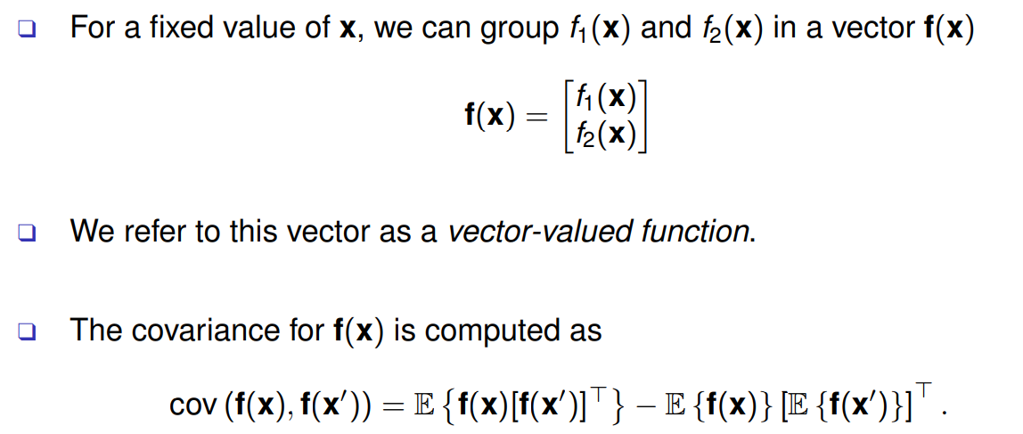
ICM: covariance

Slide 10
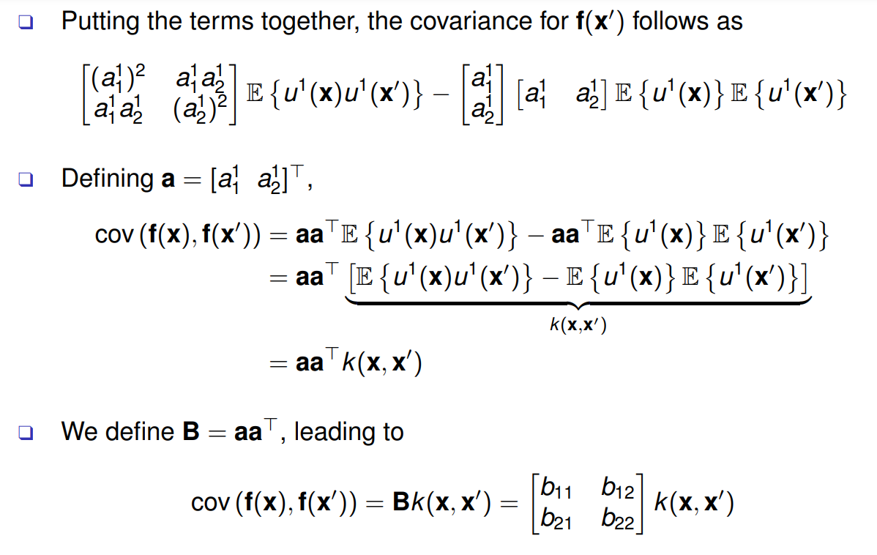
ICM: covariance

Slide 11
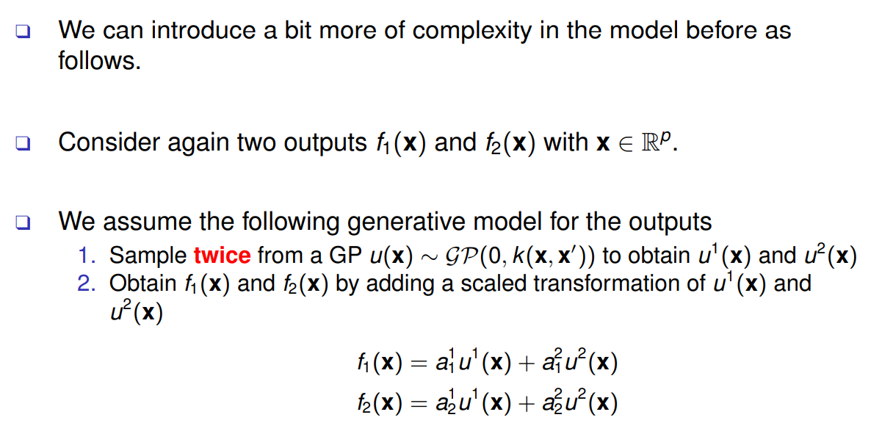
ICM: two outputs and two latent samples

Slide 12
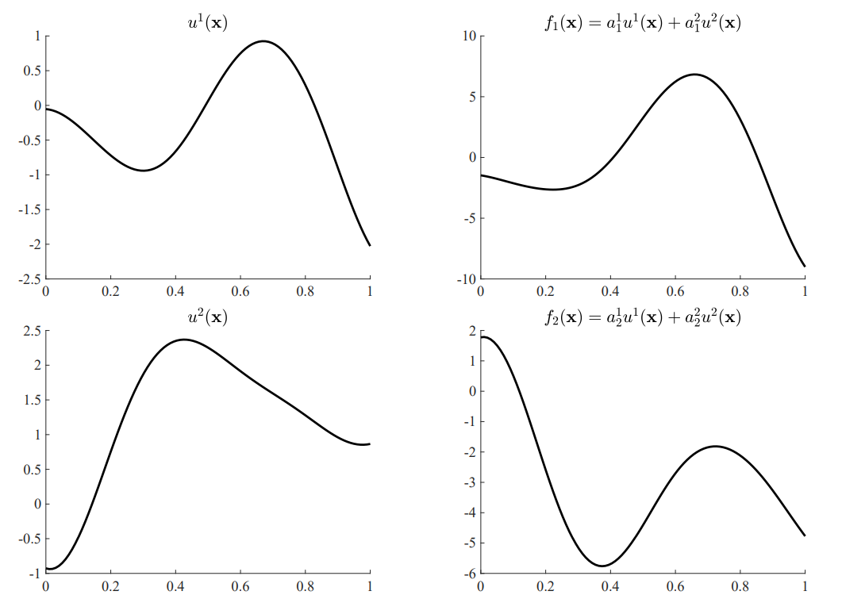
ICM: samples

Slide 13
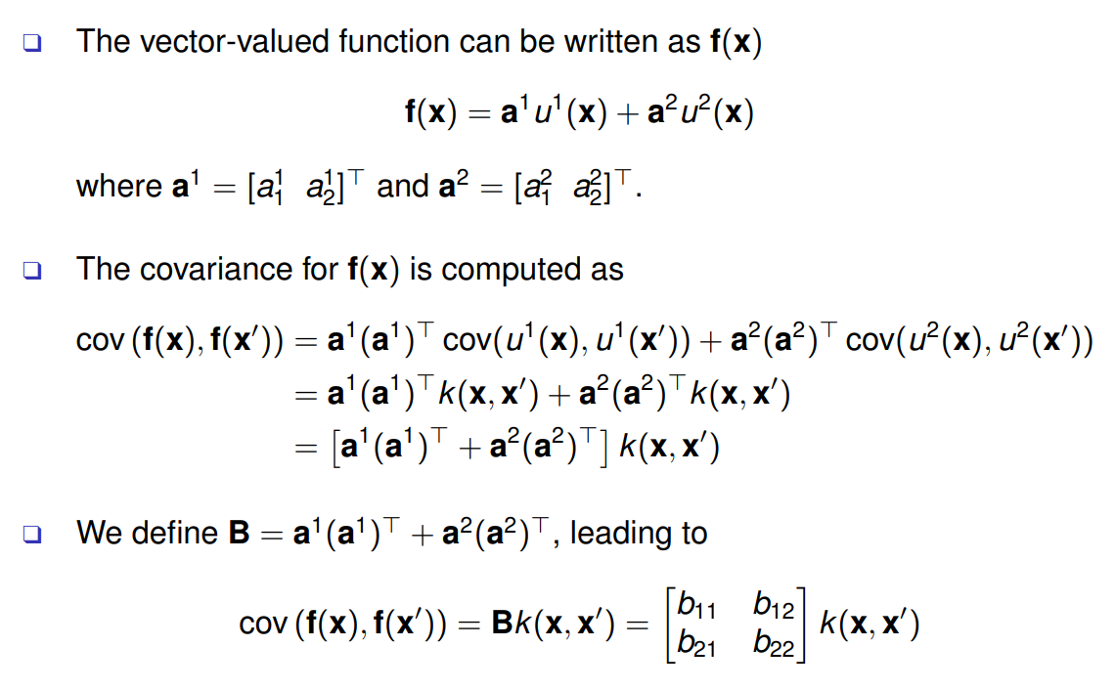
ICM: covariance

Slide 14
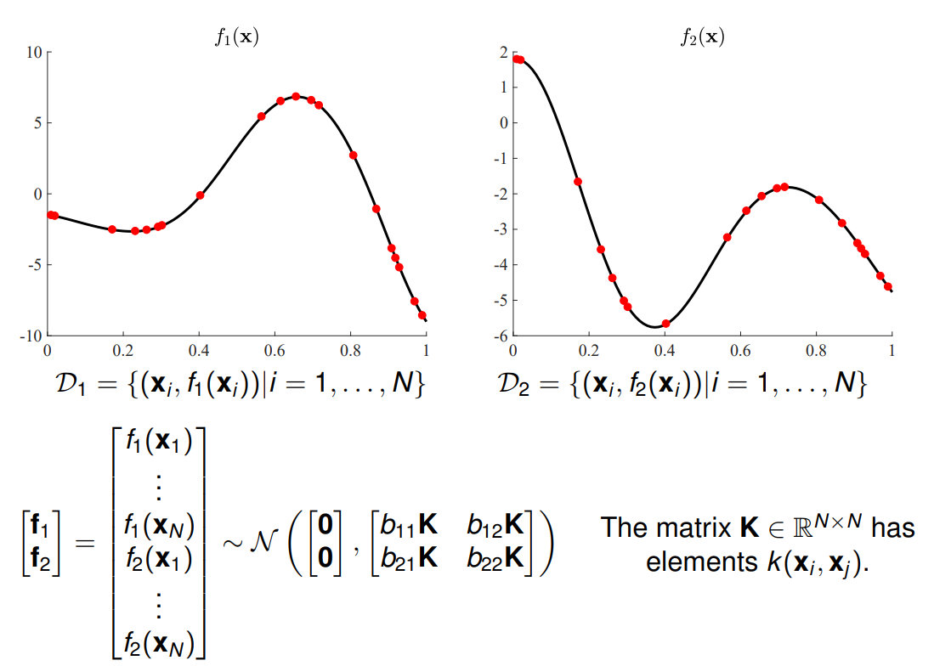
ICM: covariance

Slide 15
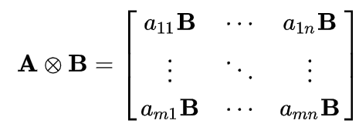
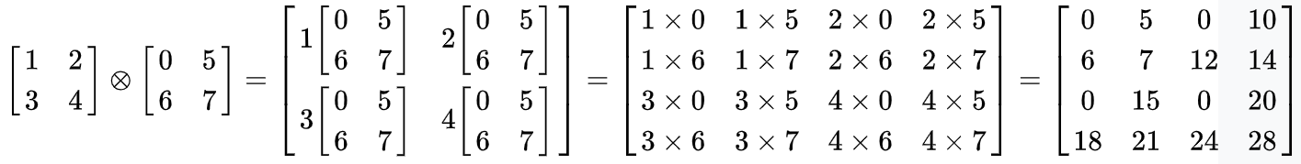
The Kronecker product between matrices
If A is an m × n matrix and B is a p × q matrix, then the Kronecker product A ⊗ B is the pm × qn block matrix
Example

Slide 16
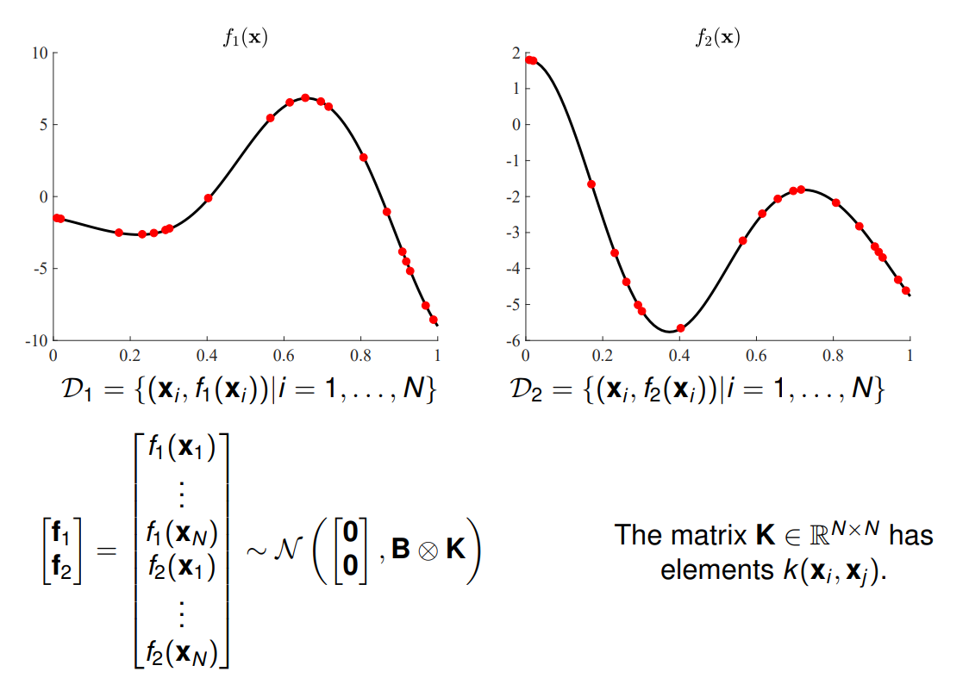
ICM: covariance

Slide 17
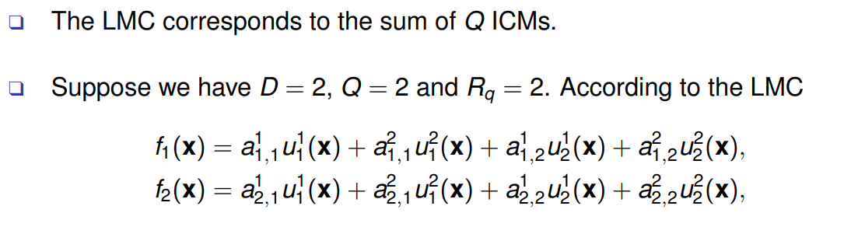
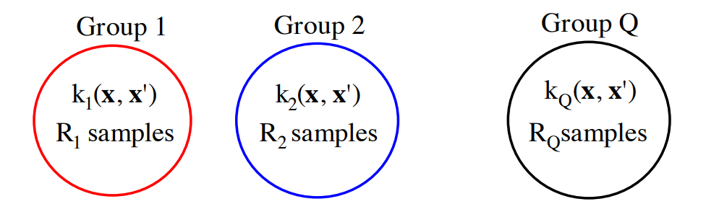
3. Linear model of coregionalization (LMC)

Slide 18
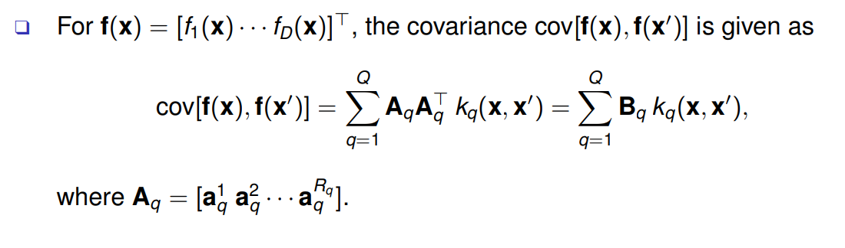
LCM: covariance

Slide 19
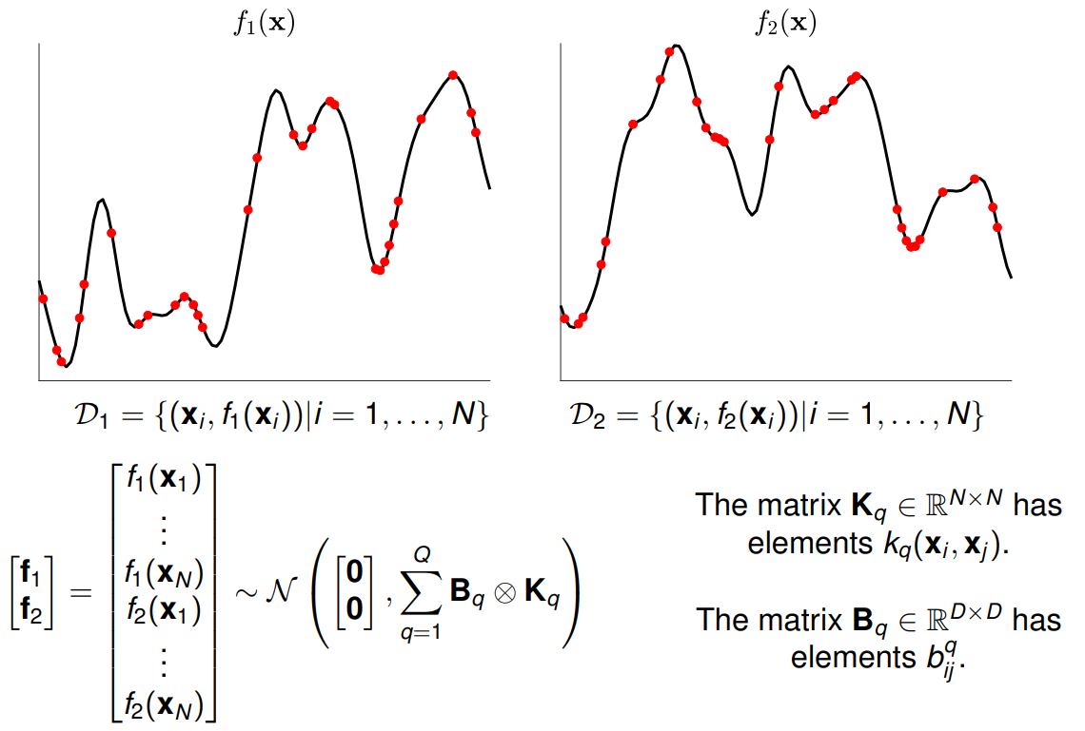
LCM: covariance

Slide 20
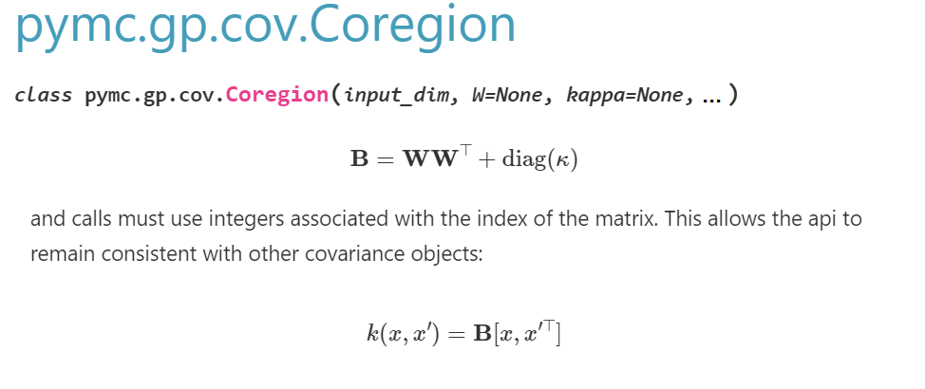
4. Pymc Coregion kernel

Slide 21
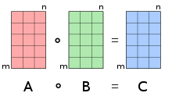

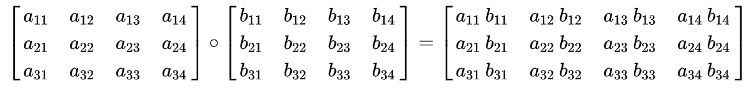
5. The Hadamard product between matrices
(also known as the element-wise product, entry-wise product)
Example

Slide 22
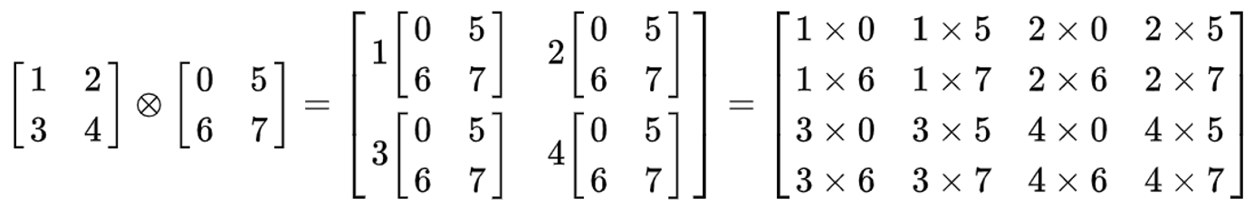
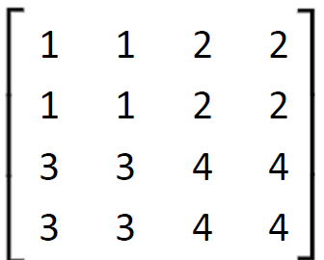
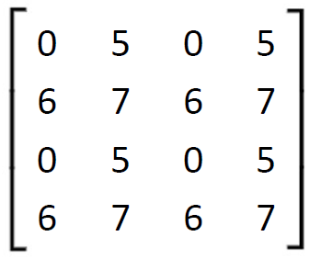

From Kronecker to Hadamard product
Broadcast matrices to convert Kronecker product to Hadamard product

Slide 23
References
This slides are a short version of “Multiple-output Gaussian processes” presentation from Mauricio A. Alvarez
PyMC Coregion: https://www.pymc.io/projects/docs/en/stable/api/gp/generated/pymc.gp.cov.Coregion.html
Kronecker product: https://en.wikipedia.org/wiki/Kronecker_product
Hadamard product: https://en.wikipedia.org/wiki/Hadamard_product_(matrices)

