Slide 1


Group Meeting
Optimizing CUDA Programming
Danh-Tai HOANG,
“Design Principles of Cellular Networks” Group,
Asia Pacific Center for Theoretical Physics (APCTP),
Pohang, KOREA
March 27, 2014
Notes:
1

Slide 2
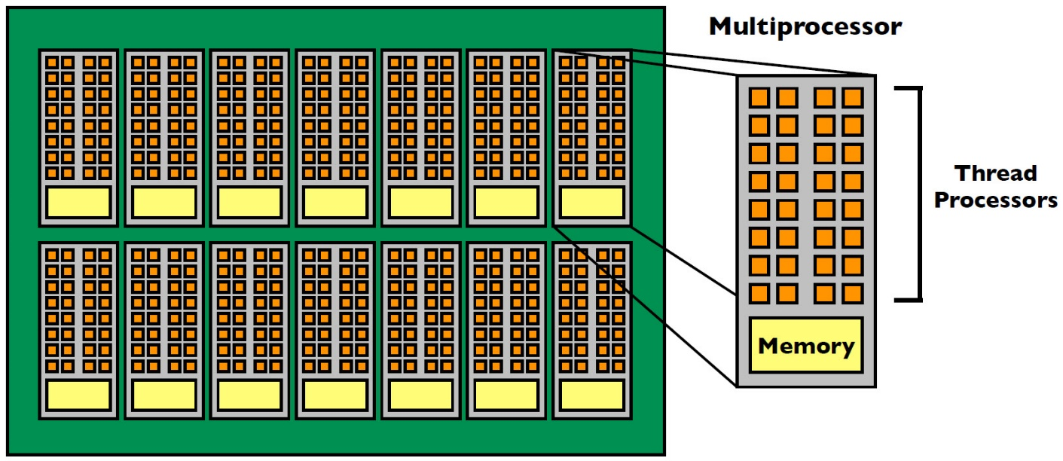
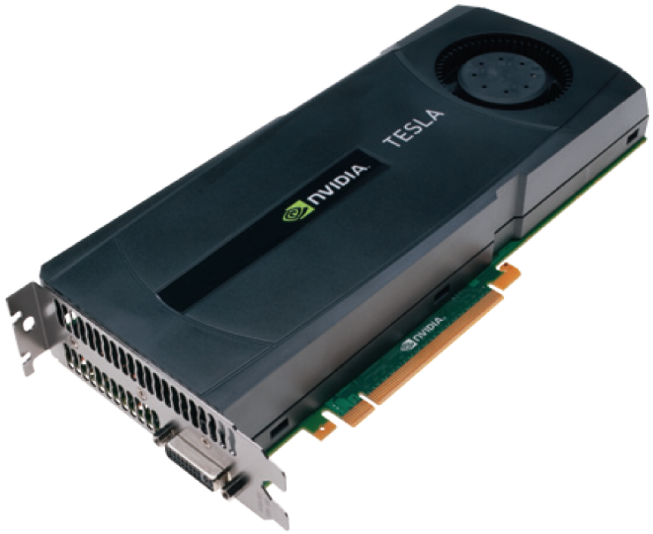
GPU Architecture
Tesla C2075:
- Compute capatibility: 2.0
- Number of multiprocessors: 14 (∼ 14 CPU)
- Number of cores: 448 (14 x 32)
Notes:
2

Slide 3
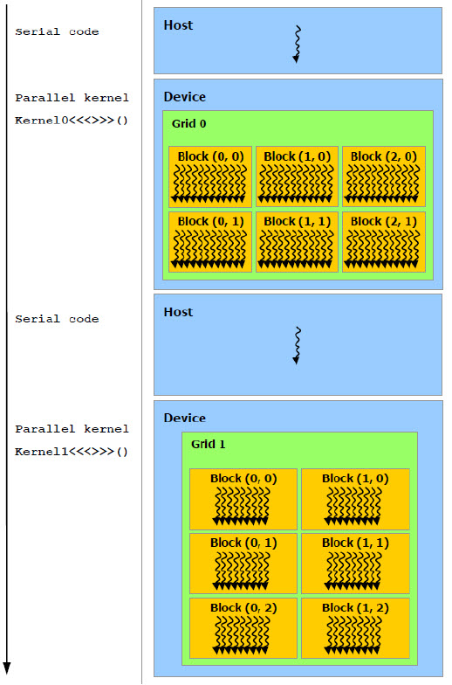
CUDA programming
Execution Model
* Host = CPU
* Device = GPU
* Kernel = function called from the host that runs on the device
- One kernel is executed at a time
- Many threads execute each kernel
- Each kernel is launched in one grid.
- Maximum number of kernel: 16
Notes:
3

Slide 4
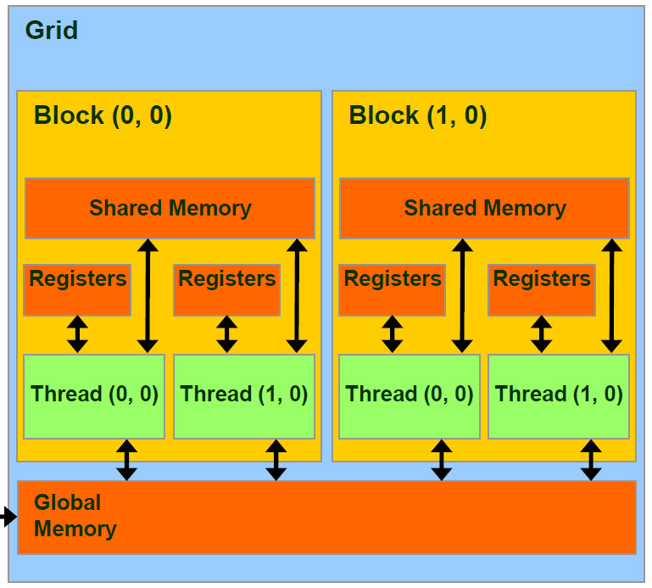
1. Registers
- Small
- Fast
2. Shared Memory
- Shared among threads in a single block
On-chip, small, as fast as registers
3. Global Memory
- Kernel input and output data reside here
- Off-chip (host), large
- Shared by all threads
- Inter-Grid communication
- Inter-Kernel sychronization.
* Host can read & write global memory but not shared memory.
* Threads within a block can:
+ communicate very quickly (shared memory)
+ Synchronize (wait for all threads to catch up)
* Threads in different block cannot cooperate
Notes:
4

Slide 5
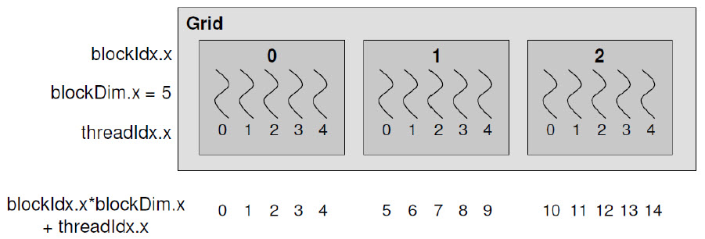
Thread ID – Block ID
+ threadIdx.x → thread ID within block
+ blockIdx.x → block ID within grid
+ blockDim.x → number of threads/block
+ gridDim.x → number of blocks/grid
Notes:
5

Slide 6
Important Numbers
- Compute capatibility: 2.0
- Number of multiprocessors: 14
- Number of cores: 448 (= 14 x 32)
- Maximum number of resident blocks / multiprocessor: 8
- Maximum number of resident warps / multiprocessor: 48
- Maximum number of resident threads / multiprocessor: 1536
- Number of 32-bit registers / multiprocessor: 32 KB
- Maximum number of 32-bit registers / thread: 63
- Shared memory size / multiprocessor: 48 KB
- Constant memory size / multiprocessor: 64 KB
- Maximum Threads / Block: 1024
- Maximum Block Dimensions: 1024 x 1024 x 64
- Maximum Grid Dimensions: 65535 x 65535 x 65535 (2³¹-1)
⇒ All blocks may be not resident at the same time.
Notes:
6

Slide 7
Optimizing
- Keep the multiprocessors on the device as busy as possible.
- The number of blocks in a grid should be larger than the number of multiprocessors so that all multiprocessors have at least one block to execute.
# blocks = 14 x const
- Threads per block should be a multiple of warp size (32)
# threads = 32 x const
128 ≤ # threads ≤ 256
Notes:
7

Slide 8
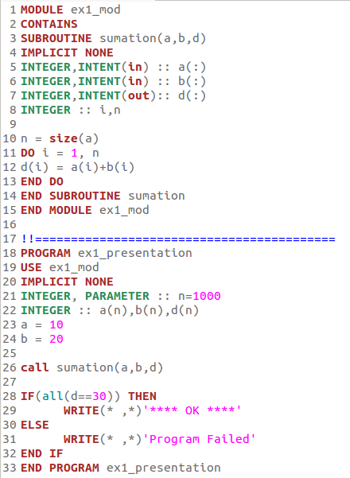
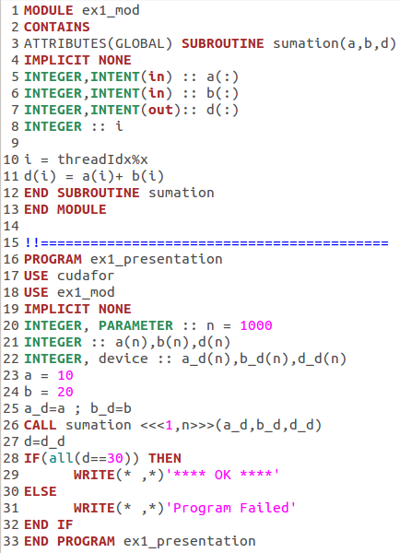
Examples
ex1.f90
ex1.cuf
Notes:
8

Slide 9
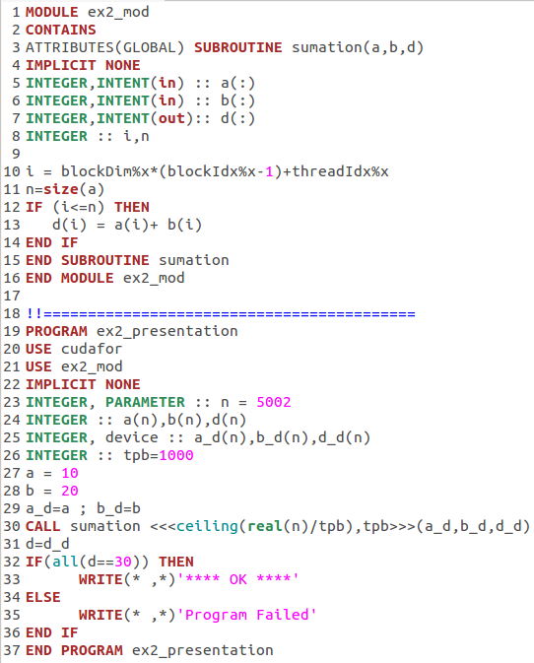
ex2.cuf
Notes:
9

Slide 10
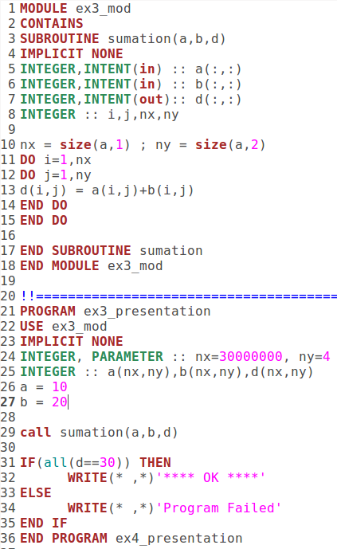
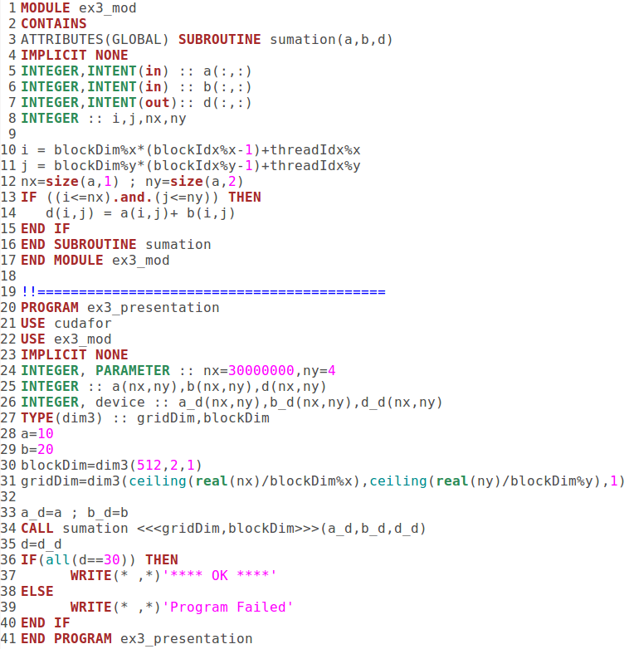
Multidimensional arrays
ex3.f90
ex3.cuf
Notes:
10

Slide 11
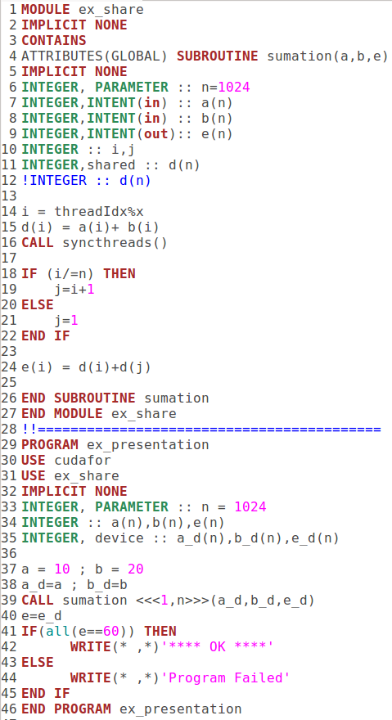
Shared memory and Synchronization
ex4.cuf
Notes:
11

