Slide 1
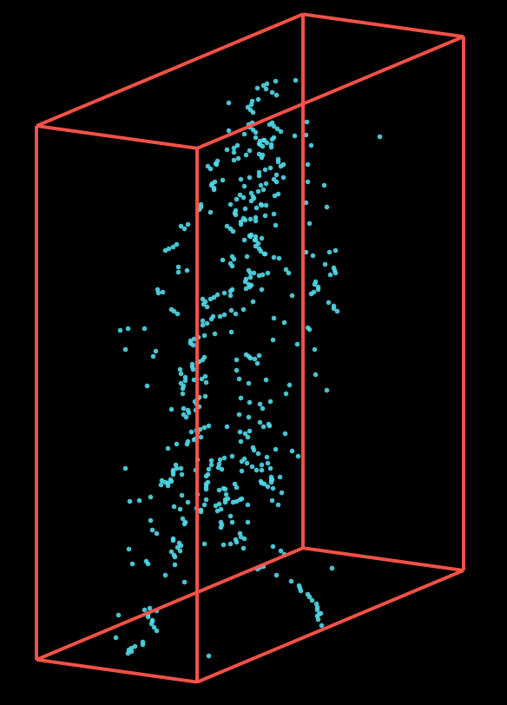
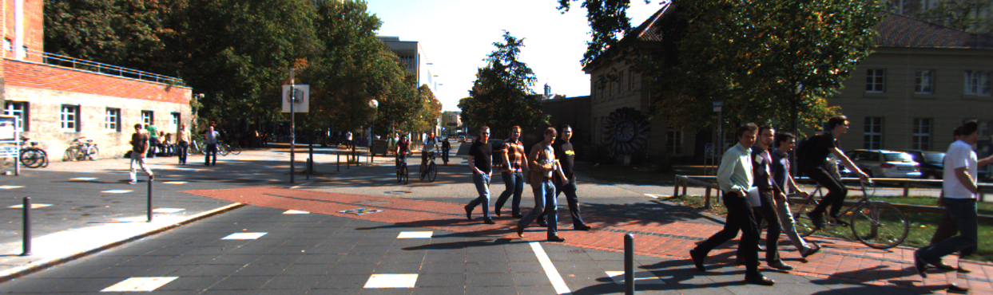
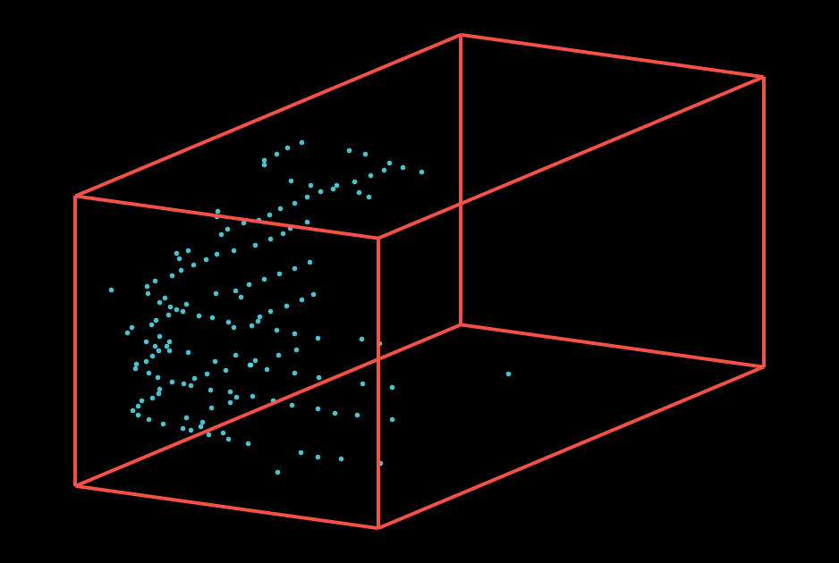
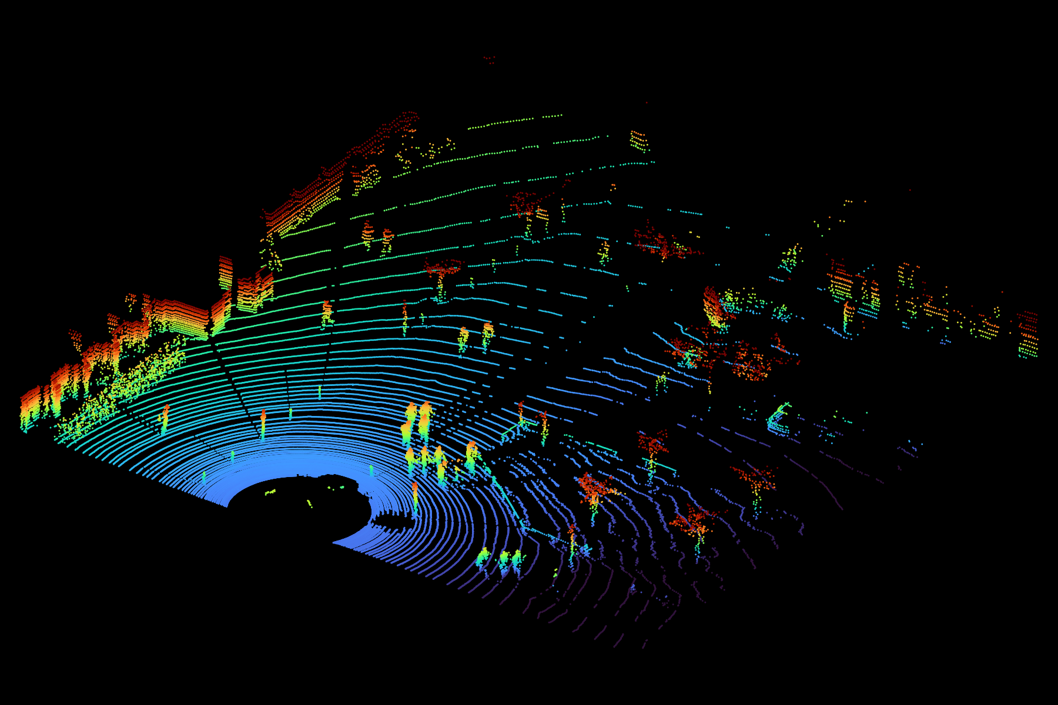
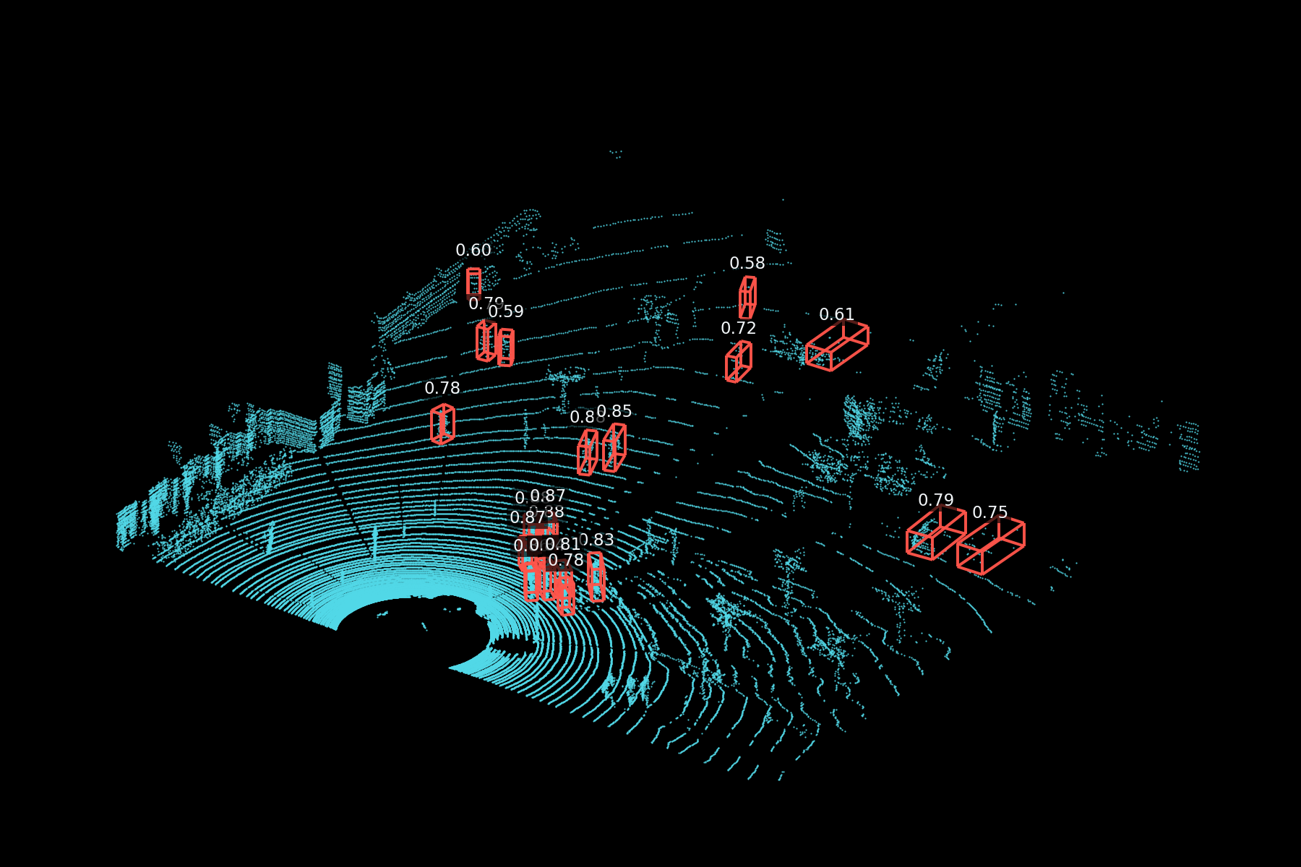
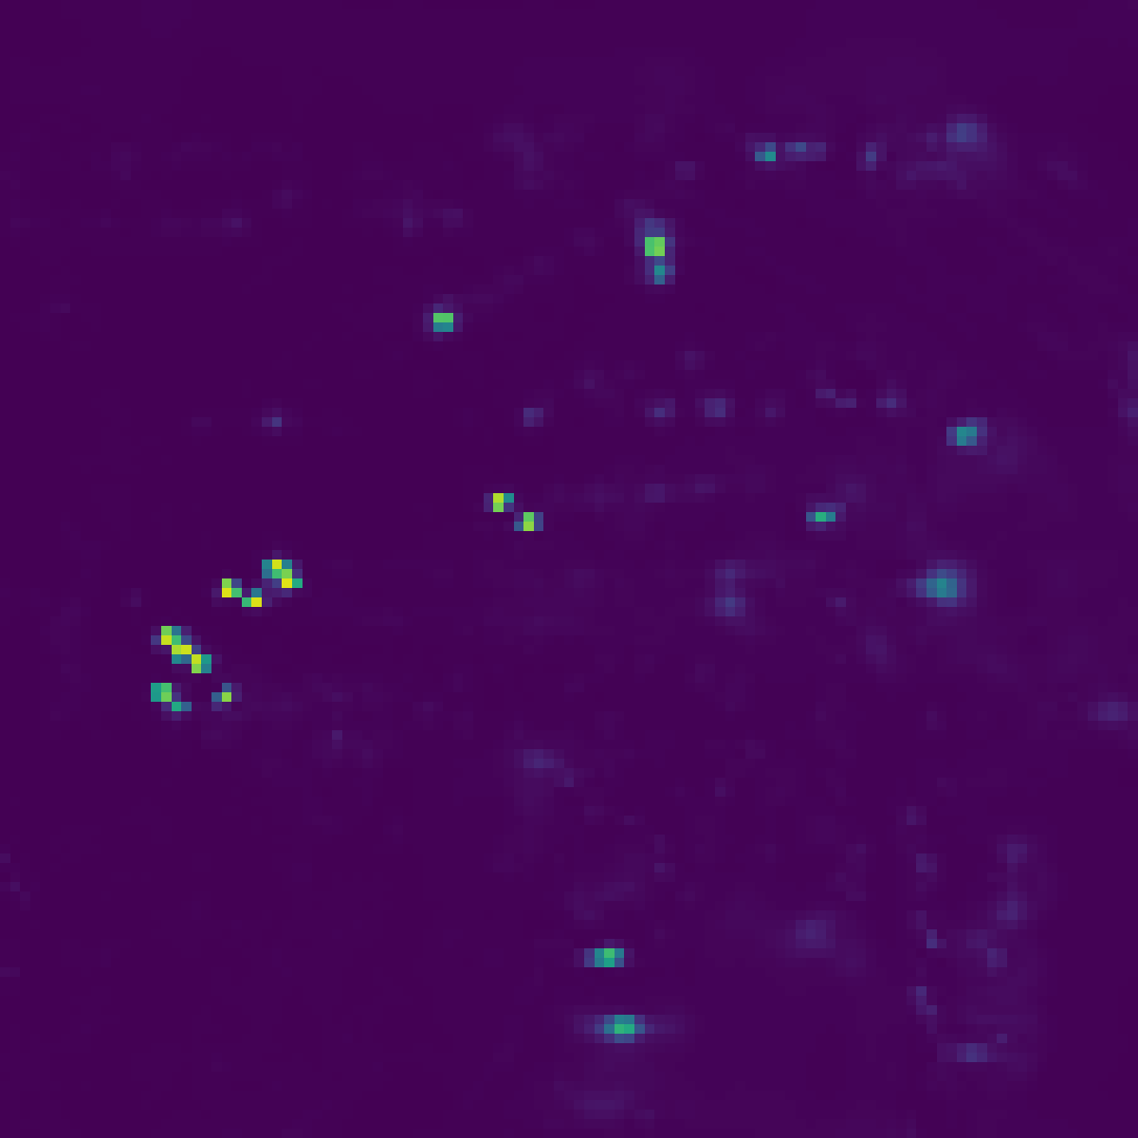
Stitched Image
Rich14
Feature Encoder
Proposed
(MobilePixorNeXt)
Detector
Gaussian Heatmap
Offset
Size
Orientation
IoU Quality
[ log w,
log l]
[cosθ,
sinθ]
[Δx, Δy]
𝛔(i)
QFL + Smooth L1 + OGL + BCE + T-SBUW
3D LIDAR Point Cloud
3D Object Detection

Slide 2
Backbone
Head: Group 1 Car
Stem
Conv 3x3, 14→32 s=2,
Conv3x3, 32→32, s=1 BN+SiLU
32 x 400 x 352, /2
Conv
Gaussian Heatmap
1x200x177
Offset
2x200x177
Conv 3×3, 24→32
BN + SiLU
Conv
Rich14
14 x 800 x 704
Conv3x3, 32→48, s=2
BN + SiLU
Size
2x200x177
Conv
Encoder
Stage 2 / C2
48 x 200 x 176, /4
Gated
Fusion (P4)
Yaw
2x200x177
L3: Conv 1×1
48→32
Conv
NeXt
NeXt
NeXt
SimAM
G
IoU Quality
1x200x177
32 × 200 × 176
Conv
Conv3x3, 48→96, s=2
Bilinear ↑2
Conv3x3, 48→24
BN + SiLU
Head: Group 2 Pedestrian/Cyclist
Stage 3 / C3
96 x 100 x 88, /8
Gaussian Heatmap
1x200x177
L4: Conv 1×1
96→48
Gated
Fusion (P4)
Conv
NeXt
NeXt
NeXt
NeXt
Focal
G
Offset
2x200x177
48 × 100 × 88
Conv
Conv3x3, 96→128, s=2
BN + SiLU
Bilinear ↑2
DWConv3x3, 48→48
BN + SiLU
Size
2x200x177
Conv
Stage 2 / C4
128 x 50 x 44, /16
Yaw
2x200x177
L5: Conv 1×1
128→48
Conv
NeXt
NeXt
IoU Quality
1x200x177
48 × 100 × 88
Conv

Slide 3
(A) MobilePixorNeXt block
Depthwise spatial mixing → pointwise channel expansion → residual
X
DW 7×7
BN
PW 1×1
SiLU
PW 1×1
γ
+
BN
Y
C→C
C→2.5C
2.5C→C
Identity shortcut
Y = X + γ ⊙ F(X) · γ is learned per channel; initialized to 10⁻⁵

Slide 4
(B) Scale-gated fusion
L: lateral feature U: upsampled feature
L
+
DWConv3×3
2 · sigmoid
×
zero-init
+
P
U
P = U + 2σ(DWConv(L + U)) ⊙ L
At initialization: gate = 1, so P = U + L

Slide 5
Stage 2: Each residual block
Stage input
Conv 3×3 · s2 +
NeXt block 1
NeXt block 2
32 × 400 × 352
BN + SiLU
48 × 200 × 176
48 × 200 × 176
48 × 200 × 176

Slide 6
MobilePixorNeXt block Stage 2
Depthwise spatial mixing → pointwise channel expansion → residual
X
DW 7×7
BN
PW 1×1 · expand
SiLU
PW 1×1 · expand
BN
γ
+
48 × 200 × 176
120 × 200 × 176
48 × 200 × 176
48 × 200 × 176
Identity shortcut
Y = X + γ ⊙ F(X) · γ is learned per channel; initialized to 10⁻⁵

Slide 7
Stage 3: Each residual block
Stage input
NeXt block 2
NeXt block 3
32 × 400 × 352
96 × 100 × 88
96 × 100 × 176
Conv 3×3 · s2 +
NeXt block 1
NeXt block 4
BN + SiLU
96 × 100 × 88
96 × 100 × 176
48 × 200 × 176

Slide 8
MobilePixorNeXt block Stage 3
Depthwise spatial mixing → pointwise channel expansion → residual
X
DW 7×7
BN
PW 1×1 · expand
SiLU
PW 1×1 · expand
BN
γ
+
96 × 100 × 88
240 × 100 × 88
96 × 100 × 88
96 × 100 × 88
Identity shortcut
Y = X + γ ⊙ F(X) · γ is learned per channel; initialized to 10⁻⁵

Slide 9
Stage 4: Each residual block
Stage input
Conv 3×3 · s2 +
NeXt block 1
NeXt block 2
96 × 100 × 88
BN + SiLU
128 × 50 × 44
128 × 50 × 44
128 × 50 × 44

Slide 10
MobilePixorNeXt block Stage 3
Depthwise spatial mixing → pointwise channel expansion → residual
X
DW 7×7
BN
PW 1×1 · expand
SiLU
PW 1×1 · expand
BN
γ
+
128 × 50 × 44
320 × 50 × 44
128 × 50 × 44
128 × 50 × 44
Identity shortcut
Y = X + γ ⊙ F(X) · γ is learned per channel; initialized to 10⁻⁵

Slide 11
SG-FPN fusion - P4
L · lateral
48 × 100 × 88
L + U
P4 = U + G ⊙ L
DW 3×3 · gate
2 × sigmoid
+
logits
⊙
+
48 × 100 × 88
48 × 100 × 88
G ⊙ L
U · top-down
48 × 100 × 88

Slide 12
Top-Down sampling U4
Top-down input
Bilinear ↑2
DW 3×3
BatchNorm
SiLU
48 × 50 × 44
48 × 100 × 88
48 × 100 × 88
48 × 100 × 88
48 × 100 × 88

Slide 13
SG-FPN fusion - P3
L · lateral
24 × 200 × 176
L + U
P4 = U + G ⊙ L
DW 3×3 · gate
2 × sigmoid
+
logits
⊙
+
24 × 200 × 176
24 × 200 × 176
G ⊙ L
U · top-down
24 × 200 × 176

Slide 14
Top-Down sampling U3
Top-down input
Bilinear ↑2
DW 3×3
BatchNorm
SiLU
48 × 100 × 88
48 × 200 × 176
24 × 200 × 176
24 × 200 × 176
24 × 200 × 176

Slide 15
Stem · two spatial convolutions
BEV input
Conv 3×3 · s2
BatchNorm
SiLU
Conv 3×3 · s1
BatchNorm
SiLU
8 × 800 × 704
32 × 400 × 352
32 × 400 × 352
32 × 400 × 352
32 × 400 × 352
32 × 400 × 352
32 × 400 × 352

Slide 16
Output projection · detector interface
Fused P3
Conv 3×3
BatchNorm
SiLU
24 × 200 × 176
16 × 200 × 176
16 × 200 × 176
16 × 200 × 176

Slide 17
BACKUP

Slide 18

Encoder
Rich14
14 x 800 x 704

Slide 19
Backbone
Detection heads
Bottom-up encoder
Top-down SG-FPN
Per branch: 3×3 + 3×3 + 1×1
Stem: Conv 3×3, 14→32, s=2
Conv
Heatmap
Conv 3×3, 32→32, s=1 · BN + SiLU
Conv 3×3, 24→32
200×176×K
32 × 400 × 352, /2
BN + SiLU
Conv
Offset
200×176×2
hist14 input
32 × 200 × 176
Conv
Size
14 × 800 × 704
200×176×2
Conv 3×3, 32→48, s=2
BN + SiLU
24 channels
Conv
Yaw
stride 4
200×176×2
Stage 2 / C3 · 3 NeXt blocks
Conv
IoU quality
L3: Conv 1×1
200×176×1
NeXt
NeXt
NeXt
SimAM
48→24
G
P3
48 × 200 × 176, /4
24 × 200 × 176
Gated fusion
Independent template per group
Car: K=1; Pedestrian+Cyclist: K=2
Conv 3×3, 48→96, s=2
Bilinear ↑2
BN + SiLU
Conv 3×3, 48→24
Feature refinement
BN + SiLU
Stage 3 / C4 · 4 NeXt blocks
C3 / stride 4: residual ECA
L4: Conv 1×1
GAP → Conv1D k=3 → sigmoid
NeXt
NeXt
NeXt
NeXt
Focal
96→48
G
P4
Y = X + β [ECA(X) − X], β₀ = 0.001
96 × 100 × 88, /8
48 × 100 × 88
Gated fusion
C4 / stride 8: Focal Context
Conv 3×3, 96→128, s=2
Bilinear ↑2
BN → Conv1×1 → Q, S, G (D=64)
BN + SiLU
DWConv 3×3, 48→48
DW3×3 d=1
DW3×3 d=2
DW3×3 d=3
BN + SiLU
Stage 4 / C5 · 2 NeXt blocks
Sequential local levels + global mean
NeXt
NeXt
L5: Conv 1×1
Softmax(G) → context mix → Conv1×1
128 × 50 × 44, /16
128→48
Q ⊙ context → projection + BN
48 × 50 × 44
Y = X + γ · residual, γ₀ = 0.001

Slide 20
Output /4
16 × 200 × 176
Stem
Conv 3×3, s=2 → s=1
Conv 3×3
each BN + SiLU
BN + SiLU
BEV · rich8
32 × 400 × 352
16 × 200 × 176
8 × 800 × 704
Backbone + SG-FPN
Stage 2 /4
Conv 1×1
P3 · scale gate
DS 3×3 + BN + SiLU
24 × 200 × 176
G
NeXt × 2
48 → 24
48 × 200 × 176
24 × 200 × 176
Bilinear ↑2
Conv 3×3
BN + SiLU
24 × 200 × 176
Stage 3 /8
P4 · scale gate
DS 3×3 + BN + SiLU
Conv 1×1
48 × 100 × 88
NeXt × 4
96 → 48
G
96 × 100 × 88
48 × 100 × 88
Bilinear ↑2
DW 3×3
BN + SiLU
Stage 4 /16
Conv 1×1
48 × 100 × 88
DS 3×3 + BN + SiLU
128 → 48
NeXt × 2
48 × 50 × 44
128 × 50 × 44
MobilePixorNeXt Stage 2 + SG-FPN

Slide 21
MobilePixorNeXt + SimAM · BEV to grouped detection heads
Backbone
Group 1: Car
K=1 · five independent prediction branches
Conv
Heatmap
P3
1 × 200 × 176
48→32
G
48→120→48
48→120→48
48→120→48
L3: Conv1×1
BN + SiLU
BN + SiLU
BN + SiLU
Downsample 2
Residual SimAM
Output Conv3×3, 32→32
Offset
BN + SiLU
NeXt block 1
NeXt block 2
NeXt block 3
48 × 200 × 176
Conv3×3, 14→32, s=2
λ=0.0001; β₀=0.001
Conv3×3, 32→32, s=1
Conv3×3, 32→48, s=2
Conv
2 × 200 × 176
Conv
Size
2 × 200 × 176
hist14 BEV
Stem /2
Stage 2 / C3 + SimAM
14 × 800 × 704
32 × 400 × 352
48 × 200 × 176 /4
Bilinear ↑2
Conv
Yaw
Conv3×3, 48→32
2 × 200 × 176
(B) Residual SimAM
BN + SiLU
Conv
IoU quality
λ = 0.0001 · β₀ = 0.001
1 × 200 × 176
Squared deviation d; spatial variance v
P4
per batch / channel, FP32
Per branch: Conv3×3 → Conv3×3 → Conv1×1
L4: Conv1×1
96→240→96
96→240→96
96→240→96
96→240→96
γ₀=0.001
96→48
G
Downsample 3
Focal Context
BN + SiLU
NeXt block 1
NeXt block 2
NeXt block 3
NeXt block 4
D=64; dilation 1,2,3
e = d / [4(v + λ)] + 0.5
Conv3×3, 48→96, s=2
Shared backbone features: 32 × 200 × 176
Group 2: Pedestrian / Cyclist
SimAM(X) = X ⊙ sigmoid(e)
K=2 · five independent prediction branches
Stage 3 / C4
Conv
Heatmap
Y = X + β [SimAM(X) − X]
96 × 100 × 88 /8
Bilinear ↑2
2 × 200 × 176
DWConv3×3, 48→48
BN + SiLU
Conv
Offset
(A) NeXt block
2 × 200 × 176
C = 48 / 96 / 128 · expansion 2.5
Conv
Size
2 × 200 × 176
Y
L5: Conv1×1
Downsample 4
128→320→128
128→320→128
128→48
BN + SiLU
NeXt block 1
NeXt block 2
PW1×1
Conv3×3, 96→128, s=2
Yaw
X
DW7×7
BN
PW1×1
SiLU
BN
γ
+
Conv
2 × 200 × 176
C→C
C→2.5C
2.5C→C
Identity shortcut
Conv
IoU quality
1 × 200 × 176
Stage 4 / C5
Y = X + γ ⊙ F(X) · γ₀ = 10⁻⁵
128 × 50 × 44 /16
G: P = U + 2σ(DWConv(L + U)) ⊙ L
Per branch: Conv3×3 → Conv3×3 → Conv1×1
Shapes: C × H × W (batch omitted). G: scale-gated fusion. Cuboids are schematic; head outputs are raw predictions.

Slide 22
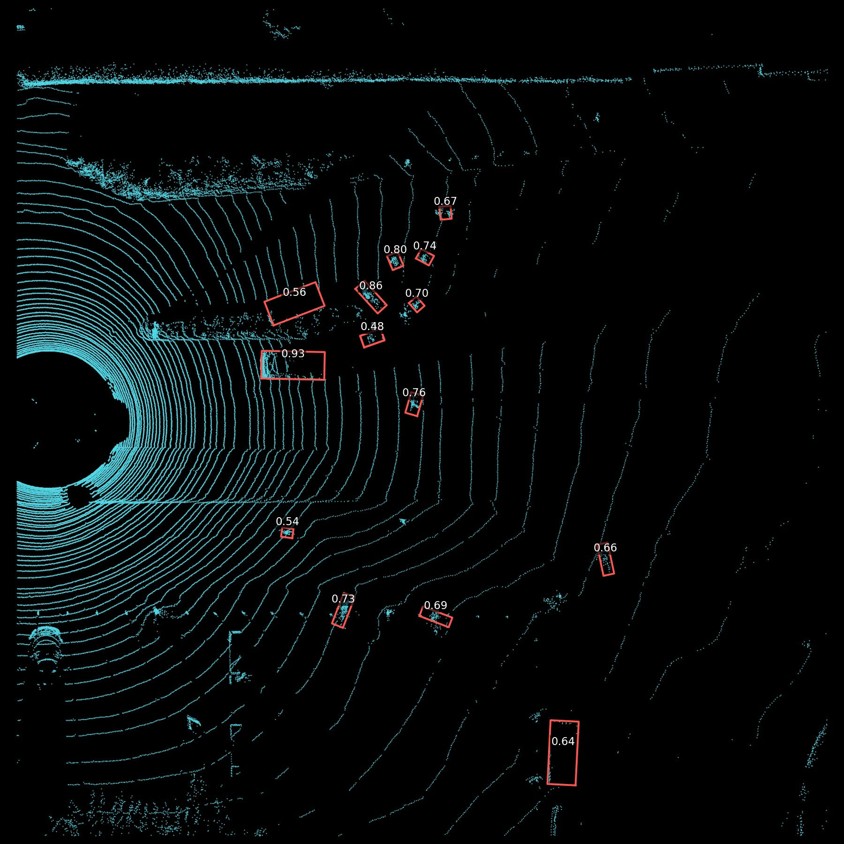
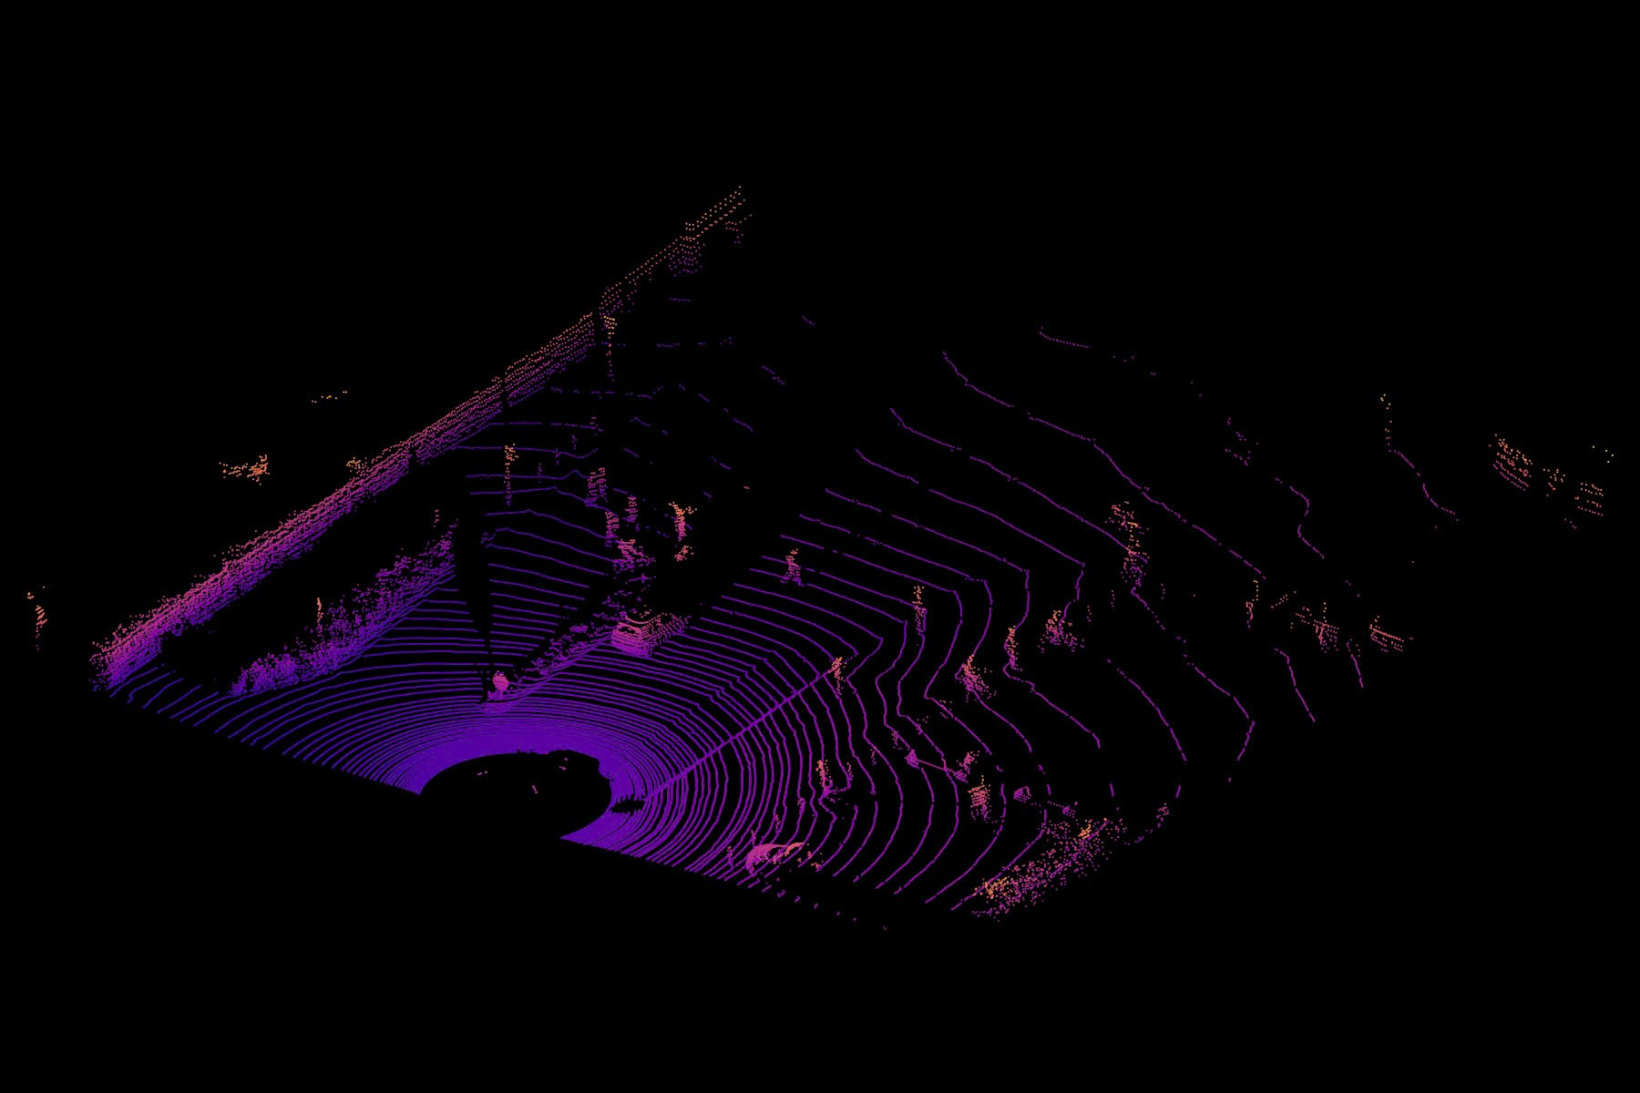
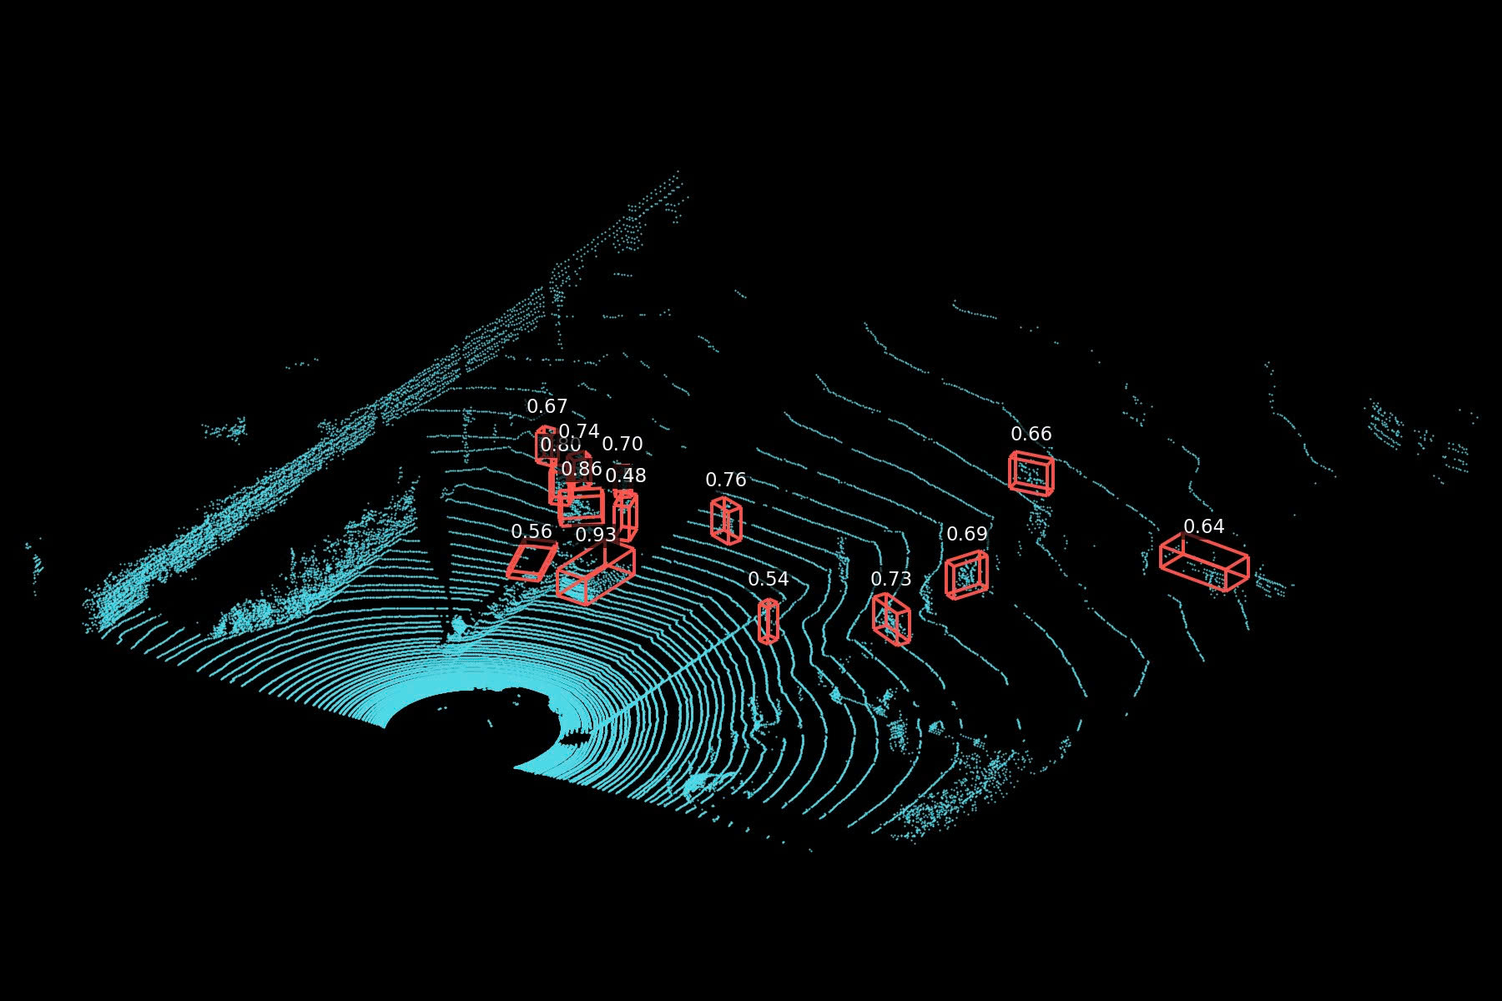

Slide 23
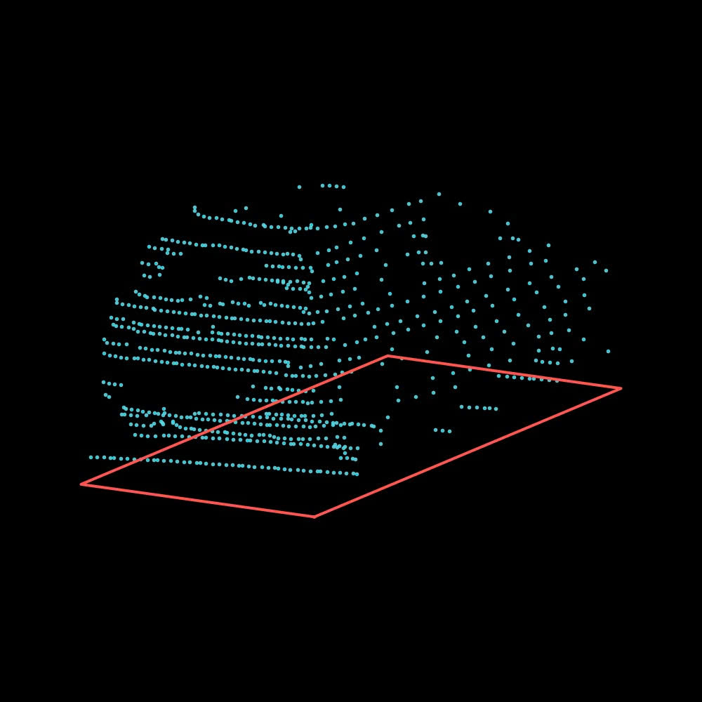
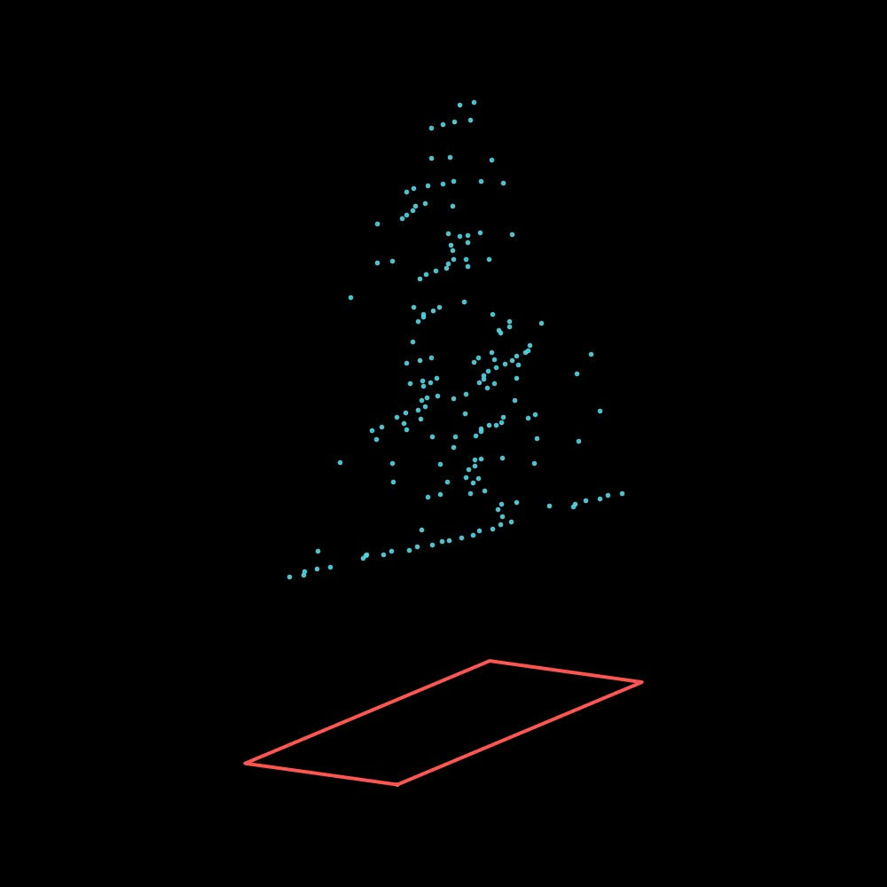
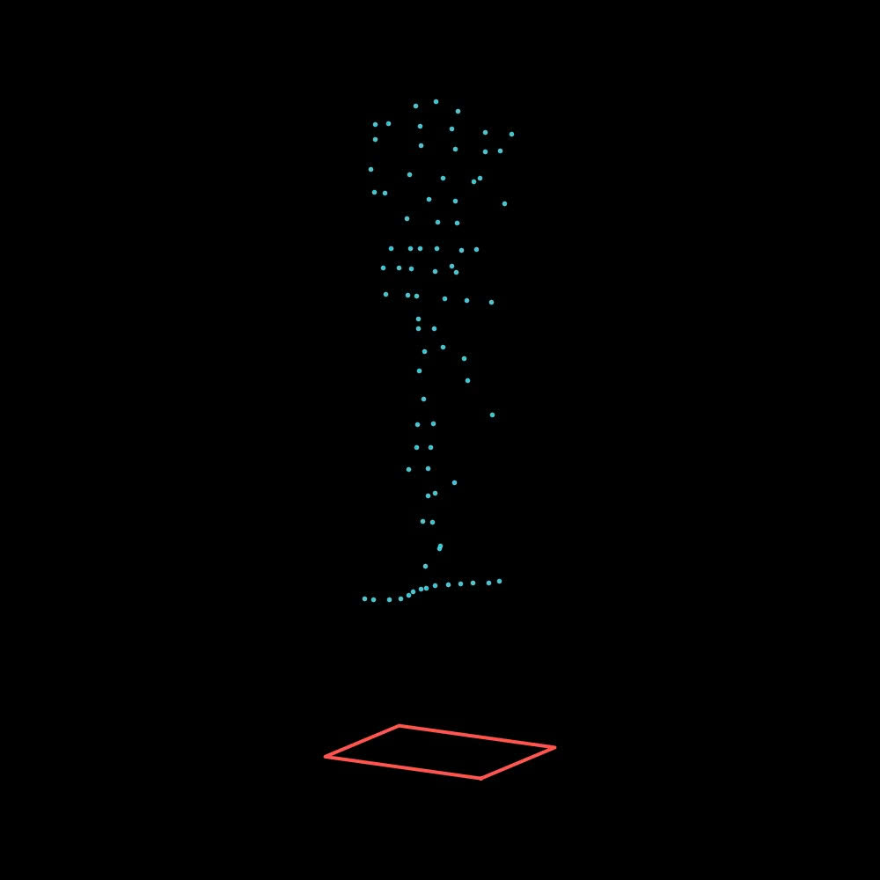

Slide 24
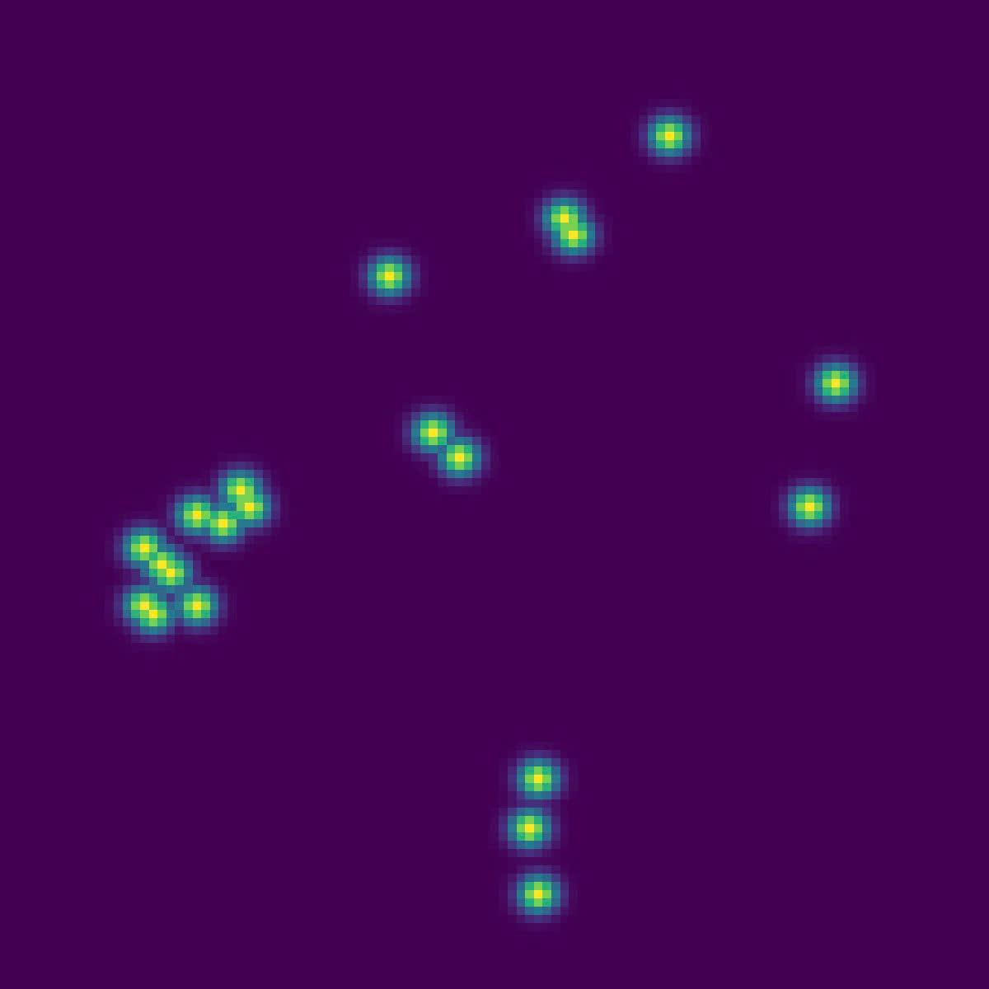
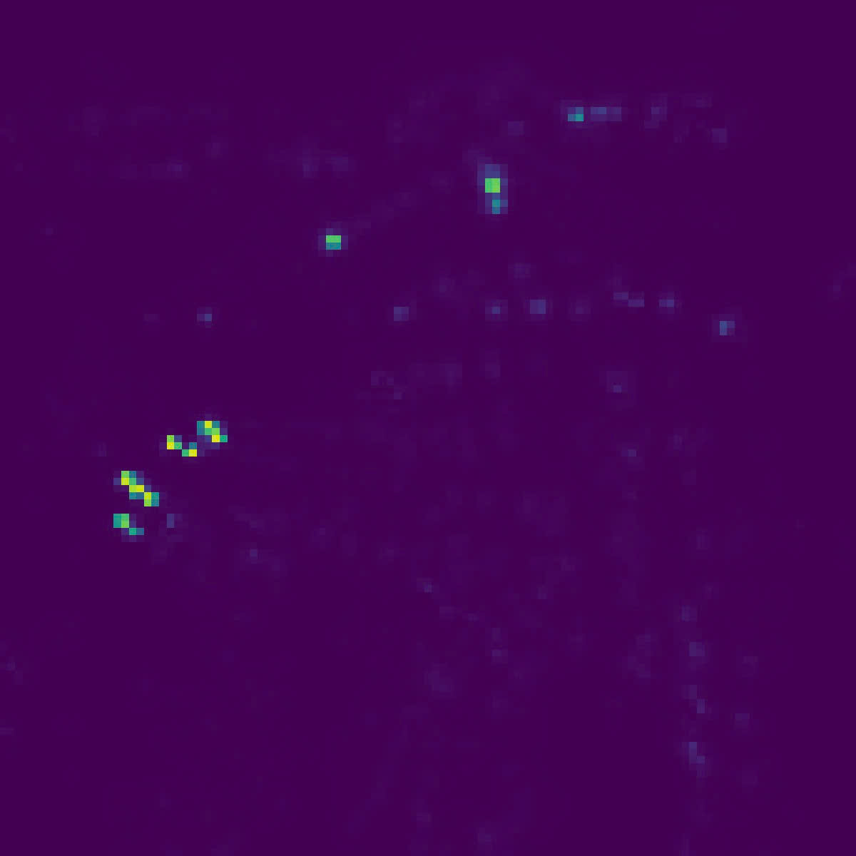
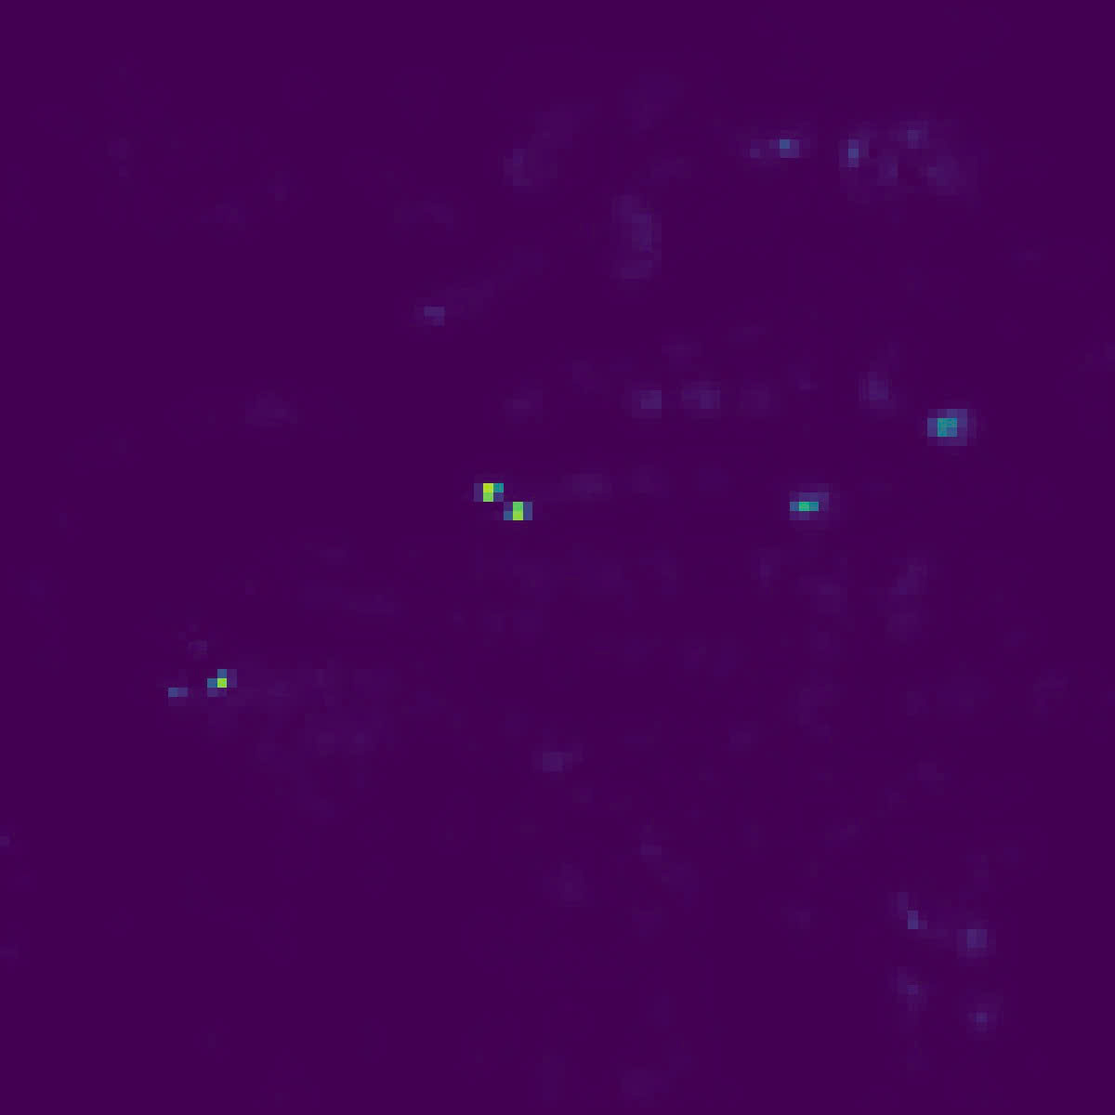
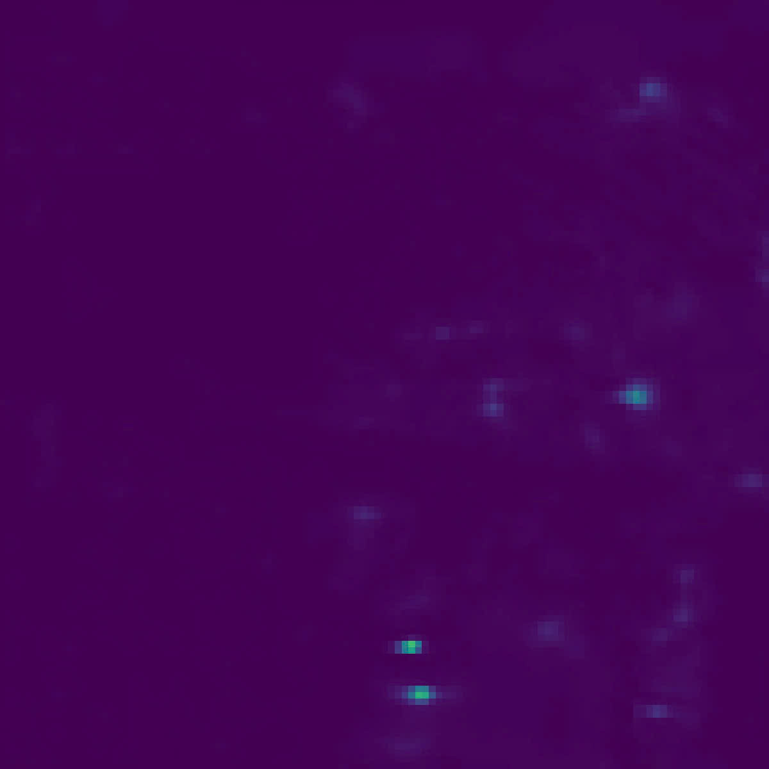
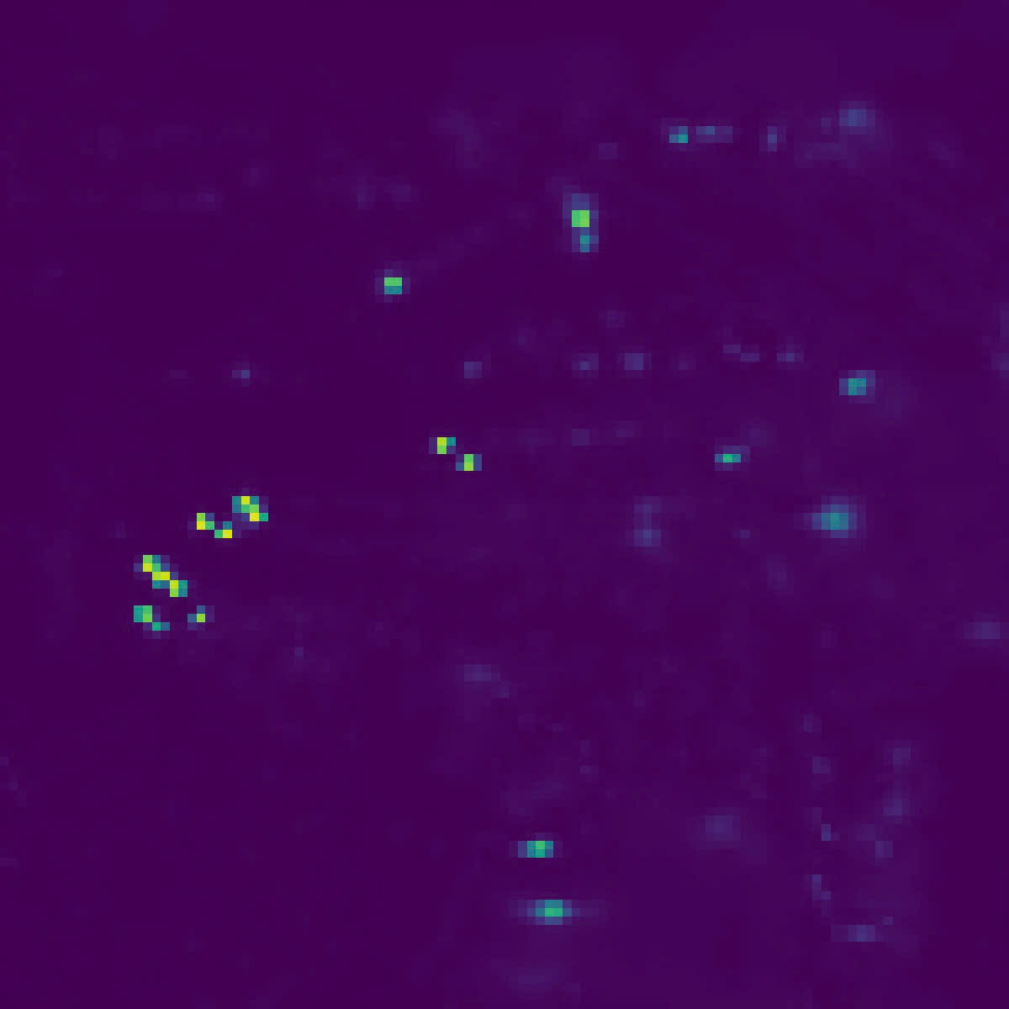

Slide 25
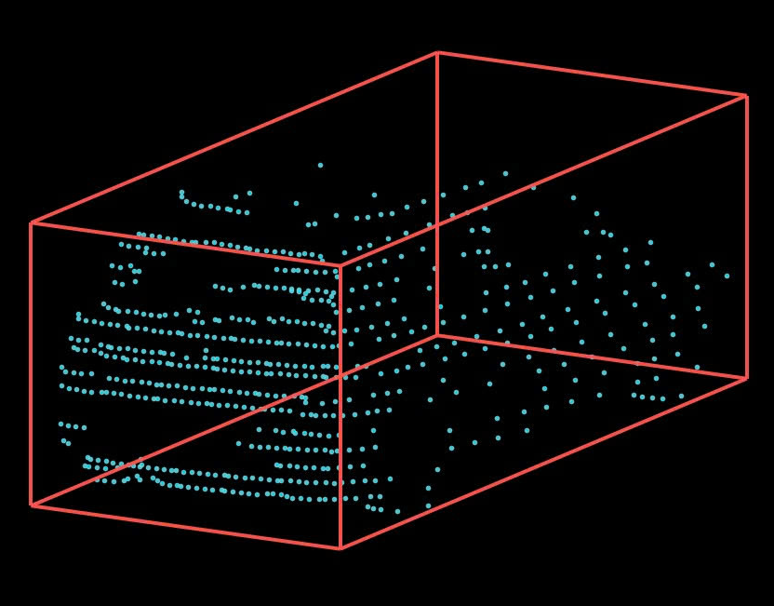
BEV feature
MobilePixorNeXt detector
encoding
Backbone + Focal Context + SG-FPN
Hist14 · 14 channels
Shared BEV feature map · stride 4
Grouped prediction heads
Car / Pedestrian + Cyclist
Gaussian
Local
Object
Object
IoU
heatmap
offset
size
orientation
quality
P(class)
[Δx, Δy]
[log w, log l]
[cos 2θ, sin 2θ]
q = σ(i)
Box decoding + rotated NMS
BEV detections
Local peaks · metric boxes · IoU-aware scores
Car / Pedestrian / Cyclist
LiDAR points
LiDAR-based vertical lifting
3D cuboids
Local ground + point height → z, h
OGA loss: focal + Smooth L1 + geometry + IoU
Dashed path: training supervision with ground truth

