Slide 1
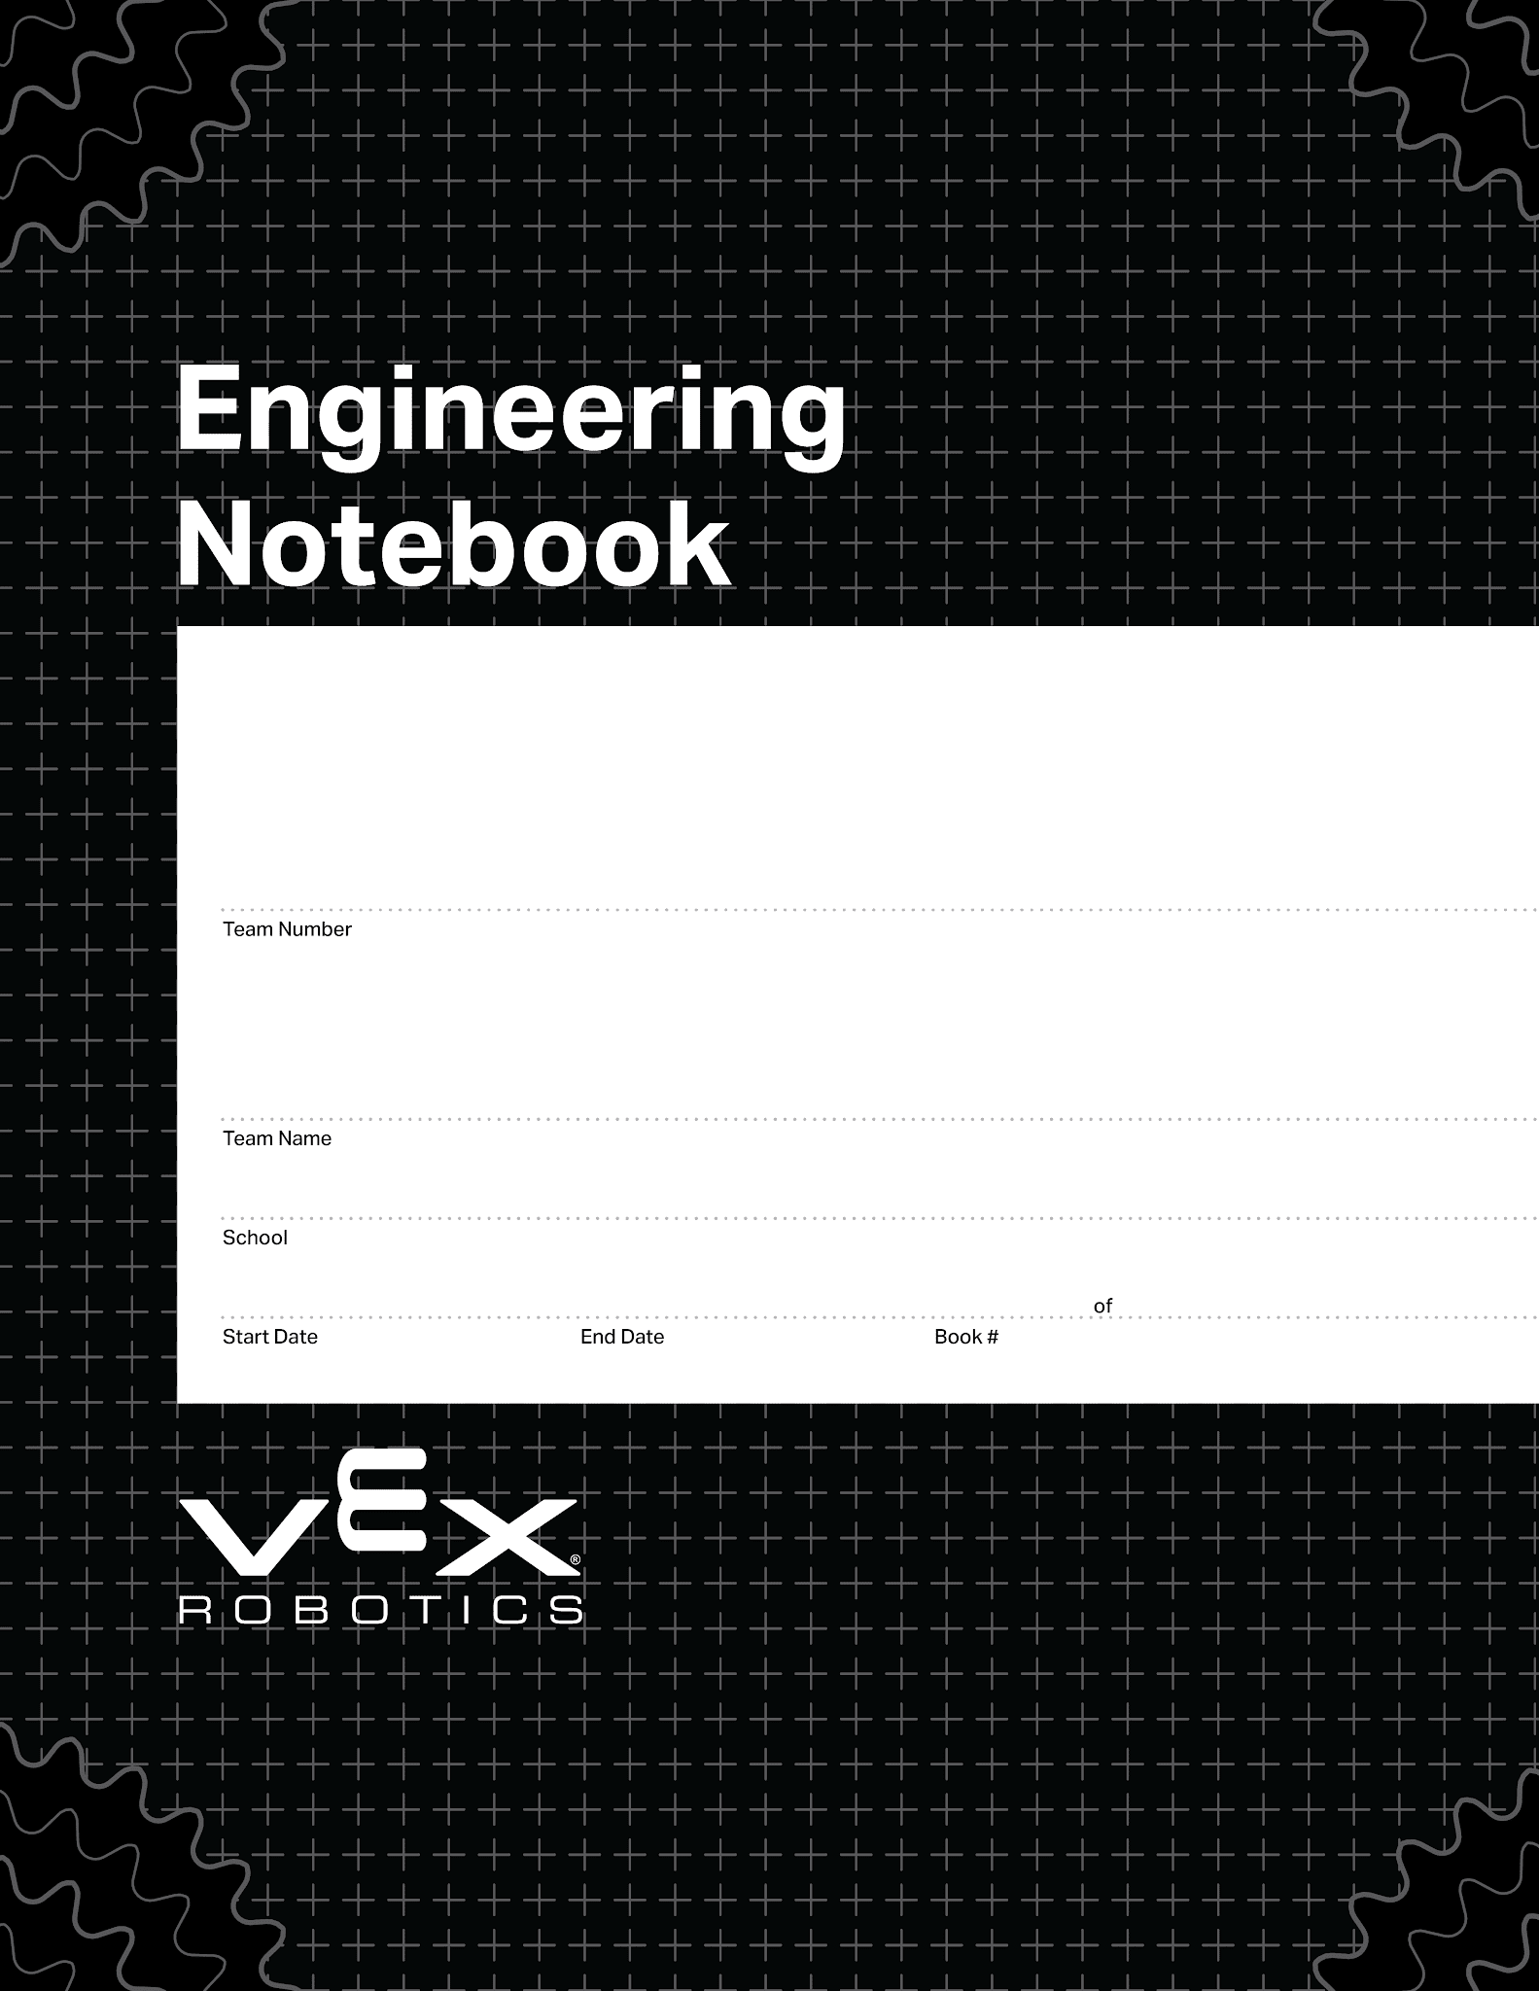
This is the basic notebook cover page.
ITSMQ
00/00/0000
00/00/0000
1
1
V5.1 Date 10.12.26

Slide 2
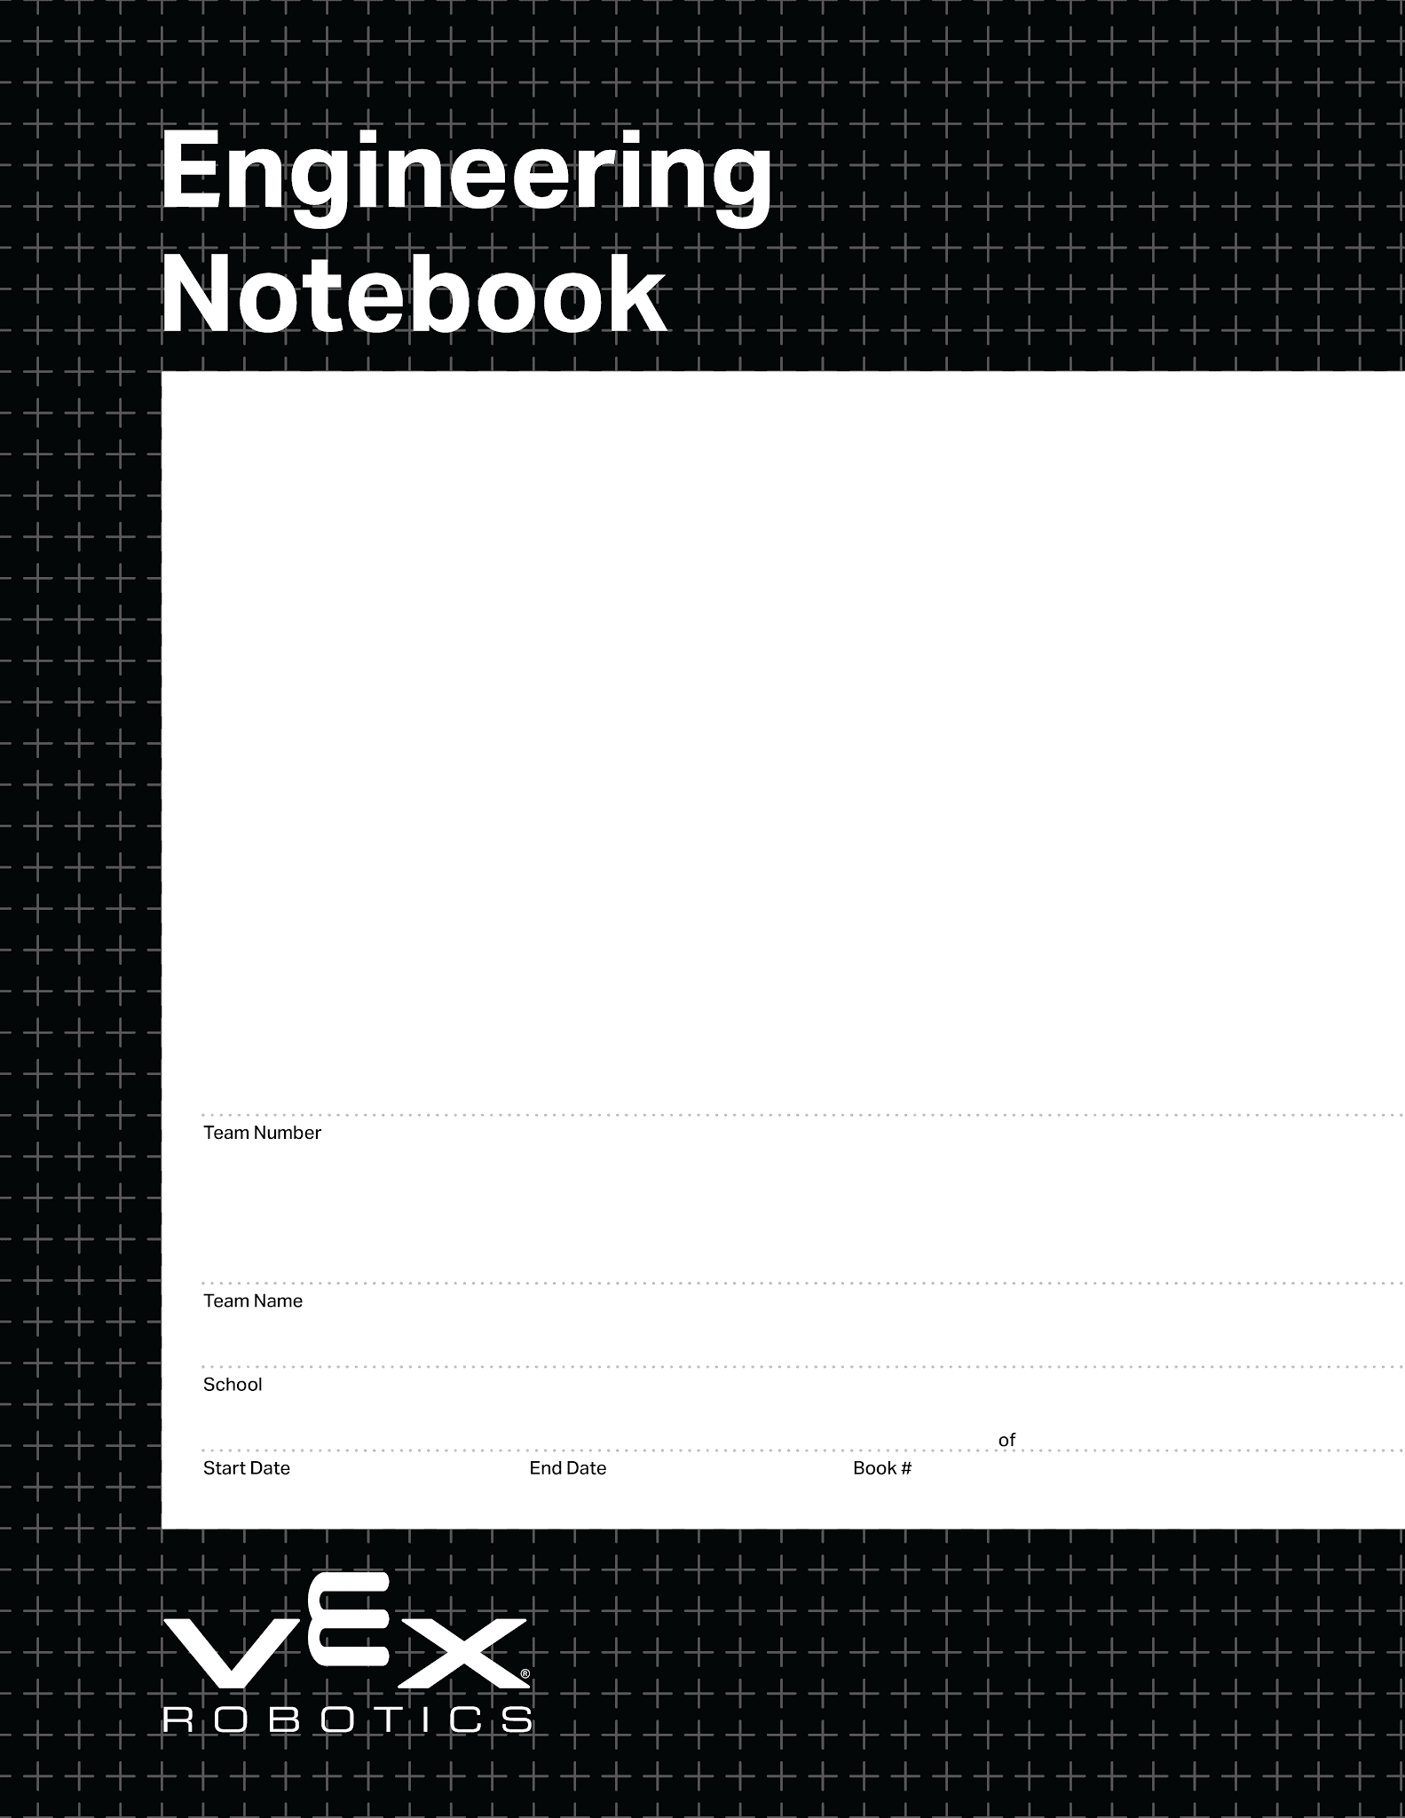
This is an alternate front page.
Place a team photo or other information here.
0000
00/00/0000
00/00/0000
1
1
V5.1 Date 10.12.26

Slide 3
INTERNAL PAGE
DELETE THIS PAGE
Delete this page and the Rubric Map before your notebook is judged.
How to Use This Template
This file is the official VEX V5 Digital Notebook Template (v5.1) plus new pages that line up with the Engineering Notebook Rubric. Official pages are kept as-is: covers, Resources, Table of Contents, calendars, field maps, brain and controller maps, grids, lined and blank pages.
HOW THE NOTEBOOK IS ORGANIZED
Common pages come first: covers, Resources, Table of Contents, the Season, Code and Credit Summaries, then the Team Organization section (members, timeline, planner, calendars).
Four topic sections follow, each opening with a divider: Mechanics, Coding, Wiring and Strategy. Each one runs its own design process: define, brainstorm, build or prototype, test, decide, document, reflect.
Reference Pages close the notebook: lined, blank and grid pages you can copy into any section.
EVERY ENTRY
Fill in the footer on every page: Project (a clear title), Name (the student who wrote it, with initials or signature), Date and Page number. The rubric checks that every entry is dated and attributed.
Put your team number on the cover and use the same team number everywhere you refer to your team.
Write about what really happened. Failed builds, bad test data and changes of mind are what show iteration and reflection.
Credit outside sources twice: name them in the entry where you used them, and list them on the Credit Summary page.
PAGES
Duplicate pages inside the right section. Right-click a page in the left filmstrip, choose Duplicate Slide, and keep the copy in its section (a new intake test stays in Mechanics). Replace [subsystem] in the title, and delete page types you never use.
Number pages by hand. The cover and Table of Contents are not numbered, so notebook page 1 is not slide 1.
Update the Table of Contents before judging, and link each entry (right-click the text, then Link) so judges can jump to it.
Keep entries in date order inside each section so judges can follow each subsystem from problem to reflection.
BEFORE YOU SUBMIT
Delete: this page, the Rubric Map, every yellow or pink sticky note, and any page type you did not use.
Check the self-assessment on the Rubric Map against your real pages: for each of the 16 criteria, can you point to the page that proves it?
Digital parts: copy parts and rulers from the separate Digital V5 Parts file (notebooks.vex.com) onto your mechanism pages.
Submission: digital notebooks are normally submitted as a link in your coach's RobotEvents.com account. Your event partner decides the format for your event, so confirm it with them.

Slide 4
INTERNAL PAGE
DELETE THIS PAGE
Delete this page before your notebook is judged.
Rubric Map & Self-Check
16 criteria, 4 points each (64 total). Fill in the last two columns as you go.
Area | Criterion | Where it lives in this notebook | Page #s / my score (1–4)
Organization | 1 Easy to reference | Table of Contents, page numbers, section dividers
Organization | 2 Contributors identifiable | Team number on cover; footer Name on every page
Organization | 3 Record spans the season | Team Organization: Season Timeline, calendars; dated entries in each section
Organization | 4 Outside sources credited | Credit Summary + credit in each entry
Define | 5 Criteria & constraints | Problem, Criteria & Constraints in Mechanics and Coding
Define | 6 Game strategy | Strategy: Game Analysis, field maps, Autonomous Routine Plan
Define | 7 Brainstorming | Brainstorming Possible Solutions in Mechanics, Coding and Strategy
Develop | 8 Prototypes | Mechanics: Prototype / Build Iteration (3+ connected)
Develop | 9 Test procedures | Test Plan & Results in Mechanics, Coding and Strategy
Develop | 10 Data collected | Test Plan & Results data tables in Mechanics, Coding and Strategy
Develop | 11 Decisions with evidence | Decision Record in each section
Optimize | 12 Mechanisms | Mechanics: Mechanism Documentation; Wiring: Wiring Documentation, port maps
Optimize | 13 Code | Coding: Code Documentation + Code Summary
Optimize | 14 Changes traceable | Change Log in Mechanics, Coding and Wiring
Reflect | 15 Reflection throughout | Reflection & Iteration at the end of each section
Reflect | 16 Iteration in sequence | Linked Build Iterations, Change Logs and Reflections in each section

Slide 5

Resources
engineering.vex.com
notebooking.vex.com
coding.vex.com
vex.com
V5RC 2026-2027 Game - Rules & Game Video
Engineering Notebook Rubric
Student-Friendly Engineering Notebook Rubric
Send suggestions and comments about these Digital Notebooks and Digital Parts
to notebooks@vex.com

Slide 6
12345 Title Title Title Date Date Date

Slide 7
SUMMARY PAGE
SUMMARY PAGE
A one-page overview of your season. Judges receive it with your notebook, so make it easy to skim.
Delete this note before judging.
Season Summary
OUR TEAM AND GOALS
Who we are, what we set out to achieve this season, and how the season went.
SEASON HIGHLIGHTS
Key events in order, with the notebook page where each is documented.
Date | What happened | Page
BIGGEST DESIGN CHANGES
The most important builds, strategy changes and code changes, and why we made them.
WHAT WE LEARNED
Technical lessons and teamwork lessons we would pass on to a new team.

Slide 8
SUMMARY PAGE
SUMMARY PAGE
A one-page overview of how your code works. Put the details on your Code Documentation pages.
Delete this note before judging.
Code Summary
WHAT OUR CODE DOES
Overview of the robot's behavior in Autonomous and Driver Control.
PROGRAMS AND WHAT EACH ONE DOES
One row per program, routine or major function.
Program / function | What it does | Page
SENSORS AND HOW WE USE THEM
Which sensors the code reads and what decisions it makes with them.
Sensor | What it measures | What the code does with it
KEY ALGORITHMS AND IDEAS
Anything special: PID control, odometry, state machines, macros, driver aids.
WHERE TO FIND THE DETAILS
Page numbers of your code documentation entries.

Slide 9
SUMMARY PAGE
RUBRIC TIP
Name outside designs, mechanisms, code and ideas your team built on. Also credit them in the entry where you used them.
Delete this note before judging.
Credit Summary
List every design, mechanism, piece of code or idea that did not come entirely from your team: videos, forums, other teams, tutorials, libraries, CAD files, mentors.
Source (name, author, link) | What we used | Where used (page #) | How we changed or built on it

Slide 10
Team Organization

Slide 11
ORGANIZATION
CONTRIBUTORS
The team number appears on the notebook and every entry is signed or initialed by the student who wrote it.
Delete this note before judging.
Team Members & Roles
TEAM
Use the same initials or signature you use in the footer of each entry.
Name | Role(s) | Grade / years in VEX | Initials / signature
HOW WE WORK TOGETHER
Meeting schedule, how we divide work, how we make decisions, how we handle disagreements.
MENTORS, COACHES AND SUPPORT
Names and what they helped with (credit their ideas in the entries where they helped).
TEAM PHOTO OR LOGO

Slide 12
ORGANIZATION
RECORD SPANS THE SEASON
Dated entries spread across the whole season show a consistent habit of notebooking. Log every meeting, even slow ones.
Delete this note before judging.
Season Timeline
Date | Meeting / event | What we did | Pages

Slide 13
Week of: MM/DD/YYYY

Slide 14
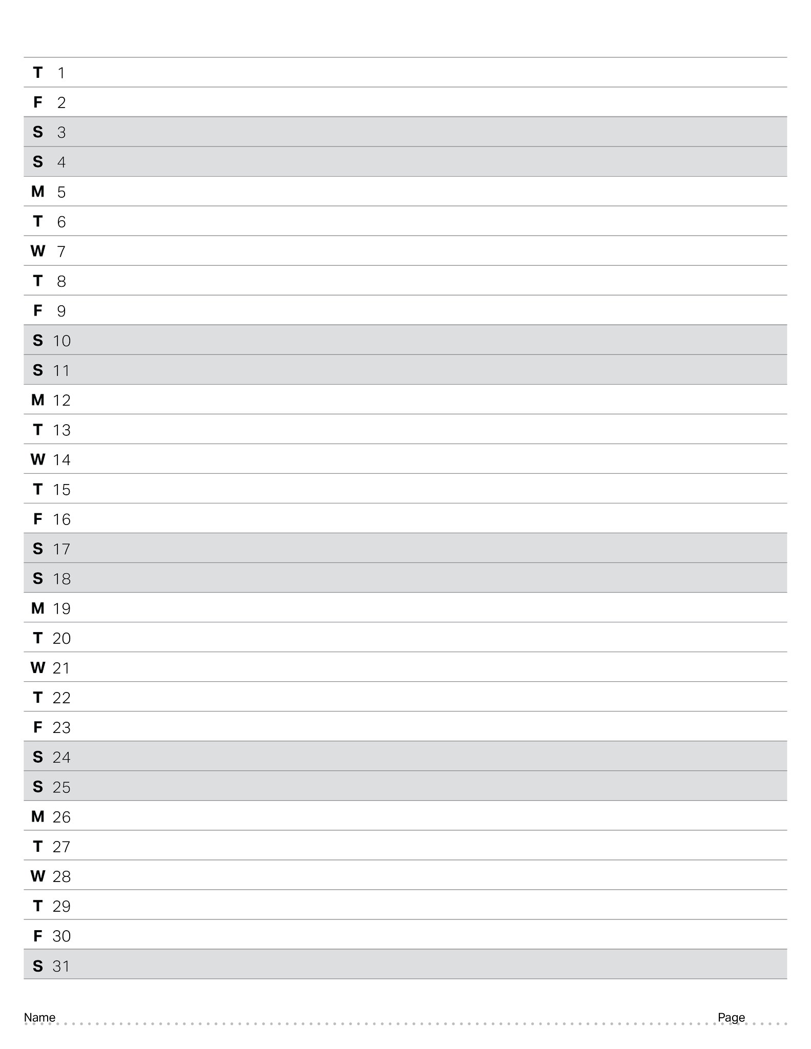
October 2026

Slide 15
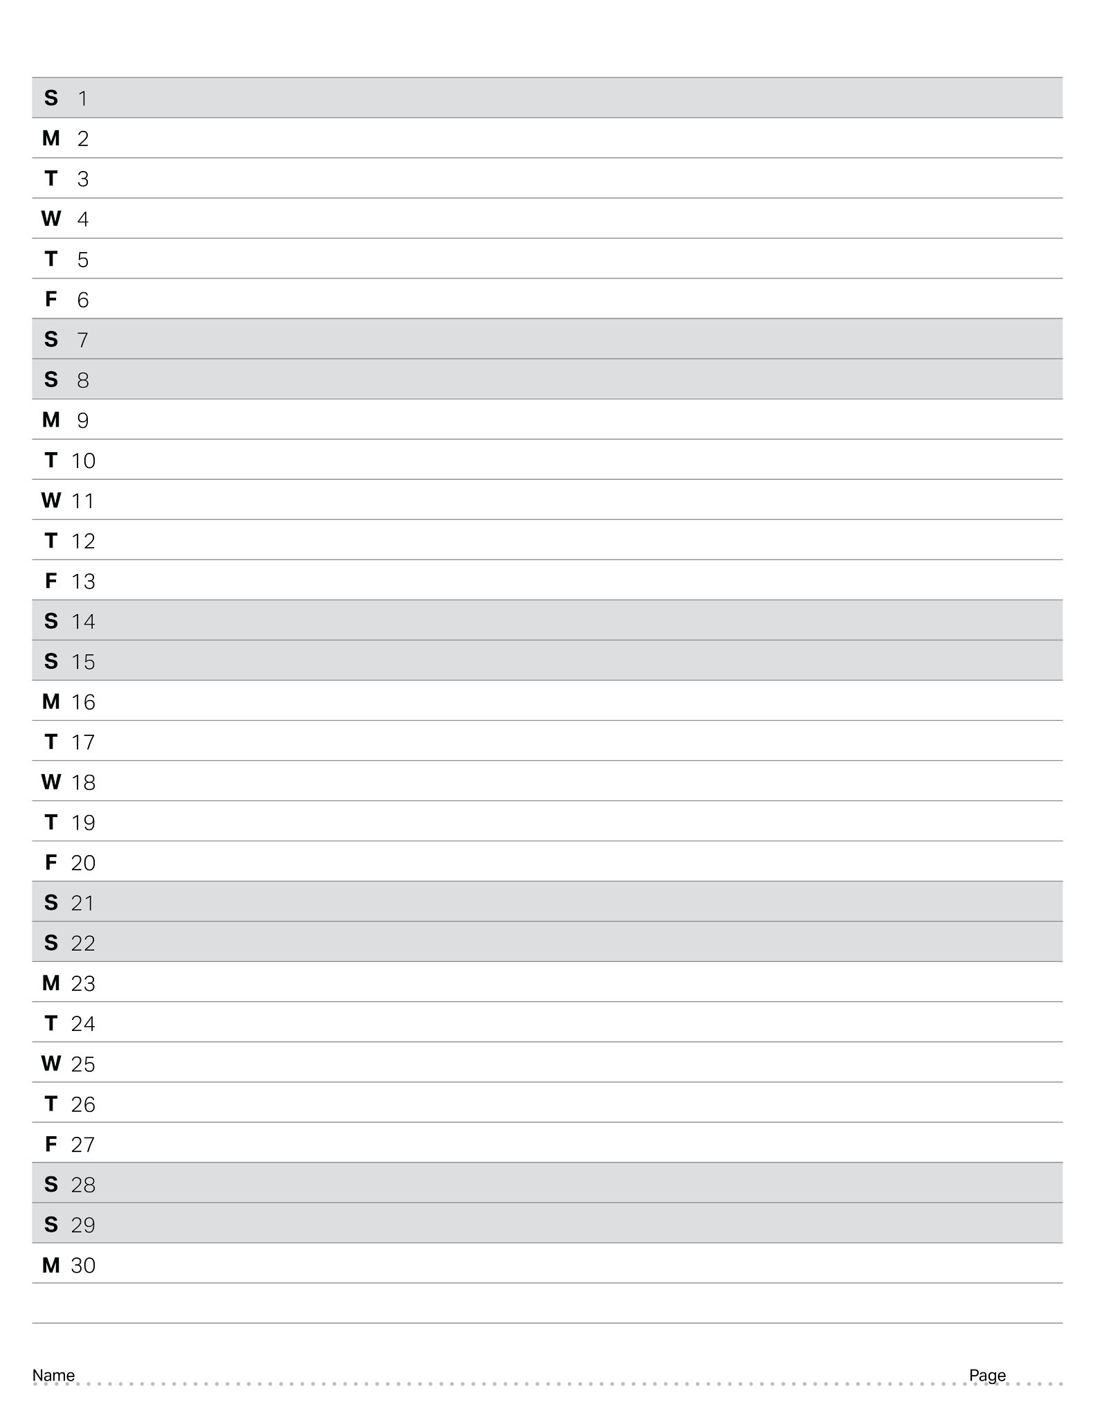
November 2026

Slide 16
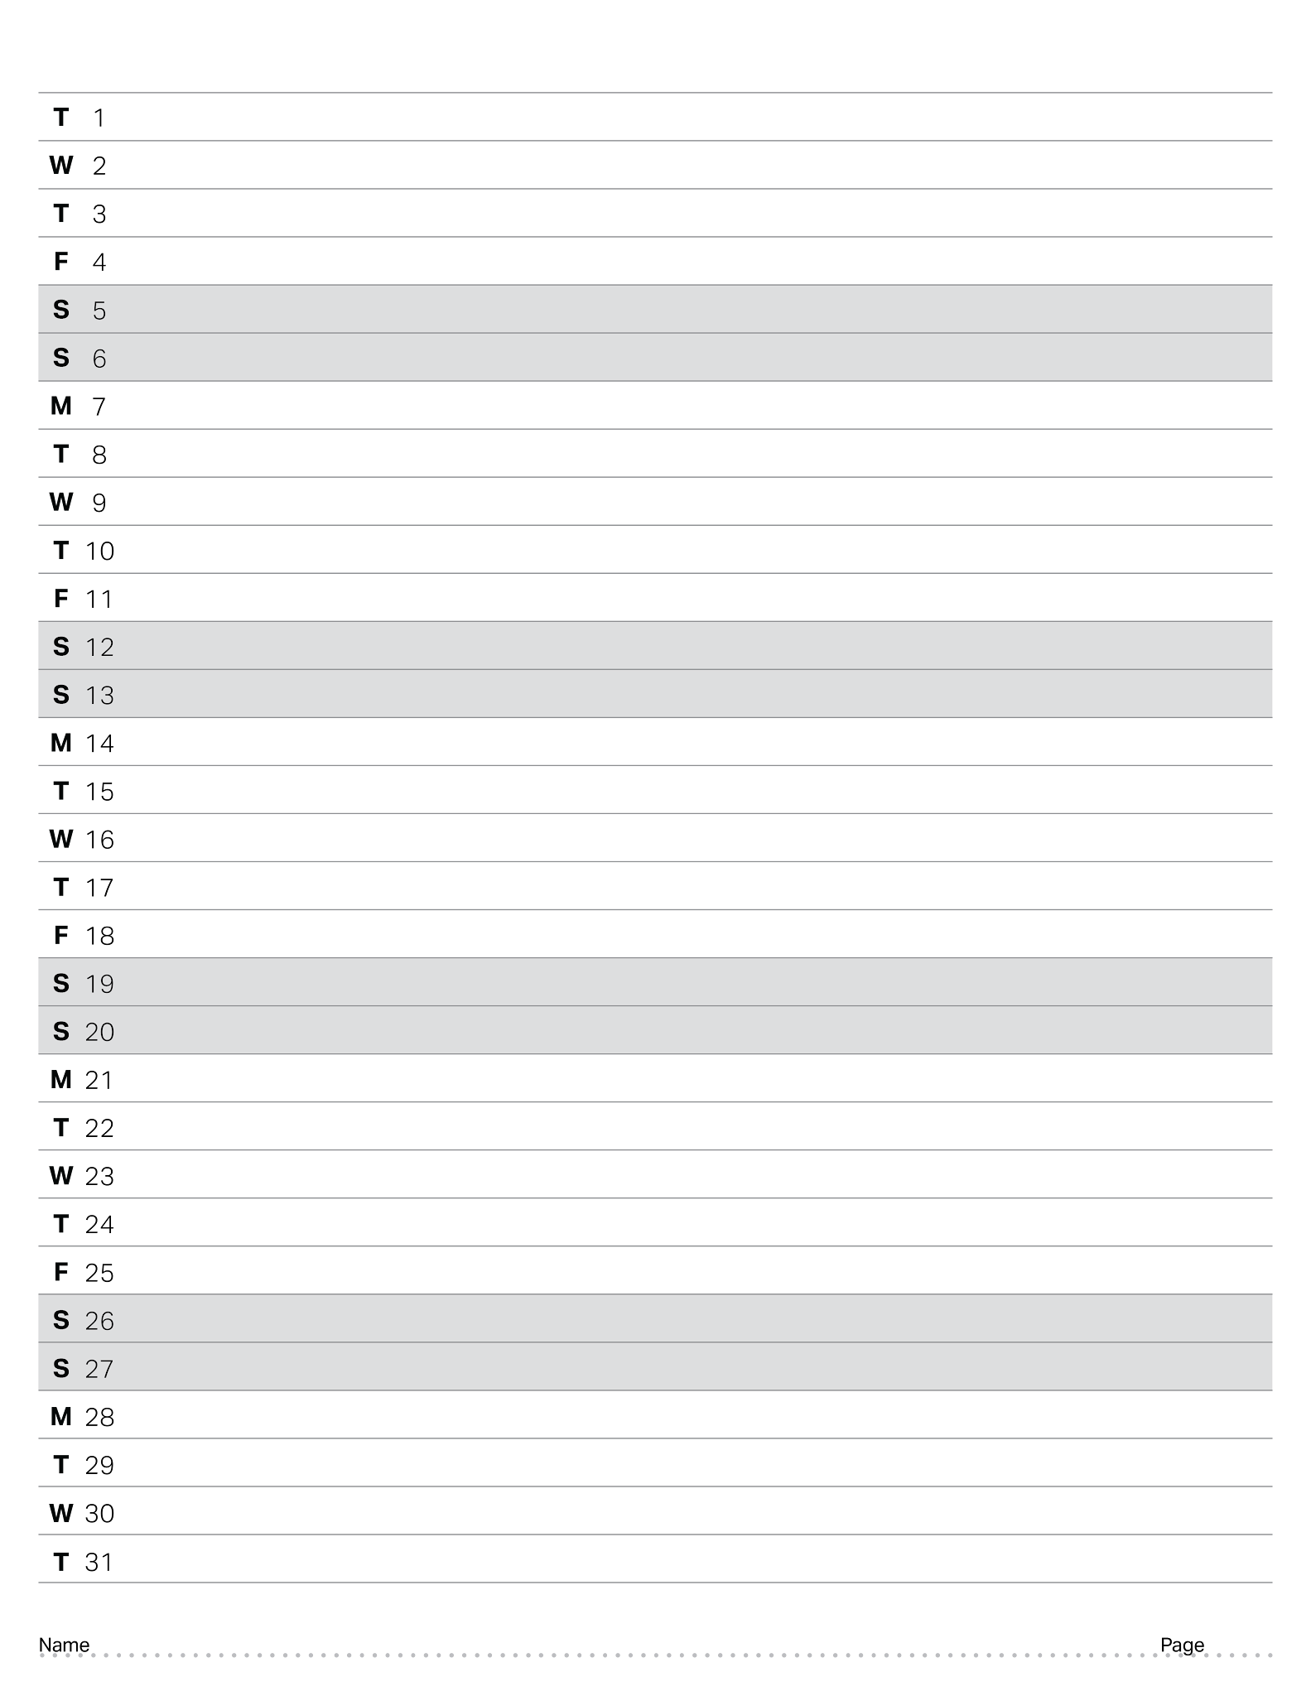
December 2026

Slide 17
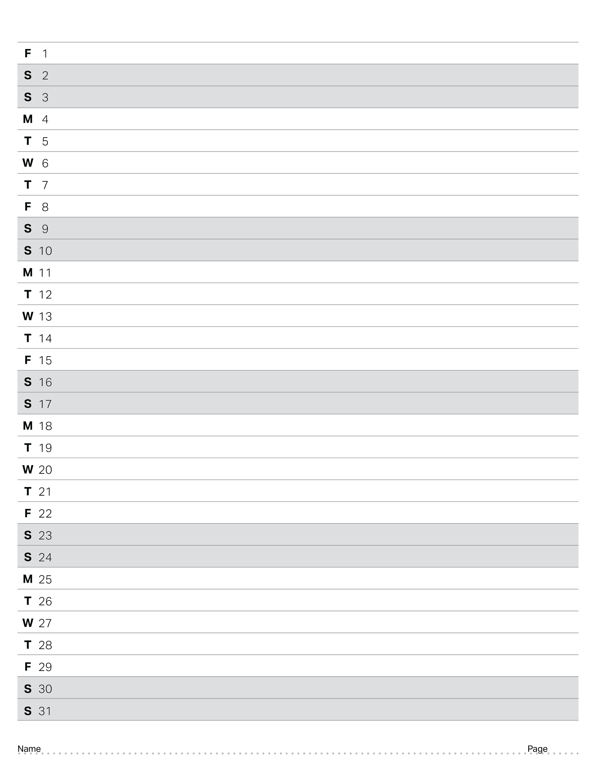
January 2027

Slide 18
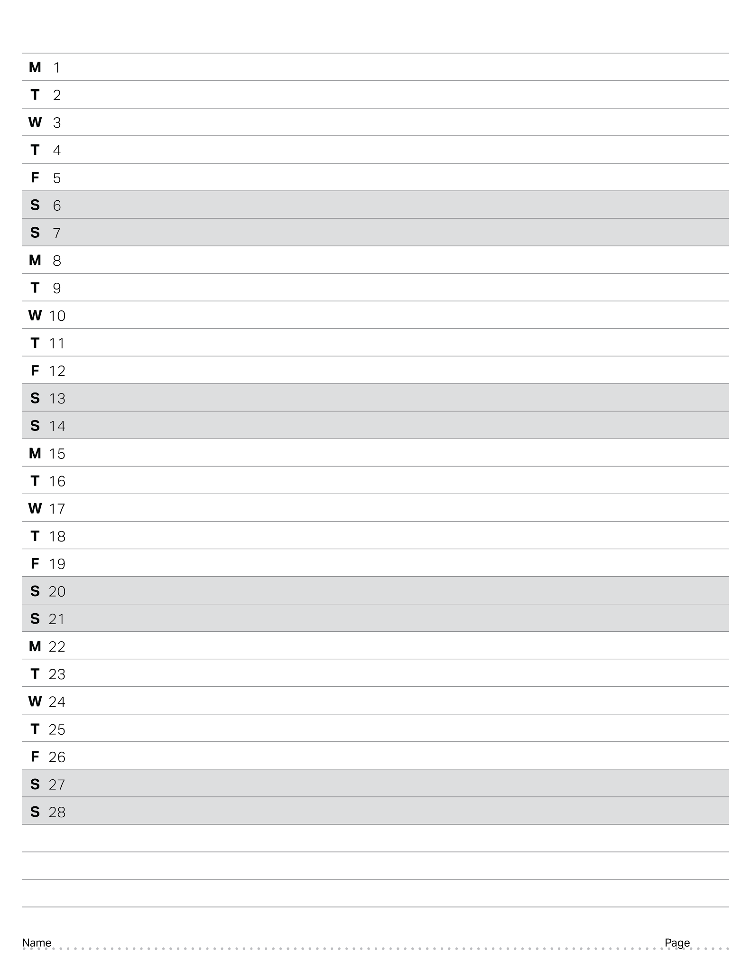
February 2027

Slide 19

March 2027

Slide 20

April 2027

Slide 21
Mechanics

Slide 22
MECHANICS · DEFINE
RUBRIC TIP
Explain the problem, then list the rules and constraints that could limit your possible solutions.
Delete this note before judging.
Problem, Criteria & Constraints: Robot design
THE CHALLENGE
Summarize the game and what the robot has to do at this stage of the season.
Override is played on a 12' x 12' field by two alliances of two robots. Our robot must drive around the field, pick up Pins and Cups, and stack them on Goals. It must also set Toggles to our alliance color, which decides who owns the yellow Pins in that Quadrant. In the last 10 seconds (Endgame), robots try to end the Match in the Midfield.
THE PROBLEM WE ARE SOLVING
In one or two sentences: what exactly are we trying to solve, and why does it matter for scoring?
We need a robot that picks up one Pin and one Cup at a time and stacks them on Goals so the Pin halves stay visible and count as Scored. Scored Pins give most of the points (5 per alliance half, 10 per owned yellow half), and each robot that ends in the Midfield adds 8 points.
CRITERIA FOR SUCCESS
What a good solution must do, how we will measure it, and the target.
Criterion | How we will measure it | Target
Place Pins so their halves score | Count Scored Pin halves after practice runs | 5 pts per alliance half
Score yellow Pins that we own | Count owned yellow halves after practice runs | 10 pts per yellow half
Seat a Toggle fully, then let go of it | Check the Toggle is seated and not touched
Stack Cups on Placed Pins | Count Placed objects per stack in practice
End the Match in the Midfield | Timed Endgame runs with a pushing robot | 8 pts per robot
CONSTRAINTS THAT LIMIT OUR SOLUTIONS
Game rules, robot size, parts and motors available, time, budget, skills.
Constraint | Where it comes from | How it limits our options
Start inside 18" x 18" x 18" | Game Manual <R3>, <SG1> | Mechanisms must fold in to fit at the start
Max 24" x 24" wide and 50" tall | Game Manual <SG2>, <SG3> | Lifts and arms must stay inside at all times
Motors: 88W total, 55W for the drive | Game Manual <R10>, <R11> | We must split motors between drive and lift
Hold max 1 Pin and 1 Cup at once | Game Manual <SG6> | Intake must not grab a second Pin or Cup
Let go of objects with power off | Game Manual <R5> | Claws and intakes must open by hand
NEXT STEP
What we will do next and which entry continues this work.

Slide 23
MECHANICS · DEFINE
RUBRIC TIP
Record several distinct approaches (coding, engineering and/or strategy) with enough detail to see how they differ.
Delete this note before judging.
Brainstorming Possible Solutions: [subsystem]
WHAT ARE WE BRAINSTORMING, AND WHO IS HERE?
Building, coding or strategy problem, and who contributed ideas.
SKETCHES OF THE IDEAS
Draw or paste a sketch for every idea. Label A, B, C…
IDEAS COMPARED
At least three distinct approaches.
Idea | How it works | Pros | Cons
DECISION MATRIX
Pick criteria, weight them 1–5, then score each idea 1–5.
Criterion | Weight | Idea A | Idea B | Idea C
WHICH IDEA MOVES FORWARD, AND WHY

Slide 24
MECHANICS · DEVELOP
RUBRIC TIP
Show continuous prototyping: three or more attempts that clearly connect to one another.
Delete this note before judging.
Prototype / Build Iteration #__: [subsystem]
WHERE THIS BUILD COMES FROM
Which earlier build or entry (page #) it continues, and what problem that one had.
WHAT CHANGED AND WHY
List each difference from the previous attempt and the reason for it.
PHOTOS, CAD OR SKETCHES
Show what was built. Label the parts that changed.
WHAT HAPPENED WHEN WE TESTED IT
Summarize the result and point to the test entry (page #).
WHAT WE LEARNED AND WHAT COMES NEXT
What we keep, what we change, and the next iteration.

Slide 25
MECHANICS · DEVELOP
RUBRIC TIP
Show continuous prototyping: three or more attempts that clearly connect to one another.
Delete this note before judging.
Prototype / Build Iteration #__: [subsystem]
WHERE THIS BUILD COMES FROM
Which earlier build or entry (page #) it continues, and what problem that one had.
WHAT CHANGED AND WHY
List each difference from the previous attempt and the reason for it.
PHOTOS, CAD OR SKETCHES
Show what was built. Label the parts that changed.
WHAT HAPPENED WHEN WE TESTED IT
Summarize the result and point to the test entry (page #).
WHAT WE LEARNED AND WHAT COMES NEXT
What we keep, what we change, and the next iteration.

Slide 26
MECHANICS · DEVELOP
RUBRIC TIP
Show continuous prototyping: three or more attempts that clearly connect to one another.
Delete this note before judging.
Prototype / Build Iteration #__: [subsystem]
WHERE THIS BUILD COMES FROM
Which earlier build or entry (page #) it continues, and what problem that one had.
WHAT CHANGED AND WHY
List each difference from the previous attempt and the reason for it.
PHOTOS, CAD OR SKETCHES
Show what was built. Label the parts that changed.
WHAT HAPPENED WHEN WE TESTED IT
Summarize the result and point to the test entry (page #).
WHAT WE LEARNED AND WHAT COMES NEXT
What we keep, what we change, and the next iteration.

Slide 27
MECHANICS · DEVELOP
RUBRIC TIP
State what was measured, how, and under what conditions so the test can be repeated. Record qualitative and quantitative results.
Delete this note before judging.
Test Plan & Results: [subsystem]
QUESTION OR HYPOTHESIS
What do we want to find out? What do we expect to happen?
TEST SETUP (SO ANYONE COULD REPEAT IT)
Item | Details
What we measure (variable, unit)
How we measure it (tools)
Conditions (battery, surface, versions)
Number of trials
Date and who ran the test
RESULTS
Record numbers with units AND what you observed.
Trial | Quantitative result (with units) | Qualitative observations | Robot / code version
ANALYSIS
Average, range, patterns. Paste a graph here.
CONCLUSION AND DECISION
What the data tells us and what we decided (see Decision Record, page #).

Slide 28
MECHANICS · DEVELOP
RUBRIC TIP
State what was measured, how, and under what conditions so the test can be repeated. Record qualitative and quantitative results.
Delete this note before judging.
Test Plan & Results: [subsystem]
QUESTION OR HYPOTHESIS
What do we want to find out? What do we expect to happen?
TEST SETUP (SO ANYONE COULD REPEAT IT)
Item | Details
What we measure (variable, unit)
How we measure it (tools)
Conditions (battery, surface, versions)
Number of trials
Date and who ran the test
RESULTS
Record numbers with units AND what you observed.
Trial | Quantitative result (with units) | Qualitative observations | Robot / code version
ANALYSIS
Average, range, patterns. Paste a graph here.
CONCLUSION AND DECISION
What the data tells us and what we decided (see Decision Record, page #).

Slide 29
MECHANICS · DEVELOP
RUBRIC TIP
State what the team decided, how the decision was made, who was part of it, and what evidence led to the choice.
Delete this note before judging.
Decision Record: [subsystem]
DECISION
What did we decide? One or two sentences.
OPTIONS WE CONSIDERED
Include why the other options were set aside.
Option | Pros | Cons | Evidence (page #)
EVIDENCE BEHIND THE DECISION
Test data, measurements, observations. Point to the page where each lives.
HOW WE DECIDED AND WHO TOOK PART
Vote, consensus, decision matrix… and the names of the people involved.
WHAT WE EXPECT AND HOW WE WILL CHECK
How will we know the decision was right?

Slide 30
MECHANICS · OPTIMIZE
RUBRIC TIP
Sketches, images or CAD of the built solution, with descriptive labels showing how or why parts of the mechanism exist.
Delete this note before judging.
Mechanism Documentation: [subsystem]
MECHANISM NAME AND JOB
What is it and what does it do for the robot?
SKETCH, PHOTO OR CAD
Add arrows and labels. Digital V5 parts and rulers can be pasted here.
LABEL KEY
Every label on the picture gets a row: what it is, what it does, and why it is there.
Label | What it does | Why it is there / why we chose it
HOW IT WORKS
Motion, gearing or gear ratio, motors, sensors, how force moves through it.

Slide 31
MECHANICS · OPTIMIZE
RUBRIC TIP
Sketches, images or CAD of the built solution, with descriptive labels showing how or why parts of the mechanism exist.
Delete this note before judging.
Mechanism Documentation: [subsystem]
MECHANISM NAME AND JOB
What is it and what does it do for the robot?
SKETCH, PHOTO OR CAD
Add arrows and labels. Digital V5 parts and rulers can be pasted here.
LABEL KEY
Every label on the picture gets a row: what it is, what it does, and why it is there.
Label | What it does | Why it is there / why we chose it
HOW IT WORKS
Motion, gearing or gear ratio, motors, sensors, how force moves through it.

Slide 32
MECHANICS · OPTIMIZE
RUBRIC TIP
Changes to the robot or code follow from recorded test results, and the notebook makes the connection explicit.
Delete this note before judging.
Change Log: [subsystem]
Date | Change (robot, code or strategy) | Test result that led to it (page # and data) | Result after the change

Slide 33
MECHANICS · REFLECT
RUBRIC TIP
Reflect throughout the season, not only at the end, and let reflections shape what happens next. Show iteration in building, strategy and coding.
Delete this note before judging.
Reflection & Iteration: [subsystem]
PERIOD THIS COVERS
Dates or page numbers.
WHAT WORKED
With examples and evidence.
WHAT DID NOT WORK, AND WHY
Be honest. This is where improvement starts.
WHAT WE LEARNED
Technical and teamwork lessons.
HOW OUR PLAN CHANGES
Specific actions for what comes next, and who does them.
ITERATION TRACKER
Where are we in the Engineering Design Process for each area, and what do we repeat next?
Area | Where we are (Define · Develop · Optimize · Reflect) | What we iterate next
Building
Strategy
Coding

Slide 34
Coding

Slide 35
CODING · DEFINE
RUBRIC TIP
Explain the problem, then list the rules and constraints that could limit your possible solutions.
Delete this note before judging.
Problem, Criteria & Constraints: Autonomous & driver control
THE CHALLENGE
Summarize the game and what the robot has to do at this stage of the season.
Each Match starts with a 15-second Autonomous Period, where the robot runs only on our code and sensors, with no driver input. Then comes a 1:45 Driver Controlled Period, where our driver uses the V5 Controller. In autonomous, our code must score Pins on our side of the Autonomous Line. In driver control, our code must make stacking, setting Toggles and reaching the Midfield in the Endgame quick and reliable.
THE PROBLEM WE ARE SOLVING
In one or two sentences: what exactly are we trying to solve, and why does it matter for scoring?
Our autonomous code must score more points than the other team in 15 seconds without any rule Violation, because that earns the 12-point Autonomous Bonus. Our driver control code must let the driver score Pins quickly for 1:45 and still reach the Midfield at the end for 8 points per robot.
CRITERIA FOR SUCCESS
What a good solution must do, how we will measure it, and the target.
Criterion | How we will measure it | Target
Outscore opponents in autonomous | Count both alliances' points at 0:15 | 12 pt Autonomous Bonus
Complete the Autonomous Win Point tasks | Checklist after each run: Pins, Goals, Perimeter | 6 Pins; 2 Goals x 2 Pins
Finish autonomous with no Violations | Watch runs for line crossing or contact | 0 Violations
Finish the routine before time runs out | Time each autonomous run with a stopwatch | 15 seconds
Driver controls that make scoring fast | Count Pins Scored in timed driver runs | 1:45 Driver period
CONSTRAINTS THAT LIMIT OUR SOLUTIONS
Game rules, robot size, parts and motors available, time, budget, skills.
Constraint | Where it comes from | How it limits our options
No driver input during autonomous | Game Manual <GG12> | Robot can act only on code and sensors
Stay on our side of Autonomous Line | Game Manual <SG7> | Auton paths must not touch the opponent side
Any auton Violation loses the Bonus | Game Manual <GG13>, <SC7> | Risky moves can cost the Bonus and Win Point
Use a Competition Template | Game Manual <R9> | Code must follow field enable and disable
Midfield Goal closed in Endgame | Game Manual <SG12> | Driver must stop Placing there at 0:10 left
NEXT STEP
What we will do next and which entry continues this work.

Slide 36
CODING · DEFINE
RUBRIC TIP
Record several distinct approaches (coding, engineering and/or strategy) with enough detail to see how they differ.
Delete this note before judging.
Brainstorming Possible Solutions: [subsystem]
WHAT ARE WE BRAINSTORMING, AND WHO IS HERE?
Building, coding or strategy problem, and who contributed ideas.
SKETCHES OF THE IDEAS
Draw or paste a sketch for every idea. Label A, B, C…
IDEAS COMPARED
At least three distinct approaches.
Idea | How it works | Pros | Cons
DECISION MATRIX
Pick criteria, weight them 1–5, then score each idea 1–5.
Criterion | Weight | Idea A | Idea B | Idea C
WHICH IDEA MOVES FORWARD, AND WHY

Slide 37
CODING · OPTIMIZE
RUBRIC TIP
Use pseudocode, flowcharts, annotated screenshots or commented code to show the intention behind the code and how it was developed.
Delete this note before judging.
Code Documentation: [subsystem]
WHAT THIS CODE MUST DO
The behavior we want from the robot.
WHY WE DESIGNED IT THIS WAY
The intention behind the code and the options we rejected.
PSEUDOCODE, FLOWCHART OR ANNOTATED SCREENSHOT
Paste a screenshot of the code and annotate each important part, or write pseudocode.
HOW WE DEVELOPED AND DEBUGGED IT
Versions, bugs we hit, how we fixed them, and who wrote it.
RELATED TESTS (PAGE #)

Slide 38
CODING · OPTIMIZE
RUBRIC TIP
Use pseudocode, flowcharts, annotated screenshots or commented code to show the intention behind the code and how it was developed.
Delete this note before judging.
Code Documentation: [subsystem]
WHAT THIS CODE MUST DO
The behavior we want from the robot.
WHY WE DESIGNED IT THIS WAY
The intention behind the code and the options we rejected.
PSEUDOCODE, FLOWCHART OR ANNOTATED SCREENSHOT
Paste a screenshot of the code and annotate each important part, or write pseudocode.
HOW WE DEVELOPED AND DEBUGGED IT
Versions, bugs we hit, how we fixed them, and who wrote it.
RELATED TESTS (PAGE #)

Slide 39
CODING · DEVELOP
RUBRIC TIP
State what was measured, how, and under what conditions so the test can be repeated. Record qualitative and quantitative results.
Delete this note before judging.
Test Plan & Results: [subsystem]
QUESTION OR HYPOTHESIS
What do we want to find out? What do we expect to happen?
TEST SETUP (SO ANYONE COULD REPEAT IT)
Item | Details
What we measure (variable, unit)
How we measure it (tools)
Conditions (battery, surface, versions)
Number of trials
Date and who ran the test
RESULTS
Record numbers with units AND what you observed.
Trial | Quantitative result (with units) | Qualitative observations | Robot / code version
ANALYSIS
Average, range, patterns. Paste a graph here.
CONCLUSION AND DECISION
What the data tells us and what we decided (see Decision Record, page #).

Slide 40
CODING · DEVELOP
RUBRIC TIP
State what the team decided, how the decision was made, who was part of it, and what evidence led to the choice.
Delete this note before judging.
Decision Record: [subsystem]
DECISION
What did we decide? One or two sentences.
OPTIONS WE CONSIDERED
Include why the other options were set aside.
Option | Pros | Cons | Evidence (page #)
EVIDENCE BEHIND THE DECISION
Test data, measurements, observations. Point to the page where each lives.
HOW WE DECIDED AND WHO TOOK PART
Vote, consensus, decision matrix… and the names of the people involved.
WHAT WE EXPECT AND HOW WE WILL CHECK
How will we know the decision was right?

Slide 41
CODING · OPTIMIZE
RUBRIC TIP
Changes to the robot or code follow from recorded test results, and the notebook makes the connection explicit.
Delete this note before judging.
Change Log: [subsystem]
Date | Change (robot, code or strategy) | Test result that led to it (page # and data) | Result after the change

Slide 42
CODING · REFLECT
RUBRIC TIP
Reflect throughout the season, not only at the end, and let reflections shape what happens next. Show iteration in building, strategy and coding.
Delete this note before judging.
Reflection & Iteration: [subsystem]
PERIOD THIS COVERS
Dates or page numbers.
WHAT WORKED
With examples and evidence.
WHAT DID NOT WORK, AND WHY
Be honest. This is where improvement starts.
WHAT WE LEARNED
Technical and teamwork lessons.
HOW OUR PLAN CHANGES
Specific actions for what comes next, and who does them.
ITERATION TRACKER
Where are we in the Engineering Design Process for each area, and what do we repeat next?
Area | Where we are (Define · Develop · Optimize · Reflect) | What we iterate next
Building
Strategy
Coding

Slide 43
Wiring

Slide 44
WIRING · DOCUMENT
RUBRIC TIP
Photos or diagrams of the built wiring, with labels showing what each connection is and why it was routed that way.
Delete this note before judging.
Wiring Documentation: [subsystem]
PHOTO OR DIAGRAM
Label every cable and port. Arrows help judges follow each route.
PORTS AND CONNECTIONS
One row per port: what is plugged in, the cable used and why.
Port | Device | Cable or connection | Why this port or route
WIRING DECISIONS AND PROBLEMS
What we chose, what went wrong (loose cables, bad ports) and how we fixed it.

Slide 45
PORT
PORT
PORT
PORT
PORT
PORT
PORT
PORT
PORT
PORT
PORT
PORT
PORT
PORT
PORT
PORT
PORT
PORT
PORT
PORT
PORT
PORT
PORT
PORT
PORT
PORT
PORT
PORT
PORT

Slide 46
BUMPER
BUMPER
BUMPER
BUMPER
STICK
STICK
STICK
STICK
BUTTON
BUTTON
BUTTON
BUTTON
BUTTON
BUTTON
BUTTON
BUTTON

Slide 47
WIRING · DEVELOP
RUBRIC TIP
State what the team decided, how the decision was made, who was part of it, and what evidence led to the choice.
Delete this note before judging.
Decision Record: [subsystem]
DECISION
What did we decide? One or two sentences.
OPTIONS WE CONSIDERED
Include why the other options were set aside.
Option | Pros | Cons | Evidence (page #)
EVIDENCE BEHIND THE DECISION
Test data, measurements, observations. Point to the page where each lives.
HOW WE DECIDED AND WHO TOOK PART
Vote, consensus, decision matrix… and the names of the people involved.
WHAT WE EXPECT AND HOW WE WILL CHECK
How will we know the decision was right?

Slide 48
WIRING · OPTIMIZE
RUBRIC TIP
Changes to the robot or code follow from recorded test results, and the notebook makes the connection explicit.
Delete this note before judging.
Change Log: [subsystem]
Date | Change (robot, code or strategy) | Test result that led to it (page # and data) | Result after the change

Slide 49
WIRING · REFLECT
RUBRIC TIP
Reflect throughout the season, not only at the end, and let reflections shape what happens next. Show iteration in building, strategy and coding.
Delete this note before judging.
Reflection & Iteration: [subsystem]
PERIOD THIS COVERS
Dates or page numbers.
WHAT WORKED
With examples and evidence.
WHAT DID NOT WORK, AND WHY
Be honest. This is where improvement starts.
WHAT WE LEARNED
Technical and teamwork lessons.
HOW OUR PLAN CHANGES
Specific actions for what comes next, and who does them.
ITERATION TRACKER
Where are we in the Engineering Design Process for each area, and what do we repeat next?
Area | Where we are (Define · Develop · Optimize · Reflect) | What we iterate next
Building
Strategy
Coding

Slide 50
Strategy

Slide 51
STRATEGY · DEFINE
RUBRIC TIP
Describe your scoring priorities, your reasoning, and the tradeoffs that come with those priorities.
Delete this note before judging.
Game Analysis & Scoring Strategy: [subsystem]
SCORING PRIORITIES
Rank the ways to score. Explain why each priority is where it is and what it costs us.
# | Way to score | Points | Why this priority | Tradeoff (what we give up)
MATCH PLAN
How the priorities turn into a plan for each part of the match.
Part of match | Plan | Expected points
Autonomous
Driver control
Endgame
STRATEGY WE CHOSE AND WHY
Connect the choice back to the priorities and tradeoffs above.
WHO TOOK PART IN THIS DECISION
Names and what each person contributed.

Slide 52









“Override” Blank Field

Slide 53
“Override” Starting Field with Moveable Game Objects

Slide 54
“Override” Starting Field with Static Game Objects

Slide 55
STRATEGY · PLAN
RUBRIC TIP
Describe your scoring priorities, your reasoning, and the tradeoffs behind them.
Delete this note before judging.
Autonomous Routine Plan: [subsystem]
PATH DRAWN ON THE FIELD MAP
Paste the field map here, then draw the robot's path with numbered arrows.
STEPS
One row per step, numbered to match the arrows on the map.
Step | Action | Expected result | Points
WHY THIS ROUTINE AND WHAT WE GIVE UP
What we score first, and what we skip or risk.
TEST RESULTS (PAGE #)
Where this routine was tested, and how it scored.

Slide 56
STRATEGY · DEFINE
RUBRIC TIP
Record several distinct approaches (coding, engineering and/or strategy) with enough detail to see how they differ.
Delete this note before judging.
Brainstorming Possible Solutions: [subsystem]
WHAT ARE WE BRAINSTORMING, AND WHO IS HERE?
Building, coding or strategy problem, and who contributed ideas.
SKETCHES OF THE IDEAS
Draw or paste a sketch for every idea. Label A, B, C…
IDEAS COMPARED
At least three distinct approaches.
Idea | How it works | Pros | Cons
DECISION MATRIX
Pick criteria, weight them 1–5, then score each idea 1–5.
Criterion | Weight | Idea A | Idea B | Idea C
WHICH IDEA MOVES FORWARD, AND WHY

Slide 57
STRATEGY · DEVELOP
RUBRIC TIP
State what was measured, how, and under what conditions so the test can be repeated. Record qualitative and quantitative results.
Delete this note before judging.
Test Plan & Results: [subsystem]
QUESTION OR HYPOTHESIS
What do we want to find out? What do we expect to happen?
TEST SETUP (SO ANYONE COULD REPEAT IT)
Item | Details
What we measure (variable, unit)
How we measure it (tools)
Conditions (battery, surface, versions)
Number of trials
Date and who ran the test
RESULTS
Record numbers with units AND what you observed.
Trial | Quantitative result (with units) | Qualitative observations | Robot / code version
ANALYSIS
Average, range, patterns. Paste a graph here.
CONCLUSION AND DECISION
What the data tells us and what we decided (see Decision Record, page #).

Slide 58
STRATEGY · DEVELOP
RUBRIC TIP
State what the team decided, how the decision was made, who was part of it, and what evidence led to the choice.
Delete this note before judging.
Decision Record: [subsystem]
DECISION
What did we decide? One or two sentences.
OPTIONS WE CONSIDERED
Include why the other options were set aside.
Option | Pros | Cons | Evidence (page #)
EVIDENCE BEHIND THE DECISION
Test data, measurements, observations. Point to the page where each lives.
HOW WE DECIDED AND WHO TOOK PART
Vote, consensus, decision matrix… and the names of the people involved.
WHAT WE EXPECT AND HOW WE WILL CHECK
How will we know the decision was right?

Slide 59
STRATEGY · REFLECT
RUBRIC TIP
Reflect throughout the season, not only at the end, and let reflections shape what happens next. Show iteration in building, strategy and coding.
Delete this note before judging.
Reflection & Iteration: [subsystem]
PERIOD THIS COVERS
Dates or page numbers.
WHAT WORKED
With examples and evidence.
WHAT DID NOT WORK, AND WHY
Be honest. This is where improvement starts.
WHAT WE LEARNED
Technical and teamwork lessons.
HOW OUR PLAN CHANGES
Specific actions for what comes next, and who does them.
ITERATION TRACKER
Where are we in the Engineering Design Process for each area, and what do we repeat next?
Area | Where we are (Define · Develop · Optimize · Reflect) | What we iterate next
Building
Strategy
Coding

Slide 60
Reference Pages

