Slide 1

Analysis of Fire Incidents in Greensboro NC
By Danielle Mirzaeian and Nahom Fisseha

Slide 2
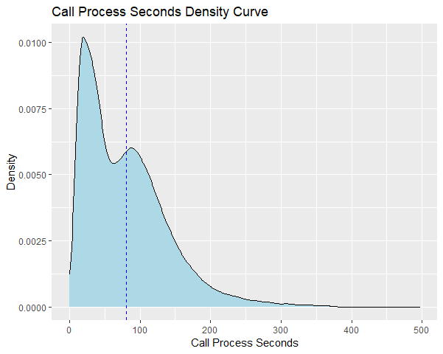

Slide 3
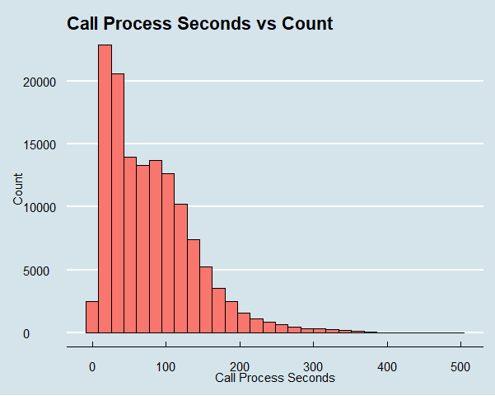

Slide 4
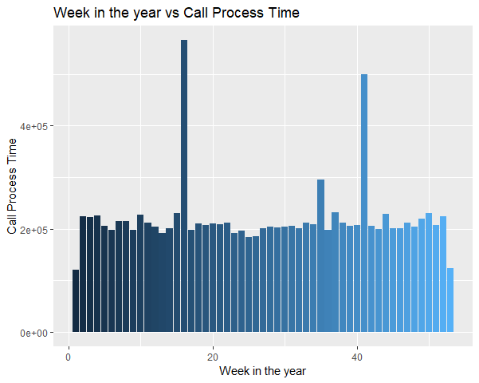

Slide 5
