Slide 1



Capstone 1
Business Analysis with SQL and Excel
Dania Kabakibi
April 30, 2026

Slide 2

Introduction
I was assigned to perform a sales analysis for EmporiUm, a student bookstore chain that also sells tech products, art supplies, and other products in the state of Massachusetts.
Michael Jarvis, manager for the Northeast Region, assigned me to analyze the performance of Sales Manager Bo Heap.

Slide 3
Sales Analysis
What is total revenue overall for sales in the assigned territory, plus the start date and end date that tell you what period the data covers?
What is the month by month revenue breakdown for the sales territory?
Provide a comparison of total revenue for the specific sales territory and the region it belongs to.
What is the number of transactions per month and average transaction size by product category for the sales territory?
Can you provide a ranking of in-store sales performance by each store in the sales territory, or a ranking of online sales performance by state within an online sales territory?
What is your recommendation for where to focus sales attention in the next quarter?

Slide 4
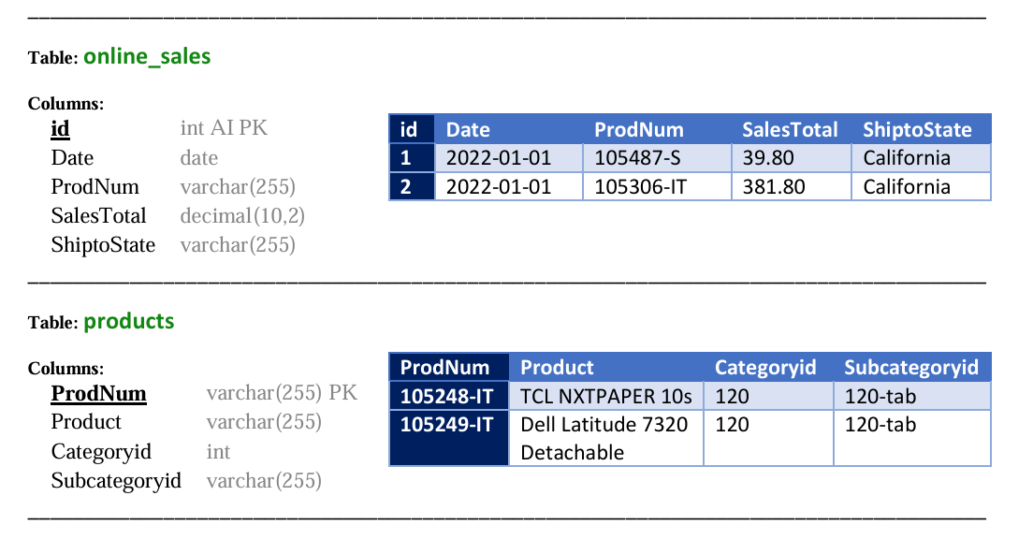
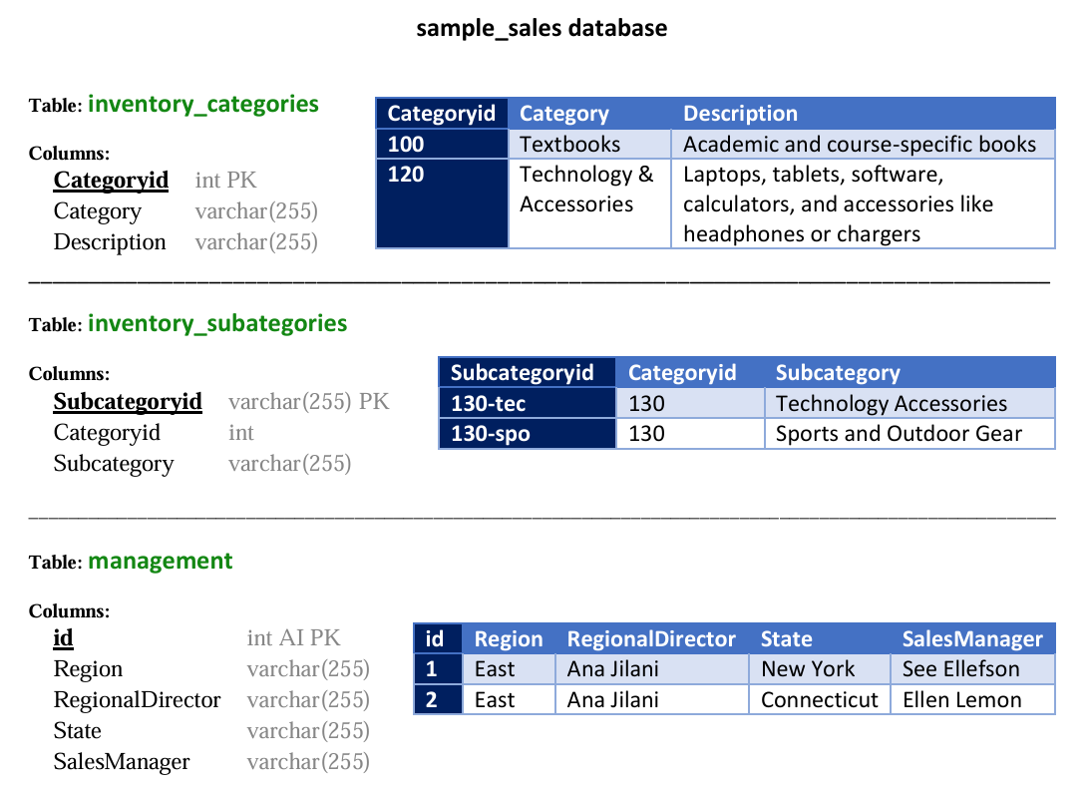
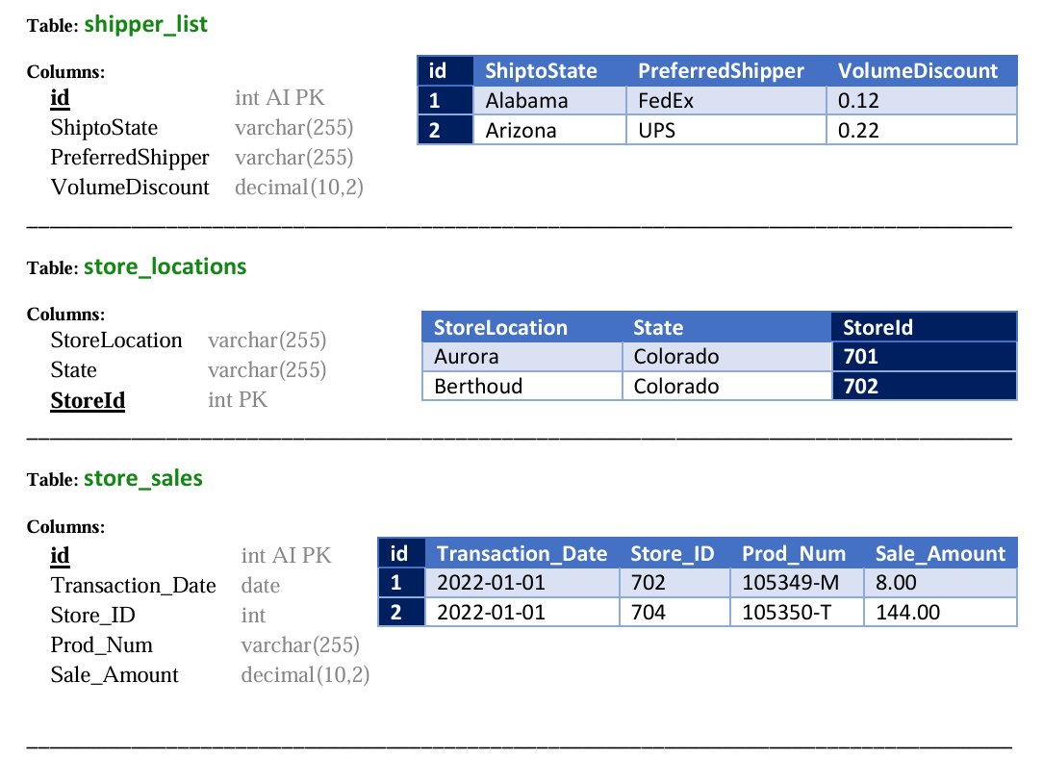
Database

Slide 5
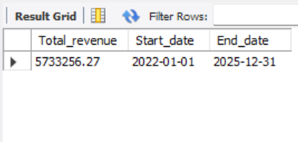
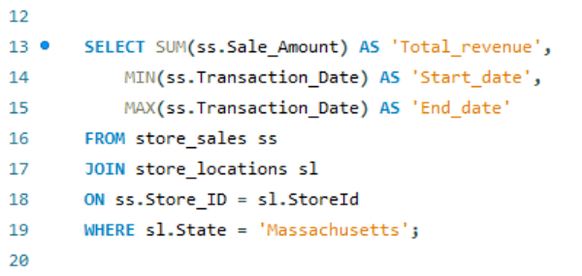
What is total revenue overall for sales in the assigned territory, plus the start date and end date that tell you what period the data covers?
01
Result
Query

Slide 6
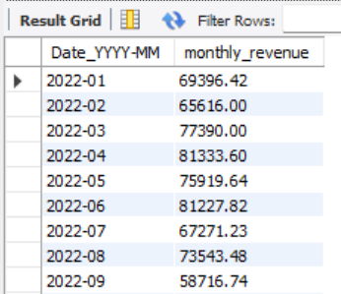
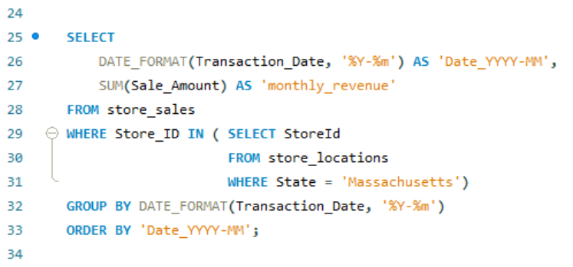
What is the month by month revenue breakdown for the sales territory?
02
Result
Query

Slide 7
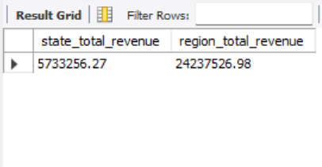
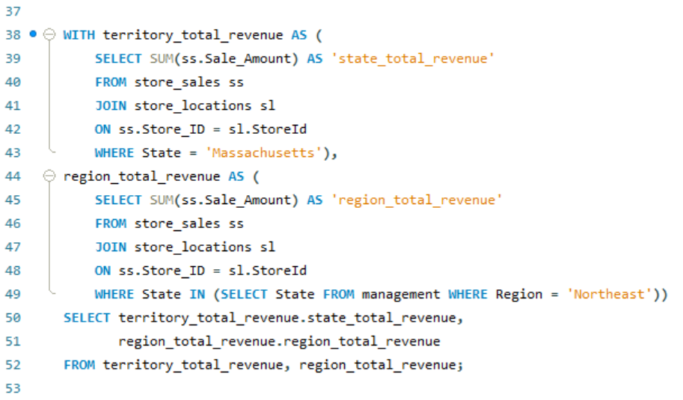
Provide a comparison of total revenue for the specific sales territory and the region it belongs to.
03
Result
Query

Slide 8
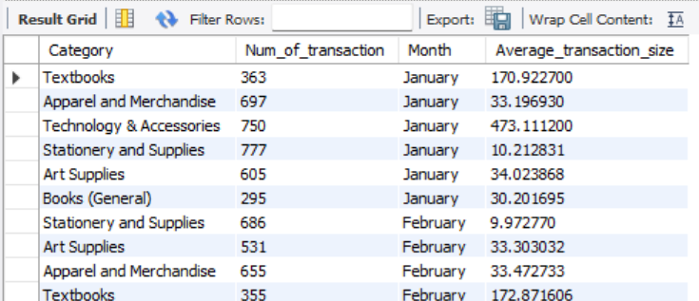
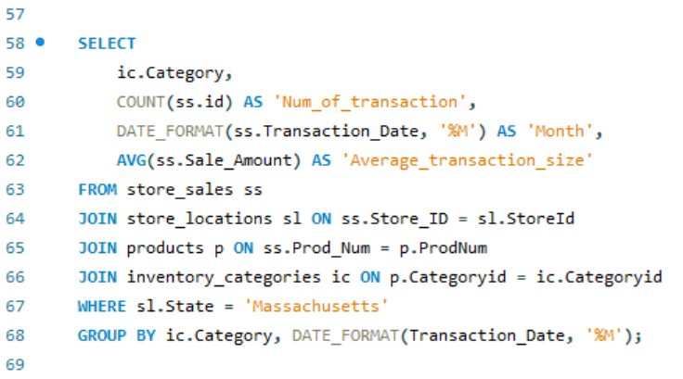
What is the number of transactions per month and average transaction size by product category for the sales territory?
04
Result
Query

Slide 9
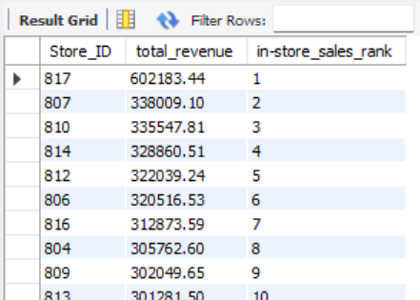
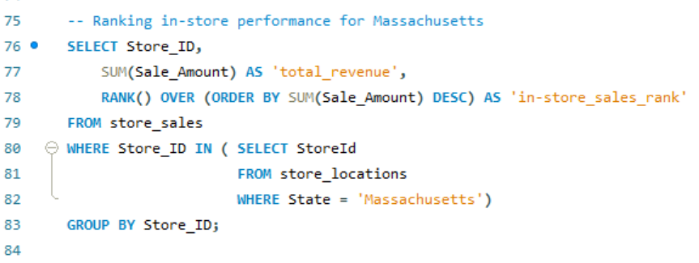
Can you provide a ranking of in-store sales performance by each store in the sales territory, or a ranking of online sales performance by state within an online sales territory?
05
Result
Query

Slide 10
What is your recommendation for where to focus sales attention in the next quarter?
06
Based on my SQL analysis, I observed the following key trends:
Growth & Impact: Monthly revenue in the Massachusetts territory increased gradually from 2022 to 2025. Furthermore, comparing the state total revenue ($5,733,256.27) to the Northeast regional total ($24,237,526.98) shows that Massachusetts is a significant contributor, accounting for nearly 24% of the entire region's revenue.
Product Value: The 'Technology & Accessories' category maintains the highest average transaction size across all months, followed closely by the 'Textbooks' category.
Store Performance Gap: There is a substantial performance gap within the territory. Store 817 is the top performer ($602,183.44), while the second-highest, Store 807, lags significantly behind ($338,009.10).
Recommendation:
I recommend a dual-focus strategy for the next quarter. First, we should maximize high-value categories by prioritizing 'Technology & Accessories' sales across the state through targeted promotions. Second, we must bridge the performance gap between our top-tier and mid-tier locations. Specifically, I recommend using Store 817 as a training model and having the manager of Store 807 observe their sales techniques and floor layout to help increase overall territory revenue.

Slide 11
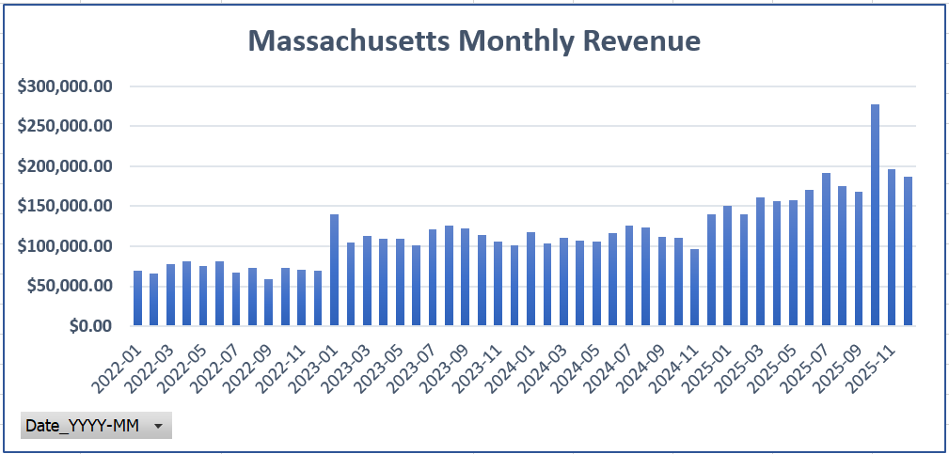
Visualization
06
Question
What is the month by month revenue breakdown for the sales territory?

Slide 12
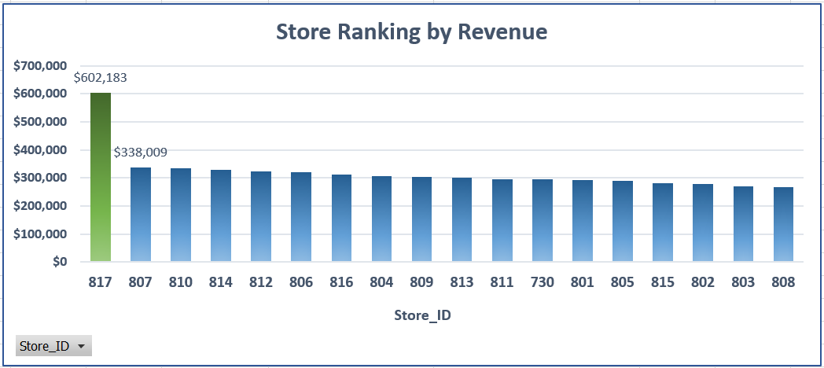
Question
Can you provide a ranking of in-store sales performance by each store in the sales territory, or a ranking of online sales performance by state within an online sales territory?

Slide 13
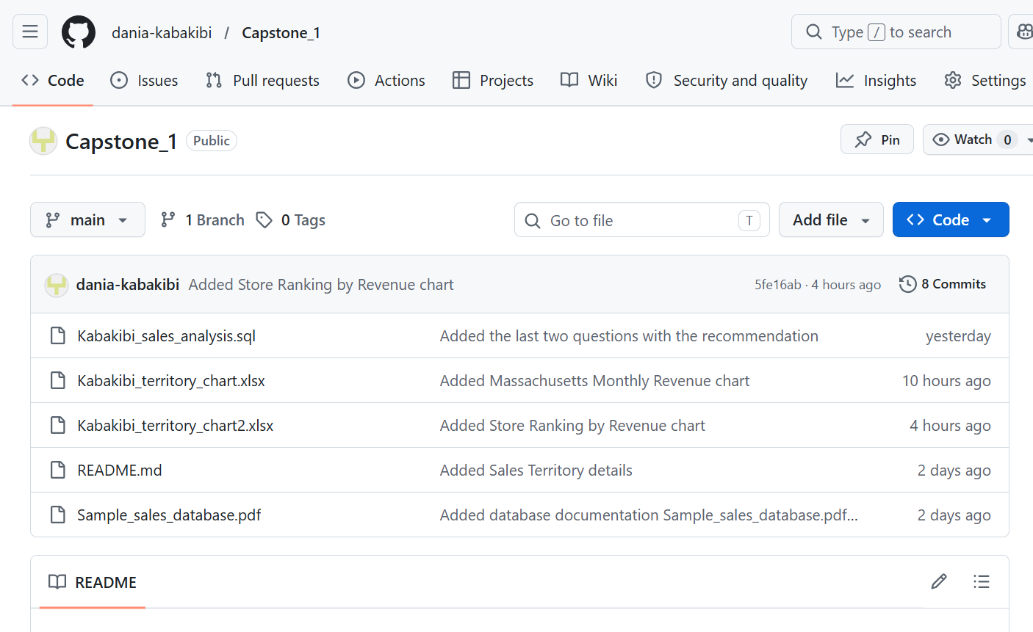
GitHub Repository

Slide 14



Dania Kabakibi
Thank
You.
dkabakibi@my.yearupunited.org
https://github.com/dania-kabakibi
/Capstone_1.git

