Slide 1
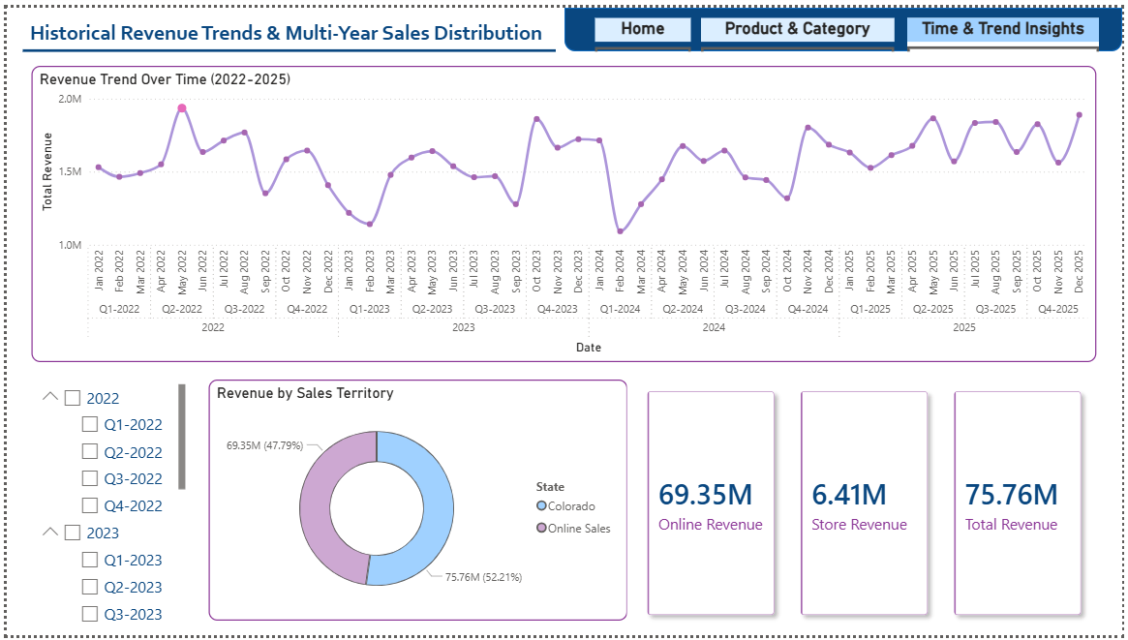
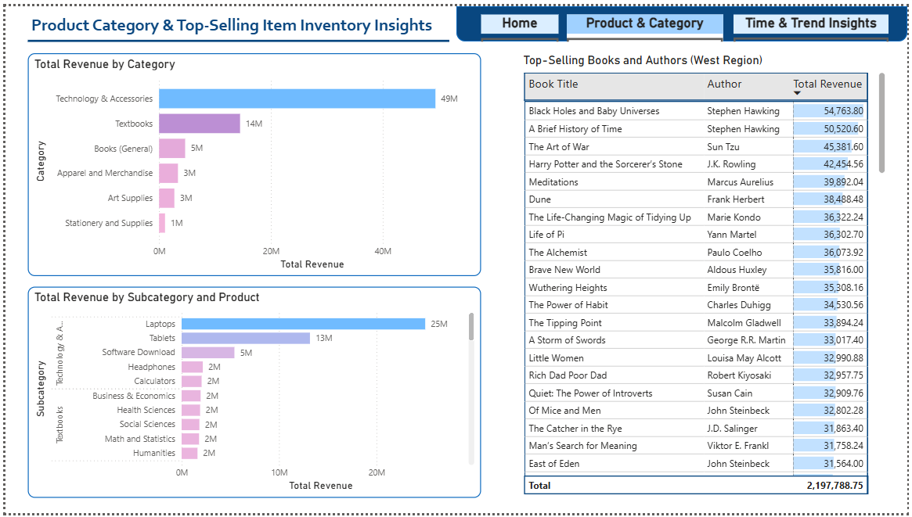
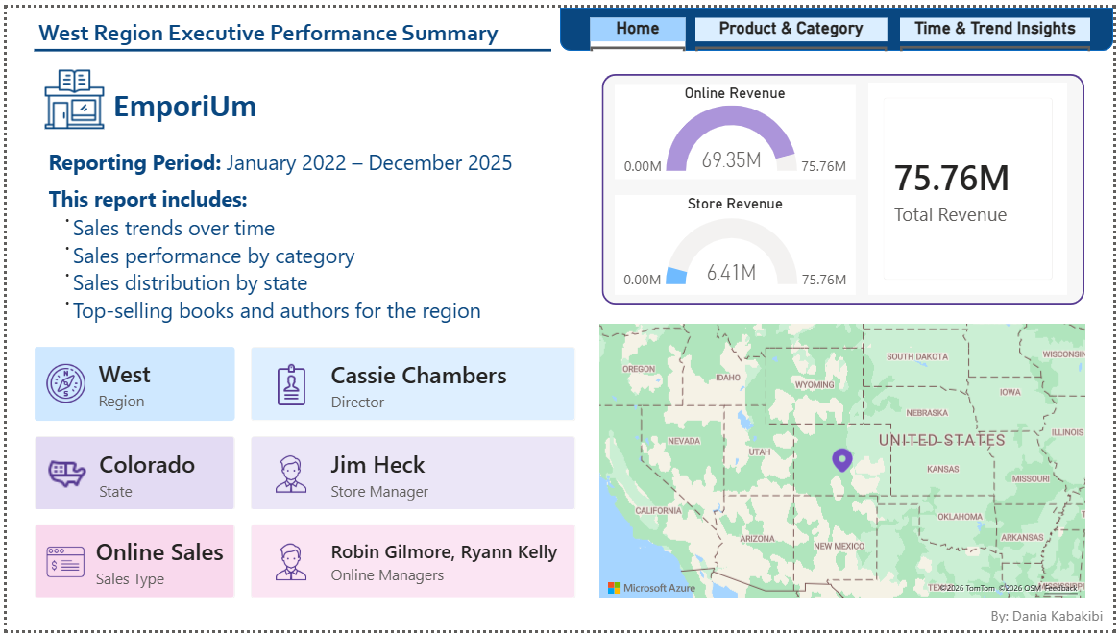

Capstone 3
Analysis with
Power BI
Dania Kabakibi
6/26/2026

Slide 2
Project Overview:
I was assigned to perform a sales analysis for EmporiUm, a student bookstore chain that also sells tech products, art supplies, and other products in the state of Colorado.
The goal was to analyze revenue performance, identify top-performing categories and products, and provide insights that could support business decisions.

Slide 3
Workflow:
Data cleaning using Power query editor
Building the Data Model
Building Report Visuals
Publishing the Report

Slide 7
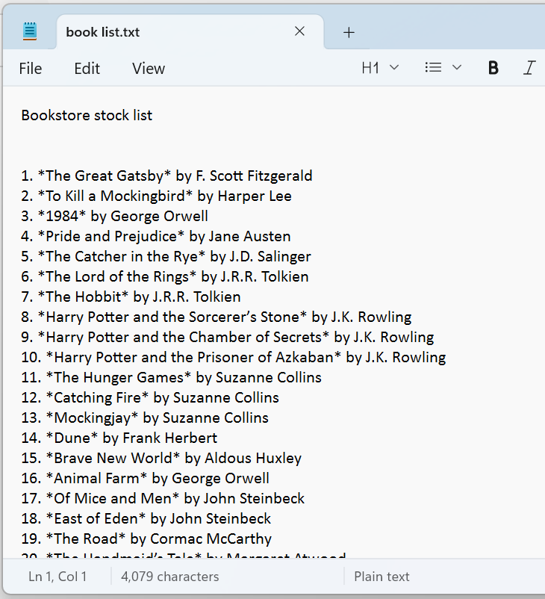
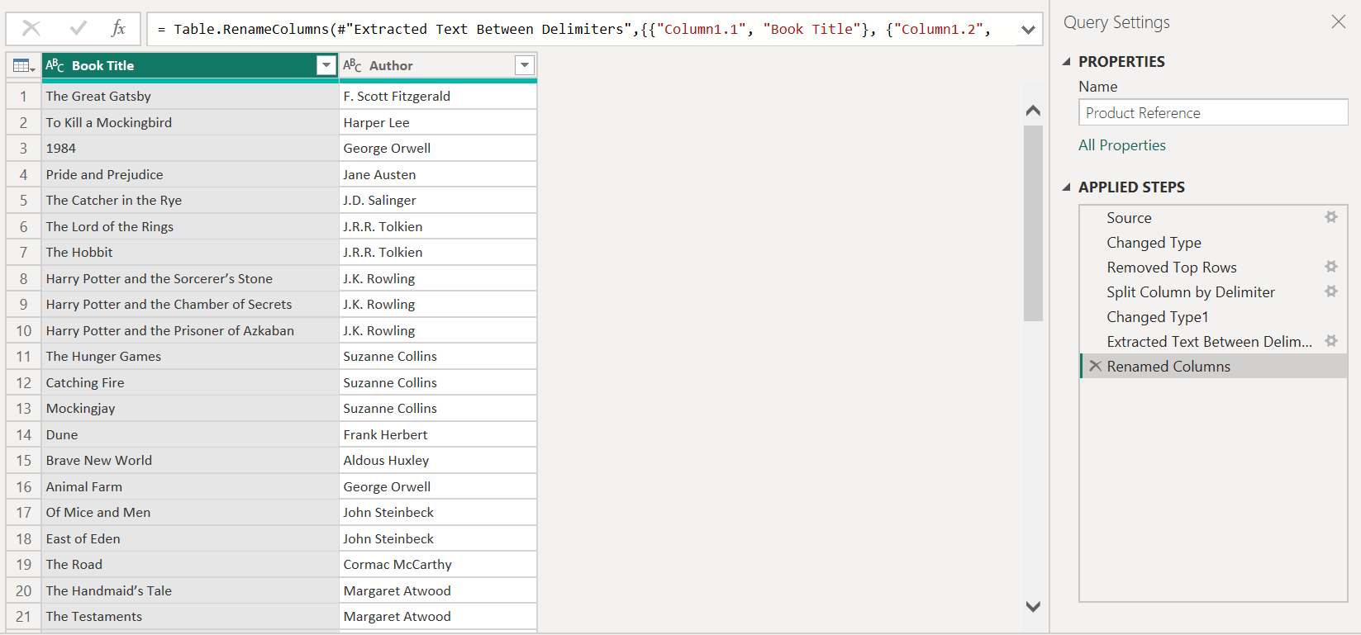
1- Data cleaning using Power query editor
book list.txt

Slide 8
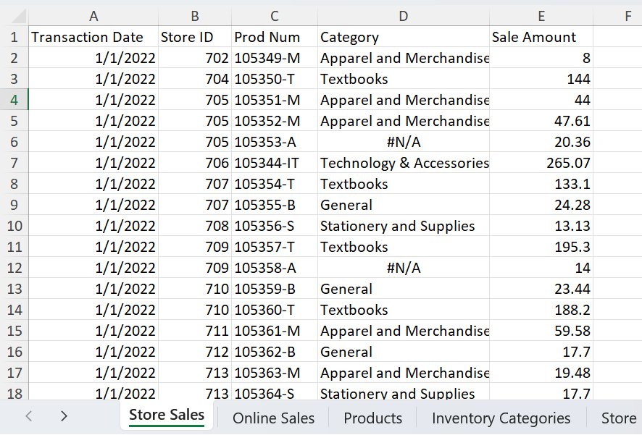
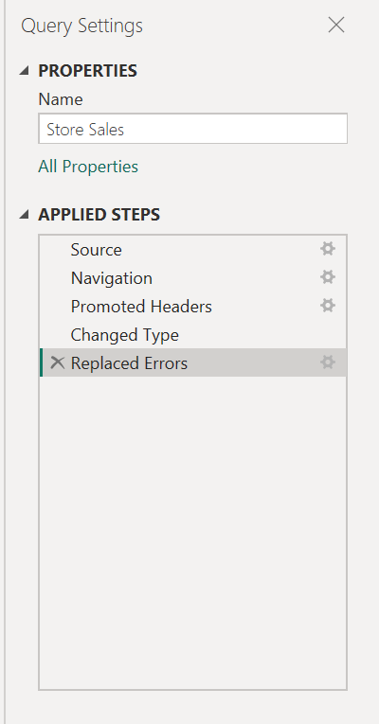
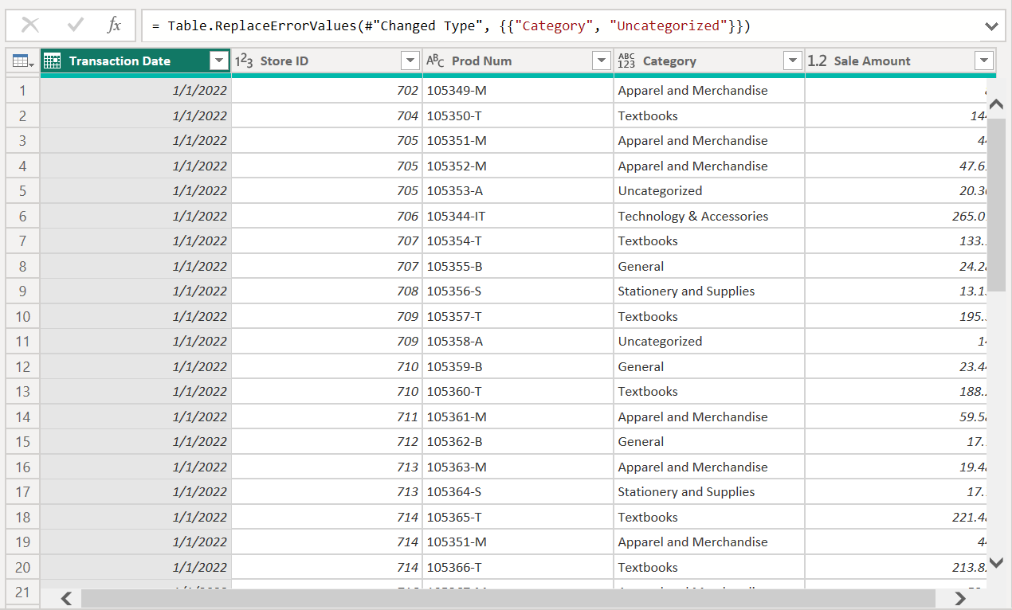
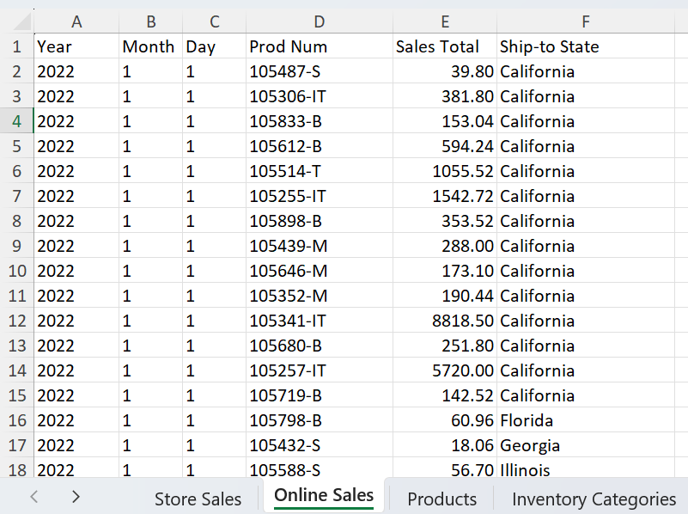
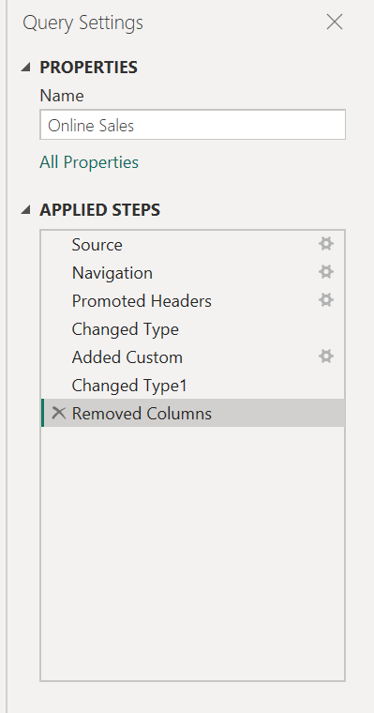
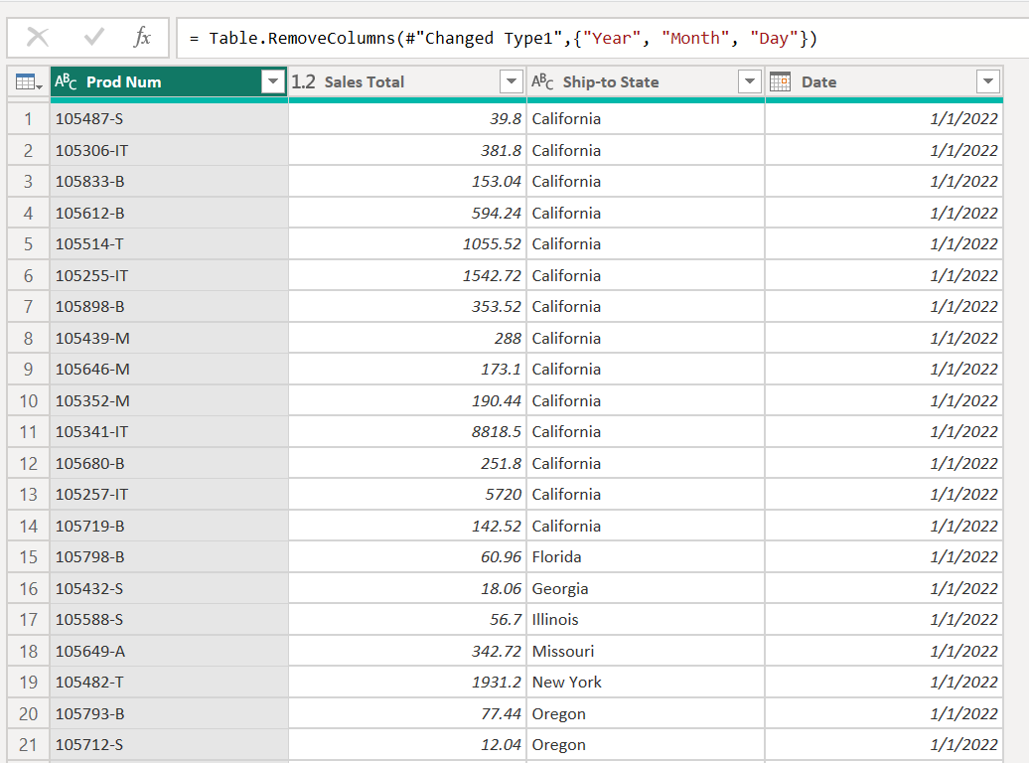
Store Sales, Online Sales
Capstone3_Sample_Sales.xlsx

Slide 9
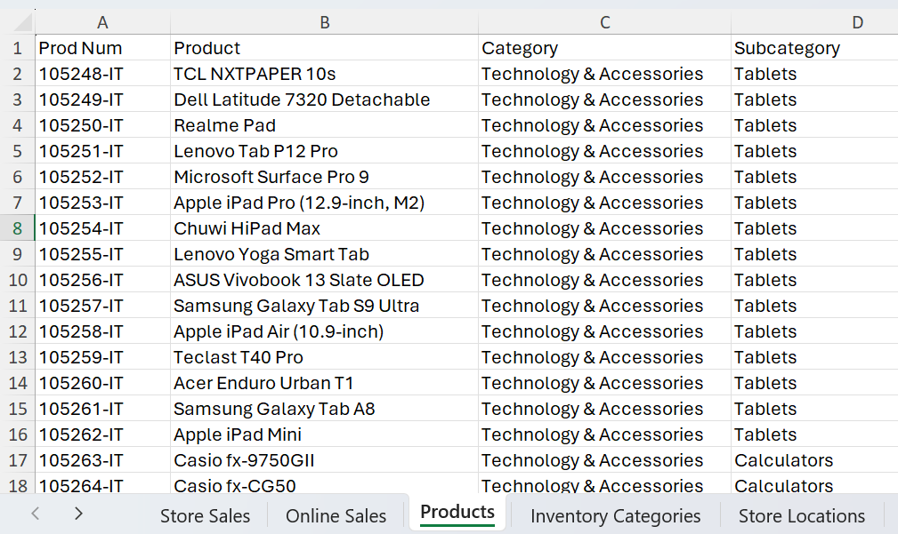
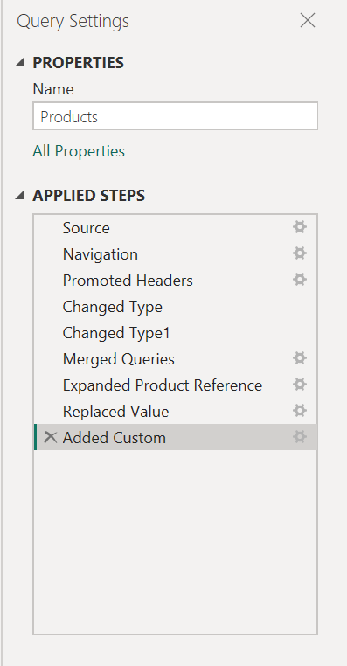
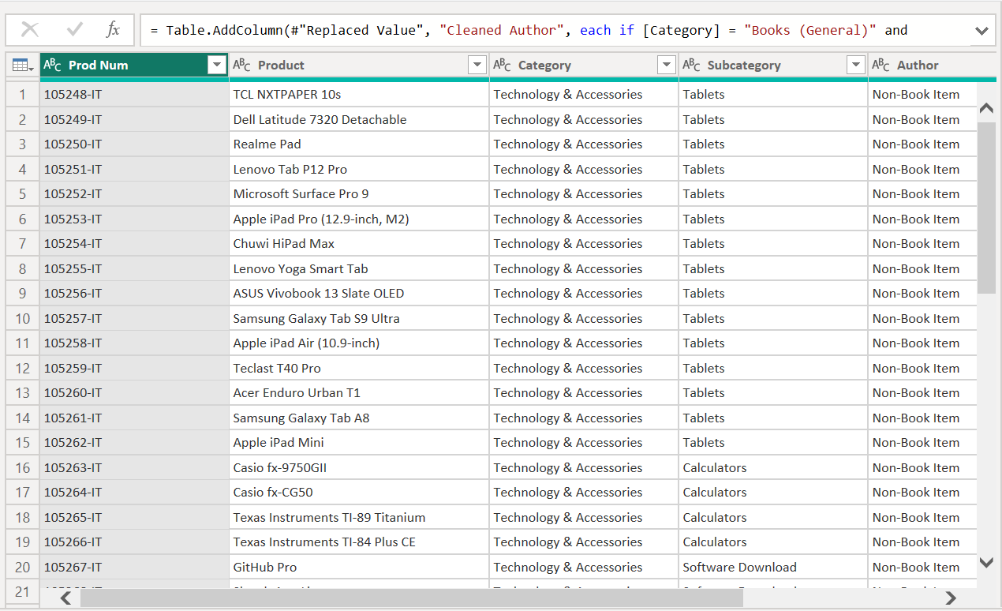
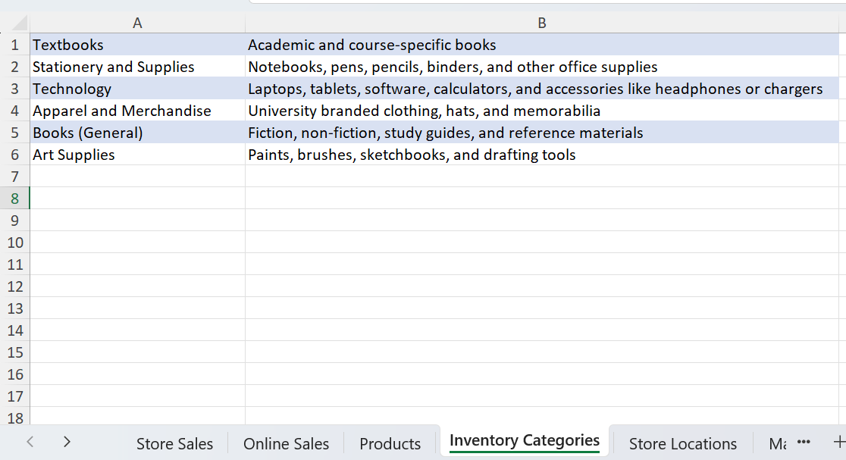
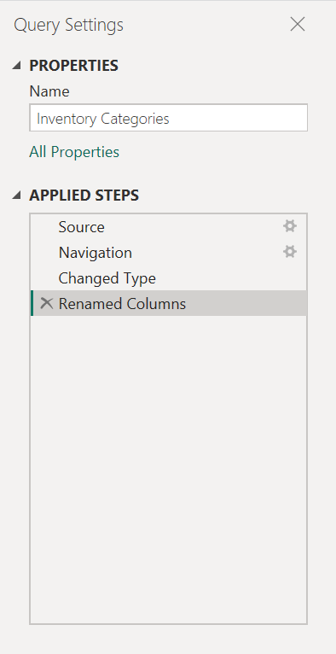
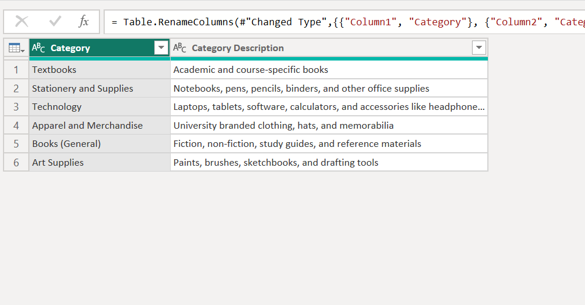
Products, Inventory Categories
Capstone3_Sample_Sales.xlsx

Slide 10
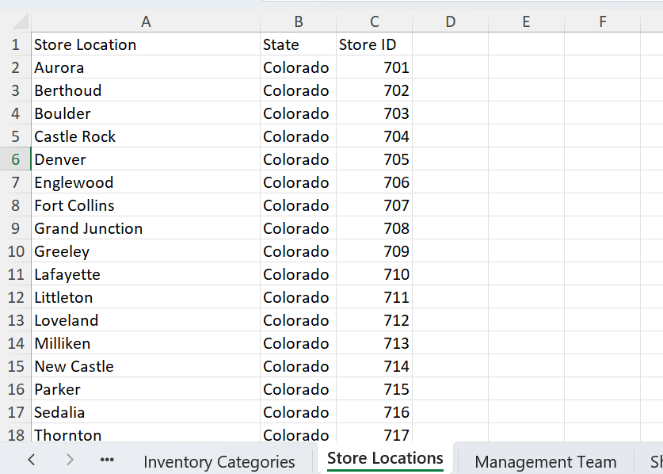
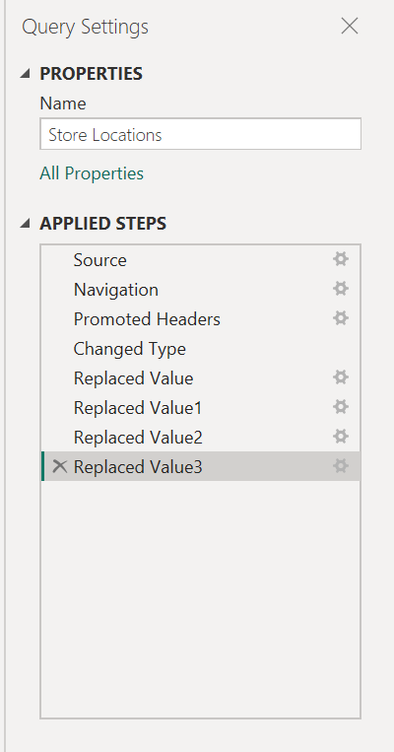
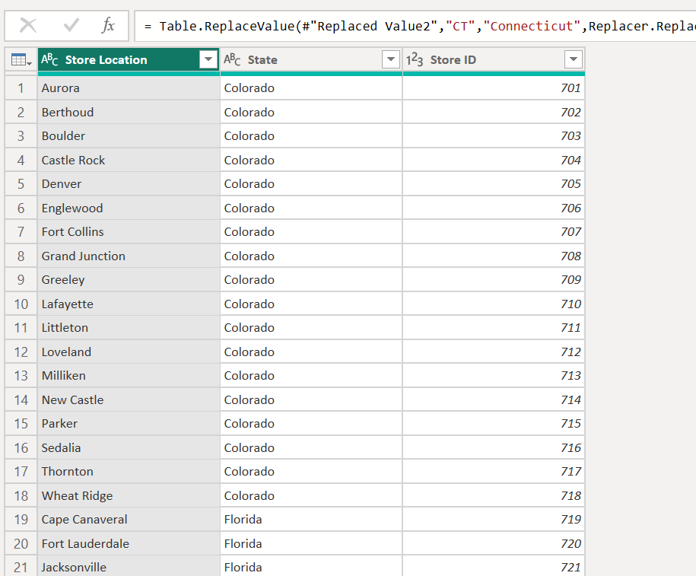
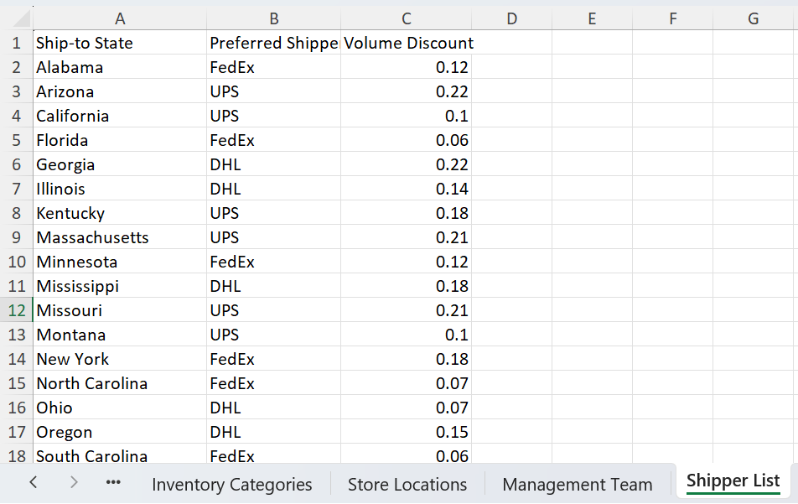
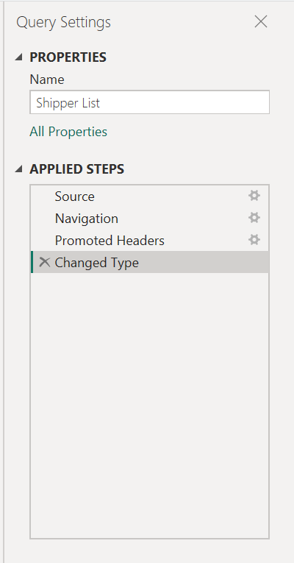
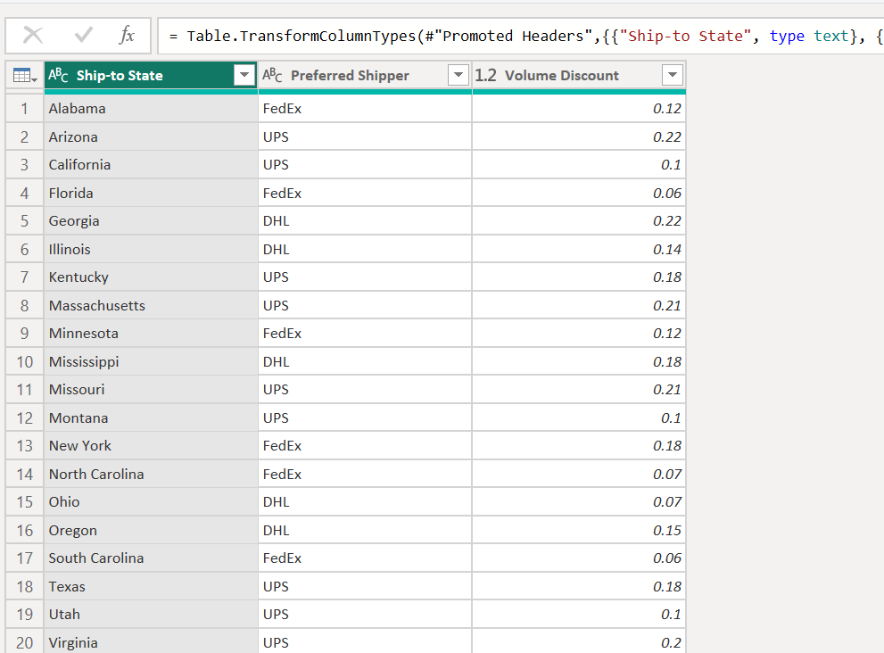
Store Locations, Shipper List
Capstone3_Sample_Sales.xlsx

Slide 11
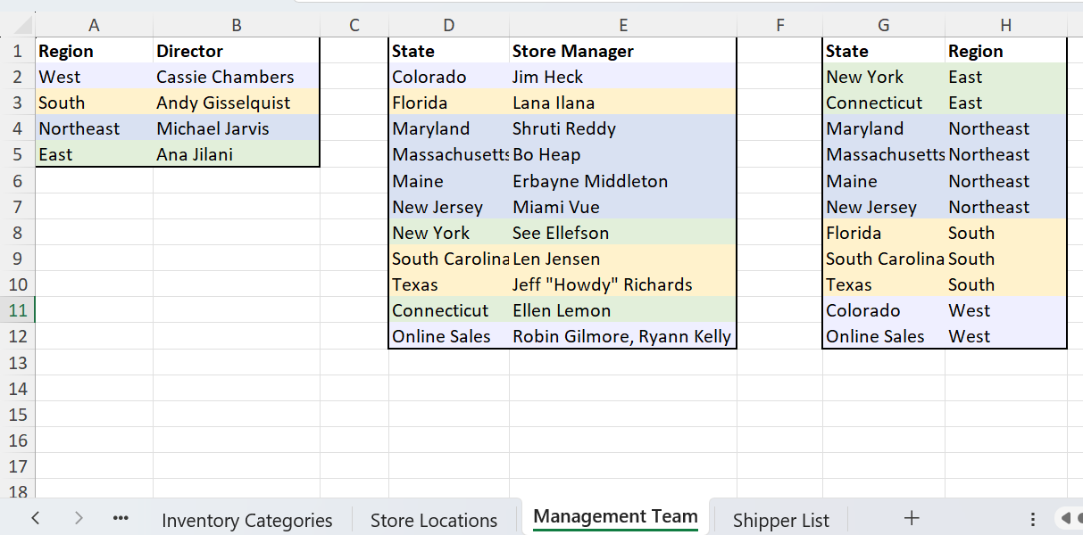
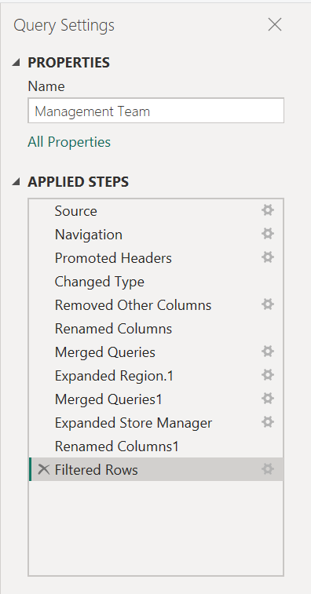
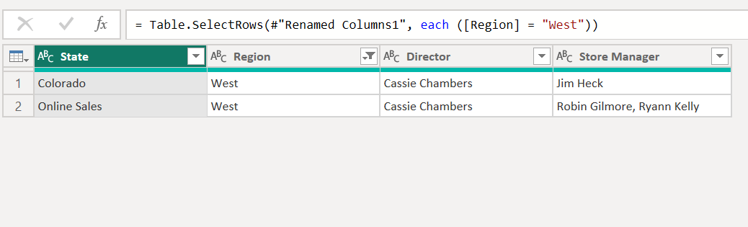
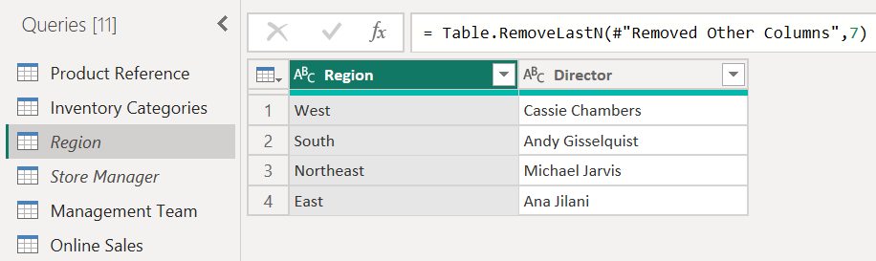
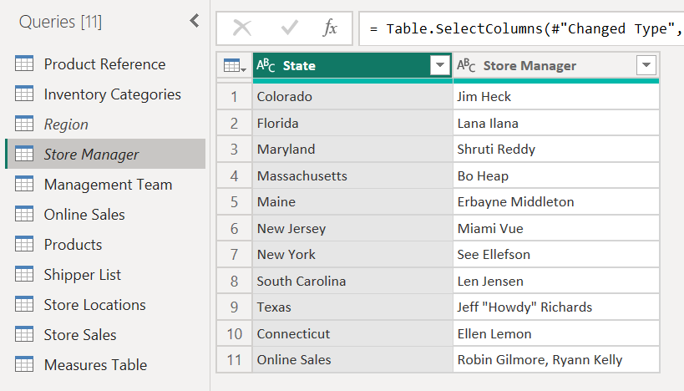
Management Team
Capstone3_Sample_Sales.xlsx

Slide 12
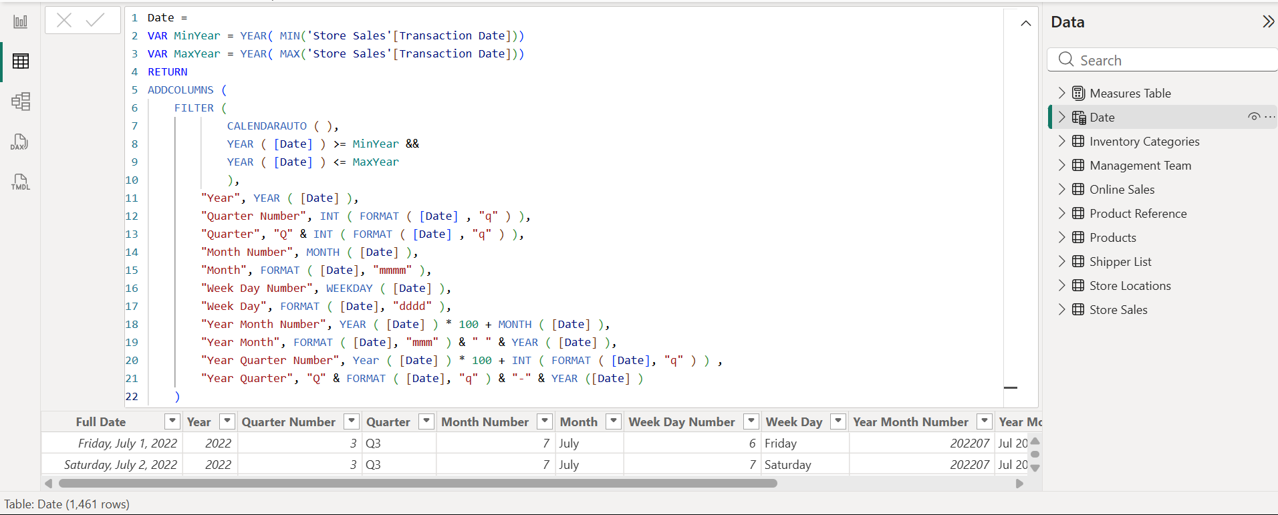
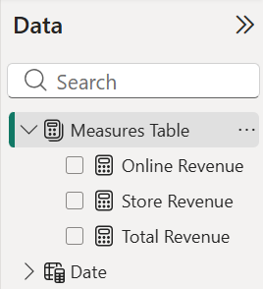
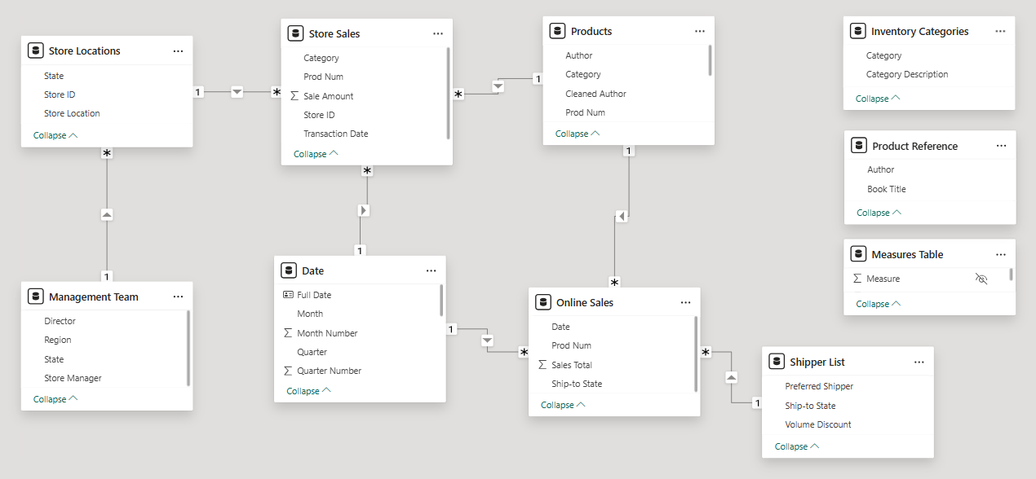
2- Building the Data Model
Create a Date / Calendar table
Write explicit DAX measures
Define table relationships in Model View

Slide 13
Challenges and Improvements
Challenges:
Cleaning and transforming inconsistent raw data from multiple sources
What I Learned:
Data cleaning and modeling are important steps before creating visualizations
A good data model improves report accuracy and performance
Future Improvements:
Add more interactive filters and drill-through features
Add more detailed analysis of customer and product performance

Slide 14
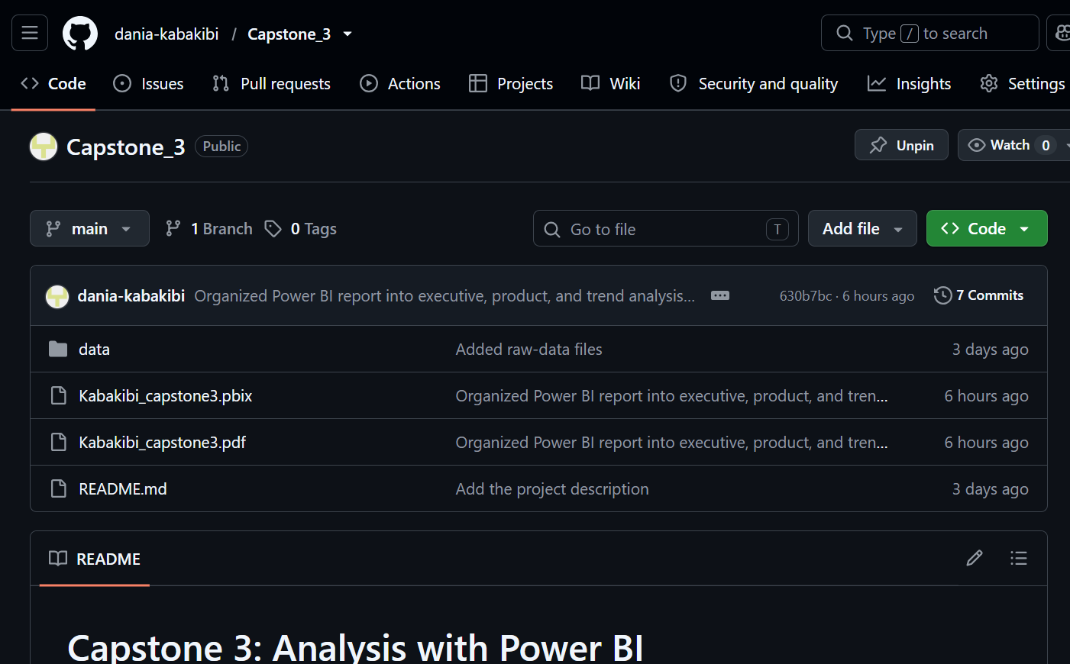
GitHub Repository

Slide 15
Thank you
dkabakibi@my.yearupunited.org
https://github.com/dania-kabakibi/Capstone_3.git
Report’s link

