Slide 1
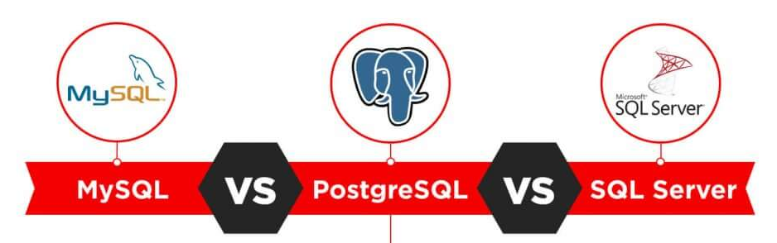
Relational DataBase Management Systems (RDBMS)

Slide 2
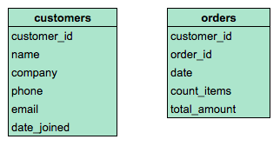
A relational database is a set of tables (datasets with rows and columns) that contain information relating to other tables in the database.
The diagram below contains information about columns in two tables in an example relational database. Both tables contain columns named customer_id, which establishes a relationship between the tables. As the company grows and records thousands (or millions) of orders, storing data in separate tables helps optimize for space and reduce the size of the database.

Slide 3
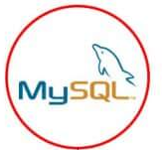
SQL, or Structured Query Language, is the standard language for interacting with relational databases. With SQL, you can query, or ask questions of, the data in a relational database. Working with SQL and relational databases is an invaluable skill set for a data analyst, data engineer, or a data scientist.

Slide 4

PostgreSQL is a powerful, open source object-relational database system that uses and extends the SQL language combined with many features that safely store and scale the most complicated data workloads.
PostgreSQL has earned a strong reputation for its proven architecture, reliability, data integrity, robust feature set, extensibility, and the dedication of the open source community behind the software to consistently deliver performant and innovative solutions. PostgreSQL runs on all major operating systems, has been ACID-compliant since 2001, and has powerful add-ons such as the popular PostGIS geospatial database extender.

Slide 5
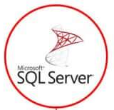
SQL Server is a relational database management system, or RDBMS, developed and marketed by Microsoft.
Similar to other RDBMS software, SQL Server is built on top of SQL, a standard programming language for interacting with the relational databases. SQL server is tied to Transact-SQL, or T-SQL, the Microsoft’s implementation of SQL that adds a set of proprietary programming constructs.
SQL Server works exclusively on Windows environment for more than 20 years. In 2016, Microsoft made it available on Linux. SQL Server 2017 became generally available in October 2016 that ran on both Windows and Linux.

Slide 6
Difference between these 3 RDBMS:
PostgreSQL, MySQL, and SQLite use very similar syntax, with some notable differences highlighted below. Microsoft SQL Server has the greatest contrast in SQL syntax, as well as a wide variety of functions not available in other platforms. The table below highlights some examples of basic differences between SQL platforms.

Slide 7
