Slide 1

Introduction to Pandas
Pandas is a powerful Python library designed for data manipulation and analysis. It excels in handling structured data, making it an essential tool for anyone working with data in Python.
DH
by Dania Hih

Slide 2
Reading Data with Pandas
Various File Formats
CSV Example
JSON Example
Pandas can read different file formats, including CSV, JSON, Excel, and TXT files.
pd.read_csv('filename.csv')
pd.read_json('filename.json')

Slide 3
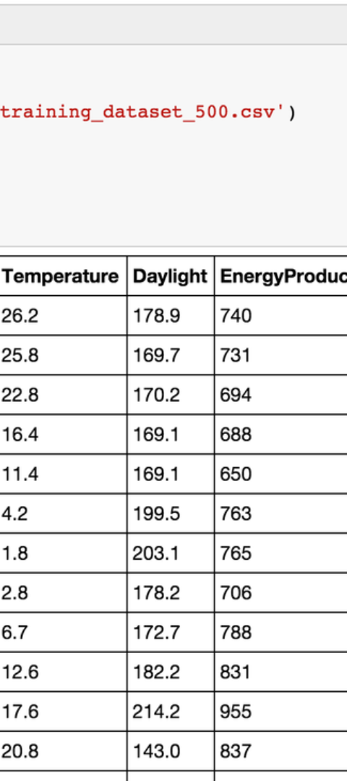
The DataFrame Object
1
2D Labeled Data Structure
2
Code Example
A DataFrame is a versatile 2D labeled data structure that can efficiently handle data in rows and columns.
df = pd.DataFrame(data)

Slide 4
The Series Object
1
One-Dimensional Array-Like
Series is a one-dimensional array-like object that is essential for manipulating and analyzing individual data elements.
2
Code Example
series = pd.Series([1, 3, 5, 7, 9])

Slide 5



Exploring DataFrames
Discuss Data Inspection
Methods such as df.info() and df.shape are valuable for exploring DataFrames.
Display Options
Customize data display with pd.set_option('display.max_rows', None).

Slide 6
Viewing Data in DataFrame
Basic Data Viewing
Advanced Data Viewing
Learn to view the start of your data with df.head().
Examine the end of your data using df.tail().

Slide 7
Accessing DataFrame Data
1
Single Column Access
2
Multiple Columns Access
Access specific columns using df['columnName'].
Retrieve multiple columns with df[['column1', 'column2']].

Slide 8
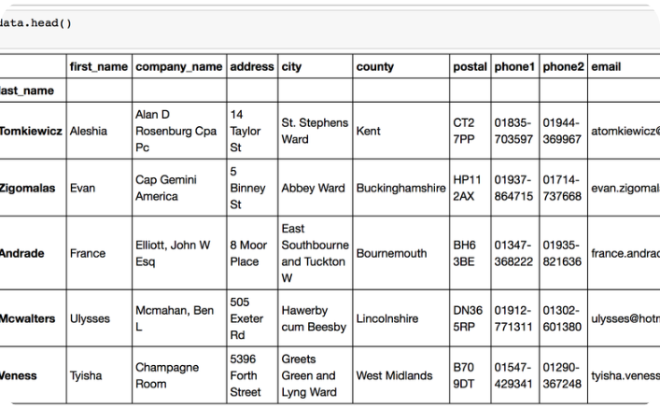
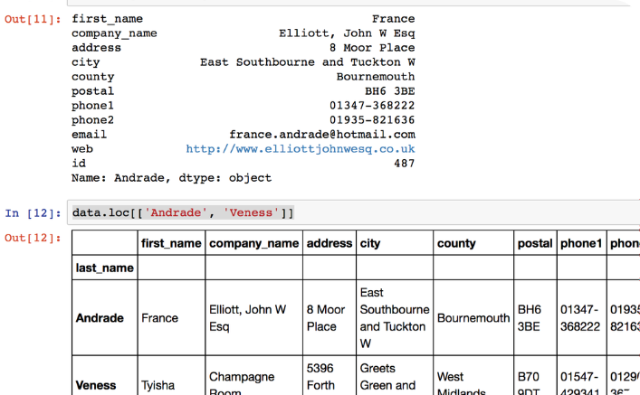
loc and iloc in Pandas
Loc Function
Iloc Function
Use df.loc[0] to access a group of rows and columns by label(s).
Utilize df.iloc[:, 0] to access groups of rows and columns by integer position(s).

Slide 9
Index in DataFrames
The Role of Indexes
Indexing Example
Understand the crucial role of indexes in DataFrames for efficient data representation and retrieval.
Set an index using df.set_index('columnName', inplace=True) for improved data access.

Slide 10
Data Aggregation
The value_counts() method returns a Series containing counts of unique values in descending order, so that the first element is the most frequently-occurring element.
By default, it excludes NA/null values. To include them, set dropna=False
df['columnName'].value_counts()
df['columnName'].value_counts(dropna=False)

Slide 11
Slicing DataFrames
Slicing in pandas DataFrames is a crucial technique used to select specific rows or columns from the data. It allows you to carve out subsets of data based on index positions or labels, making it easier to focus on specific segments of your dataset for analysis, manipulation, or visualization.
df[0:3]

Slide 12
Filtering
Filtering data in pandas is a crucial technique for selecting specific subsets of data from a DataFrame based on conditional logic. It's used extensively in data analysis for tasks like cleaning data, analyzing subsets, and preparing data for further processing or visualization.
You can filter rows in a DataFrame based on a single condition. This is done by specifying the condition within square brackets.
filtered_data = df[df['columnName'] > value]
Multiple Conditions Filtering
To filter data based on multiple conditions, you can use logical operators (& for AND, | for OR).
filtered_data = df[(df['columnName1'] > value1) & (df['columnName2'] < value2)]

Slide 13
String Operations
String filtering in DataFrames.
df[df['columnName'].str.contains('substring')]

Slide 14
Sorting Data
sort_values(): This method is used to sort the data in a DataFrame based on the values in one or more columns. You can specify whether you want the sorting in ascending or descending order.
df.sort_values(by='columnName')
df.sort_values(by='Age', ascending=True)
sort_index(): This method sorts the DataFrame or Series based on its index. If your DataFrame's index is out of order, you can use sort_index() to sort it.
df.sort_index(ascending=True)
Sorting by Multiple Columns: You can also sort by more than one column. This is useful when you want to sort by a primary column, then by a secondary column (for rows having the same value in the primary column).
df.sort_values(by=['Category', 'Price'], ascending=[True, False])

Slide 15
Advanced Filtering and Sorting
Filtering: df[(df['Age'] > 25) & (df['Gender'] == 'Female')]
df.nlargest(5, 'Age')

