Slide 1
School of Engineering
Year: 2019-20
Programming with Data
EL4013
NETFLIX Data Analysis and Recommendation
Muhammad Danial Khilji
Registration Number: G20876075
EL4013: 2019-20
Your Project
Notes:
EL3251 Lecture 1
In this lecture, we will cover lists and tuples, these are called compound data types and are one of the key types of data structures in Python.

Slide 2
Abstract
Main aim is to research movie recommendation model using NETFLIX dataset
How is the NETFLIX recommendation algorithm able to recommend movie within seconds from such a huge database system?
Data handling and cleaning for analysis
Different correlation models implementation
Evaluate performance of the model based on the dataset
EL4013: 2019-20
Your Project

Slide 3
Motivation
The main motivation for the project is to study Netflix current recommendation model as more than 80% of movies/series watched are discovered through its recommendation system [8]
Although there are more than 250 million active profiles, their complex algorithm does not crash and recommend movies/series within 90 seconds [3][8]
Other machine learning techniques are more common and can be used easily. Meanwhile, correlation is not given enough attention in the models
This work can be used to design and implement a more efficient and faster algorithm
EL4013: 2019-20
Your Project

Slide 4
Dataset(s)
Data set was downloaded from the Kaggle website from the forum of the Netflix Prize Competition section [4]
Total size of the dataset was 1.98 GB. The main dataset was in the form of four separate .csv files
Total 24058263 ratings (one file size only) were in the dataset with Customer_Id and Rating columns. Both float64 data types
Movie titles included from another file, which includes Movie_Id, Year (the movie was released) and Name. All float64 data types
Total 17770 movie names (file size)
An effort was made to load the entire dataset and store it in single file. But loading such huge dataset and combining it caused the kernel to die constantly. Therefore, data analysis was carried out on only one file
EL4013: 2019-20
Your Project

Slide 5
Data Preparation and Cleaning
On exploring the dataset, total number of customers were 24 million!
Data visualization was carried out in a form of bar plot that shows percentage of each rating in a range 1-5 (shown in next slide)
Numbers of ratings per each rating value was calculated
For cleaning the data, the NaN values were removed from the main dataset
Then Movie_Id column was added in the main dataset in order to compare with movie titles dataset
Data types of Movie_Id and Customer_Id columns were then changed to int
EL4013: 2019-20
Your Project

Slide 6
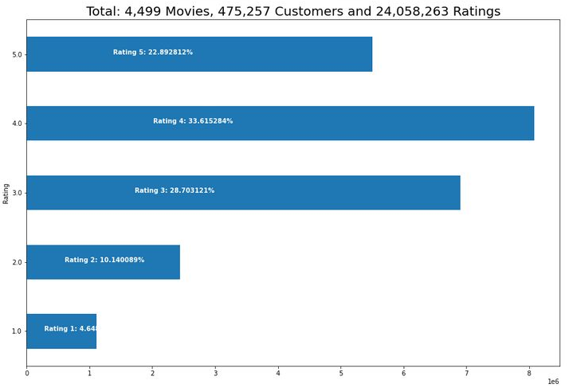
EL4013: 2019-20
Your Project

Slide 7
Data Preparation and Cleaning
At the end, NaN values of the movie titles dataset were also removed
Major problem was that Pearsons’ R algorithm took hours to run
While exploring dataset, it was also noticed that there were a huge number of customers that were not giving any rating
Therefore, these customers were removed by using 0.7 quantile. This reduced execution time of the code considerably
Lastly, Dataset was arranged in order around Rating, Customer_Id and Movie_Id, in this order using .pivot function of Pandas library
EL4013: 2019-20
Your Project

Slide 8
Research Question(s)
Firstly, it is researched that the methods used in the NETFLIX system are fast enough to recommend movies within 90 seconds?
Since collaborative filtering algorithm uses SVD which takes hours to run, does it slows down the process?
Which algorithm is suggested for such huge datasets?
EL4013: 2019-20
Your Project

Slide 9
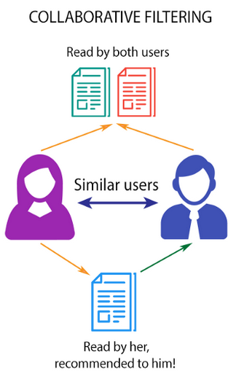
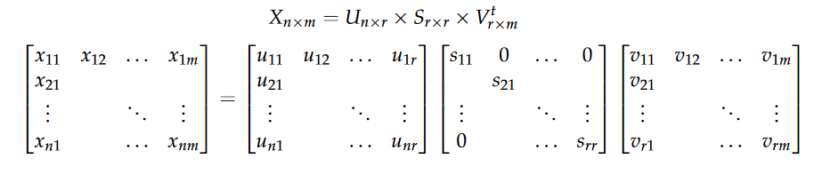
Methods
User-Based collaborative filtering [1]
  It finds customers with similar ratings and then suggest them a new item based on their preferences [5]
  It uses SVD (Singular Value Decomposition) to factorize the matrix which is a user-item matrix [6]
  It does not uses factors like age or type of movie to measure similarity
EL4013: 2019-20
Your Project

Slide 10
Methods
  Where U represent the feature vectors of the users and V represent the feature vectors of the items . Elements of the diagonal S are known as singular values of X [7]
EL4013: 2019-20
Your Project

Slide 11
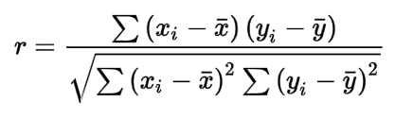
Methods
Item based collaborative filtering [1]
  Pearsons’ R Correlation. It gives recommendation based on movie watched [2]
  Pearson correlation coefficient r (formula shown below) can range from -1 to +1. 0 means there is no correlation whereas positive value means positive correlation and vice versa
  It tries to draw a best fit line through a data points. In our case, different ratings given in past. r calculates linear correlation between Xi and x̅. Where Xi is the rating current user gave and x̅ is the mean rating of all users [7]
EL4013: 2019-20
Your Project

Slide 12
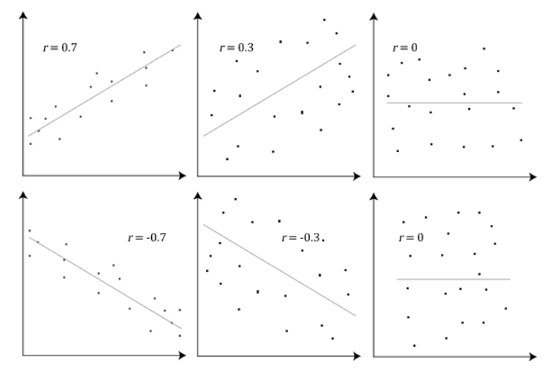
Methods
  Once the r is calculate. It will suggest movie which is closest to the correlation line
EL4013: 2019-20
Your Project

Slide 13
Findings
  Although SVD takes more than an hour to run, it doesn’t need to run continuously. Once it has huge amount of data it can be run once and then it is used in run time to recommend movies which takes only few seconds
  If there is need to run SVD again due to new accumulation of data, then the SVD can be run in isolation first and then it can be used to recommend movies in real time later on
  SVD is a slow algorithm due to the reason that it needs to calculate result of three matrices in order to get resultant matrix
  Pearsons’ R takes considerably less time to run but it is an item-based algorithm unlike SVD which is user-based. This is preferred over SVD if entire algorithm need to be run on run time as its speed is not slow on huge datasets
EL4013: 2019-20
Your Project

Slide 14
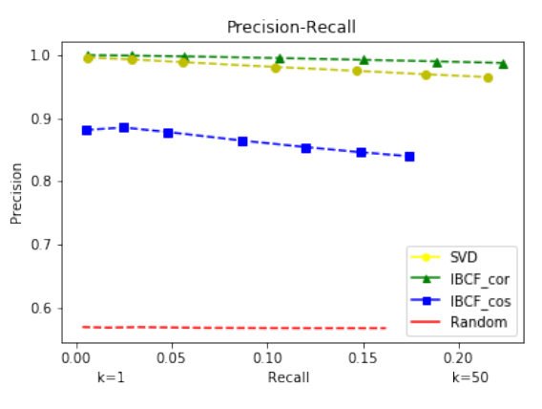
Findings
  In terms of precision, SVD is the best algorithm (shown in figure below) [7]
  Out to the two methods, SVD took the longest time to run (1.74 hrs), that might reduce in time by running it on faster machine
EL4013: 2019-20
Your Project

Slide 15
Limitations
Main limitation is that it has only used one kind of method (correlation)
Secondly, due to kernel issues, not all of the data files were successfully loaded and merged
EL4013: 2019-20
Your Project

Slide 16
Conclusions
Evidently, SVD is slowest to run but it give the better results as compared to the Pearsons’ R correlation
Large datasets are required to run for further analysis
Collaborative and Content-Based approaches together results in Hybrid approach which can be the next research topic
EL4013: 2019-20
Your Project

Slide 17
References
[1] AJITSARIA, A., , Build a Recommendation Engine With Collaborative Filtering. Available: https://realpython.com/build-recommendation-engine-collaborative-filtering/#:~:text=Collaborative%20filtering%20is%20a%20family,type%20of%20collaborative%20filtering%20approach.
[2] BENESTY, J., CHEN, J., HUANG, Y. and COHEN, I., 2009. Pearson correlation coefficient. Noise reduction in speech processing. Springer, pp. 1-4.
[3] INDIA, S., Nov 05, 2019-last update, How Netflix’s Recommendation Engine Works?. Available: https://medium.com/@springboard_ind/how-netflixs-recommendation-engine-works-bd1ee381bf81.
[4] LAO, D., Sept, 2020-last update, Netflix - Movie recommendation. Available: https://www.kaggle.com/laowingkin/netflix-movie-recommendation.
[5] LIAO, K., Nov, 2018-last update, Prototyping a Recommender System Step by Step Part 1: KNN Item-Based Collaborative Filtering. Available: https://towardsdatascience.com/prototyping-a-recommender-system-step-by-step-part-1-knn-item-based-collaborative-filtering-637969614ea.
[6] MNIH, A. and SALAKHUTDINOV, R.R., 2008. Probabilistic matrix factorization, Advances in neural information processing systems 2008, pp. 1257-1264.
[7] MOLINA, L.E. and BHULAI, S., 2018. Recommendation System for Netflix.
[8] PLUMMER, L., Aug 22, 2017-last update, This is how Netflix's top-secret recommendation system works. Available: https://www.wired.co.uk/article/how-do-netflixs-algorithms-work-machine-learning-helps-to-predict-what-viewers-will-like.
EL4013: 2019-20
Your Project

