Slide 1




Penang Branch
CROW EDUCATION
Presented by Bird2 Group
1. Lim Shang Wen
2. Loh Kien Ee
3. Teoh Jia XIn
4. Ng Ying Zhe
5. Yew Jason

Slide 2

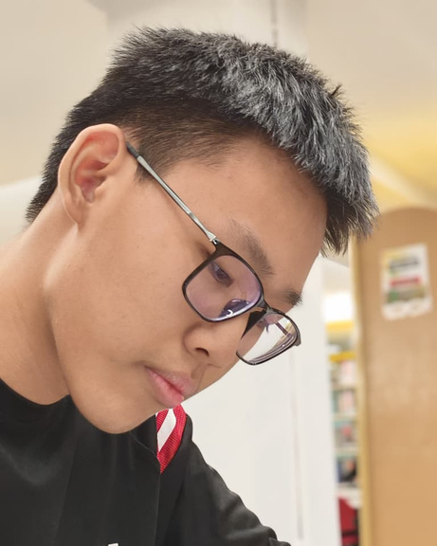

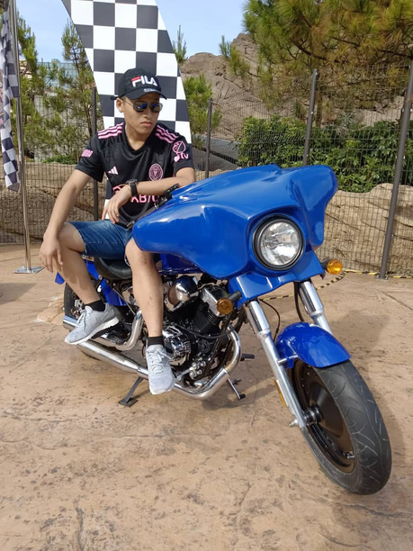

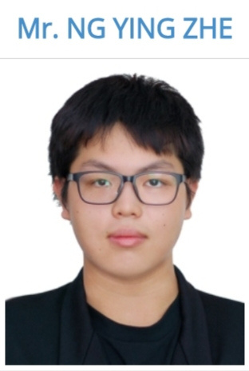
TEAM MEMBERS
Lim Shang Wen
Leader / Database Developer
Loh Kien Ee
Co-Leader/ Back-end developer
Teoh Jia Xin
Back-end developer
Yew Jason
Front-end developer
Ng Ying Zhe
Front-end developer

Slide 3
Problem Statement
Duolingo
Khan Academy
Many students lack access to quality, affordable education and personalised learning support. Traditional classrooms often can’t meet every learner’s needs. Khan Academy aims to solve this by providing free, self-paced, and accessible online education for everyone worldwide.
Learning a new language is often expensive, time-consuming, and difficult to access for many people. Traditional methods lack motivation and flexibility. Duolingo was created to solve this by offering free, gamified, and engaging language learning that is accessible anytime and anywhere.

Slide 4
Solution Overview
Duolingo
Khan Academy
Khan Academy provides:
Free educational content covering K–12 to college-level subjects
Interactive practice exercises and quizzes
Personalised learning dashboard for progress tracking
Teacher dashboards to assign and monitor student progress
Available in multiple languages for global accessibility
Duolingo transforms learning into a game-like experience using:
Gamification elements: XP points, streaks, levels, and leaderboards
Short, interactive lessons (5–10 minutes each)
AI personalization to adapt to user ability
Free access model for global inclusivity
Duolingo for Schools – a tool for teachers to track students’ progress

Slide 5
Problem Statement
Crow Education
The Problem for Malaysian Students
Problem: For many secondary school students, learning is not interactive or enjoyable. This leads to students feeling unexcited about their education.
The Gap: Current educational tools are often generic. They lack content that is specifically and "locally relevant" to the Malaysian curriculum.
Our Proposed Value: We make learning exciting. Crow Education provides an interactive and enjoyable platform built specifically for the needs of Malaysian secondary school students.

Slide 6
Our Solution
Crow Education
"Crow Education" is a new learning platform designed specifically for secondary school students.
Our solution is built on three core features to make learning interactive and enjoyable:
Our Novelty: The technological novelty lies in the synthesis of gamification and real-time assessment that is hyper-focused on the Malaysian curriculum.
1. Chat with friends
2. Assessment feedback from educator
3. Listen music (chill when study)

Slide 7
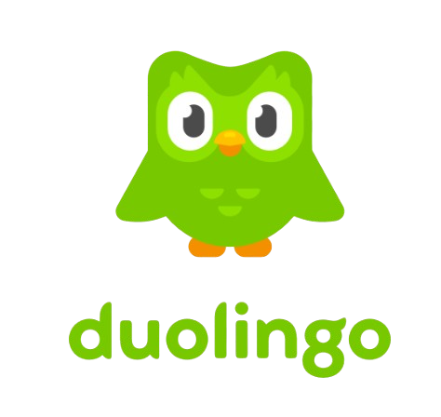
Introduction of
Duolingo
Duolingo is a free language learning platform founded in 2011 by Luis von Ahn and Severin Hacker in Pittsburgh, USA. It offers gamified lessons through its website and app, covering 40+ languages like English, Spanish, and Japanese. Using AI-powered adaptive learning, Duolingo tailors exercises to each user’s skill level, combining reading, writing, listening, and speaking. With over 500 million global users, it makes language learning fun, accessible, and effective.

Slide 8

Introduction of
Khan Academy
Khan Academy is a free online education platform founded in 2008 by Salman Khan in California, USA. It provides high-quality video lessons and exercises across subjects like math, science, and economics. Learners can study at their own pace through structured courses and interactive practice. Trusted by millions of students and teachers worldwide, Khan Academy’s mission is to offer a free, world-class education for anyone, anywhere.

Slide 9
Business Model
Duolingo
khan Academy
Duolingo uses a freemium model: Free version:
Access to all lessons (with ads) Super / Max
Duolingo (Paid): Ad-free experience, unlimited hearts, AI features, and progress tracking
Other revenue: Duolingo English Test (DET) – used for university admissions Partnerships & brand collaborations
💰2024 Revenue: US$748 million
💎Paid Subscribers: 10.9 million (2025)
Provides different services or products that solve similar customer needs or problems.
Targets overlapping or adjacent market segments but may not directly compete with us.
Might offer complementary products or services that could substitute or supplement ours.
Can include companies from different industries or sectors that indirectly impact our market.

Slide 10
MARKET AND IMPLEMENTATION PLAN
Khan Academy
Duolingo
Marketing
Marketing
Targets students, teachers, and schools.
Operates in the $400B global e-learning market.
Promoted through school partnerships, NGOs, and YouTube.
Accessible via website and mobile app.
Targets global learners (students, professionals, travelers).
Part of the $100B+ language learning market.
Promoted via social media, gamification, and partnerships.
Available on mobile app and web globally.
Implementation
Implementation
Create localized educational content.
Improve AI tools and analytics.
Strengthen ties with ministries and foundations.
Provide free teacher training and stay donation-funded.
Add more languages and cultural courses.
Use AI for personalized learning.
Expand Duolingo Plus and school programs.
Grow in Asia and Europe with localized content.

Slide 11


COMPETITIVE ANALYSIS WITH KHAN ACADEMY AND DUOLINGO

Slide 12
Duolingo
Khan Academy
Fun, free, easy to use, engaging gamification
High-quality academic content, trusted globally
Strengths
Limited grammar depth, repetitive lessons
Less interactive, relies on donations
Weaknesses
Strong brand, AI personalization, Duolingo English Test
Competitive Edge
Credibility, partnerships with schools & governments
Ads, Premium (Duolingo Plus), English Test
Revenue Source
Donations, Grants, Partnerships
Make language learning accessible for everyone
Provide free, world-class education for anyone, anywhere
Goal / Mission

Slide 13
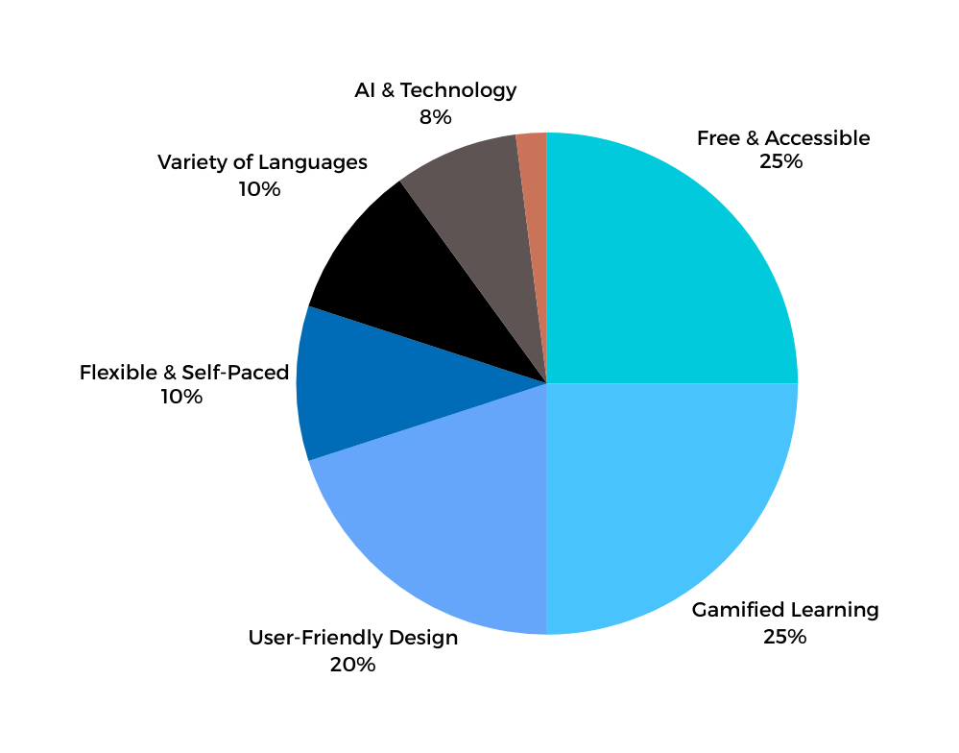
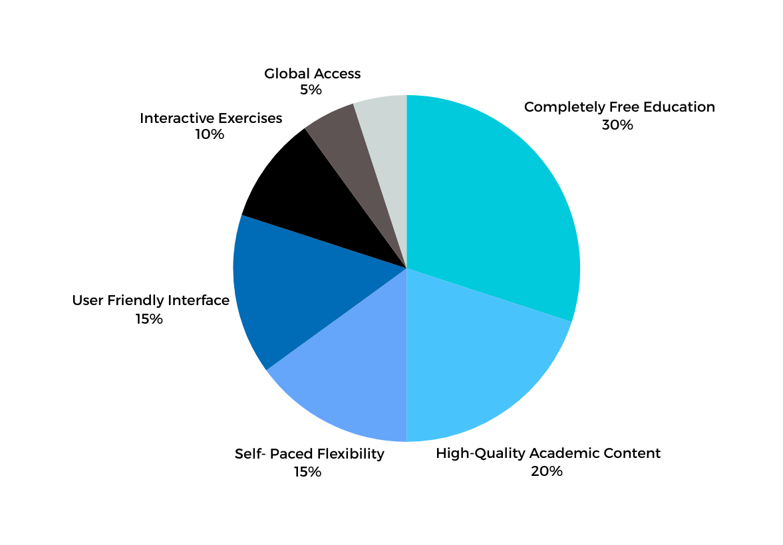
Data Research
Duolingo
Khan Academy
Source : https://www.softwareadvice.com/lms/duolingo-profile/vs/khan-academy/

Slide 14
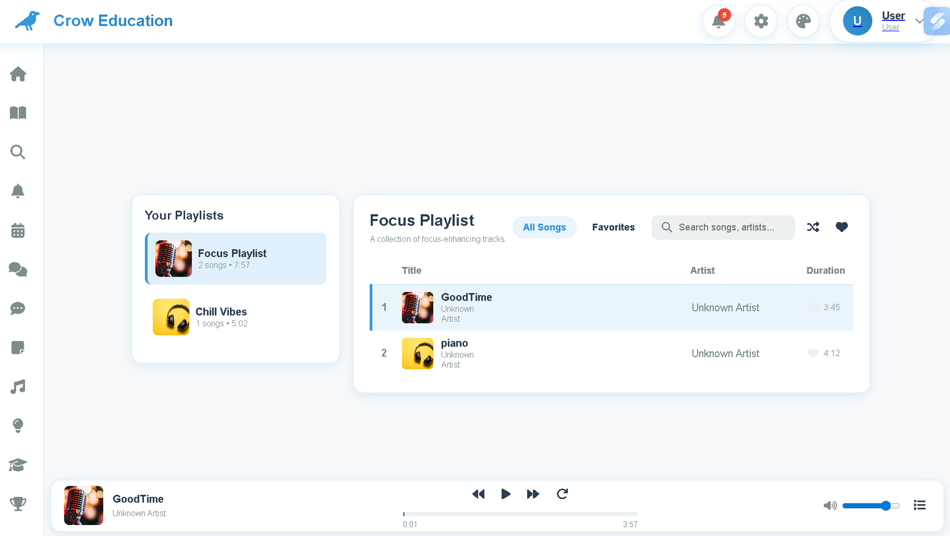
Our Unique Selling Point (USP)
Main Feature 1 (Music)

Slide 15
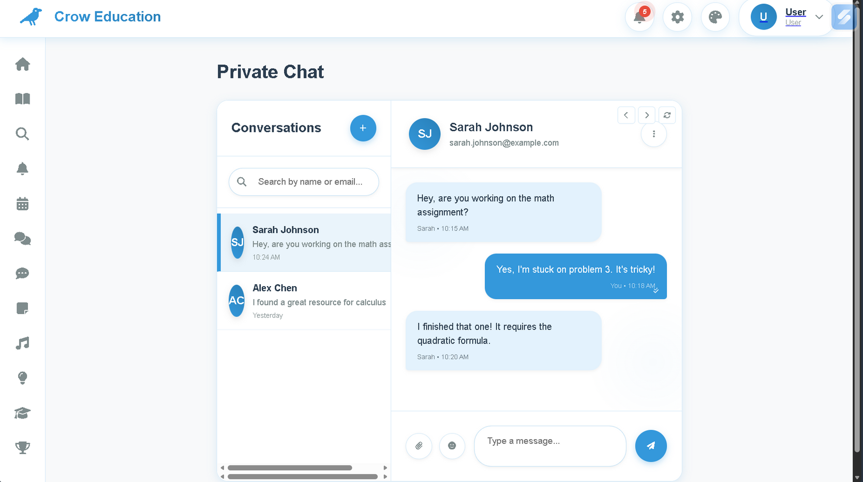
Our Unique Selling Point (USP)
Main Feature 2 (chat with friends)

Slide 16
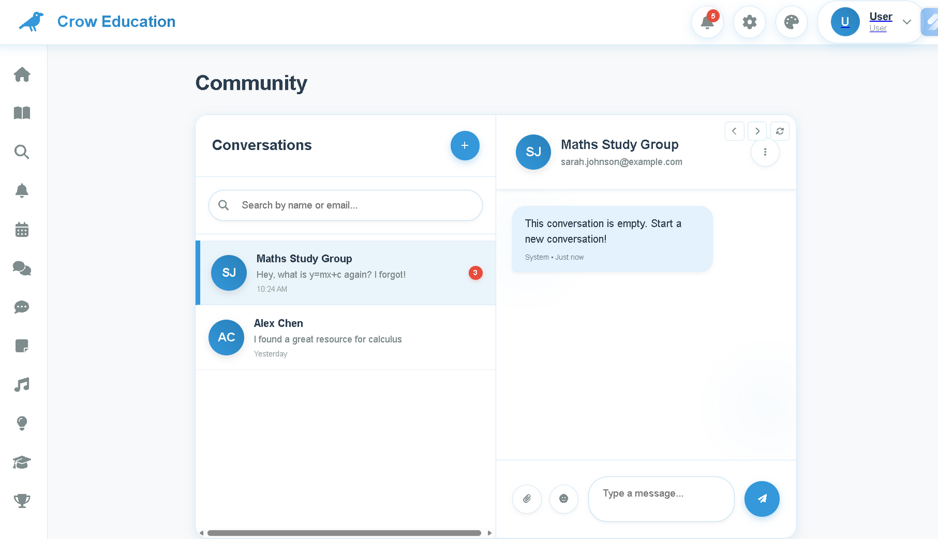
Our Unique Selling Point (USP)
Main Feature 2 (chat in Community)

Slide 17
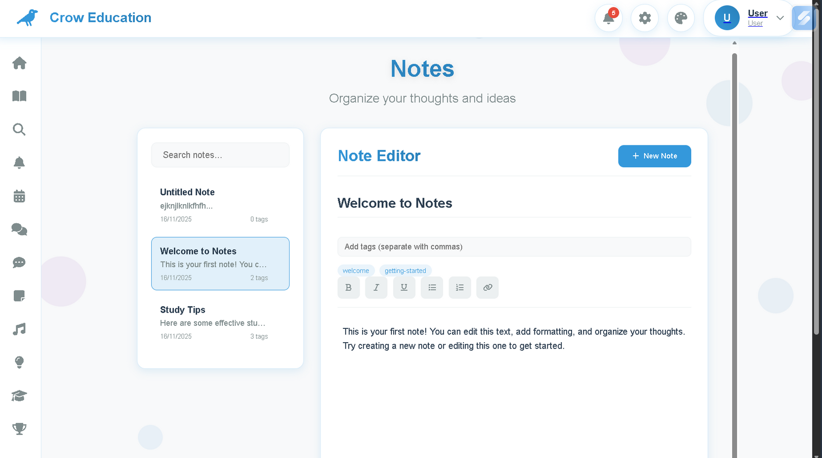
Our Unique Selling Point (USP)
Main Feature 3 ( Make own notes)

Slide 18
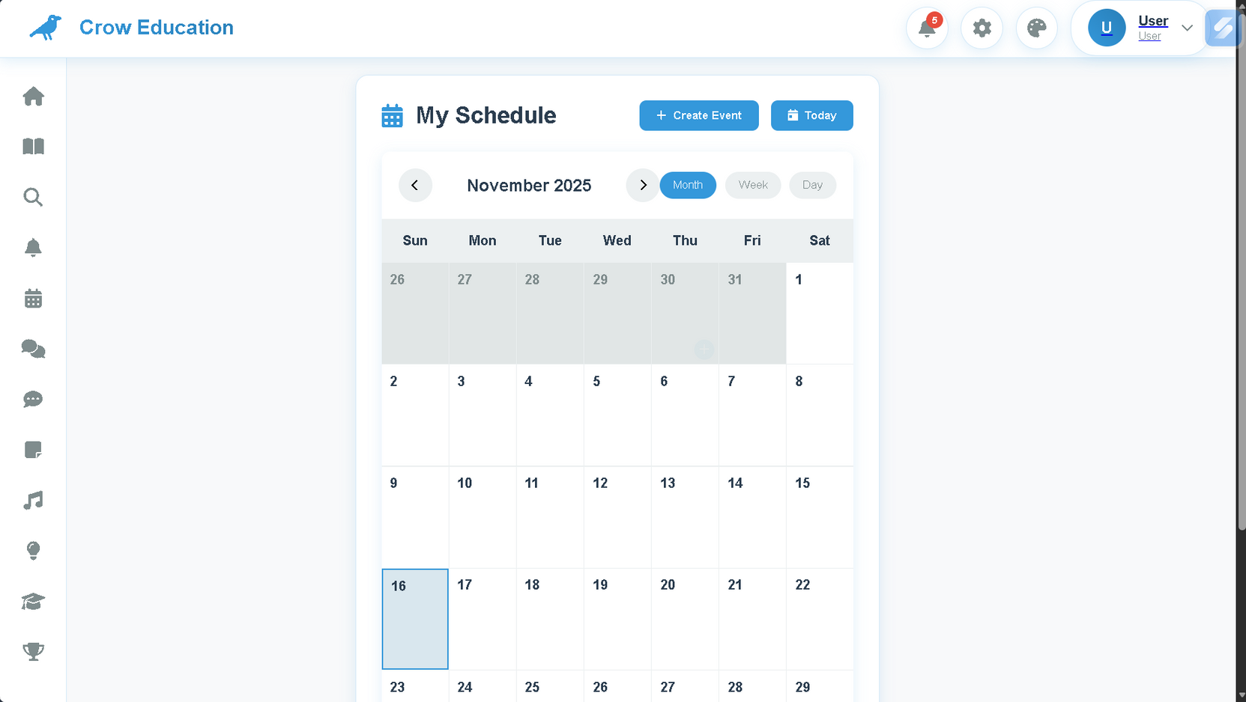
Our Unique Selling Point (USP)
Main Feature 4 (Watch calendar)

Slide 19
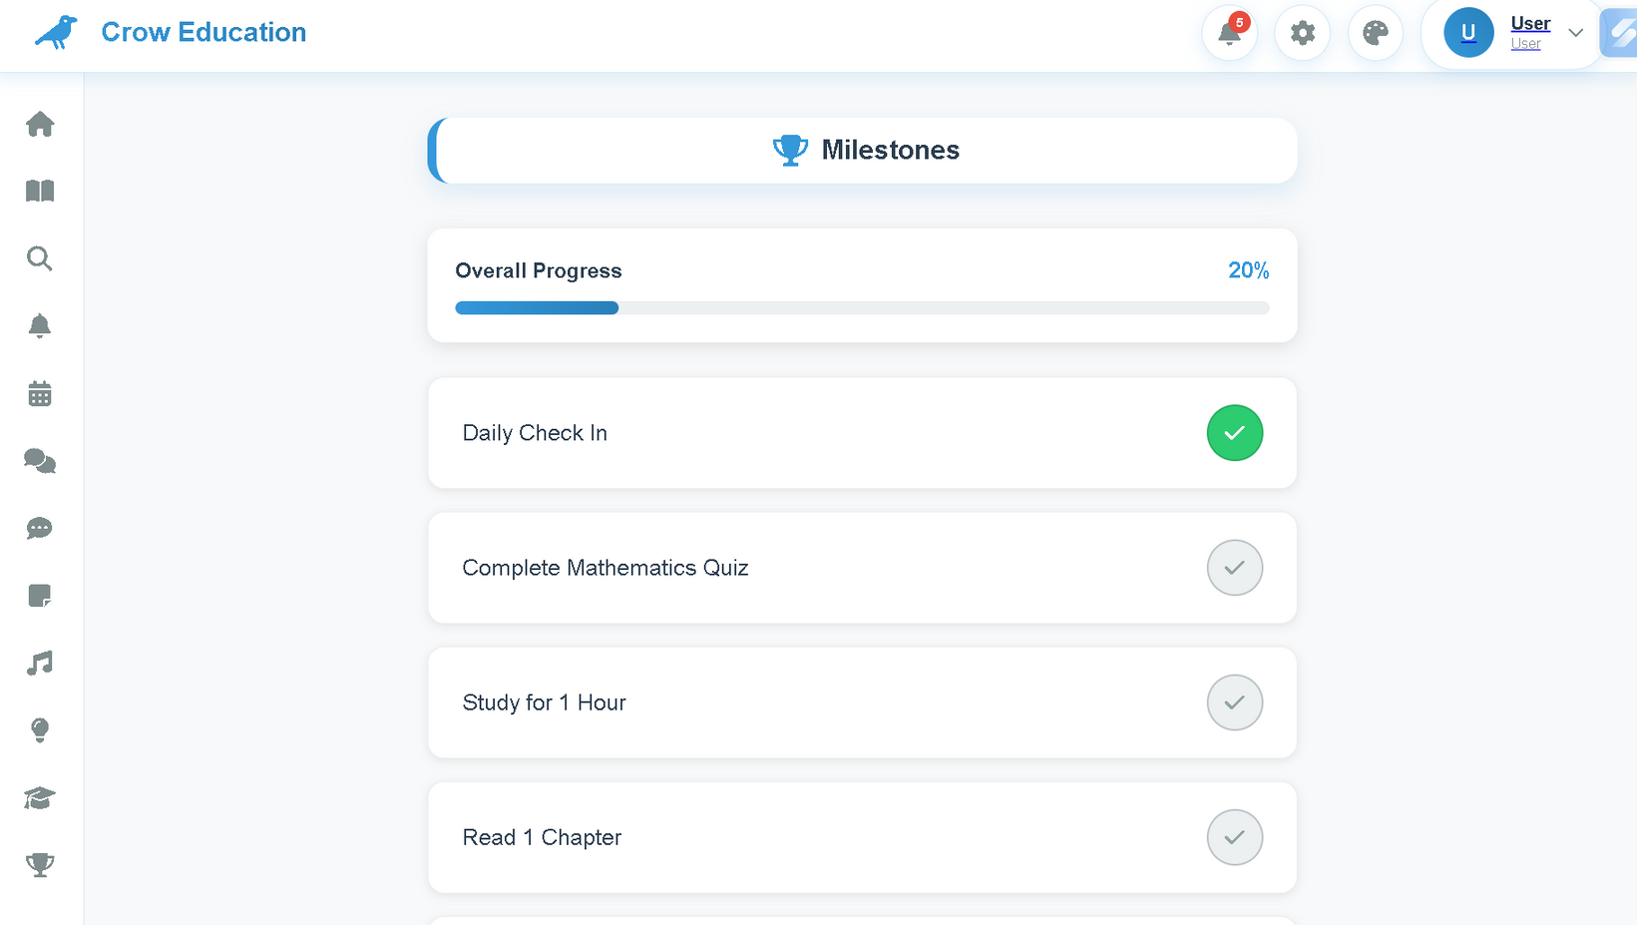
Our Unique Selling Point (USP)
Main Feature 5 ( Milestome)

Slide 20
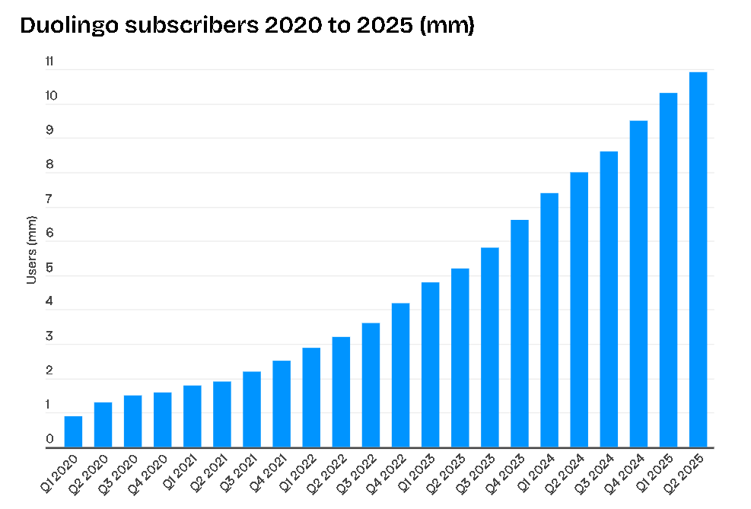
Target User (Duolingo)
Source: https://www.businessofapps.com/data/duolingo-statistics/

Slide 21
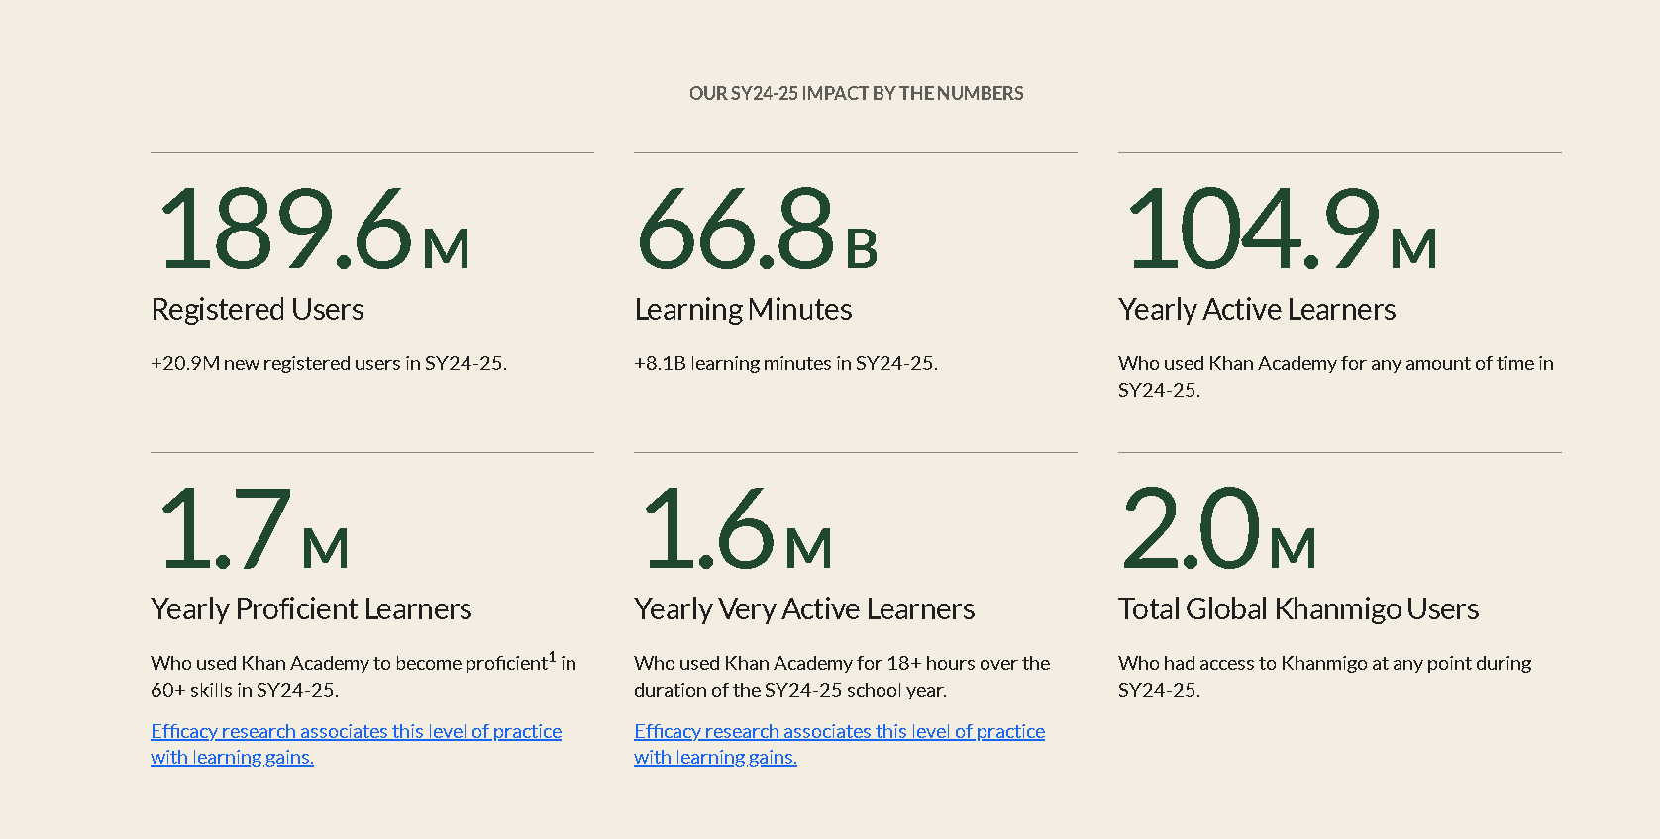
Target User (Khan Academy)
Source: https://annualreport.khanacademy.org/

Slide 22
How We Market
Funnel 1: B2B Validation (The "Khan Academy" Model)
We will replicate this by launching a free pilot program for secondary schools. We will provide a "Teacher Dashboard" to track student progress, turning educators into our advocates and gaining invaluable testimonials.
Funnel 2: B2C Acquisition (The "Duolingo" Model)
We will leverage the B2B testimonials from Funnel 1 to launch a targeted social media campaign. Seeing that "Crow Education" is teacher-approved will build instant trust and drive student (B2C) downloads on Instagram.

Slide 23
Why We Will Be Sucessful Successful
Our competitors are global generalists. We are local specialists.
Curriculum Alignment: We are 100% aligned with the Malaysian National Curriculum. This positions us as an essential academic tool, not a supplemental app.
Strategic Trust: Our B2B (school-first) model validates our product and builds trust with educators. This "teacher approval" is our most powerful marketing asset for B2C adoption and creates a competitive barrier.
Hyper-Focused Solution: Unlike competitors with broad targets, we are 100% focused on a single market: the Malaysian secondary student. Our entire product is precision-engineered for them.

Slide 24
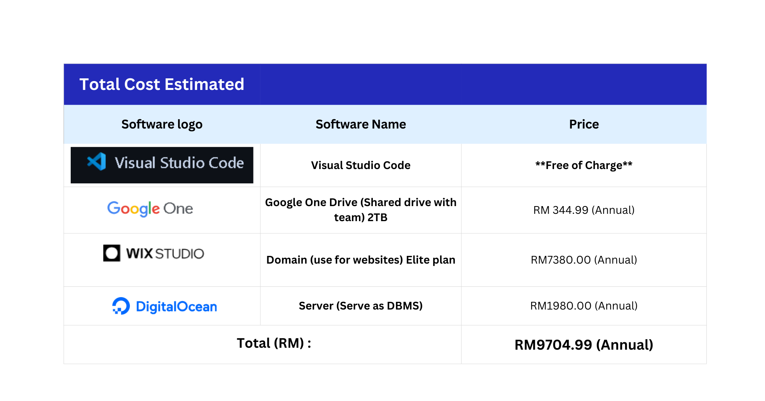
Cost in Real-life
(Web category)

Slide 25
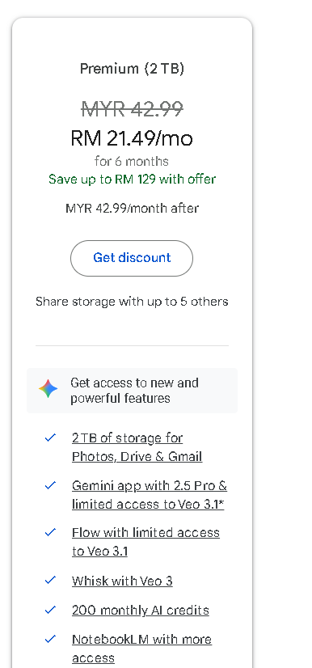
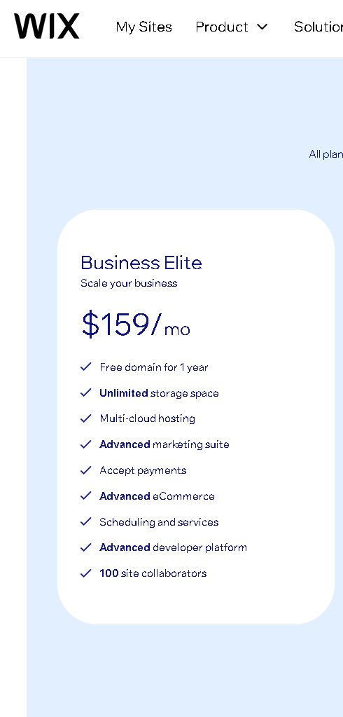
Google Drive
Wix Studio (Domain)

Slide 26
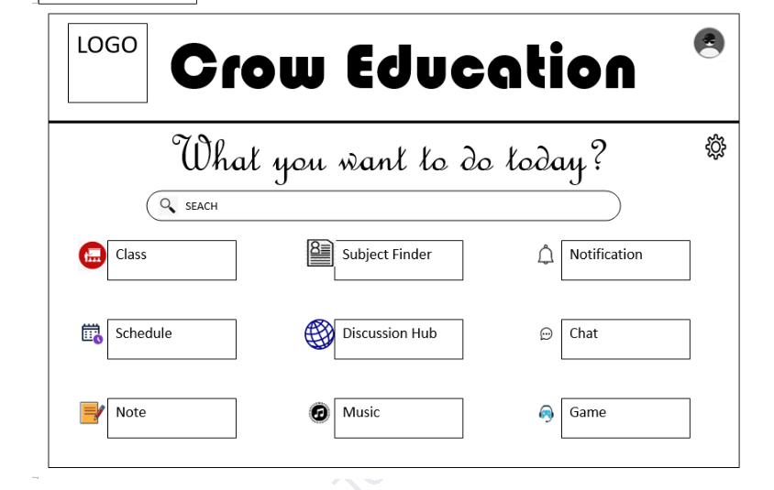
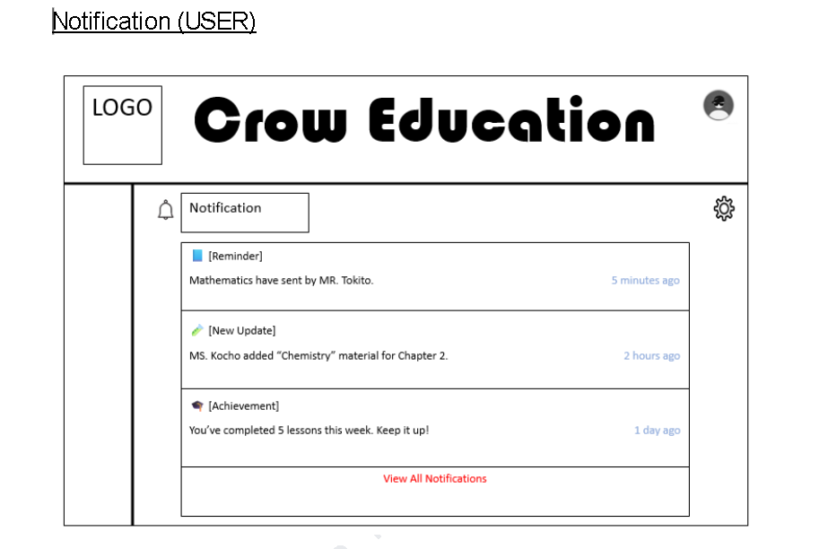
Prototype (User)

Slide 27
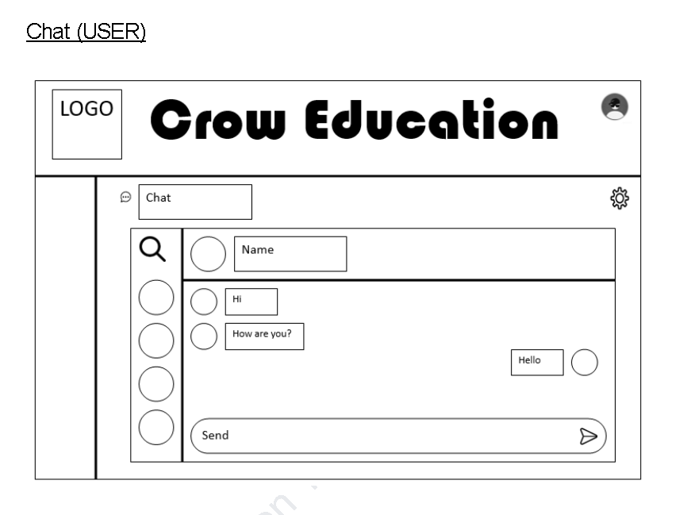
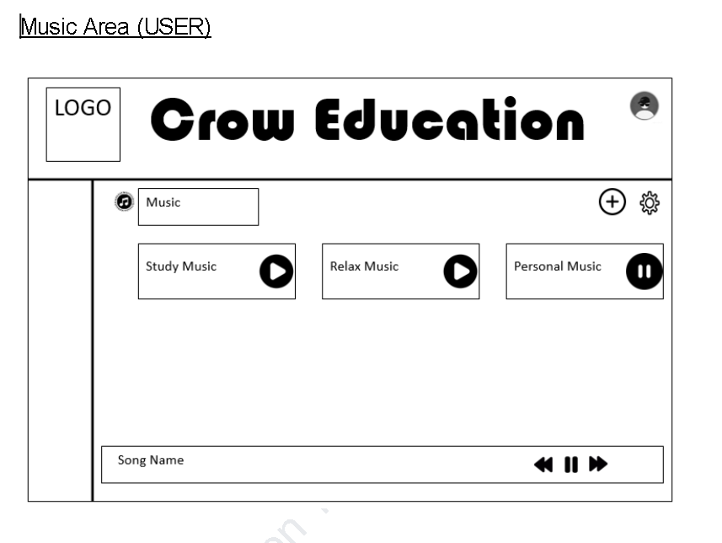
Prototype (User)

Slide 28
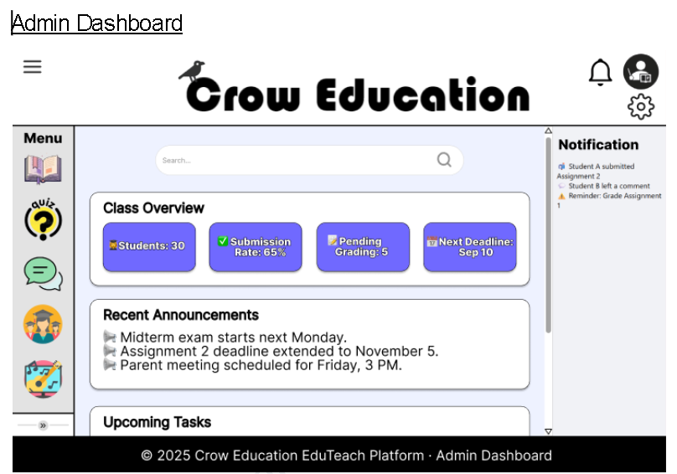
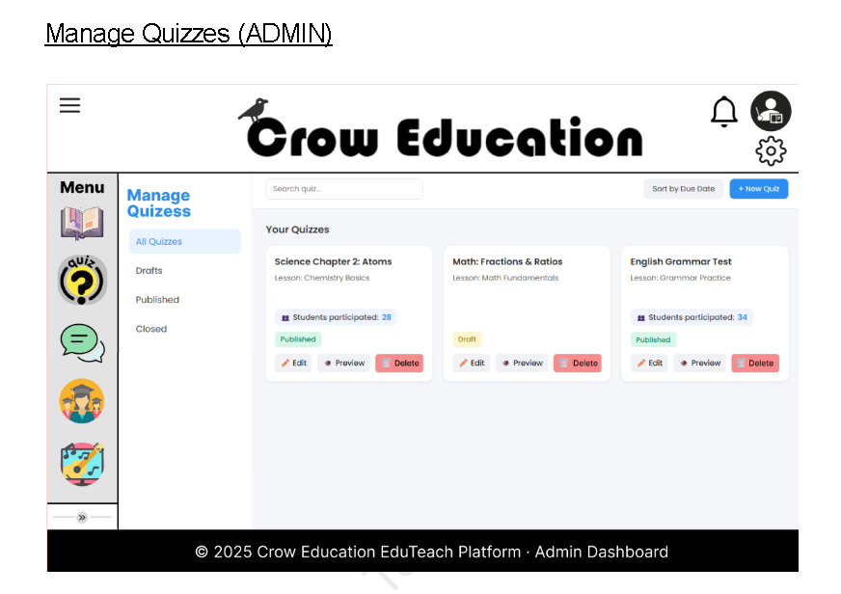
Prototype (Admin)

Slide 29
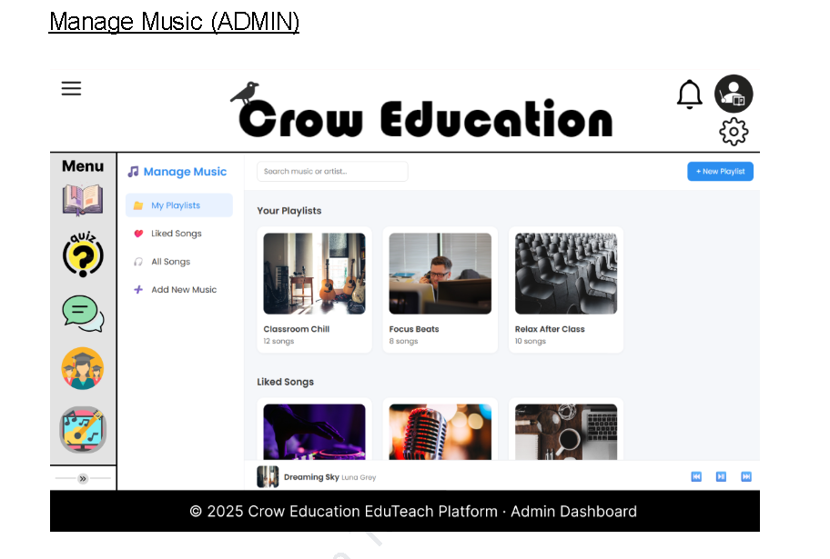
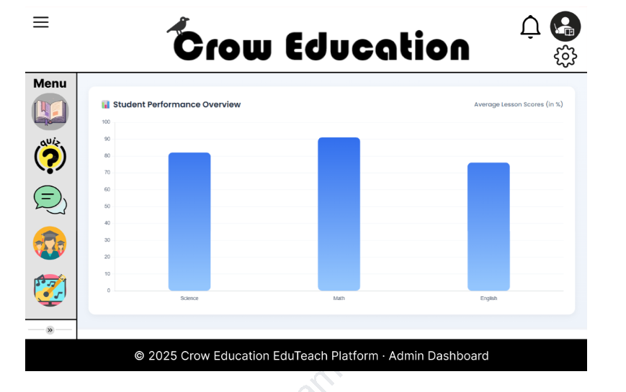
Prototype (Admin)

Slide 30
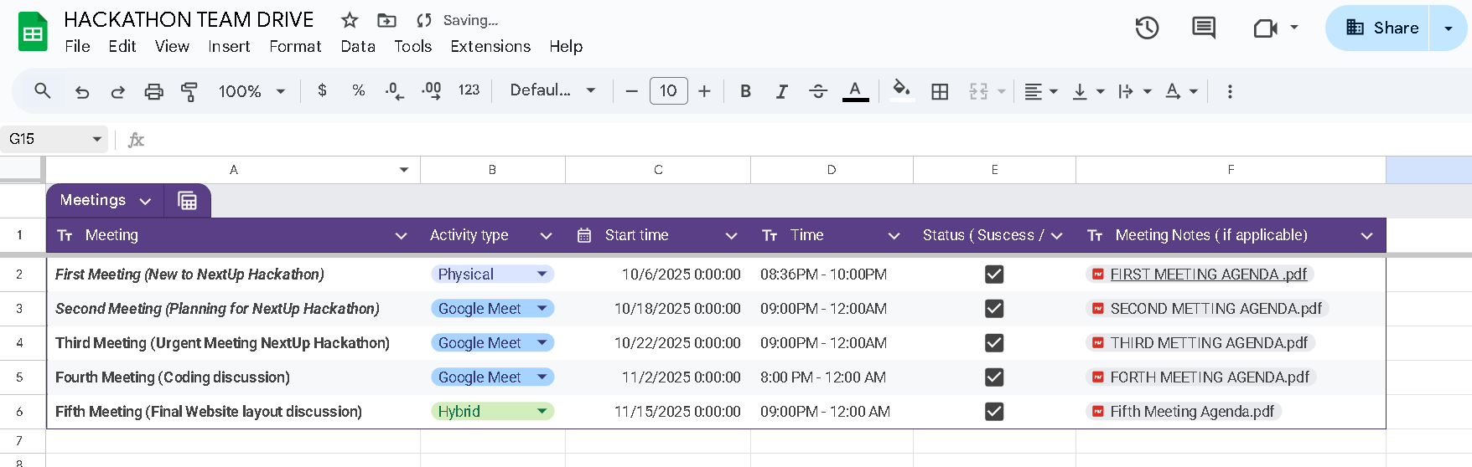
Team Roadmap

Slide 31
Trust the team
Trust the Team
We are Bird2 Group , a complete team from TARUMT with all the skills needed to execute this project.
Why We Will Succeed: Technical Skills: We have a balanced team covering leadership, database, back-end, and front-end development . Proven Teamwork: Through "countless discussions and brainstorming sessions," we have developed a "special sense of understanding and teamwork".
Local Insight: As students, we are part of our own target market. We understand the problem deeply and are passionate about building the solution.
Lim Shang Wen : Leader / Database Developer
Loh Kien Ee : Co-Leader / Back-end developer
Teoh Jia Xin : Back-end developer
Yew Jason :Front-end developer
Ng Ying Zhe :Front-end developer

Slide 32

Thank You!!
Grow with Us , Glow Your Future

