Slide 1



EST · 2016
Barcelona · Spain
Technology Systems Integrator · Since 2016
Technology
that transforms operations
Systems integration, Agentic AI, IoT and Smart Cities for organisations
that cannot afford to fail. End-to-end. Mission-critical. Measurable ROI.
• 25+ Countries • AI Expertise • 150K+ IoT Devices
www.mingothings.com · info@mingothings.com
01

Slide 2

Manifesto · 02
We build technology
that operates where
it matters most -
the moments organisations cannot afford to fail.
What we believe
02
Since 2016 · Barcelona
Certified
25+
150K+
8 Hubs
Certified quality management
Countries of operation
IoT devices connected
Global engineering + delivery

Slide 3

Global presence · 05
Global reach · local execution
Eight hubs. One delivery model.
From Barcelona HQ we deliver mission-critical projects across three continents — with regional teams that speak the local language and know the local regulation.
Hub · Full delivery capability
Business development office
8 hubs · 25+ countries · one team

Slide 4





Why MTi · 05
Four strategic pillars
Technology that operates where
it matters most.
PILLAR 01
PILLAR 02
PILLAR 03
PILLAR 04
Mission-
Critical Focus
End-to-End
Delivery
Proprietary
Platforms
Measurable
ROI
We deliver where failure is not an option — airports, metros, hospitals, industrial plants, sovereign infrastructure.
Concept, engineering, integration, deployment, operations. One accountable partner from RFQ to 24/7 maintenance.
Own IoT, Digital Twin, Smart City OS and Agentic AI platforms — never re-selling. Fully controlled roadmap and IP.
Every project reports quantified impact — hours saved, quotes generated, downtime avoided, ROI delivered from day one.

Slide 5
At a glance · 04
Proven at scale
One integrated delivery model.
Years of innovation
IoT devices connected
Governments served
AI cases in production
10+
150K+
Public.
30+
Operating since 2016
via thethings.io platform
AENA · TMB · KAFD · Cities
Agentic AI, real deployments
Countries of operation
Reference customers
25+
20+
Global reach · local execution
Navantia · TMB · AENA · Abertis · Fujitsu · Indra
MTi Group · Company Presentation

Slide 6
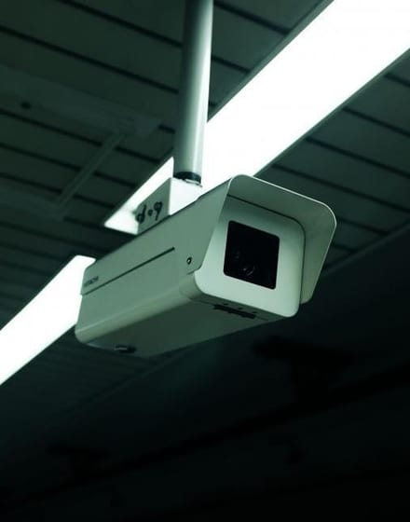
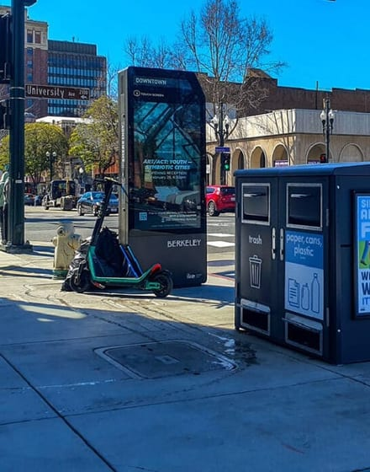
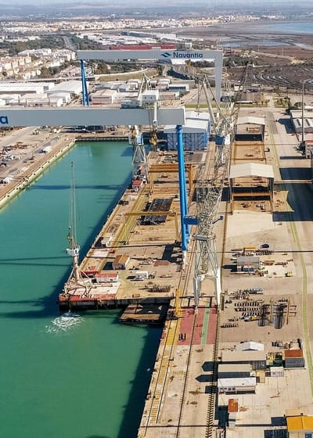


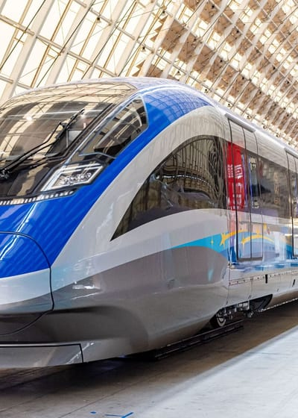
Sectors · 07
Sectors of activity
We understand your sector.
01 · Priority
02 · Focus
03 · Depth
Security
Smart Cities
Industry & Naval
CCTV, VMS, access control, perimeter, control-room operations.
Command centres, waste, lighting, mobility, utilities, IoT metering.
Digital Twin, SCADA, Industry 4.0, shipyard digital factories.
AENA · SIPA · Metro · Airports
KAFD · Qatar · Hospitalet · NSU
Navantia · Freire · Industry 4.0
04 · Layer
05 · Venue
06 · Scale
Cybersecurity
Sports Venues
Transports
SOC design, network segmentation, NIS2 & ISO 27001 compliance.
Stadium CCTV, access, IoT, digital twin of the venue.
Metros, buses, airports — VMS, ITxPT, PIS, onboard CCTV.
Zero-trust · Encrypted fabric
FC Barcelona · PortAventura
TMB · Moventia · AENA
Also serving
Water & Utilities · Data Centers · Telecom · Healthcare & Campus · Public Buildings · Retail & Hospitality

Slide 7



















References · 08
Trusted by · Public + Private
A decade of critical deployments.
From national airports and city councils to shipyards and industrial groups — MTi delivers to both regulated public procurement and demanding private operators.
Selected customers
Public sector · Governments · Municipalities
Private sector · Industry · Enterprise
MTi delivers to public tenders.
And to enterprise operators.
National authorities, city councils and public transport operators choose MTi for mission-critical projects — subject to public tender processes, security clearance and long-term SLA obligations.
Shipyards, industrial groups, sports venues and services operators — chosen for demanding SLAs, secure integration and measurable ROI on operations.
AENA · TMB · Hospitalet · KAFD · Ministry of Defence · NSU Florida
Navantia · Abertis · Moventia · Freire · FC Barcelona · PortAventura

Slide 8
Who we are · 03
About MTi Group
Division · 01
A technology
integrator
built for scale.
Services
Design & Engineering, Installation & Integration, Certification & Audit, Configuration & Maintenance — for transport, airports, metro, security & critical infrastructure.
Multi-brand · ITxPT expert · Turnkey
Founded in 2016 in Barcelona, MTi delivers complex, mission-critical solutions for public and private sectors — engineering, technical office, project design, integration of innovative technologies and turnkey project management.
Division · 02
Solutions
Proprietary platforms & software — IoT, Digital Twin, Smart City OS and Agentic AI — deployed in production across cities, industry and utilities.
Recently strengthened by the acquisition of Ingeco Vallès and Diprotech — now part of the MTi Group.
MTi Hypervisor · thethings.io · Digital Twin · Agentic AI

Slide 9

Chapter · Services
09 / 30
01
What we do — Part one
Services.
50%
Engineering, integration, installation, maintenance and 24/7 operation of the physical + digital systems that keep airports, metros, cities and industry running.

Slide 10








What we do · 08
Eight service lines
End-to-end expertise.
From concept and engineering to AI deployment and 24/7 operations — one accountable partner.
01
02
03
04
Design & Engineering
Installation & Integration
IoT & Connectivity
Agentic AI
Project design, technical office, electronics & mechanical component design, prototyping.
Multidisciplinary on-site teams: CCTV, ITS, ticketing, PIS/SIU across multi-brand hardware.
150K+ devices, real-time telemetry, alarms & analytics via thethings.io.
Orchestrator + specialised agents connected to ERP, CRM, IoT and documents.
05
06
07
08
Digital Twin & BIM
Smart City Platforms
Certification & Audit
Configuration & 24/7 O&M
Building- and factory-scale twins for operations, maintenance, energy.
MTi Hypervisor and city-scale command centres for districts and utilities.
Product certification, audits & functional testing to ensure compliance.
Turnkey installs, commissioning, SLA-critical preventive & corrective maintenance.

Slide 11


Service · 10
Live · Field team
Certified engineers on-site
Service line · 01
System Integration.
We install the technology that runs your operation — from the CCTV pole on the runway to the SCADA gateway inside the shipyard. Multi-brand, ITxPT-standard, turnkey.
What we deliver
Design & engineering
Multi-brand hardware
On-site installation
Networking & fibre
Commissioning
SLA-based maintenance
24/7 O&M
Vendor-agnostic
We install technology
that already works together.
1 · DESIGN
2 · DEPLOY
3 · INTEGRATE
4 · OPERATE
Bosch · Axis · Milestone · Genetec · Nedap · Siemens · Cisco · Advantech and more — chosen for the job, not the margin.
1,900 cameras · 5,000 buses · 150K IoT devices · one turnkey partner

Slide 12






Service · 11
Service line · 02
Where we intervene
Digital
Transformation
& Innovation.
Five levers, one plan.
Process re-engineering
Model current ops, remove hand-offs, sequence quick wins.
Data foundations
Unified data model across ERP, IoT, CRM, documents — ready for AI.
AI use-case activation
We help operational-heavy companies re-imagine how they run — mapping processes, prototyping AI use-cases, and building the roadmap that turns technology into measurable business outcomes.
Prototype an Agentic AI use-case in 6 weeks — the fastest path to ROI.
People & adoption
Train ops teams, define governance, own the change curve.
Engagement model
Compliance & security
GDPR · NIS2 · ISO 27001 built into every solution, not bolted on.
01 · Discover
02 · Design
03 · Deploy
Opportunity mapping
Roadmap & ROI
Go live & scale
◆ Proven at Navantia · FERRI · Merchant Union · Hospital Álvaro Cunqueiro
Ops audit & automation opportunity scoring
Technical & commercial plan with expected ROI
MVP → production → team enablement

Slide 13




Service · 12
Reference client
AENA · Barcelona-El Prat · SIPA
Service line · 03
CCTV &
Security Systems.
A decade designing, installing and operating mission-critical surveillance for airports, metros, cities, industrial sites and stadiums. From single-camera pilots to multi-thousand-camera national deployments.
1,900
5,000
L9 / L10
24/7
Cameras at AENA T1
Buses on-board CCTV
Metro CCTV since 2005
Control room ops
End-to-end · Design → Install → Operate
Full-stack CCTV expertise
We build the surveillance layer
your operation can trust.
◆ Bosch · Axis · Hikvision · Milestone · Genetec · Nedap

Slide 14






Service · 13
Service line · 04
Maintenance & Support.
Installation is only day one. We keep your systems running for the next ten years — with contracted SLAs, preventive plans and a spare-parts stock ready to move.
01
02
Preventive
Corrective
Scheduled inspections, firmware & calibration cycles.
On-site & remote diagnosis, hot-swap, full spare-parts stock.
Response SLA
On-site in <4h.
Anywhere in Spain.
03 · AI-powered
04
Predictive
Extended warranty
thethings.io telemetry + AI anomaly detection — fix before failure.
Multi-year contracts backed by our own field team, not resellers.
24/7 · 365 · Spare-parts warehouse in HQ
10+ years maintaining TMB · AENA · KAFD · Hospitalet

Slide 15
Chapter · Products
15 / 30
02
What we do — Part two
Products.
Four proprietary platforms built from a decade of field deployments — the software that runs behind every MTi delivery.
Command & Control
IoT Platform
Digital Twin Platform
Autonomous ops
MTi Hypervisor
thethings.io
Digital Twin
Agentic AI
Smart-city intelligence layer
150K+ devices connected
Any facility · LOD 100–500
8 productised agents

Slide 16





Products · 16
Four proprietary platforms
The software behind every delivery.
Each product solves a specific problem. Together they form one integrated stack — from the sensor on the pole to the AI agent making the decision.
01 · Command & Control
02 · IoT Platform
03 · Digital Twin
04 · Autonomous Ops
MTi Hypervisor
thethings.io
Digital Twin
Agentic AI
One control room for every city system. Fuses CCTV, transit, safety, utilities and emergency feeds into a single real-time picture with automated response protocols.
Every sensor, meter and gateway — connected, normalised and analysed. Rules engine, dashboards and API surface for any downstream system to consume live data.
A living 3D model of your facility. Combines BIM, IoT sensor data, point clouds and GIS into one interactive view — from a single room to a whole city.
Eight productised agents connected to your ERP, IoT, documents and CRM. From reading emails to closing deals — real autonomy, with full traceability.
Best for · Cities · Airports · Metros
Best for · Utilities · Smart cities · Industry
Best for · Naval · Industry · Buildings · Cities
Best for · Any ops-heavy company
25+ cities · <1s response · 99.99% uptime
150K+ devices · 10 years · 25+ countries
50+ projects · LOD 500 · Dell NativeEdge
8 agents · 30+ cases · Full explainability

Slide 17


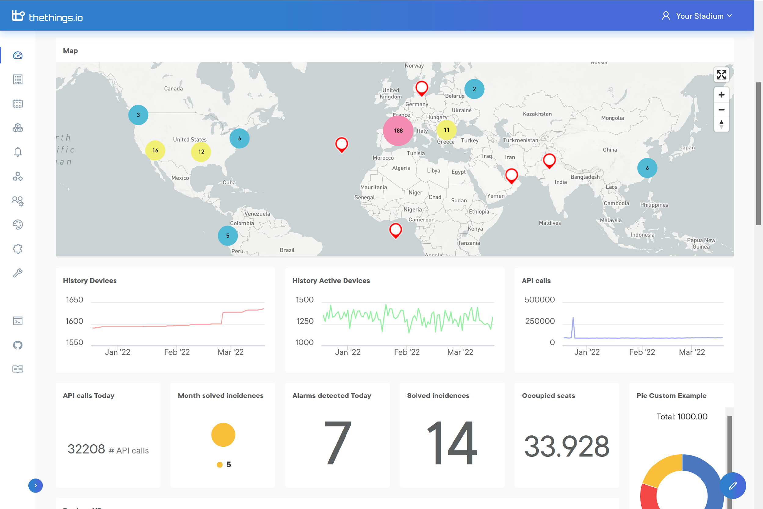
Own product · 18
thethings.io
IoT PLATFORM · 10 YEARS · 25+ COUNTRIES
Live · 150,000+ Devices Reporting
Every device.
Every reading. One layer.
thethings.io is MTi's IoT ingestion layer — a rules-engine, dashboards and API surface that consolidates every sensor, meter, gateway and controller into a single normalised data model.
The stack
150K+
10y
MQTT
24/7
01 · Devices
02 · Platform
03 · Consumers
Sensors · Gateways · Meters
thethings.io
ERP · SCADA · Hypervisor · Twin
Devices connected
In production
HTTP · CoAP · LoRaWAN
Managed service
Sample deployments
Hospitalet · 157 metering boxes · 30 data sources
Navantia · Real-time acquisition from 80+ industrial machines
Smart-city districts

Slide 18


Own product · 17
MTi Hypervisor · Unified command & control
One brain for
every city system.
Live · Control room
MTi Hypervisor is our command & control intelligence layer — ingests data from every urban system, fuses it in real time and drives automated responses across traffic, transit, safety, utilities and emergency services.
Platform architecture
Presentation Layer
Control room UI · Mobile app · Public APIs
Application Layer
Incident mgmt · Protocols · Analytics · Reporting
25+
100+
<1s
99.99%
Intelligence Layer
CEP engine · AI models · Correlation rules
Cities deployed
Integrations
Alert response
HA uptime SLA
Integration Layer
100+ connectors · Normalisation · Event bus
Built for control rooms · Proven in cities
Infrastructure Layer
Traffic Management
Emergency Operations
Public Transport
Smart City Command
HA cluster · Edge nodes · Encrypted data fabric
◆ On-premise · Private cloud · Hybrid · Edge nodes for low-latency processing

Slide 19






Own product · 19
Digital Twin platform · Any facility
Use cases — one platform, every asset
Buildings. Industry. Cities.
Your assets, alive in the cloud.
01
02
Buildings & Facilities
Data Centers
Energy, predictive FM, space & occupancy management.
Live rack model, PUE tracking, cooling & load simulation.
Our Digital Twin platform connects BIM geometry, IoT sensor data, point clouds and operational documents into a single living model — from a single room to an entire city.
03
04
Industry & Naval
Sports Venues
SCADA, PLC, predictive maintenance, digital factories.
Stadium twin, crowd flow, ops during matchdays.
50+
LOD 500
IFC 4
20+
Active projects
Open standard
Data connectors
Model fidelity
05
06
Smart Cities
Infrastructure
3D city model (LOD 1–3), utility overlays, planning simulation.
Bridges, roads, tunnels — structural health monitoring.
Deployed at Navantia · Freire Shipyard · Hospitalet · Industrial facilities.

Slide 20

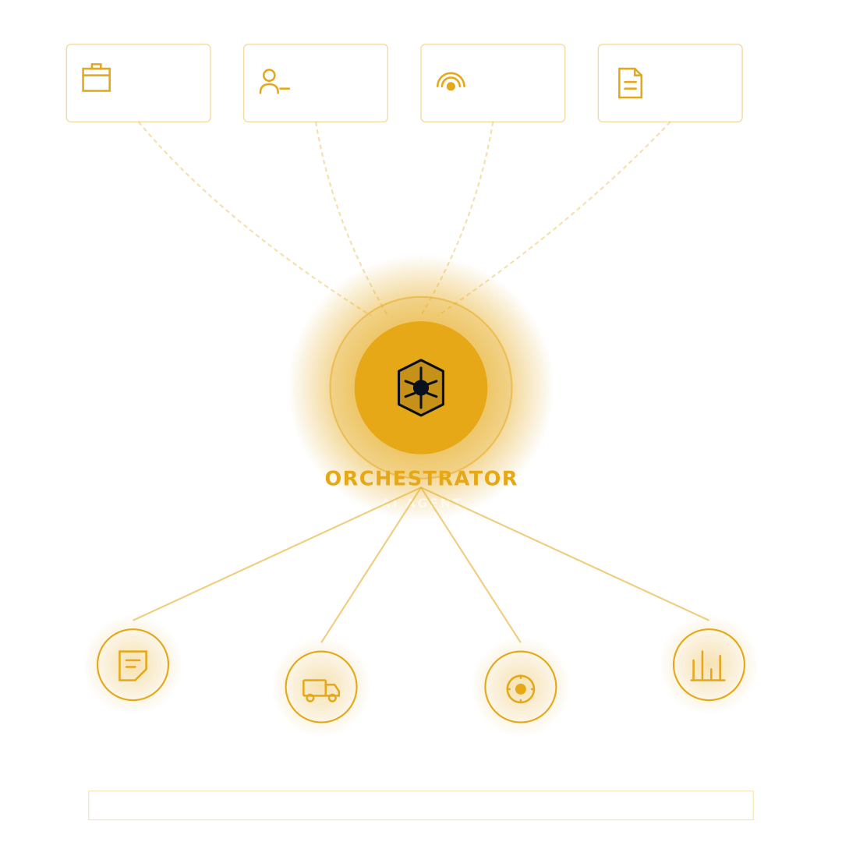
Own product · 20
Agentic AI
Orchestrator architecture
Real autonomy in your operations.
Not prototypes — solutions in production with measurable outcomes. An Orchestrator Agent coordinates specialised agents connected to your ERP, IoT, documents and CRM.
−80%
−65%
−70%
8
Quote gen. time
Manual mgmt.
Offer prep.
Productised agents
COPEGAL
RCFIL
FERRI
SEE NEXT SLIDE
Capabilities
Predictive Alerts
Automated Tasks
NL Assistants
ERP + CRM Integration
Twin Updates
Full Explainability

Slide 21









Agentic AI · Suite · 21
Agentive AI product suite
Eight agents. One platform.
Productised agents built from 30+ real deployments — integration-first, auditable, ready for your ERP, IoT, documents and CRM.
C01
C02
C03
C04
AI Email Operations
AI Tender & Offer Engine
AI Voice Support
AI Sales Intelligence
Every email answered. Every action triggered. Reads intent, extracts data, queries ERP/CRM and drafts a contextual reply.
Win more tenders. In a fraction of the time. Analyses complex documentation, costs each line item, drafts the technical offer.
24/7 intelligent call handling. Seamlessly hands off to human agents. Structures incidents in real time — privacy-first.
Your CRM, always up to date. Your pipeline, always enriched. Auto-logs meetings, scores leads, surfaces next-best actions.
Multi-intent classification · Full audit trail
−50% prep time · 100% traceability
Zero audio stored · GDPR compliant
HubSpot · Salesforce · Zoho
C05
C06
C07
C08
AI Order Processing
AI Delivery & Docs
AI Knowledge Assistant
AI Incident & Quality
From order email to ERP entry — fully automated. Reads the email, parses the SKUs, validates prices, posts to ERP.
Dispatch documents generated, sent and reconciled. CMRs, invoices, POs and delivery notes — end-to-end automated.
Your company documentation, instantly searchable. RAG + Knowledge Graph over specs, manuals, contracts and regulation.
Every incident captured, classified and resolved. Correlates operations data to detect anomalies before they escalate.
SAP · Odoo · Dynamics · SAGE
Zero paperwork errors
Cited answers · Version-aware
Predictive alerts · Root-cause

Slide 22
03
Flagship projects
Real projects.
Real results.
Chapter three
From Spain's flagship airport to warship digital factories — the projects that define what MTi means by mission-critical.
23 AENA + Gibraltar · 24 Metro Barcelona · 25 TMB 5,000 Buses · 26 Hospitalet · 27 Navantia · 28 Smart City

Slide 23


Flagship · Airports · Public sector
Project · 23
Client · AENA · SIPA · Public tender
Spain's flagship
airport, seen
from every angle.
Massive installation of 1,900 Bosch CCTV cameras, the SIPA information system and comprehensive Control Tower monitoring across the new El Prat T1 terminal.
1,900
T1
24/7
Location · Barcelona · Spain
Barcelona
El Prat · T1
CCTV cameras
Terminal · new build
Control tower
Also delivered · United Kingdom
Gibraltar Airport — Iris biometric access · 126 readers · 16 biometric units.

Slide 24
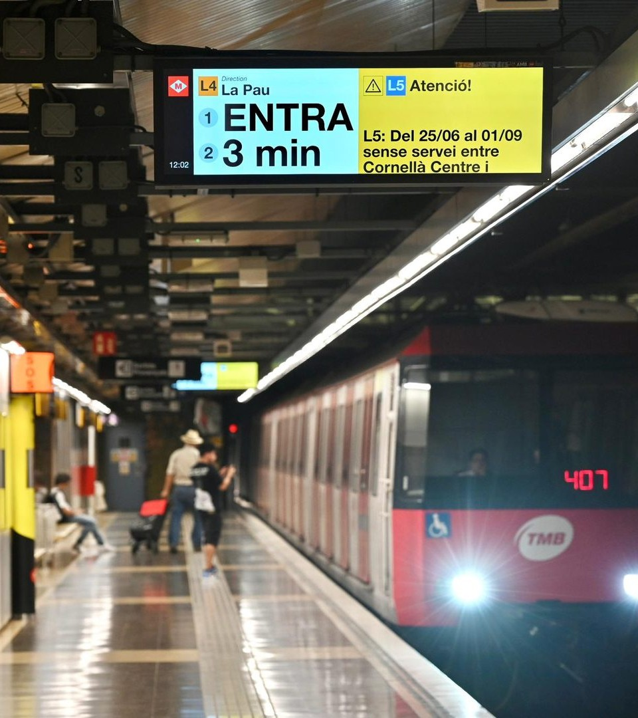

Project · 24
Flagship · Metro · Public sector
Client · TMB · Barcelona
Metro CCTV -
an entire network
watched.
Comprehensive engineering, development and customisation of the VMS visualisation software, recording and CCTV control applications for the fully-automatic Metro Line 9 — plus continuous service on L9/L10 and thousands of IP cameras since 2005.
Since 2005 · SLA critical 24/7 · L9 · L10 · Full network integration

Slide 25
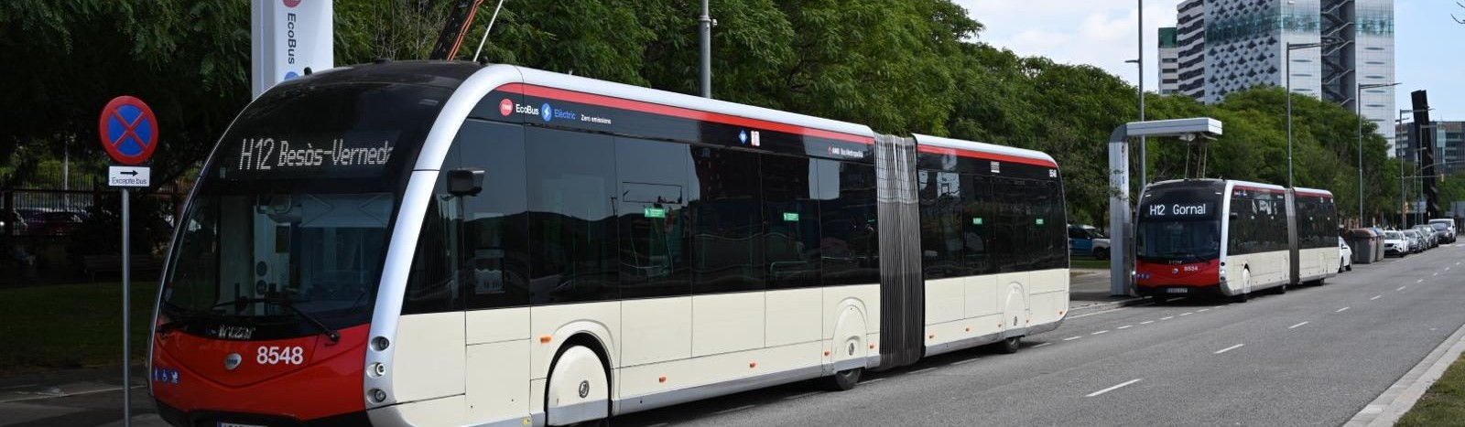

Project · 25
Flagship · Bus fleet · Public sector
5,000 buses.
One integrated fleet.
Client · TMB · Onboard systems
Project scope
Installation & management of onboard CCTV, PIS and ticketing across TMB's entire bus fleet — mainly at Zona Franca, Triangle, Horta and Ponent depots.
5,000
4
Buses equipped
Depots · Barcelona
EN 50155
100%
EN50155-certified dome cameras · Full-cabin coverage · GDPR-compliant privacy masking · Turnkey installation across every depot.
Rail-grade certification
GDPR compliance

Slide 26

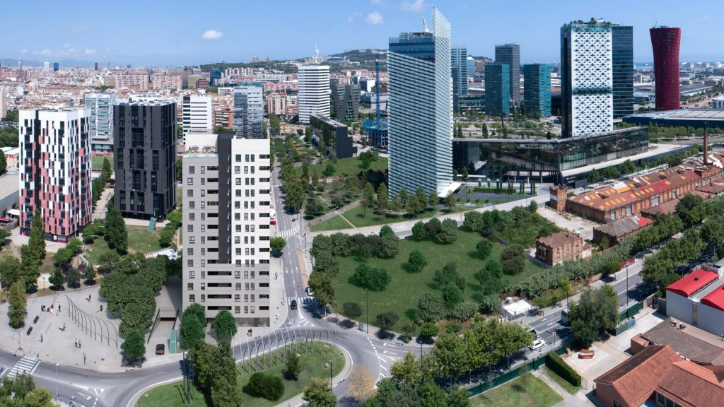
Project · 26
Flagship · Smart City · City Council
Client · L'Hospitalet de Llobregat · Spain
Building
automation,
city-scale.
MTI deployed 157 metering boxes centralising real-time data from more than 30 data sources to optimise building management and advance smart-city sustainability in Hospitalet.
157
30+
Live
Metering boxes
Data sources
Realtime · in production

Slide 27
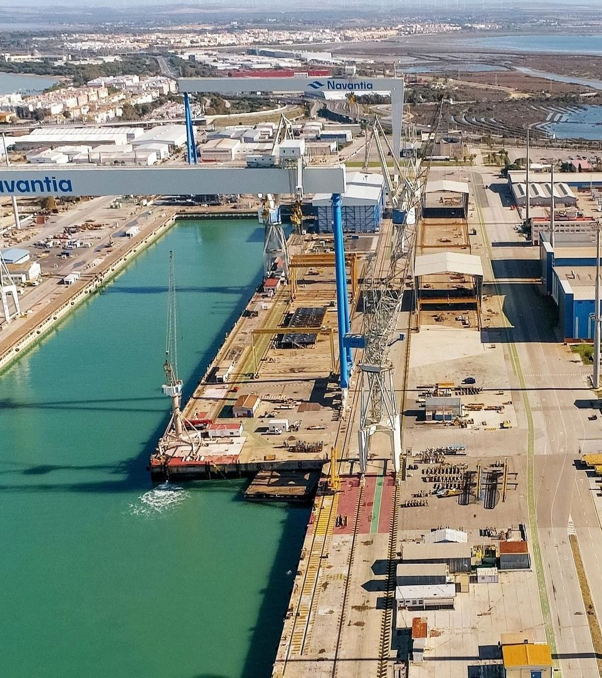

18
Project · 27 · MTi Group
Flagship · Naval & Defence · State-owned
Client · Navantia · Warship yards
A digital
factory for
warships.
Digital-factory transformation of Navantia's warship operation — over 80 machines connected, integrated with SCADA, PLCs and IoT sensors under one operational Digital Twin, certified by Dell NativeEdge.
Digital Twin · SCADA integration · thethings.io · Industry 4.0

Slide 28




Projects · 28
More flagship deployments
Smart cities in production.
Saudi Arabia · Sovereign
Qatar · Municipal
USA · Public Univ.
Malaysia · Environmental
KAFD Smart District
Smart Waste Mgmt.
NSU Florida · Living Lab
Predictive AQI
160-hectare flagship district. Digital backbone integrating BMS, security, ITS, GIS and citizen apps under a single command layer.
Connected platform: RFID bins, GPS route control and municipal integration. Modular rollout across key districts of the metro area.
Nova Southeastern University Living Lab — environmental sensing, mobility flows and community analytics for tomorrow's cities.
Network of CO, NO₂, PM2.5 and PM10 sensors giving local authorities live data-driven public-health decisions.
160 ha · Hypervisor · IoT · District
RFID · GPS · Multi-district
thethings.io · R&D · Campus
thethings.io · Alerting · IoT
4 continents · Public tenders · Long-term SLAs · One integrated MTi stack

Slide 29





Value proposition · 29
Why choose MTi
Five reasons partners choose us.
01
02
03
04
05
Multi-Brand
Installation
ITxPT
Expertise
Project
Management
Post-Sale
Support
Heterogeneous
Systems
Experts in hardware from diverse manufacturers with no brand dependency.
Deep mastery of standards for open and scalable architecture.
Comprehensive coordination of complex deployments in large fleets.
Continuous accompaniment after installation and commissioning.
We unify diverse technologies into a coherent operational solution.
→ Data Bus Integration
→ Protocol Auditing
→ System Homologation
→ Installation Logistics
→ Minimized Downtime
→ QA Quality Control
→ Preventive Maintenance
→ Warranty Management
→ OTA Updates
→ Real Interoperability
→ Custom Configuration
→ Turnkey Solution
→ Tech Independence
→ Certified Assembly
→ Mixed Fleet Adaptation

Slide 30






Let's talk · 30
Ready when you are
Let's build
the next one
together.
Get in touch
Email
info@mingothings.com
Call
+34 934 860 961
Visit
www.mingothings.com
Tell us your challenge. We'll show you how MTi can solve it — with real technology, real integrations and measurable results from day one.
HQ · Barcelona, Spain · +7 hubs globally
© 2026 MTi Group — Mingothings S.L. · All rights reserved · ISO 9001 certified
Thank you.

