Slide 1
Apache Spark
Notes:
RDD: https://www.usenix.org/system/files/conference/nsdi12/nsdi12-final138.pdf

Slide 2
Cluster Components
Driver
Machine where the application is running and that creates the SparkContext. Driver communicates directly with workers when the application is running.
Master / Cluster Manager ←- external service
The machine where cluster manager is running. In standalone mode, it's called master. Master assigns resources to worker when the application is starting.
Worker
Run in each machine in the cluster, always report available resources to master. Workers create executors for the driver to run the application.
Notes:
When the Driver process needs resources to run jobs/tasks, it ask the "Master" for some resources. The "Master" allocates the resources and uses the "Workers" running through out the cluster to create "Executors" for the "Driver". Then the Driver can run tasks in those "Executors".

Slide 3
Terms
Spark Context
Connection to the cluster where all configurations are specified.
RDD
The data which will be distributed to the cluster. The computation (transformations or actions) also happened in RDD. RDD is created from Spark Context.

Slide 4
Application Submission
Driver connect to master
Master launches executors on all workers
Master notifies driver³ that executors are added
Driver starts specX thread (only if specX is enabled)
Master tells driver that executors are running
Driver sends command (e.g. flatMap, map, reduceByKey in WordCount) to executors.
Notes:
1. See AppClient.scala for driver execution
2. WorkerInfo.scala ← on master
3. In “launchExecutor” in Master.scala, master notifies worker to run executor and notifies driver (in AppClient.scala)

Slide 5
DAG (Direct Acyclic Graph)
When action on RDD is called, Spark creates DAG on driver (from DAGScheduler.scala).
The DAGScheduler will create some stages to run the process on RDD.
Sometimes the data needs to be shuffled to group the data differently across partitions. (e.g. on reduceByKey() in word count)

Slide 6
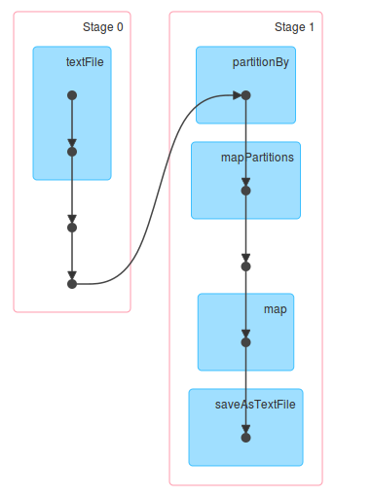
DAG – Example
(from spark monitoring website)

Slide 7
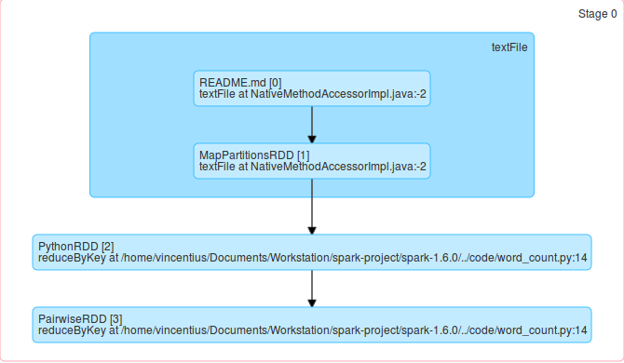
DAG – Example contd.

Slide 8
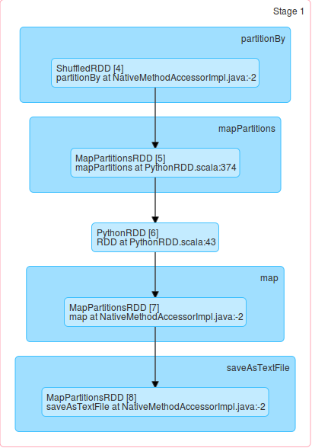
DAG – Example contd.

Slide 9
SpecX in Spark
TaskSchedulerImpl → start specX thread (driver log)
TaskSetManager → mark a task as speculatable if it ran more than x ms (driver log)
TaskSetManager → run specX every x ms, with min 1 task has already finished, see checkSpeculatableTasks() by 'dequeueSpeculativeTask' for task in queue
Driver saves a list of speculatable tasks and speculate them on ???

Slide 10
SpecX in Spark (contd.)
Outline:
(CoarseGrainedSchedulerBackend)|(SparkDeploySchedulerBackend)
receive-reviveOffers → makeOffers
(TaskSchedulerImpl)resourceOffers → resourceOfferSingleTask →
(TaskSetManager)resourceOffer → dequeueTask → dequeueSpecX
Driver will dequeueTask for the given node including the speculative task
Driver checks that the task should not have an attempt running on this host in case the host in slow.
Driver checks locality constraint http://stackoverflow.com/questions/26994025/whats-the-meaning-of-locality-levelon-spark-cluster
How does it choose worker on specX?
→

Slide 11
SpecX in Spark - Detection
Check: checkSpeculatableTask in TaskSetManager
If running time > threshold
(threshold = median_duration * SPECULATION_MULTIPLIER)
SpecX doesn't run since Spark assigns hostname = localhost to all node.. see TaskSchedulerImpl in resourceOffers .. where does it create the executorData?

Slide 12
SpecX in Spark - Execution
Driver prepares the offers to executor by getting the executor data from the list of activeExecutors (detail ???)
→ search for where executorDataMap is filled in CoarseGrainedSchedulerBackend
(check receiveAndReply in RegisterExecutor)
Driver makes resource offers to all executors in round robin manner.
For every node, offer the task in increasing order of locality levels (PROCESS_LOCAL,NODE_LOCAL,RACK_LOCAL,ANY).
Driver will dequeue speculative task for the executor
First, check if speculative task can run on host
1. the task idx should not have been attempted on that host
2. this should not be a re-execution of a failed task on executor before EXECUTOR_TASK_BLACKLIST_TIMEOUT has elapsed
Then, driver will do the speculative task based on the given locality levels.
DAGSCheduler will be given a report that the task is starting.
Notes:
All of these are serialized and send to executors

Slide 13
SpecX in Spark - Detail
If a task's running time is larger than threshold, then put it in the speculatableTask (a hash set).
  threshold = mul * median duration of all tasks; where mul is configurable – by default 1.5
Driver creates a new task for the speculatable task. It offer the task to every executor until an executor takes the job and mark the task as speculative.
  This is the same method with running a normal task, except the task is currently marked as speculative.
If the speculatableTask is not empty (the task has not finished yet), check if the task doesn't have attempt on the chosen executor and the chosen executor is not blacklisted.
  Blacklist → has failed before and still in the blacklist timeout.
Try to run the task based on the locality level.
Run the speculative task and notifies the DAGScheduler that task is starting.
Whichever task finished earlier will be used and the task which finished later will be ignored.

Slide 14
How does executor get worker's address?
AppClient?
CoarseGrainedSchedulerBackend?
Worker creates executor and tell master that the executor has been created.
BIG HINT!! – CoarseGrainedExecutorBackend – in sparkHostPort assignment, the port is null
CoarseGrainedExecutorBackend: env.rpcEnv.setupEndpoint → onStart (“the executor's rpc env is not listening for incoming connections”)
SparkEnv (createExecutorEnv) → AkkaUtils → Utils
ExecutorRef = null

Slide 15
How does Spark divide the jobs?
Partition → based on hadoop partition (1 block = 64MB)
Data Locality → Spark will choose the nearest worker
Tasks are divided in a round robin manner
SparkContext(runJob) → DAGScheduler(runJob)
Spark Context will initialize DAGScheduler

Slide 16
General
SparkContext – runJob
DAGScheduler – runJob – submitJob
– handleJobSubmitted
Master only gets notification of state change in executor
RDD is divided into hadoop partition
Executor reads directly hadoop partition from HDFS (from HadoopRDD)

Slide 17
DataFlow
SparkContext – textFile
SparkContext – hadoopFile (create hadoop RDD in driver)
SparkContext – broadcast hadoop conf file
RDD – PythonRDD – collect() – calls runJob
SparkContext – def runJob[T, U: ClassTag](rdd: RDD[T], func: Iterator[T] => U)
SparkContext – def runJob[T, U: ClassTag]

Slide 18
Task Placement
TaskSet is submitted from DAGSCheduler
ExecId is from shuffledOffers
TaskSchedulerImpl → resourceOffers
TaskSchedulerImpl → resourceOfferSingleTaskSet, from resourceOffer, offer an execId
ResourceOfferSingleTaskSet, execId from shuffledOffers
TaskSet.. with x tasks
Compute locality level

Slide 19
SubmitMissingTasks in DAGScheduler.scala

