Slide 1

Capstone Project Phase A
24-2-R-15
Interactive Mathematical Proof Verification System
Daniel Armaganian, Tzahi Bakal
Supervisors: Dr. Dan Lemberg, Mrs. Elena Kramer

Slide 2

Motivation
LLMs like ChatGPT, can generate complex mathematical proofs.
Background
ChatGPT lacks the ability to verify these proofs.
Problem
A system to verify AI-generated proofs for accuracy.
Need

Slide 3
Introduction
Study Focus
Objective
Address the challenge of verifying ChatGPT-generated mathematical proofs.
Create a system that verifies proofs generated by ChatGPT, verified through Agda.
Methodology
Outcome
Utilizes ChatGPT’s API and Agda’s verification based on Intuitionistic and Homotopy Type Theories.
A system that reliably verifies ChatGPT-generated mathematical proofs.

Slide 4

Technologies and Theories
Intuitionistic and Homotopy Type Theories
01
02
Agda
03
ChatGPT

Slide 5
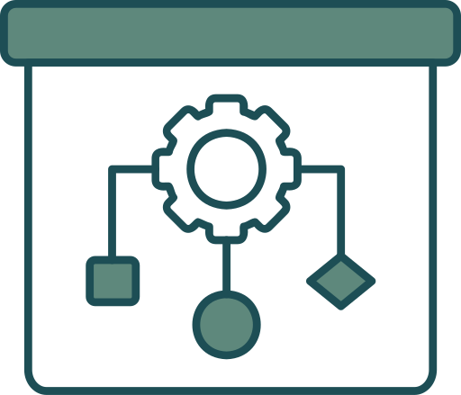
Intuitionistic and Homotopy Type Theories
Intuitionistic Type Theory:
Treats proofs as algorithms — proving something means constructing it step by step.
Homotopy Type Theory:
Simplifies handling complex structures using the Univalence Axiom, treating equivalent objects as identical.
Notes:
Proofs as Programs (ITT)
In your project, ChatGPT generates proofs, and Agda checks them. ITT’s idea that proofs are like programs fits perfectly here. Each proof can be written and verified step-by-step, just like a program that’s tested to ensure it works.
This helps make ChatGPT’s output verifiable by breaking down a proof into constructive steps that Agda can check.
2. Constructive Approach (ITT)
ITT's focus on constructing proofs ensures that the proofs generated are not just logically possible but are actually built step by step. This matches your goal of iterative refinement in the project, where the proof is improved and checked multiple times until it's verified.
It also helps your system to spot errors early, since every step needs to be justified.
3. Flexible Equality (HoTT)
HoTT’s flexible approach to equality means that even if two things look different but are logically the same, your system can treat them as equivalent. This makes it easier for the system to handle complex mathematical proofs, where different formulations can represent the same idea.
This improves the robustness of your verification system, allowing it to handle more diverse proofs without getting stuck on minor differences.
4. Univalence Axiom (HoTT)
The Univalence Axiom helps ensure that equivalent proofs or structures can be treated as identical. In your project, this means ChatGPT’s generated proofs can be more flexible, and Agda can still validate them even if they use different but logically equivalent approaches.
This enhances your project’s ability to adapt to different styles of proof generation and still reach a verified result.

Slide 6
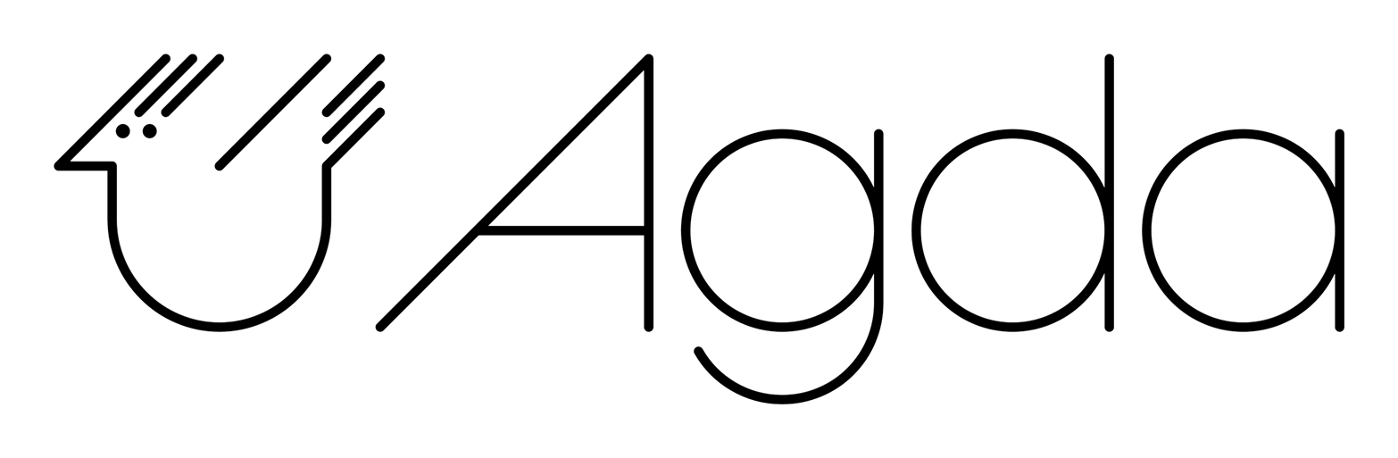

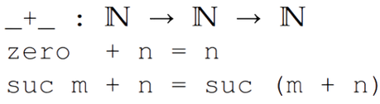
Agda
What is Agda?
A dependently typed functional programming language.
Used for writing and verifying formal proofs.
Why Agda?
Treats proofs as algorithms.
Allows complex mathematical structures with precise verification.
Notes:
dependent types help ensure that mathematical proofs are not only syntactically correct but also logically correct by encoding these kinds of constraints directly into the types. This allows the system to catch errors early and verify complex properties about the proofs it generates.
52
Dependent types enable larger set of logic errors to be eliminated at compile time. To illustrate this consider the following specification on function f:
Function f must take only even integers as input.
Without dependent types you might do something like this:
def f(n: Integer) := {
if n mod 2 != 0 then
throw RuntimeException
else
// do something with n
}
Here the compiler cannot detect if n is indeed even, that is, from the compiler's perspective the following expression is ok:
f(1) // compiles OK despite being a logic error!
This program would run and then throw exception at runtime, that is, your program has a logic error.
Now, dependent types enable you to be much more expressive and would enable you to write something like this:
def f(n: {n: Integer | n mod 2 == 0}) := {
// do something with n
}

Slide 7

ChatGPT
What is ChatGPT?
A Large Language Model designed for natural language processing.
Why ChatGPT?
Generates human-like proofs mathematical from natural language inputs.
Provides an API that will be used for communication with Agda.

Slide 8
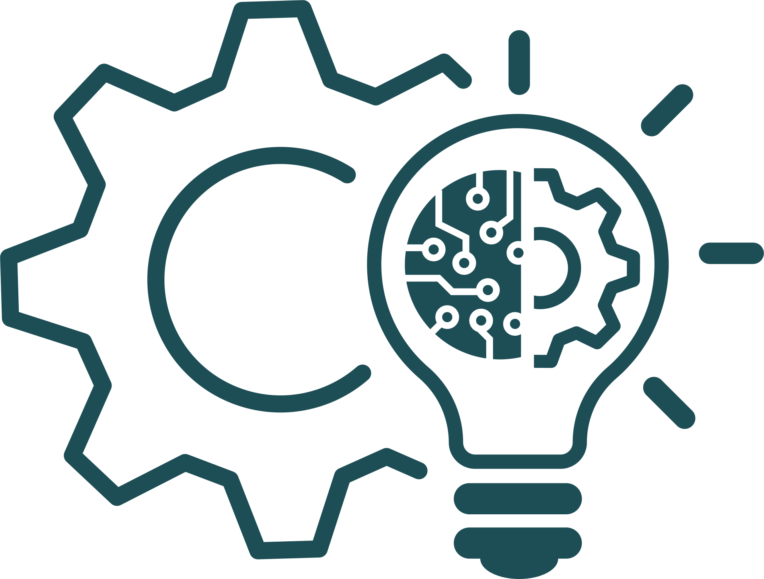
Research/Engineering Process
01
Algorithm
02
Diagrams
03
Challenges
04
Prototype

Slide 9


Algorithm
Receive mathematical proof request from user
ChatGPT generates mathematical proof
Verify generated mathematical proof using Agda
Refine proof
Send feedback back to ChatGPT
Display results

Slide 10
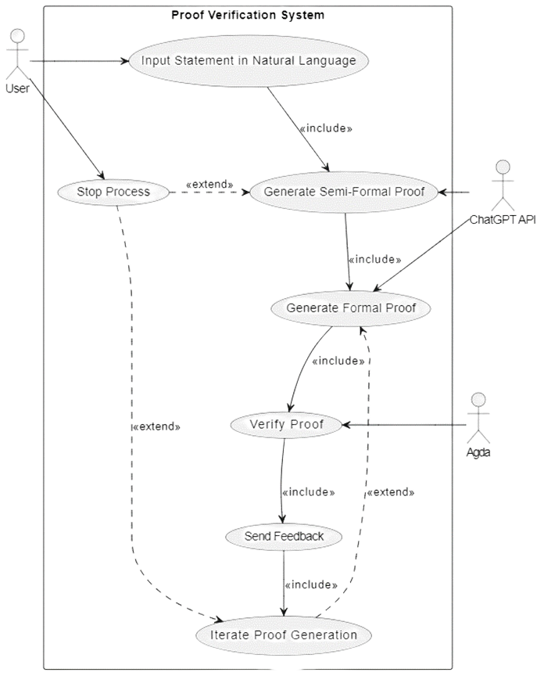
Diagrams
Use Case Diagram

Slide 11
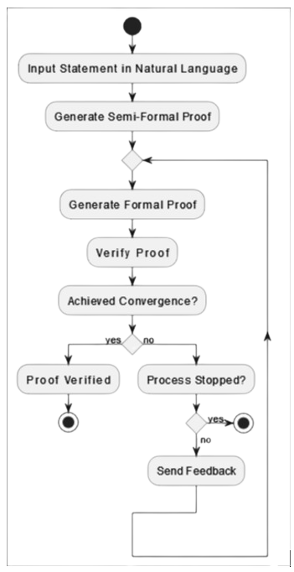
Diagrams
Activity Diagram

Slide 12

Challenges
Non-Convergence
Efficiency
Integration between ChatGPT and Agda
Agda code
Notes:
Non-Convergence: Some proofs may not converge within the allowed
iteration limit, requiring manual intervention or additional refinement
strategies.
• Efficiency: Optimizing the API to handle large and complex proofs efficiently
will be a key technical challenge.
• Integration: Ensuring smooth communication between ChatGPT and Agda,
while maintaining robustness across different types of proofs.
• Agda code: Generating Agda code with ChatGPT can be difficult as it requires
from ChatGPT to constantly meet all the complex syntactic rules with Agda.

Slide 13
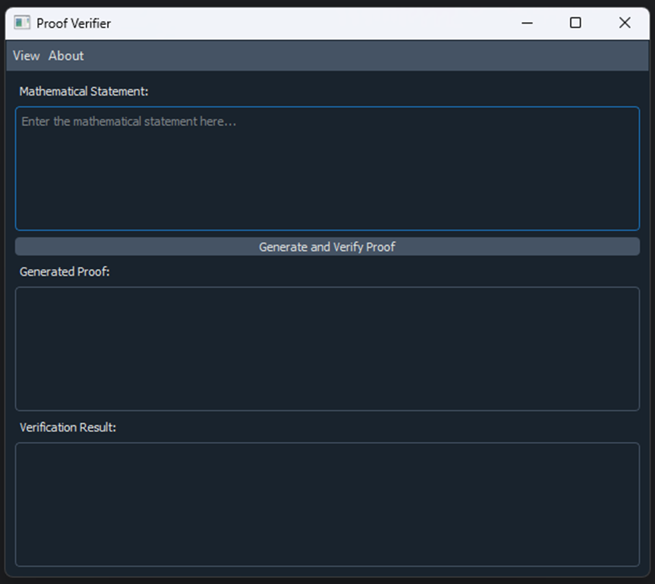
Prototype

Slide 14
Verification Plan
Test Case | Test Case Description | Expected Outcome
1 | Input a valid natural language mathematical statement into ChatGPT | ChatGPT generates a semi-formal proof, which is translated into Agda code for verification
2 | Proof verification fails due to incorrect input | The system provides feedback, and ChatGPT refines the proof
3 | Input a large and complex proof statement | The system efficiently handles the input and completes verification within an acceptable time-frame

Slide 15
Verification Plan
Test Case | Test Case Description | Expected Outcome
4 | Attempt to verify an invalid or incomplete proof | The system detects the errors, provides feedback, and does not falsely confirm validity
5 | User interrupts the iterative refinement process | The system safely halts the refinement process, saving the current state of the proof
6 | The maximum duration of the iterative process is reached | The system safely halts the refinement process, saving the current state of the proof

Slide 16

Expected Achievements
1
Successful Convergence of ChatGPT Generated Proofs.
2
Increased Efficiency in Mathematical Proof Verification.
3
Improved Trustworthiness of ChatGPT Generated Proofs.
Notes:
Successful Convergence of AI-Generated Proofs
The system will iteratively refine proofs generated by ChatGPT until they are verified as correct by Agda, achieving high convergence rates.
Increased Efficiency in Mathematical Proof Verification
The integration of AI and formal verification will automate substantial portions of the proof-checking process, significantly reducing the time needed for verification.
Improved Trustworthiness of AI-Generated Proofs
The system enhances the reliability of AI-generated proofs, ensuring they are rigorously validated, leading to broader acceptance and application in mathematical research.

Slide 17


Thank You for Listening!

