Slide 1
Mental Health Patterns and Living Situations in New York State
Dania Salman
HENG-JUI CHU
Emma Francis

Slide 2
Source Links
Git Hub:
https://github.com/daniasalman6/Project-Data-Mining
Dataset Link:
https://data.ny.gov/Human-Services/Patient-Characteristics-Survey-PCS-2019/urn3-ezfe/about_data
The PCS 2019 dataset provides comprehensive information on mental health services and client characteristics across New York State.

Slide 3
Data cleaning
Convert “Unknown” to missing values
Remove missing values
146737 observations after data cleaning

Slide 4
Smart Question 1
How well can demographic characteristics predict whether an adult has a diagnosed mental illness in New York State using PCS 2019 data?

Slide 5
Smart Question 2

Slide 6
Smart Question 3
How effectively can employment and related socioeconomic variables predict an individual’s living situation category in New York State using PCS 2019?

Slide 7
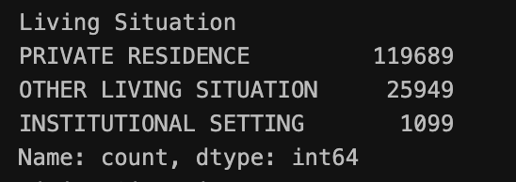
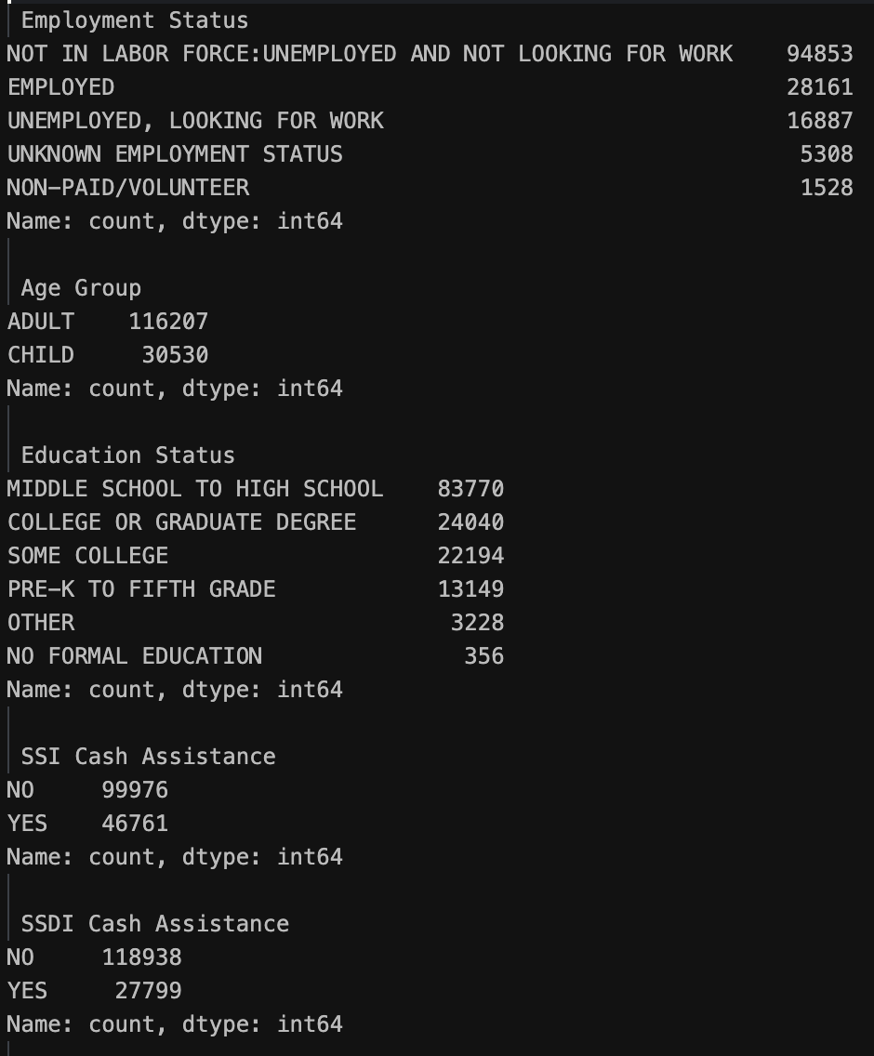
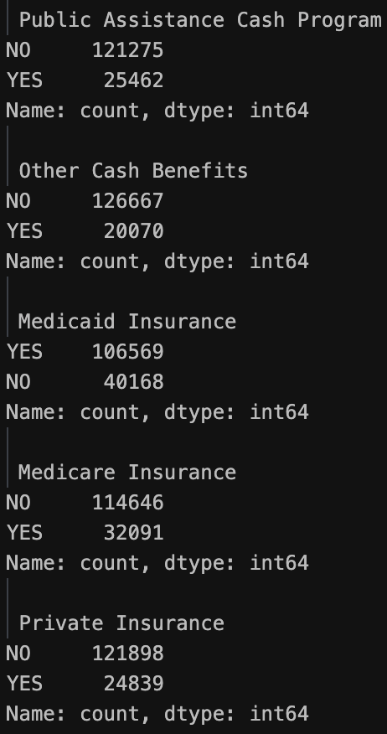
Variables Description
Y
X

Slide 8
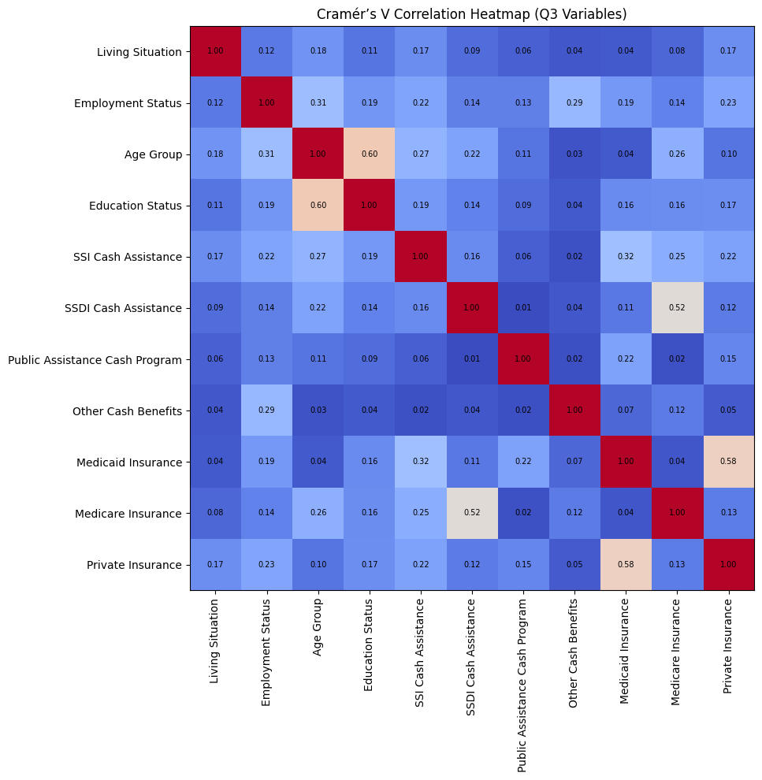
Correlation Test
Age Group with Education Status: 0.6
Medicaid Insurance with Private Insurance: 0.58
Medicare Insurance with SSDI Cash Assistance: 0.52

Slide 9
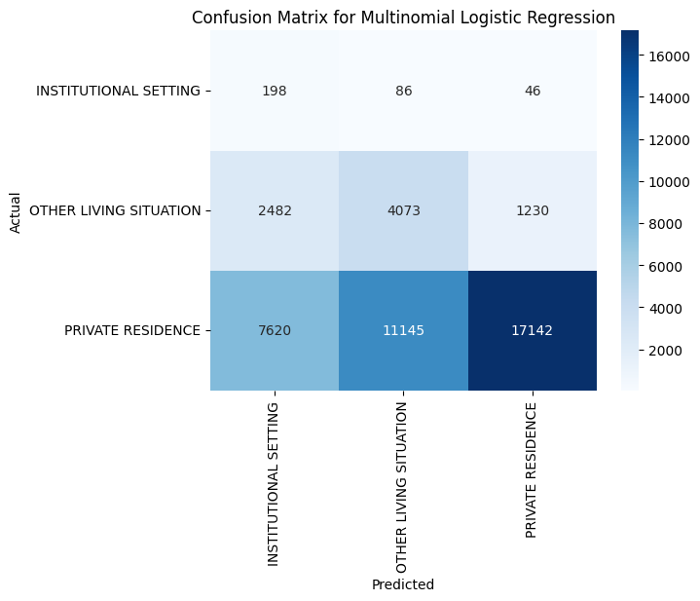
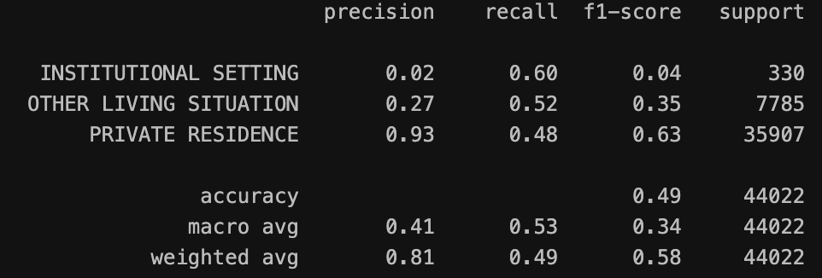
Logistic Regression
Weighted F1-score (0.58) Overall performance remains limited under imbalance.
Institutional Setting: Precision very low (0.02), showing poor identification of this minority class.
Other Living Situation: Recall moderate (0.52) but precision low (0.27).
Private Residence: Precision high (0.93) but recall only moderate (0.48).

Slide 10

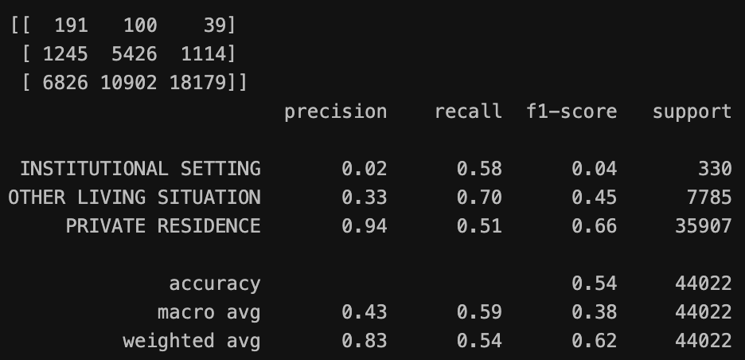
Random Forest
Weighted F1-score (0.62) Overall performance improves but is still limited by imbalance.
Institutional Setting: Precision extremely low (0.02) despite higher recall (0.58).
Other Living Situation: Recall strong (0.70) but precision moderate (0.33).
Private Residence: Precision very high (0.94) with moderate recall (0.51).

Slide 11
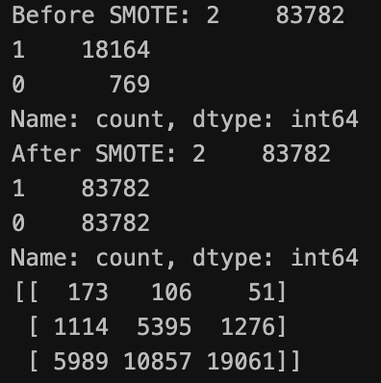
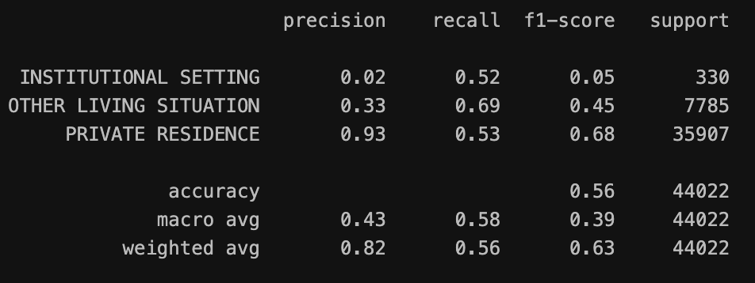
SMOTE + Random Forest
Weighted F1-score(0.63) The model shows improved and more balanced performance after applying SMOTE.
Institutional Setting: Recall improves to 0.52, though precision remains low (0.02).
Other Living Situation: Solid performance with recall at 0.69 and precision at 0.33.
Private Residence: Strong results with precision of 0.93 and improved recall of 0.53.

Slide 12
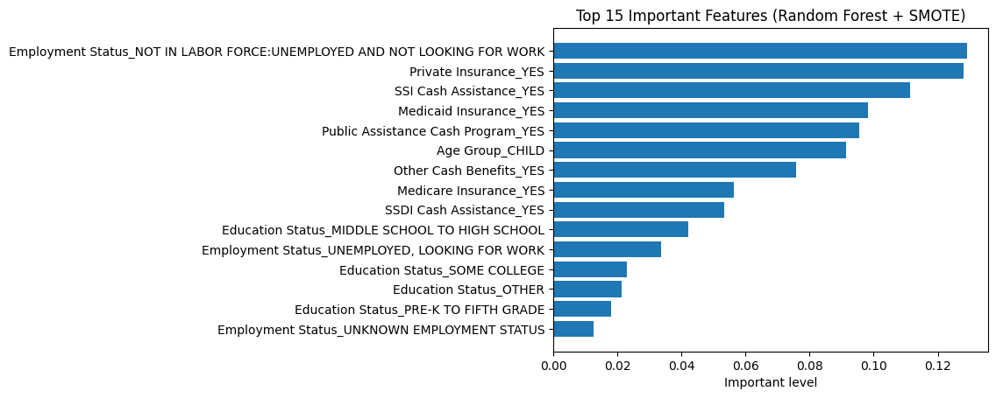
SMOTE + Random Forest - Feature Importance
Employment status is the strongest predictor.
Insurance coverage and cash assistance also rank highly.
Age (Child) and education contribute smaller but meaningful signals.

Slide 13
Conclusions – SMART Question 1
When class imbalance is accounted for, a decent amount of individuals who do not have a mental illness are identified
Being older decreases the chance of having a mental illness
Cohabitating with others and substance use minimally increases the risk of having a mental illness
All demographic variables have small impacts on mental illnesses
Region served, education status, and age group are the most influential predictors
of mental illness. Race, sexual orientation, and household consumption have some importance
# on predicting mental illness. Sex, alchohol related disorder, drug substance disorder, and
# veteran status did not contribute much to the model.
Notes:
The model accuracy is 76%
The demographic variables have modest predictive power

Slide 14
Limitations and Next Step
Severe class imbalance makes minority groups hard to model.
Only categorical variables with many small levels increase overfitting risk.
Remove imbalance data or try advanced imbalance methods like Balanced RF or XGBoost with weights.
Add continuous variables to strengthen the predictive signal.
Analyze minority groups separately to avoid majority-class dominance.

Slide 15
END

