Slide 1
G2M insight for Cab Investment firm
Virtual Internship
12-Oct-2022

Slide 2
Background – Case study
XYZ is a private firm in US. Due to remarkable growth in the Cab Industry in last few years and multiple key players in the market, it is planning for an investment in Cab industry
Aim: Provide insights to help them understand the market before taking final decision.
Analysis has been divided into the following:
Data understanding
Companies analysis
Profit analysis
Conclusion & Recommendations

Slide 3
Data understanding
Total number of features including derived features are 15
Time frame is from 2016 -2018
Size of dataset is 359,392
Cost_of_trip and price_charged were used to calculate profit
The City.csv dataset contains the total population and total cab users in each city (Pink and Yellow Cab users included).
Cab Data.csv
Customer_ID.csv
Transaction_ID.csv
df_eda.csv
date_eda.csv

Slide 4
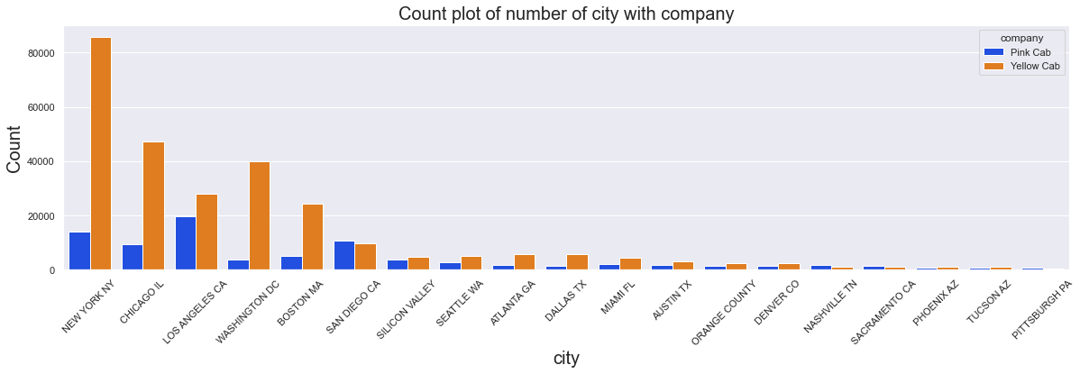
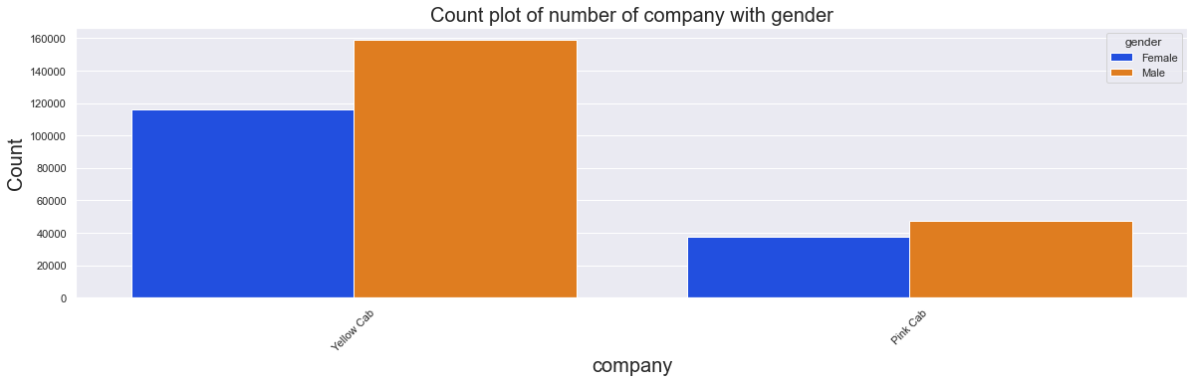
Company Analysis

Slide 5
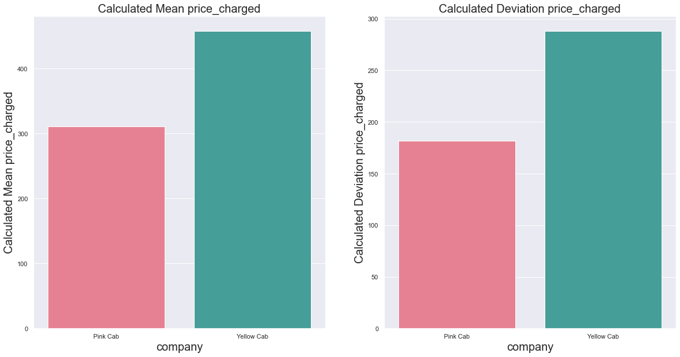
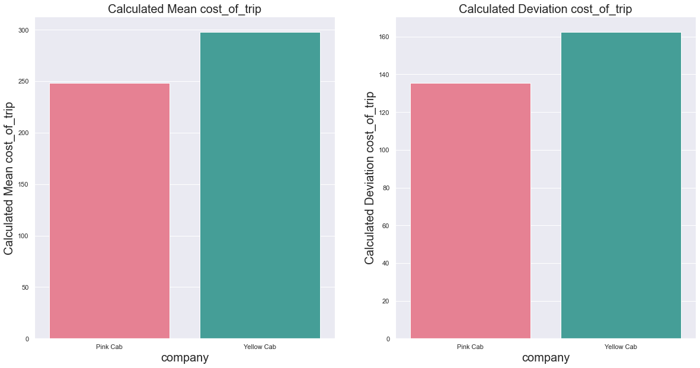
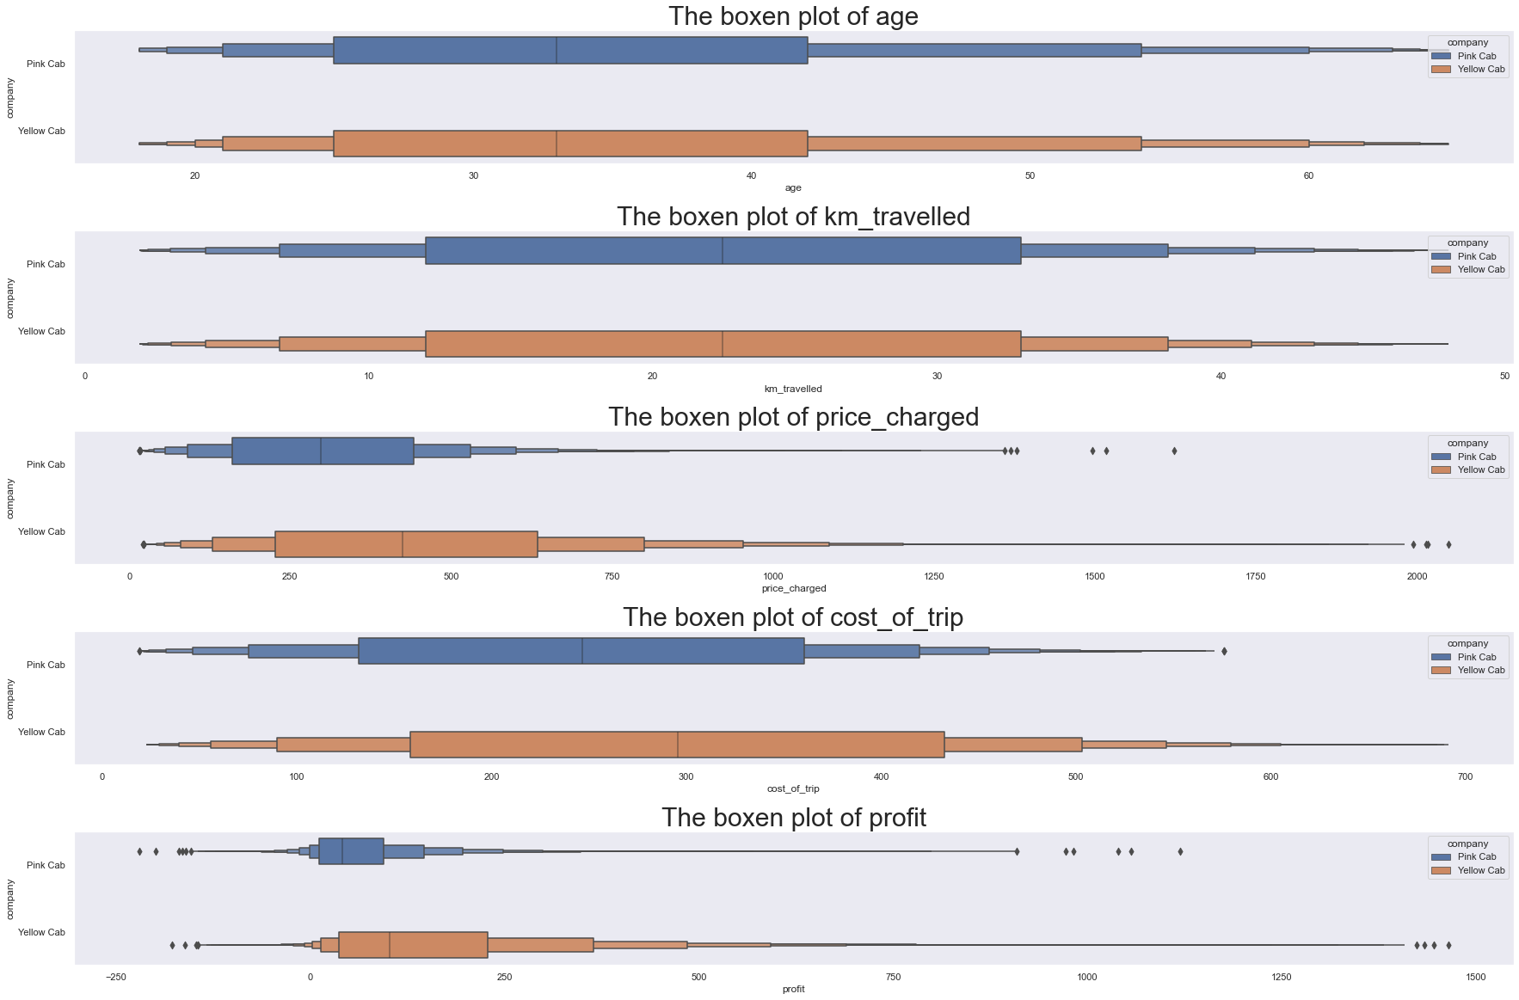
Company Analysis
The mean price charged and cost of trip is higher for Yellow Cab company.
The deviation of price charged is considerably for both companies which means variance is presence for each trip transaction.

Slide 6
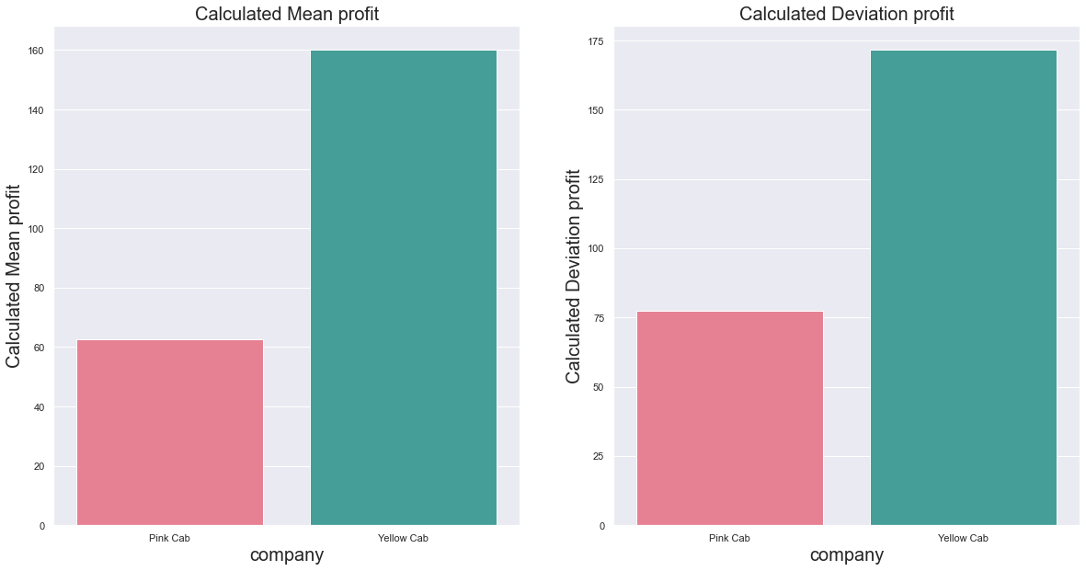
Profit Analysis
The mean profit is higher for Yellow Cab company.
The boxen plot shows high variance of profit for Yellow Cab company. Which means some trips profit are beyond $500.
Also both companies show some form of loss for some trips but the loss margin is greater in the Pink Cab company.

Slide 7
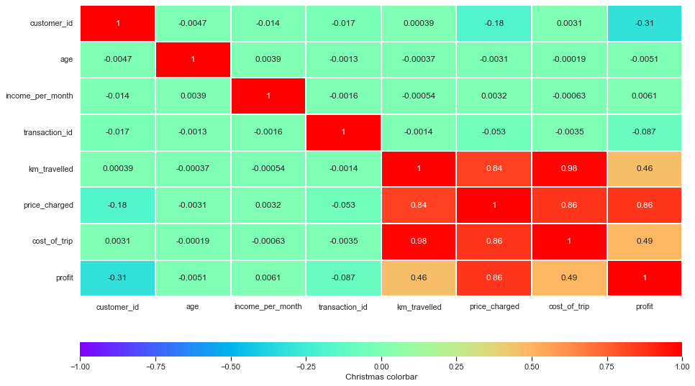
Profit Analysis
The following can be derived from the heat map:
There is a positive correlation between km_travelled and price_charged.
There is a high positive correlation between km_travelled and cost_of_trip.
The correlation between km_travelled and profit is quite small because as the kilometers driven increases, the cost of trip will increase.
There is a positive correlation between price_charged and cost_of_tri.
There is a high positive correlation between price_charged and profit.
The correlation between cost_of_trip and profit is quite small because the cost of a trip affects profits.

Slide 8
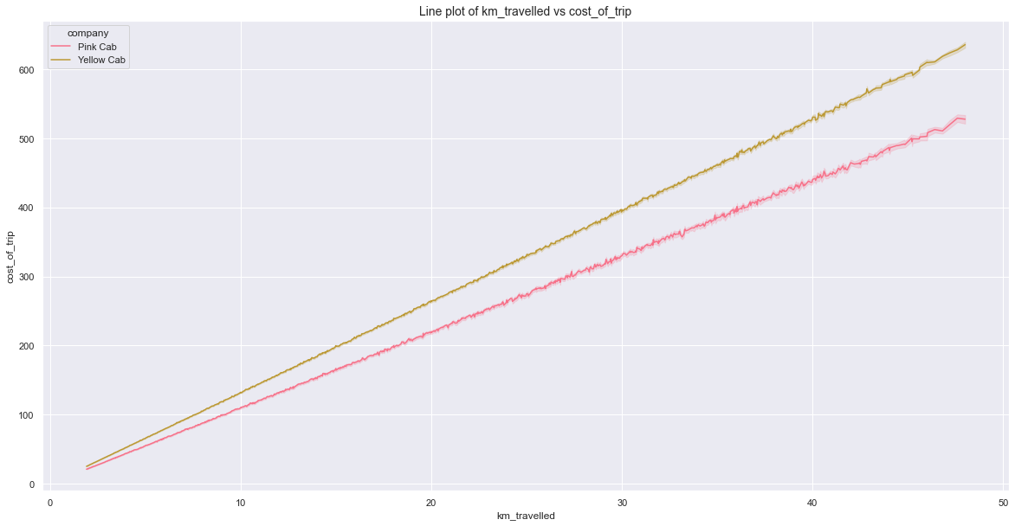
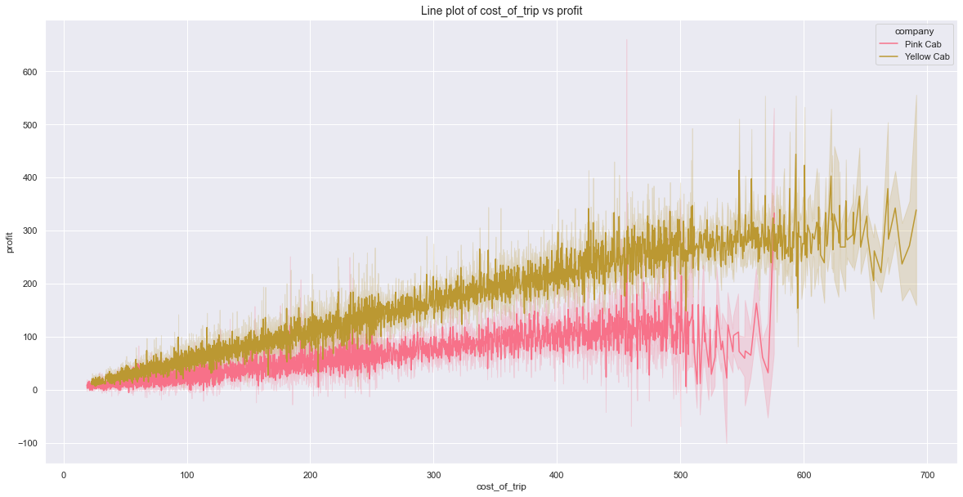
Profit Analysis

Slide 9
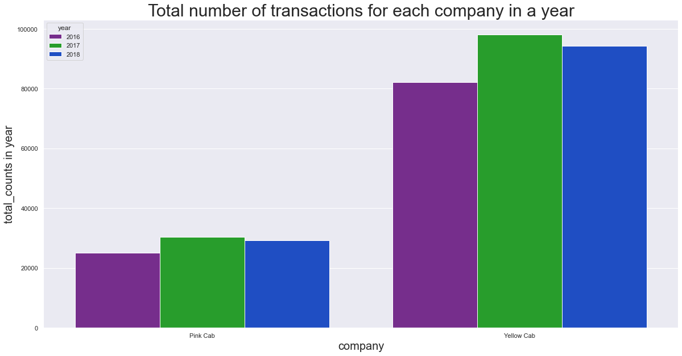
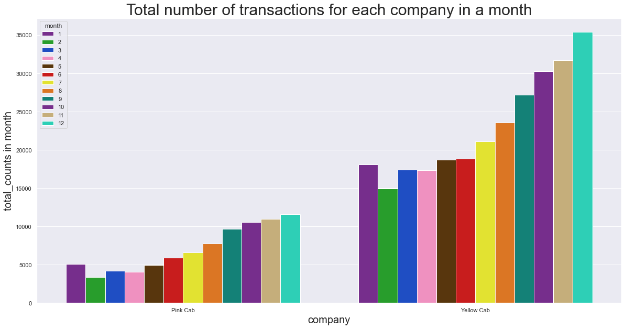
Profit Analysis
There are more transactions per year and month for the Yellow Cab company than that of Pink Cab company.
Both companies have 2017 as their highest year of transaction.
Both companies have December as their highest month of transaction.

Slide 10
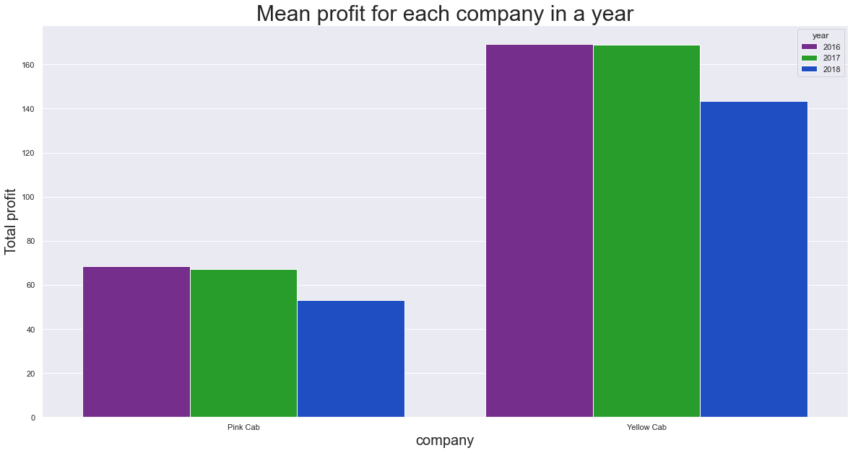
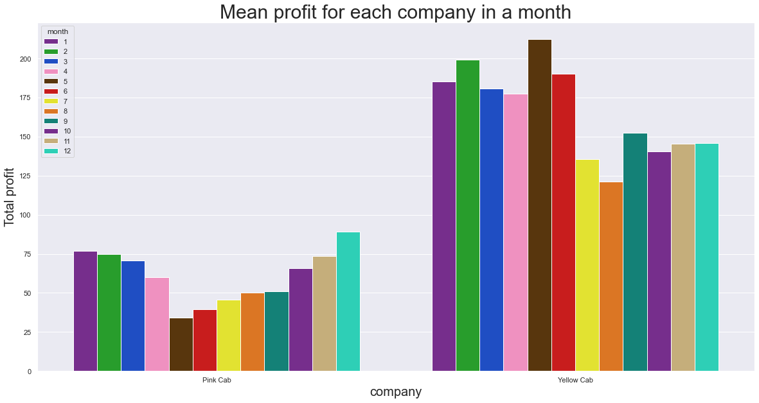
Profit Analysis
Mean profit for each year for Yellow Cab company is higher than that of Pink Cab company.
Mean Profit for Yellow Cab company is higher than that of Pink Cab company across all months.
Mean profit of Yellow Cab company has its peak monthly profit in May while Pink Cab company’s is December.

Slide 11
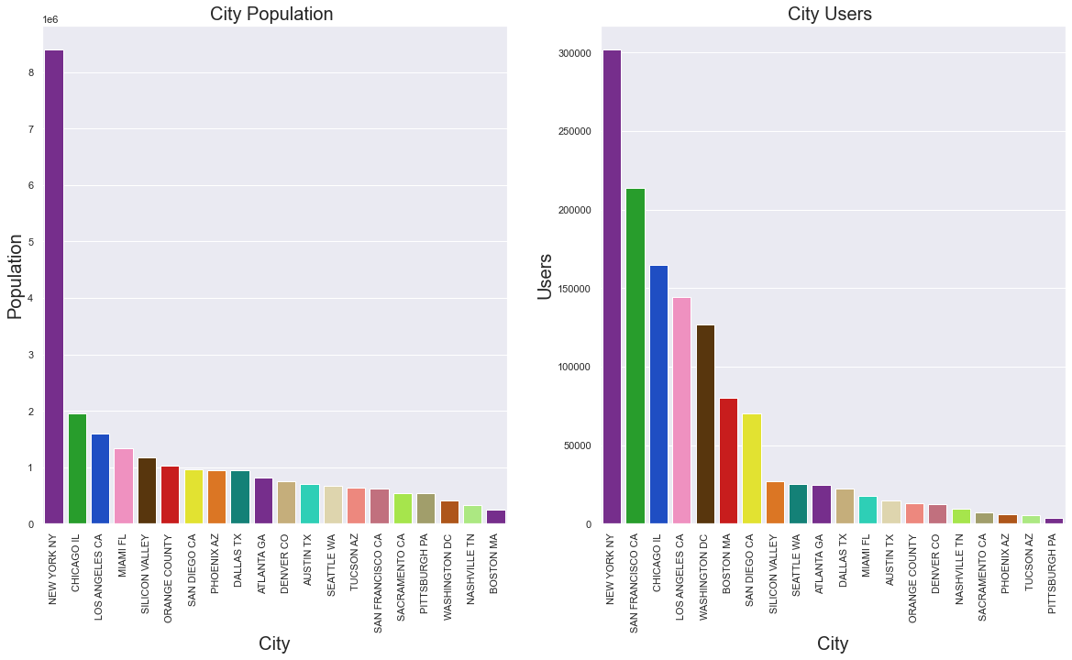
Conclusion & Reccomendations

Slide 12
Conclusion & Reccomendations

Slide 13
Conclusion & Recommendations
After analysis and observations made, Yellow Cab company has come out as the preferred choice for investment based on the following;
- Yellow Cab company has a greater reach in genders compared to that of Pink Cab company.
- Yellow Cab company has a greater profit margin compared to the Pink Cab company.
- Yellow Cab company has a lower loss margin compared to that of Pink Cab company.
- Yellow Cab company has profit increases considerably more than Pink Cab company as price charged increases.
- Yellow Cab has a higher transaction margin for each year and month more than that of Pink Cab company
- The mean profit for each year and month for Yellow Cab company is more than that of Pink Cab company
Recommendations
- Although Yellow Cab has three cities that are in the top six cities namely; New York NY, Chicago IL, Los Angeles CA and the remaining in cities with population below 1 million. It needs to increase its reach in the following remaining top six cities namely; Miami FL, Silicon Valley and Orange County.

Slide 14
THANK YOU

