Slide 1
Top-censoring in survey welfare data
Evidence from global screening and a Malawi 1997 deep dive
Literature review | LIS and outdetect screening | Pareto, GB2 and regression diagnostics
Daniela Avayu, Yuki Kimura, Nishant Yonzan
September 2026

Slide 2
Why examine the upper tail?
01
Different institutions answer different questions about extreme values.
LIS
CPS
Van Kerm (EU-SILC data)
WID
Robustness treatment
Confidentiality treatment
Sensitivity toolkit
Coverage problem
Log-IQR cap; retains records and weights. Values above it are candidates for review, not proven errors.
Top-coding, replacement and rank swapping protect respondents; public values may not be reported incomes.
Trimming deletes, winsorizing caps, and Pareto models the tail.
Combines survey, tax and administrative data to address underrepresentation of the richest households.
The literature separates two problems: limiting the influence of observed extreme values, and correcting for the possible underrepresentation of the richest households.
This project focuses on the first: do a few observed welfare values have enough influence to warrant a transparent sensitivity treatment?
Top-censoring analysis | Malawi 1997 deep dive

Slide 3
Literature lens and study design
02
The literature treats extreme values differently depending on the analytical objective.
GLOBAL SCREENING
MALAWI DEEP DIVE
KEY DISTINCTION
1,825 surveys
10,698 records
Not one rule
GMD provides welfare and weights for the LIS and outdetect comparison.
Country microdata add household characteristics for the Pareto, GB2 and regression diagnostics.
An extreme value is a candidate for review, not proof of a data error.
Our question: how sensitive are the headline indicators to extreme observed values, under transparent deletion and capping rules?
Top-censoring analysis | Malawi 1997 deep dive

Slide 4
Global screening: two complementary methods
03
Both methods identify unusually high welfare observations; survey-level rules are discussed separately.
METHOD 1
METHOD 2
LIS
OUTDETECT
Log-IQR ceiling identifies upper-tail candidates using a transparent robust rule.
Median plus a robust S-estimator identifies upper-tail candidates in log-welfare space.
LIS
exp[ Q0.75(ln y) + 3 x IQR(ln y) ]
outdetect
exp[ median(ln y) + 3S ]
Interpretation
Flagged observations are candidates for review, not confirmed errors. The methods answer the same screening question with different robust summaries of the upper tail.
Top-censoring analysis | Malawi 1997 deep dive

Slide 5
Top surveys by outlier concentration
04
Survey | LIS welfare share | LIS population share | Outdetect welfare share | Outdetect population share
MWI 1997 (IHS-I) | 41.6% | 0.4% | 46.9% | 1.5%
BLZ 1993 (LFS) | 20.1% | 0.2% | 21.5% | 0.3%
BLZ 1994 (LFS) | 20.0% | 0.3% | 20.0% | 0.3%
BLZ 1997 (LFS) | 18.2% | 0.1% | 19.4% | 0.2%
SYC 2013 (HBS) | 12.1% | 0.2% | 17.6% | 0.9%
MDV 2002 (HIES) | 11.8% | 0.3% | 12.7% | 0.5%
MWI 2016 (IHS-IV) | 11.0% | 0.1% | 15.8% | 0.8%
ETH 1995 (HICES) | 10.9% | 0.4% | 15.7% | 1.0%
MDG 1993 (EPM) | 8.8% | 0.3% | 11.6% | 0.5%
PRY 2002 (EPH) | 8.4% | 0.1% | 14.0% | 0.3%
Top-censoring analysis | Malawi 1997 deep dive

Slide 6
Arbitrary cutoffs: experimental approach
05
These are empirical reference points for prioritizing surveys for review, not an official statistical cutoff.
REFERENCE RULE 1
>5% of the welfare above threshold
REFERENCE RULE 2
>1% of the weighted population above threshold
RESULT
LIS: 24 surveys | outdetect: 399 surveys meet the welfare-share rule.
RESULT
LIS: 0 surveys | outdetect: 151 surveys meet the population-share rule.
OVERLAP Four survey-years satisfy both rules at once: Comoros 2004, Malawi 1997, Rwanda 2005, Rwanda 2013 (table below).
Country | Year | Survey | LIS welfare share | Outdetect population share
Comoros | 2004 | EIM | 7.6% | 1.4%
Malawi | 1997 | IHS-I | 41.6% | 1.5%
Rwanda | 2005 | EICV-II | 6.1% | 1.2%
Rwanda | 2013 | EICV-IV | 5.4% | 1.5%
Top-censoring analysis | Malawi 1997 deep dive

Slide 7
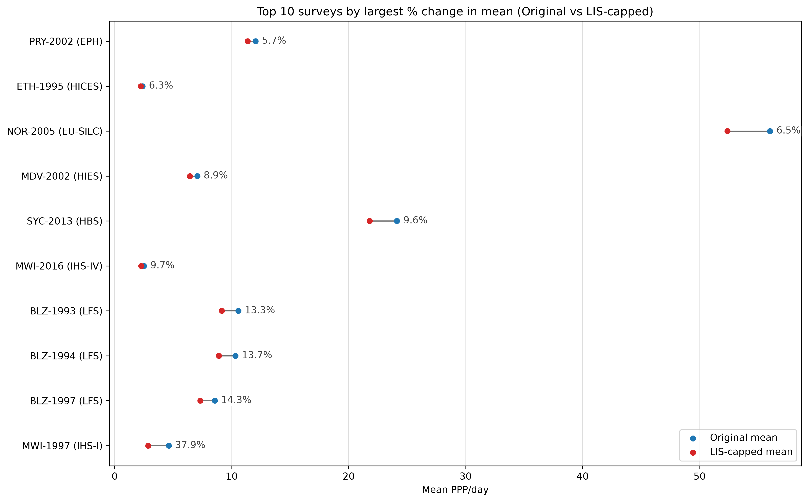
Malawi 1997: sensitivity to top coding
06
The chart shows the effect of applying the LIS top-coding rule across surveys.
Malawi 1997
Mean
5.78 → 3.59
-37.9%
Gini
0.658 → 0.448
-31.8%
MLD
0.811 → 0.337
-58.5%
Atkinson(2)
0.647 → 0.431
-33.4%
Poverty
essentially unchanged
upper tail
Interpretation: LIS top-coding materially reduces means and inequality, while poverty is protected because the capped records are far from the bottom of the distribution.
Top-censoring analysis | Malawi 1997 deep dive

Slide 8
Treatment comparison
07
The comparison now separates deletion from capping, using the two screening caps as the thresholds.
All figures in this Malawi deep dive come from country/MWI_1997.dta; the GMD file is used separately for the global screening comparison.
Approach | Mean | Gini | MLD | Atkinson(2)
Unadjusted | 5.78 | 0.66 | 0.81 | 0.65
Remove 2 highest | 3.80 (-34.3%) | 0.48 (-27.1%) | 0.39 (-51.7%) | 0.46 (-28.5%)
Remove above LIS cap | 3.39 (-41.3%) | 0.42 (-36.1%) | 0.29 (-63.9%) | 0.40 (-38.1%)
Remove above outdetect cap | 3.12 (-46.1%) | 0.38 (-42.5%) | 0.24 (-71.0%) | 0.35 (-45.2%)
Cap at LIS cap | 3.59 (-37.9%) | 0.45 (-31.8%) | 0.34 (-58.5%) | 0.43 (-33.4%)
Cap at outdetect cap | 3.37 (-41.6%) | 0.41 (-37.1%) | 0.28 (-65.2%) | 0.39 (-38.9%)
Values are levels; percentages in parentheses show the change relative to the unadjusted scenario.
Remove = drop observations above the stated rule; Cap = retain all observations but replace values above the stated cap with the cap.
LIS cap = 48.57 PPP/day; outdetect cap = 20.22 PPP/day.
Top-censoring analysis | Malawi 1997 deep dive
Notes:
LIS ceiling: 59 observations capped, above 48.57 PPP/day.
Outdetect threshold: 206 observations capped, above 20.22 PPP/day.

Slide 9
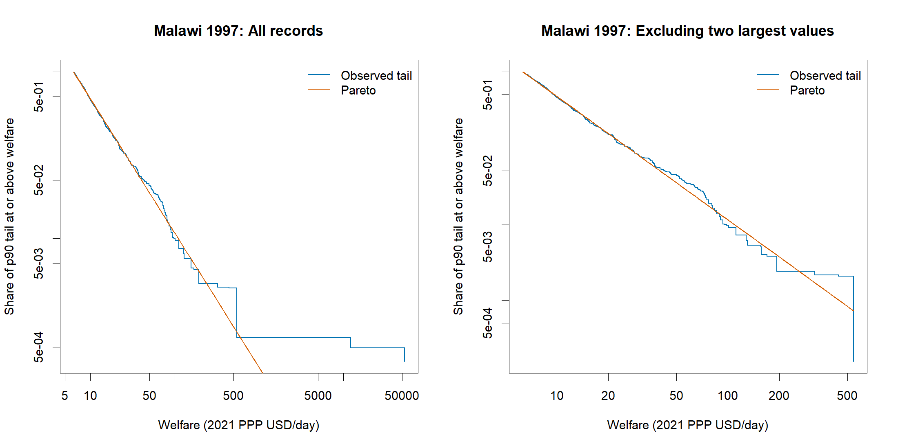
Pareto diagnostic: is the upper tail regular?
08
The fitted tail describes much of the upper distribution, but the largest observations sit well above it.
What Pareto contributes
• Models the upper tail only, rather than imposing a Pareto law on the full distribution.
• Provides a visual and quantitative benchmark for unusually large values.
• The two largest records are much more extreme than the fitted tail predicts.
Conclusion: strong evidence of tail influence.
Top-censoring analysis | Malawi 1997 deep dive

Slide 10
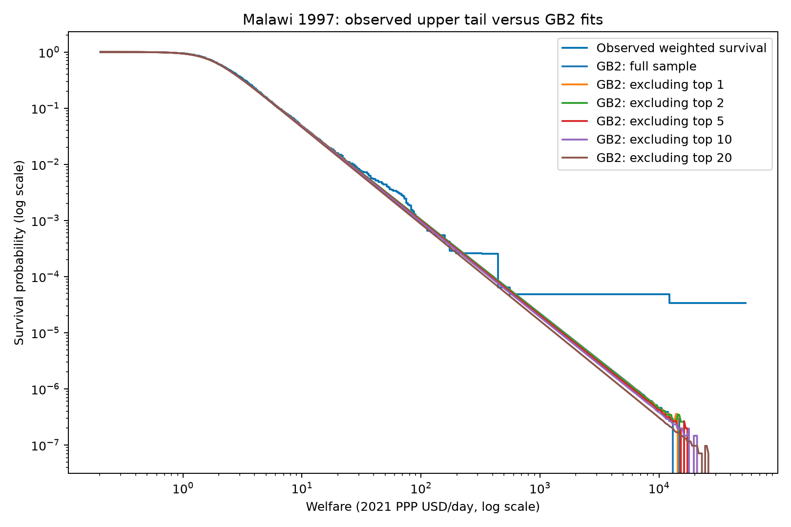
GB2 diagnostic: a flexible full-distribution benchmark
09
The fitted distribution changes when extreme observations are removed.
Weighted maximum likelihood
• GB2 fitted to all positive Malawi 1997 welfare values.
• Additional fits exclude the largest 1, 2, 5, 10 and 20 records.
• The second-largest observation has an empirical survival probability about 166 times larger than the full-sample GB2 prediction.
Diagnostic interpretation: the observations are unusually extreme relative to a smooth GB2 tail but may still reflect genuine heterogeneity or measurement issues.
Top-censoring analysis | Malawi 1997 deep dive

Slide 11
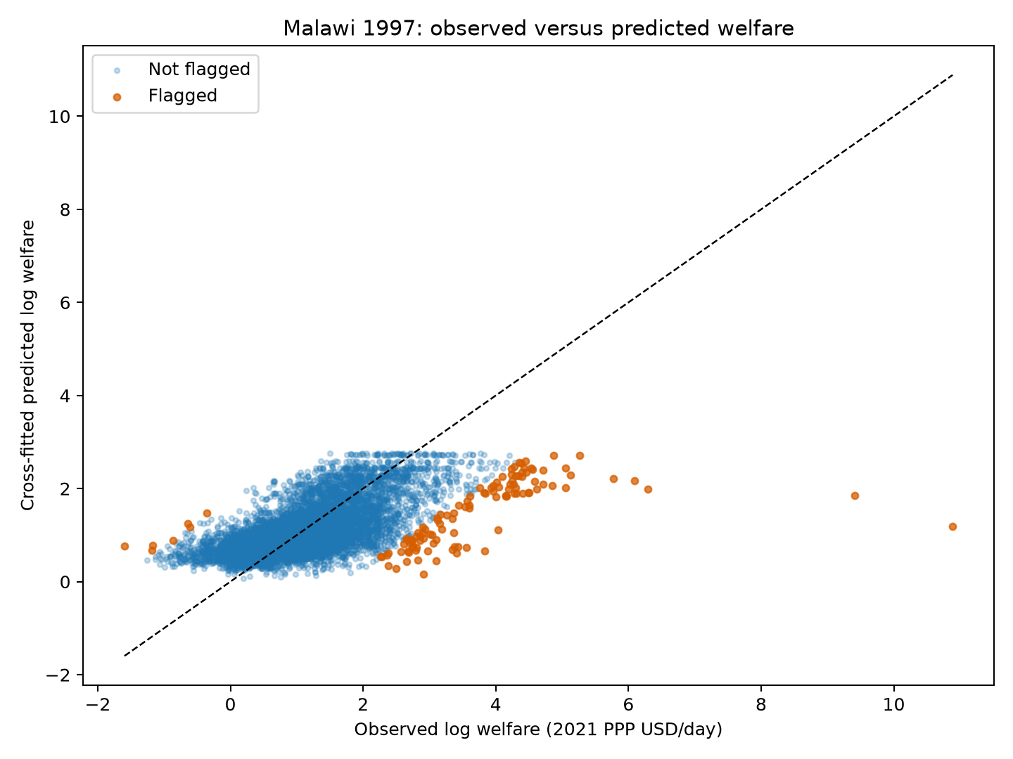
Regression diagnostic: can characteristics explain the extremes?
10
Cross-fitted predictions compare reported welfare with welfare expected from available household characteristics.
Model used
log(welfare) = urban + log(1 + household size) + subnational area
• Five-fold cross-fitting avoids comparing households with predictions from models trained on the same record.
• Weighted cross-fitted R2: 0.389.
• 111 households flagged, representing about 1.0% of sample weight.
A regression flag identifies an unusual conditional observation; it does not establish that the welfare report is erroneous.
Top-censoring analysis | Malawi 1997 deep dive

Slide 12
Top five observed welfare values
11
The largest reported values are compared with cross-fitted fitted welfare from the regression model.
Rank | Observed welfare (PPP/day) | Fitted welfare (PPP/day) | Share of weights | Urban | HH size | Subnational area
1 | 53,436 | 3.30 | 0.003% | Rural | 2 | 225 – Mchinji
2 | 12,186 | 6.38 | 0.002% | Rural | 1 | 134 – Karonga
3 | 544 | 7.30 | 0.002% | Urban | 2 | 131 – Mzuzu City
4 | 443 | 8.72 | 0.019% | Urban | 7 | 224 – Lilongwe City
5 | 322 | 9.19 | 0.001% | Urban | 1 | 131 – Mzuzu City
The largest fitted welfare in the full sample is 15.72 PPP/day.
Values are shown in levels, not logs. Fitted values use the with-intercept specification.
Top-censoring analysis | Malawi 1997 deep dive

Slide 13
Conclusion and discussion
12
The methods converge on influence and review, not automatic deletion.
MAIN FINDING
ROBUSTNESS
RECOMMENDATION
Tail influence is real
Methods agree
Treat, do not delete
A very small group can dominate means and inequality measures.
LIS, outdetect, Pareto, GB2 and regression identify Malawi 1997 as a priority case.
Report the baseline and transparent top-tail sensitivity results together.
OPEN QUESTIONS FOR DISCUSSION
• Are there other methods or strategies to identify outliers that we should evaluate?
• What should be done with flagged outliers: top-code, impute, or something else?
• Is it feasible to build outlier detection into the data-loading pipeline?
Top-censoring analysis | Malawi 1997 deep dive

