Slide 1

BlockChain Final project Elections 2019
Avraham Zilberblat 308088079
050-2421992

Slide 2
Introduction
The elections in Israel are coming and most of the time, people don’t know whom to vote for
Sometimes people don’t even bother to vote / put a blank note
Therefore I came up with the idea to build a voting system based on blockchain and ethereum

Slide 3

Technologies
Sublime
Ganache
Truffle
JavaScript
Html
Css
MetaMask
Shell

Slide 4
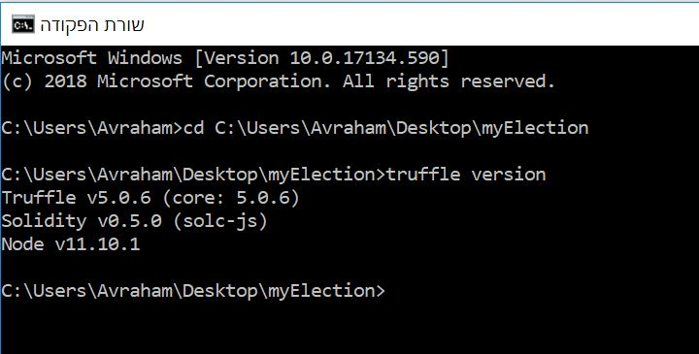
Versions
In order to get all the versions used use the command “truffle version”

Slide 5
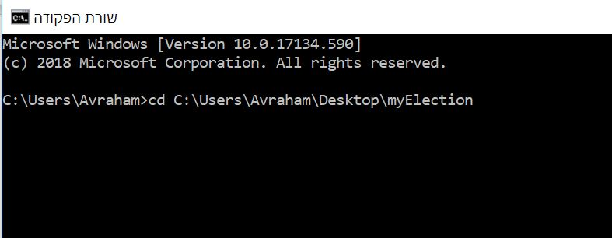
System Flow
First you need to open Shell/cmd and go to the system directory

Slide 6
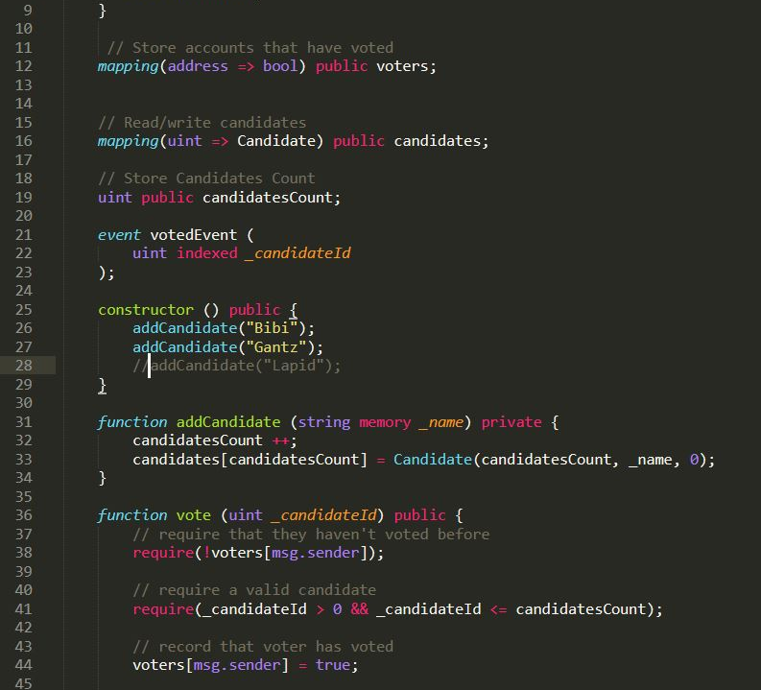
Smart Contract-Election
This is our main smart contract-Election
In order to add new candidate just use the addCandidate function inside the constructor in line 25

Slide 7
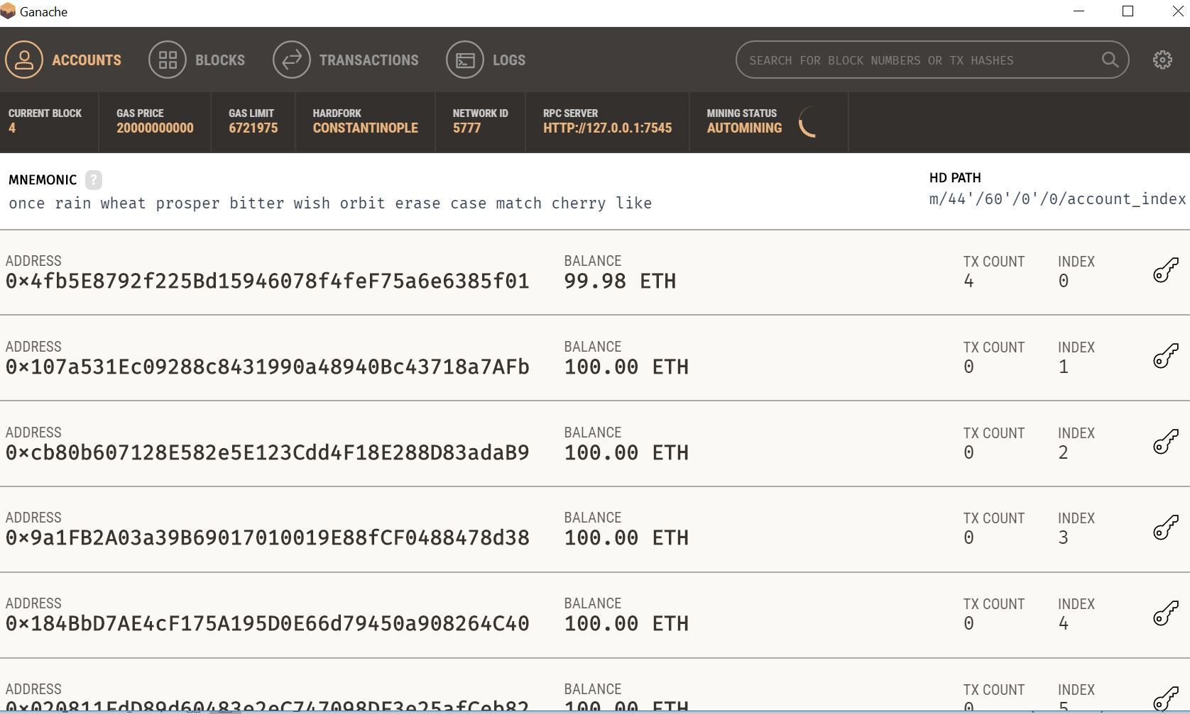
Start Ganache

Slide 8
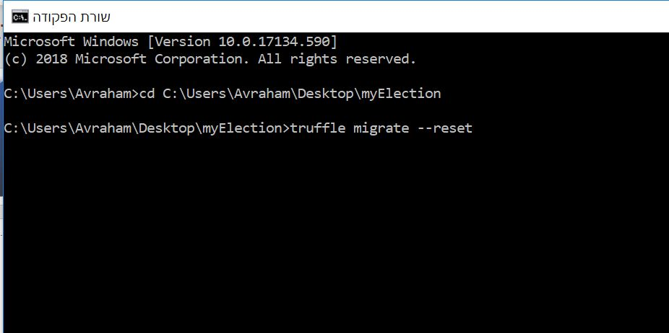
After smart contract updated/First time build
The --reset is used if we changed the contracts during the editing for the first time its ok to use only truffle migrate

Slide 9
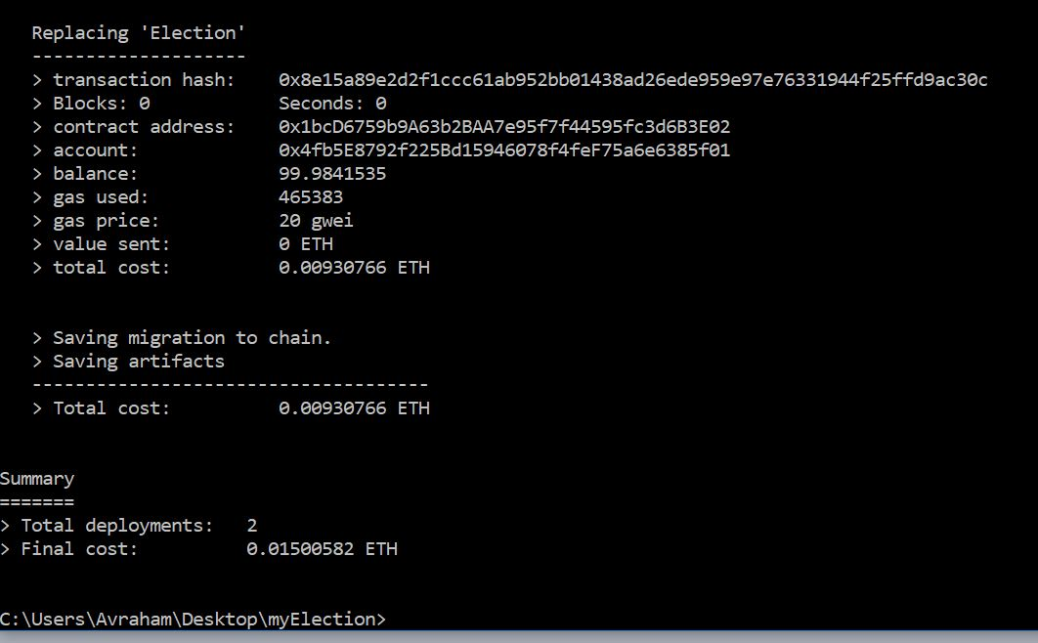
If everything is ok you should get this message

Slide 10
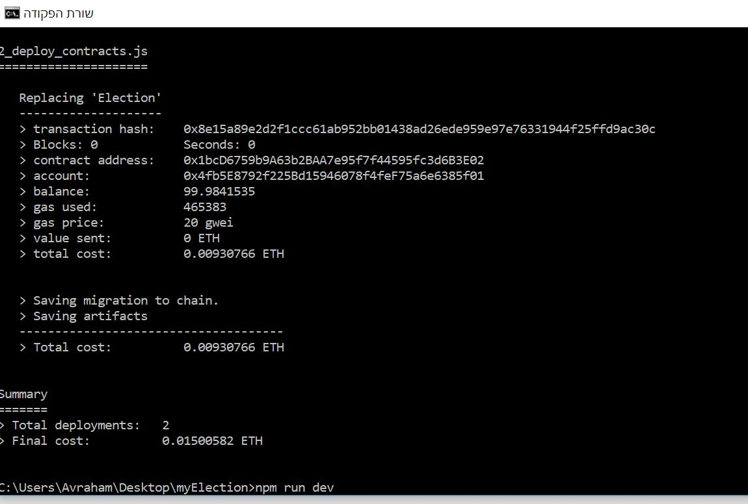
Run the client with the command “npm run dev”

Slide 11

If everything works properly the client and server will run asynch together and you should be redirected to the address of the localhost in the chrome

Slide 12
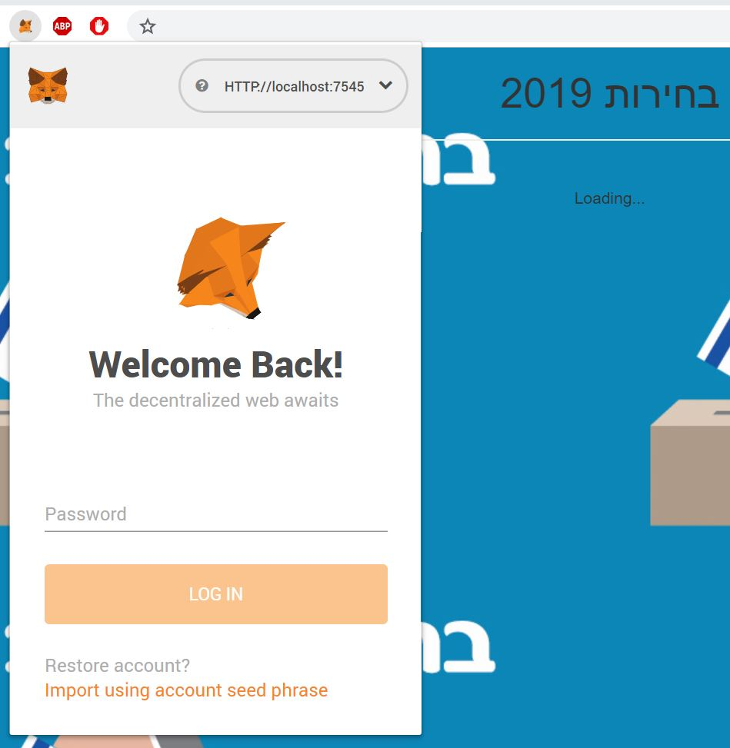
In order to vote you should connect to your account in the metamask

Slide 13
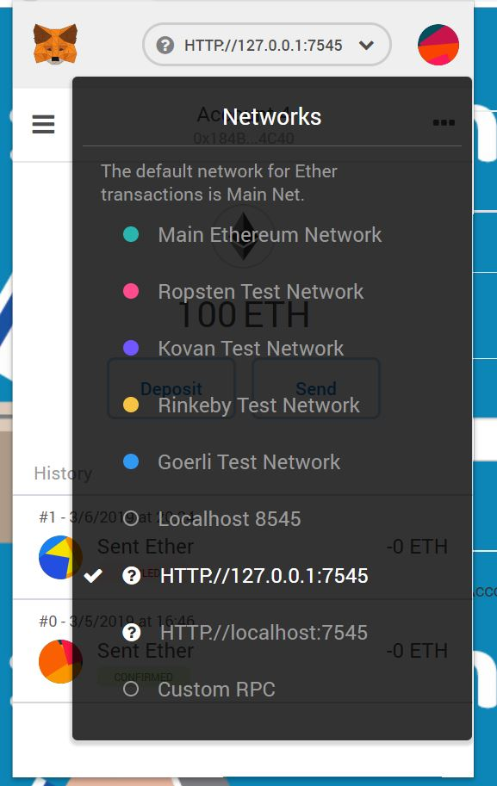
Now we need to connect to our Ganache local server. In order to do it open the metamask and in the network option choose the option “Custom RPC”

Slide 14
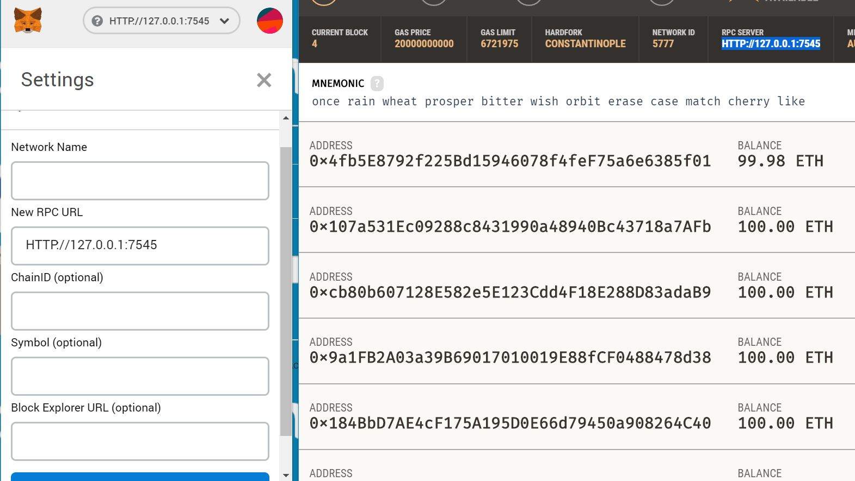
In the Ganache copy RPC server address and insert it in the metamask “New RPC URL”

Slide 15
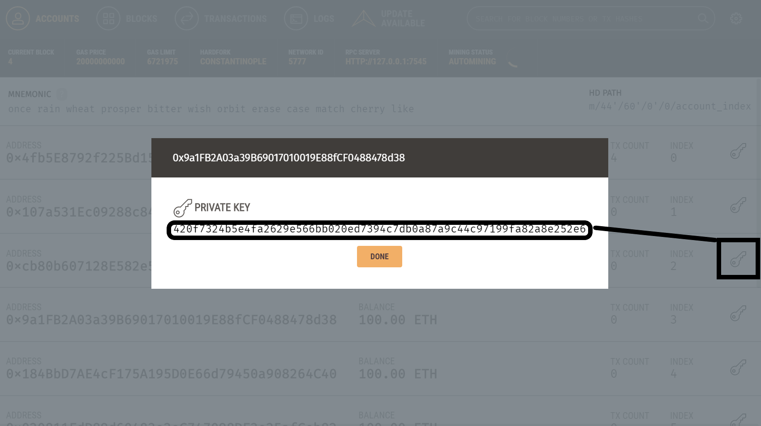
Choose an account and press the key icon and then copy the account private key
Now we can use our Ganache accounts in order to to vote!

Slide 16
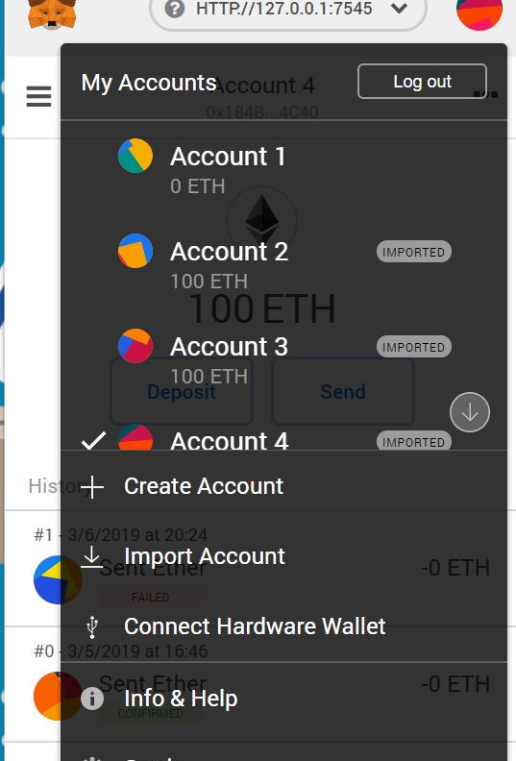
Now in metamask click on your account and choose the “import Account” option in order to import our ganache with ether, just copy the private key

Slide 17

And now the page will update itself and you will be able to vote!

Slide 18

Future Add Ons
Real time timer when voting starts and ends
Statistics
Bio about every candidate and party platform updated

