Slide 1
Object Storage
danicacorpuz.github.io/objectstorage

Slide 2
Object Storage provides an unstructured cloud data storage service to manage your files.

Slide 3
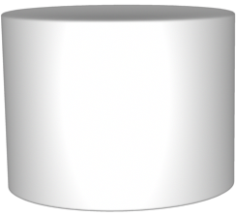
Object Storage vs Block Storage
Object IDs
Object
Object
Object
Object
Object
Object
Flat Address Space
Hierarchical File System

Slide 4
Object IDs
Add Container
Delete Container
Add File
Download File
Delete File
Object
Object
Object
Object
Object
Object
Flat Address Space

Slide 5
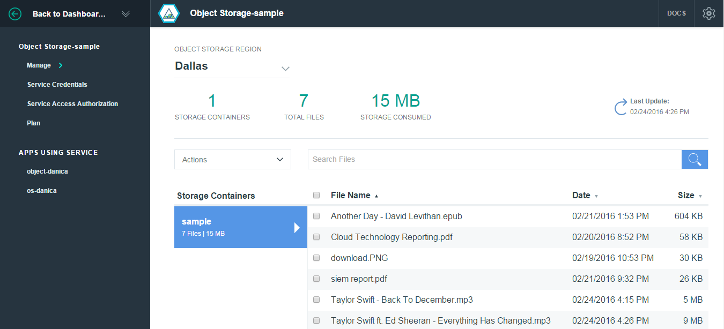

Slide 6
Advantages
Scalability
Platform Independence
Manageability

