Slide 1
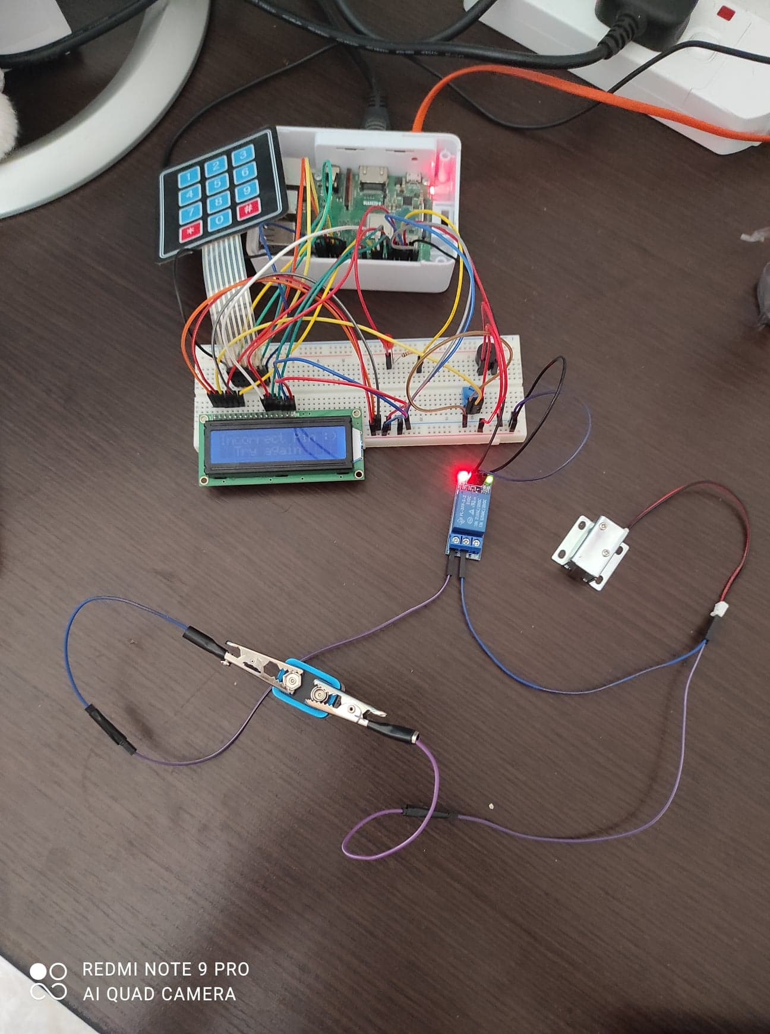
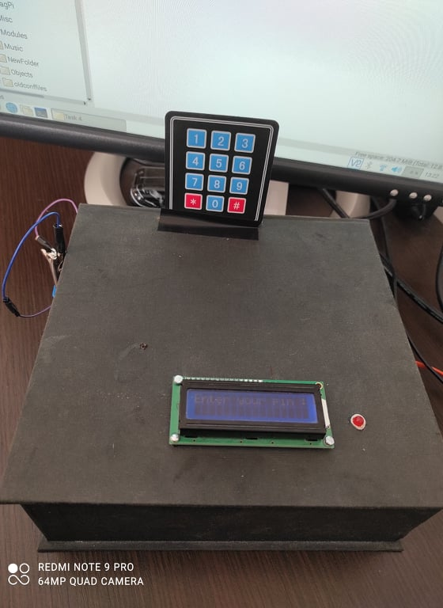
Secure Box
Danica Fiteni 4.1G

Slide 2
An explanation of the code that you have developed for the project
I had to install the ‘adafruit_CircuitPython_MatrixKeypad-master’ to make the keypad work
And also I had to install ‘Adafruit_Python_CharLCD’ to make the lcd screen work

Slide 3
Any changes made to the original proposal and why they have been applied.
I did not make any changes to the original proposal.
Mention possible future improvements (at least 2).
1) Box Design
2) Wiring

Slide 4
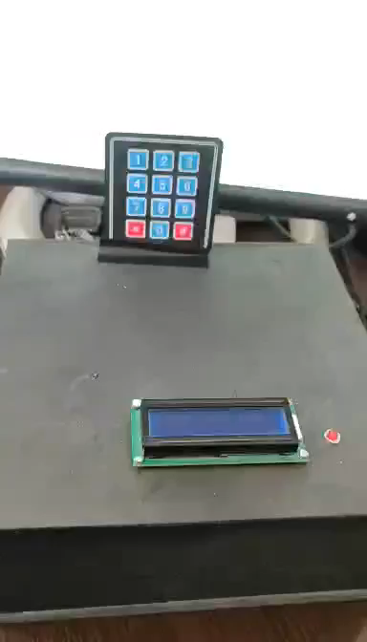
Video Youtube link: https://www.youtube.com/watch?v=l35w7fI5Ohc

