Slide 1
iot.schema.org
Integration of iot.schema.org in Node-RED
Darko Anicic
Aparna Thuluva
September 20, 2018
Unrestricted

Slide 2
iot.schema.org in Node-RED
Is there an easy way for a Web application developer to use iot.schema.org?
Our goal is to provide a tool that:
Does not require a developer to know RDF(S), JSON-LD, RDF Shapes etc.
Enables an easy configuration of things when using iot.schema.org
Avoids translations of serializations formats, data types, units etc.

Slide 3



Creating Device Models: Air Conditioner Use case
Iot:AirConditioner
iot:minValue schema:Float
iot:maxValue schema:Float
iot:propertyType schema:Float
iot:Unit { iot:Celcius, iot:Kelvin iot:Fahrenheit }
iot:TurnOn
iot:OperatingStatus
iot:FanMode
Iot:AutoMode
iot:ComfortMode
iot:TurnOff
iot:Temperature
iot:RunMode
iot:AirConditioner
iot:minValue 10.00
iot:maxValue 50.00
iot:propertyType schema:Float
iot:Unit iot:Celcius
Generated TD
iot:TurnOn
iot:Temperature
Manufacturer 1/
Web developer
iot:TurnOff
Iot:OperatingStatus
iot:AirConditioner
iot:minValue 15.00
iot:maxValue 75.00
iot:propertyType schema:Float
iot:Unit iot: Fahrenheit
Generated TD
iot:TurnOn
iot:Temperature
Manufacturer 2/
Web developer
iot:TurnOff
Iot:OperatingStatus
Iot:RunMode
iot:AutoMode, iot:ComfortMode

Slide 4
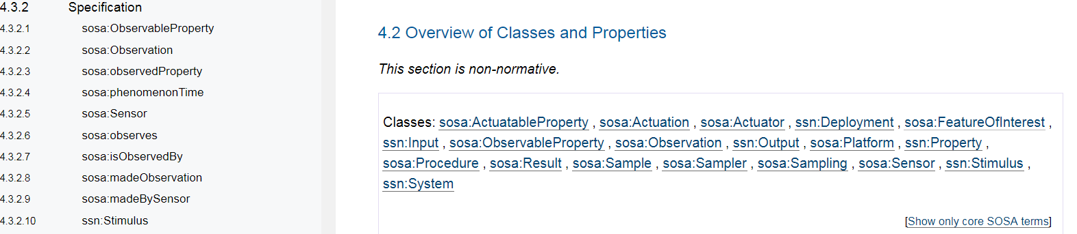
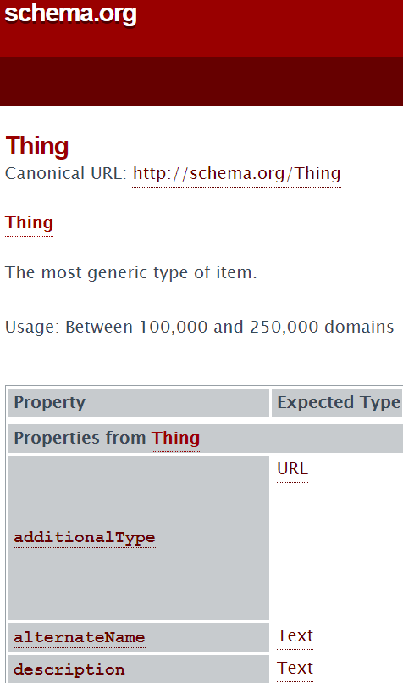
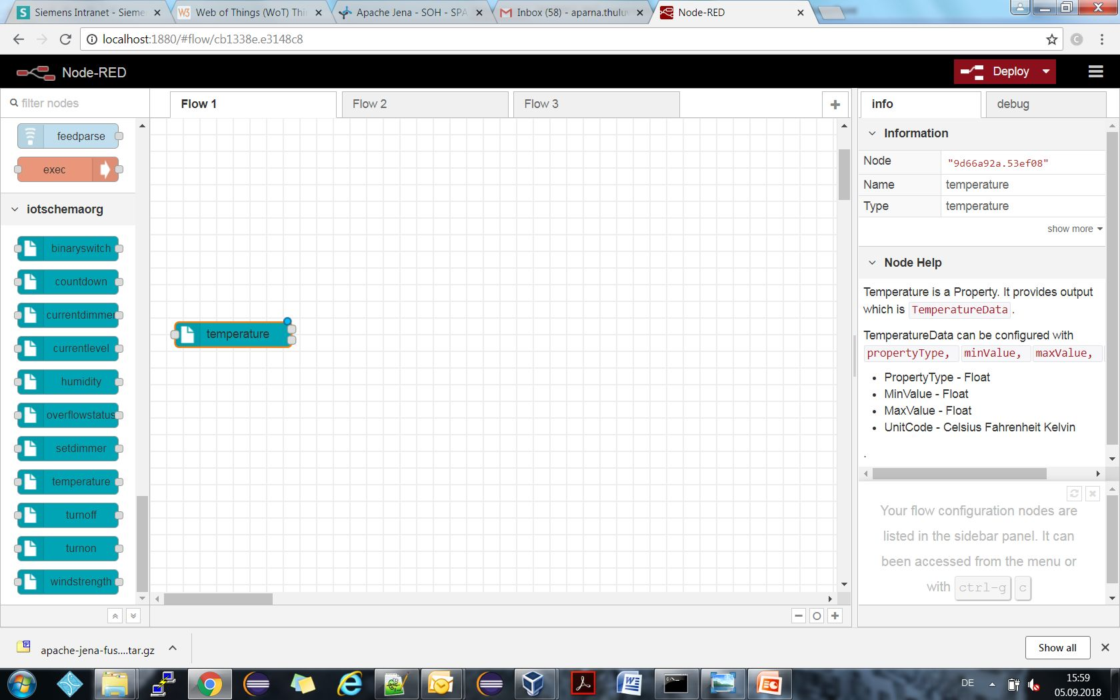
Usability of Ontologies & Schemas Web Developer Perspective
W3C SSN/SOSA Ontology:
schema.org:
extended with iot.schema.org Semantics
Node-RED

Slide 5
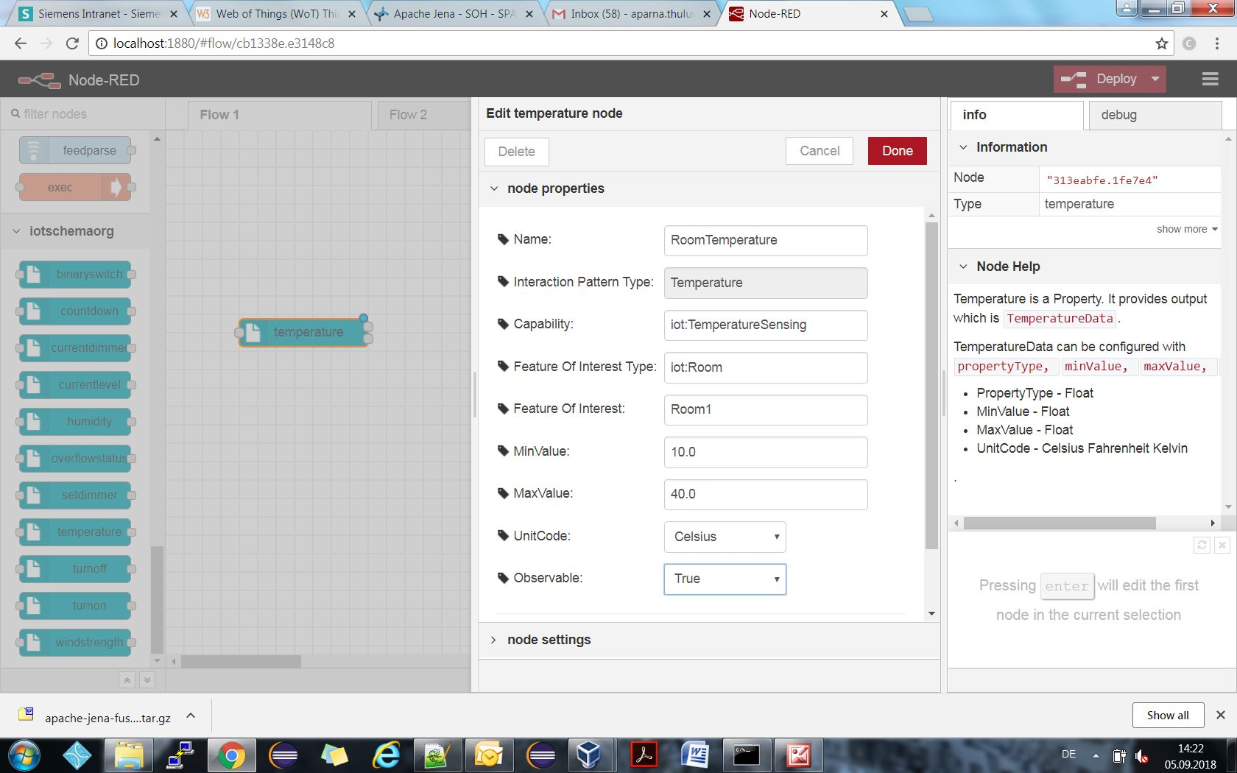
Node-RED extended with iot.schema.org Semantics Type 1 Nodes
SHACL Shape:
iotsh:TemperatureDataShape a sh:NodeShape ;
sh:and (
[ sh:property [
sh:path schema:propertyType ;
sh:datatype xsd:float ;
sh:minInclusive 10.0 ;
sh:maxInclusive 40.0 ; ]; ]
[ sh:property [
sh:path schema:unitCode ;
sh:hasValue iot:Celsius ; ]; ] ).
iotsh:TemperatureShape a sh:NodeShape;
sh:targetClass iot:Temperature ;
[sh:property [
sh:path iot:observable;
sh:hasValue true ; ]; ] .

Slide 6
Node-RED extended with iot.schema.org Semantics Type 1 Nodes
Use Cases:
Validate data
Shared documentation between manufacturers
Semantic integration of existing devices
Create semantically-enriched TDs easily
Create Recipes (semantically- interoperable applications)

Slide 7
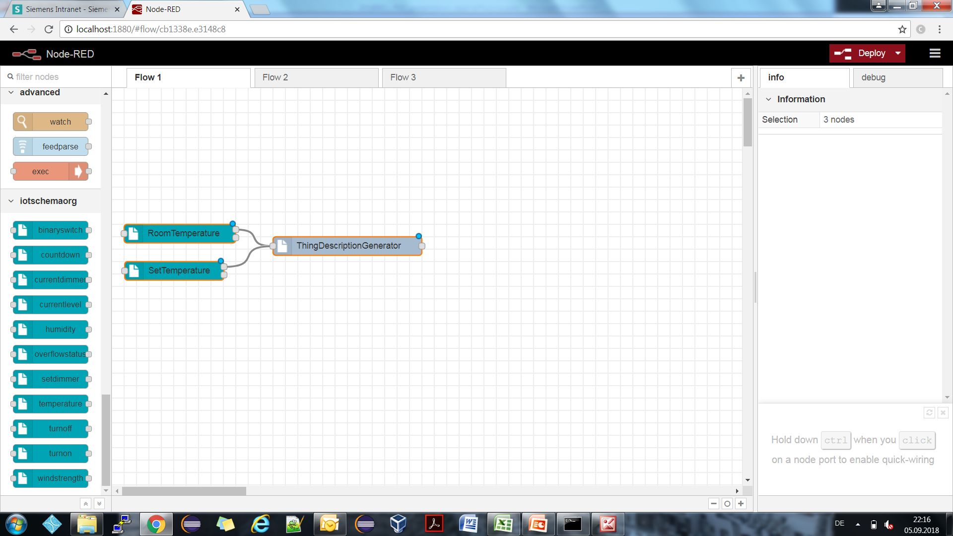

Enriching the device models with iot.schema.org Semantics
Type 1 Nodes
"@type": [ "Thing", “iot:Thermostat" ],
"id": "urn:dev:wot:panasonic:airconditioner",
"security": [{"scheme": "basic"}],
"iot:isAssociatedWith" : { "@id": "Room1", "@type": "iot:Room" },
"properties": {
"temperature": {
"@type": "iot:Temperature",
"iot:capability": {"@id":"iot:Thermostat"},
"io:isPropertyOf": { "@id": "Room1", "@type": "iot:Room" },
"type": "object",
"properties": {
"temperatureValue": { "type": "number", "minimum": 10.0, "maximum": 40.0 , “iot:unitCode”: “iot:Celcius” } },
"writable": false, "observable": true..

Slide 8
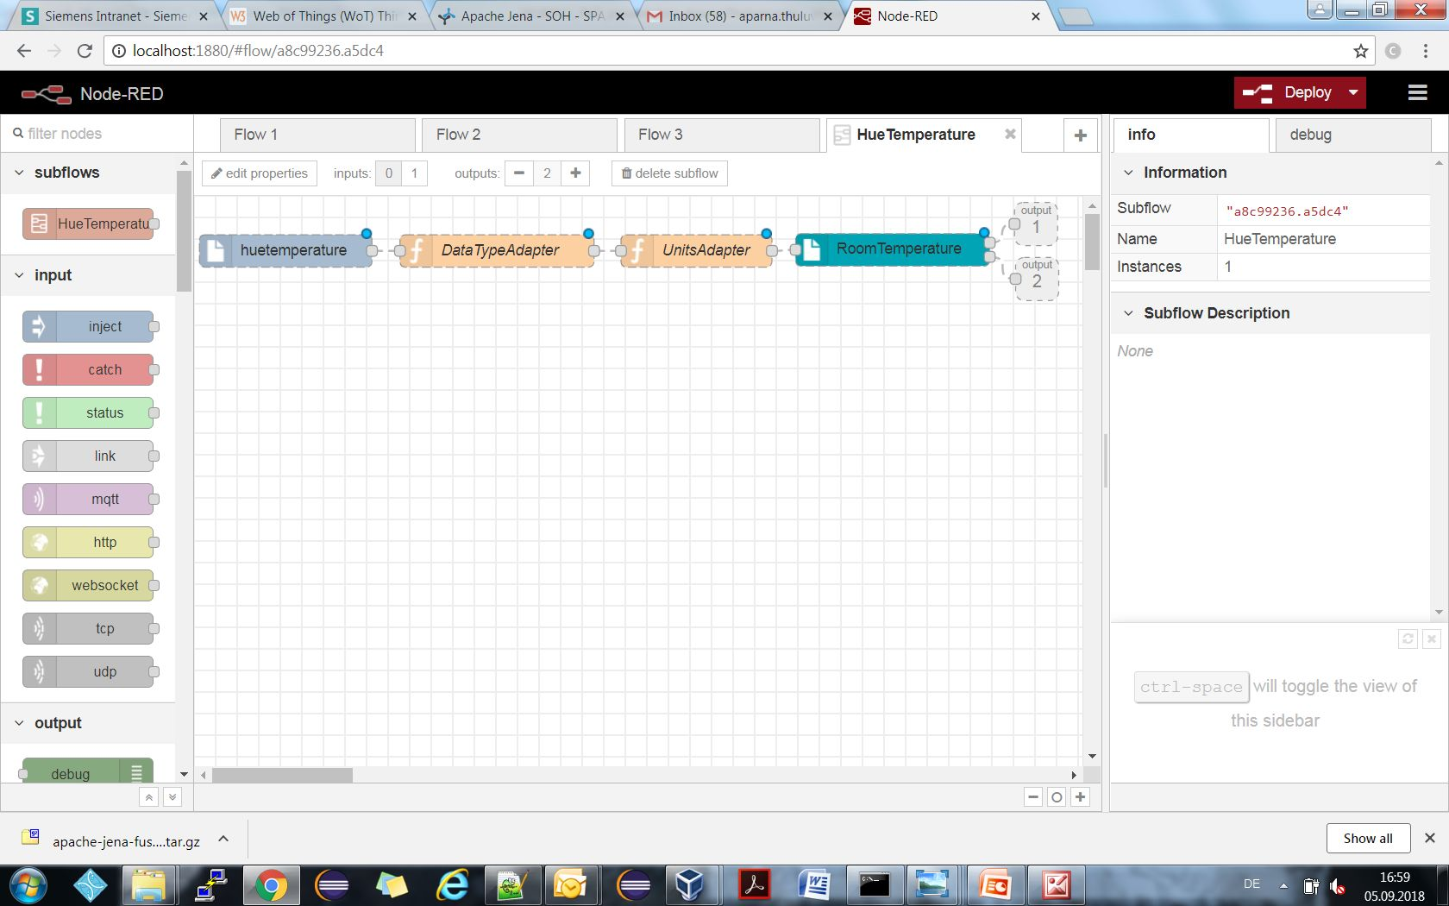
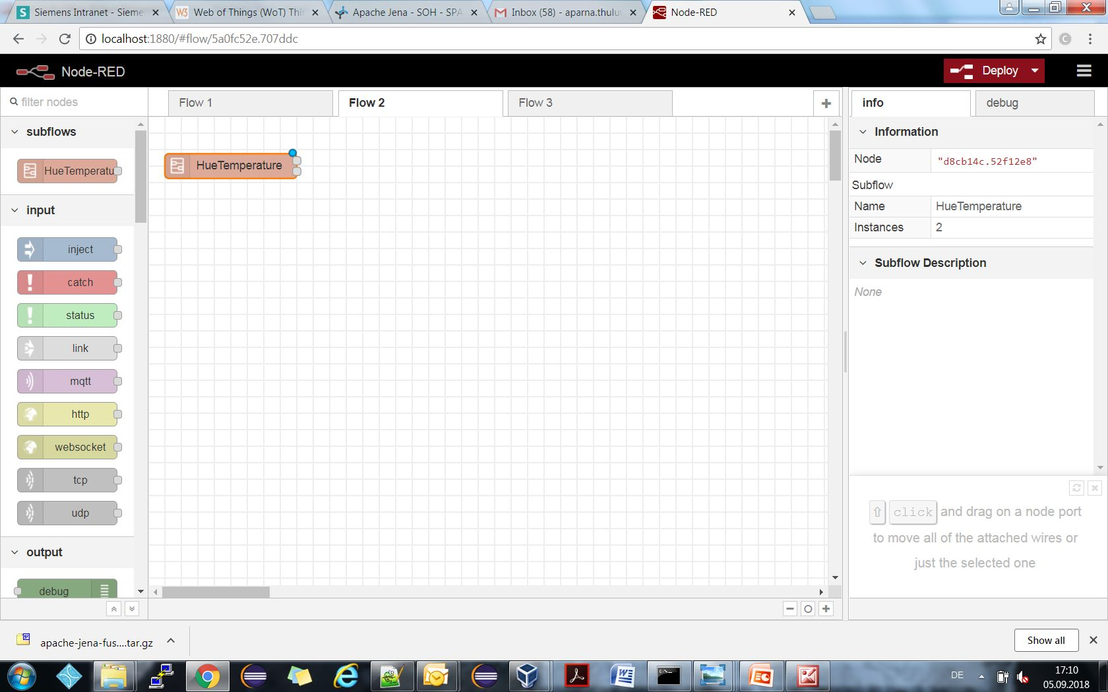
Semantic Integration of Existing Things with iot.schema.org Type 2 Nodes
{
celsius: 25,
timestamp:13:00
}
Datatype adaptor
(Int to float)
{
input: {
celcius: 25,
timestamp:13:00
},
output: {
celcius: 25.0,
timestamp:13:00
}
}
UnitCode adaptor
{
value: 77.0,
unit: fahrenheit,
timestamp: 13:00
}
Output1: {
TemperatureShape,
}
Output2: {
value: 77.0,
iot:unitCode: fahrenheit,
timestamp: 13:00
}

Slide 9
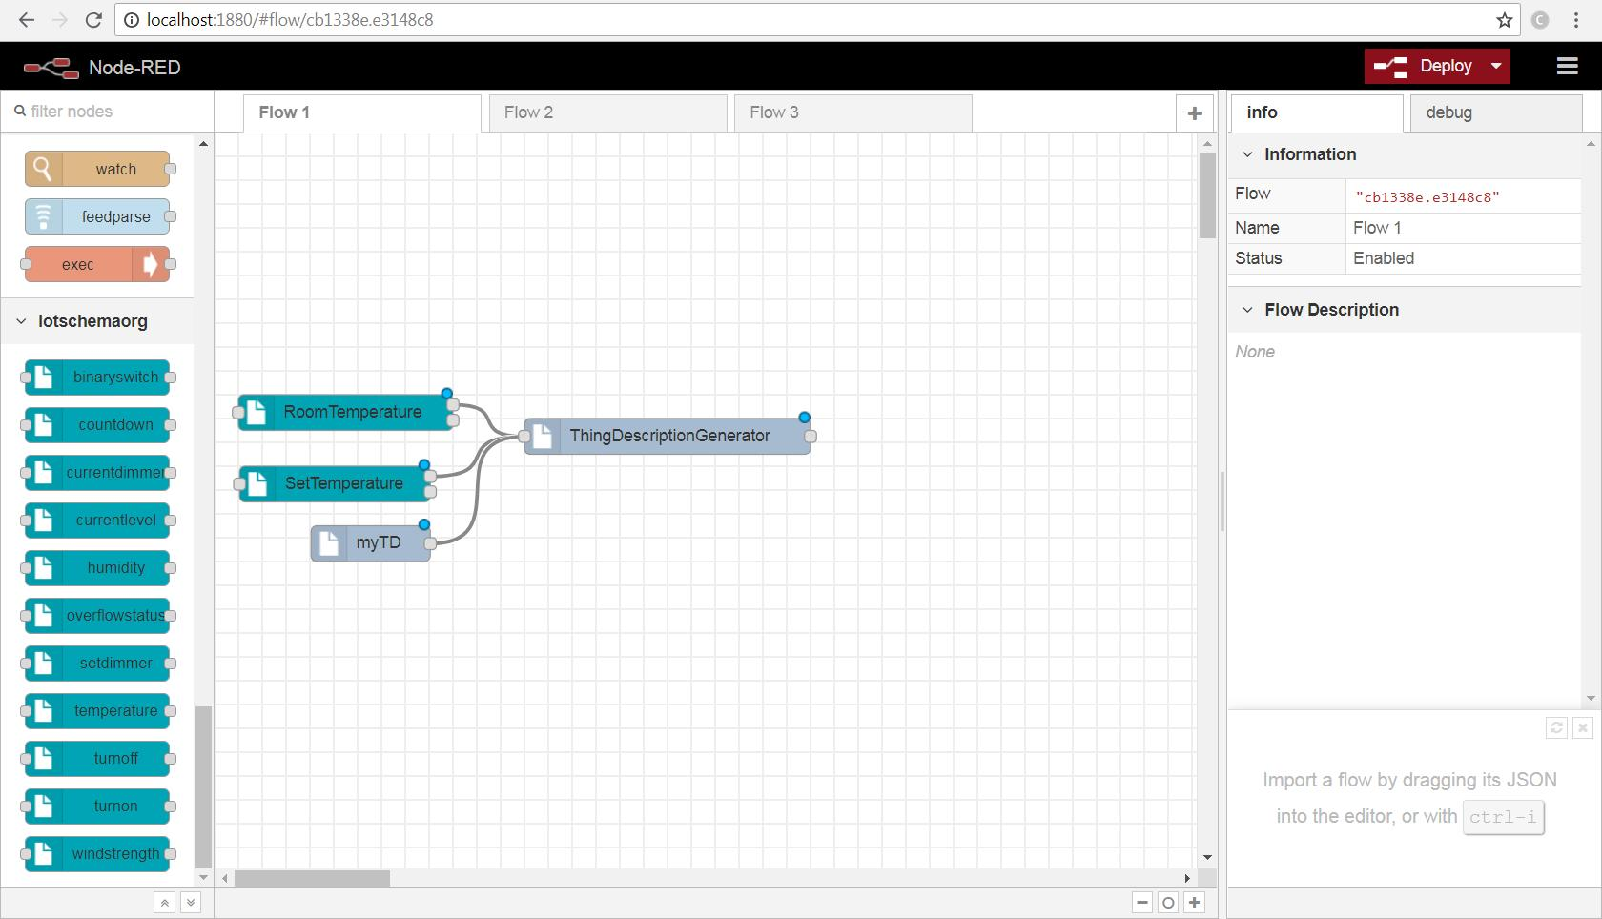
Enriching the device models with iot.schema.org Semantics
Type 2 Nodes
"@type": [ "Thing", “iot:Thermostat" ],
"id": "urn:dev:wot:panasonic:airconditioner",
"security": [{"scheme": "basic"}],
"iot:isAssociatedWith" : { "@id": "Room1", "@type": "iot:Room" },
"properties": {
"temperature": {
"@type": "iot:Temperature",
"iot:capability": {"@id":"iot:Thermostat"},
"io:isPropertyOf": { "@id": "Room1", "@type": "iot:Room" },
"type": "object",
"properties": {
"temperatureValue": { "type": "number", "minimum": 10.0, "maximum": 40.0 , “iot:unitCode”: “iot:Celcius” } },
"writable": false, "observable": true..

Slide 10
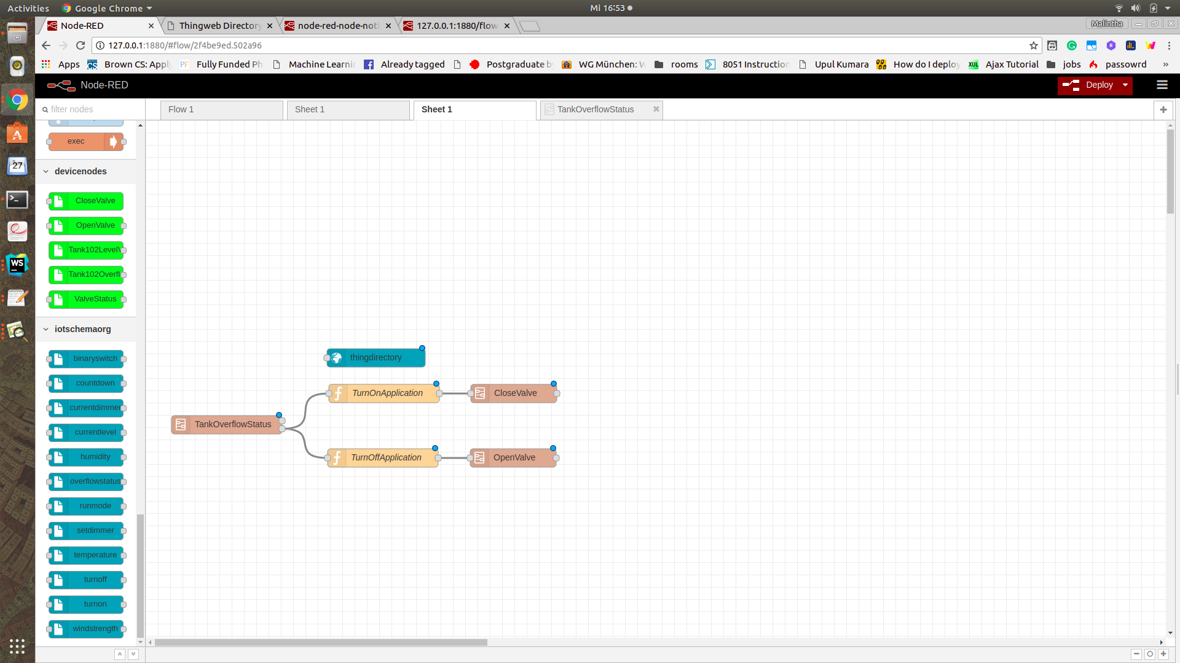
Recipe Flow Creation Application Creation
Recipe: A template that defines orchestration of Things.
Models Things required for orchestration
Describes how Things should interact
Node-RED Node: Recipe ingredient
Node-RED Wire: Recipe interaction
Use Cases:
Create a Recipe as Node-RED flow.
Add context to flow JSON description
Store Recipe to Thing Directory

Slide 11
Thank You!
Questions please…

