Slide 1
iot.schema.org
Practical Semantic Interoperability for Connected Things
or - Avoiding the XKCD 927 Effect
Michael Koster

Slide 2
This is mostly informational
What problem is being solved ?
What is iot.schema.org ?
How does iot.schema.org work ?
Who is iot.schema.org for ?
How is iot.schema.org intended to be used ?
What is the status, the gaps ?
How do I get involved ?

Slide 3
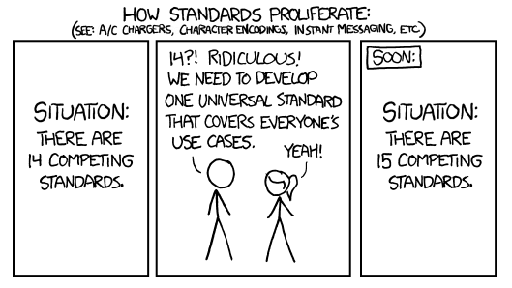
This is the Problem being solved:
Source: https://xkcd.com/927/

Slide 4
Background
IoTSI - IoT Semantic Interoperability Workshop
WISHI – Work on IoT Semantic and Hypermedia i15
Many different models and protocols for a common set of high level patterns
Semantic Normalization vs. Protocol Translation
Diversity in device protocols is a feature

Slide 5
Problem being solved – Semantic Interoperability for IoT
Acknowledge the diversity of IoT device ecosystems
Not another device standard
Adaptive to diverse protocol, language, and data models
Distill the common and stable operational features
Second "narrow waist" for systems above IP networks
Address the ease of use of Semantic Web for IoT and use of IoT for Semantic Web
Not another IoT ontology
A conceptual layer that models connected things in relation to existing ontologies

Slide 6
Narrow Waist in System Design
App
App
App
App
Many Applications. Local and Remote
Web of Things
Semantic Interoperability (Software Adaptation)
Common Infrastructure
(Protocols, Formats, and Meta Models)
Internet of Things
IP Networks LAN/WAN (WiFi, Thread)
Fairhair
OCF
dotdot
LWM2M
Many Devices, Different Ecosystems

Slide 7
Diverse Devices and Applications, Common Protocols and Semantics
Diverse Applications
Applications
Interoperable Applications
Semantic Vocab
iot.schema.org
Web of Things
Narrow Waist
of Semantics
Thing Description
W3C Thing Description
Protocol Binding
Diverse Devices
Device Ecosystems
OCF, OMA, Zigbee, Fairhair
Protocols, Formats
IETF CoAP, CBOR, Link-Format
Internet of Things
Narrow Waist
of Protocols
Transport
UDP/TCP
Networks
WiFi, IPV6, Bluetooth

Slide 8
What is iot.schema.org
A layer to bridge between device ecosystems and Semantic Web technology, consisting of
Publicly available, reusable, interoperable, and compose-able definitions for connected things
Property and relation types to enable reuse of existing ontologies and definitions
SSN, SOSA, SAREF, QUDT
Property types for e.g. Feature of Interest
Follow the example and align with Schema.org
Extend the schema.org patterns
Community contributions and open license

Slide 9
iot.schema.org Definitions
Semantic definitions that follow the design patterns and interaction affordances of connected thongs
Interoperable due to a set of static and dynamic semantic constraints
Define a "Capability" that represents – typically – the smallest practical compose-able unit of functionality
For example, a temperature sensor, or a door lock

Slide 10
iot.schema.org Capabilities
Abstract functionality around a simple functional concept, e.g. temperature sensor, or door lock
Often associated with a class of physical quantity or artifact, e.g. "temperature" or "door"
Capabilities are associated with Interactions and Data Items in the iot.schema.org conceptual model
The Interactions and Data Items are the basis for protocol and data-model neutral definitions

Slide 11
iot.schema.org Categories/Classes
schema:thing
providesOutputData
providesInteractionPattern
acceptsInputData
Capability
InteractionPattern
DataItem
schema:PropertyValue
Action
Event
Property
schema:PropertyValueSpec.
rdfs:subclassOf
schema:Property
iotschema Class
Reused Class

Slide 12
iot.schema.org Categories
Capability
Discovery of things that satisfy application requirements
Static constraints as part of the definition
Interaction
Adaptation of the application to the affordances of the connected thing
Static constraint with compose-able elements
Data Item
Adaptation of the application to the data format, types, engineering units, range and scale
Static or dynamic constraints

Slide 13
iot.schema.org Conceptual Integration with other ontologies
Feature of Interest concepts and property types to describe location, equipment, or other classifiers
For example, BrickSchema definitions from Haystack
Quantity and Units constraints can use QUDT concepts and appropriate identifiers
SSN, SOSA, SAREF concepts can extend a definition
Definitions and instances may be annotated in RDF

Slide 14
Integration with other Ontologies
Enables Well-Characterized interactions with Physical Entities
Feature of Interest, O&M Situation, Provenance
iot.schema.org Definition
Software Affordances
Quantities, Units, Shapes, Property Value Constraint

Slide 15
Connect things to the real world
"Lock Security Doors and Check" Action
DoorLock Capability
- ActuateLock Interaction
- ActuateUnlock Interaction
- GetState Interaction -> LockState Data
Door Lock
isAssociatedWith
iot.schema.org
Door
- Is A Front Door
- Opens To Outside
- Is A Security Door
other ontologies

Slide 16
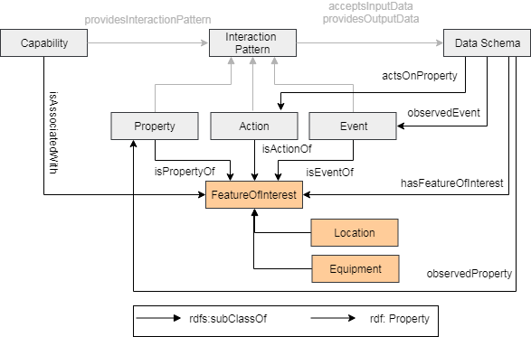
Feature of Interest Properties

Slide 17
iot.schema.org Specific Use Cases
Semantic annotation of thing and data instances
RDF instances, LDP, etc.
WoT Web of Things Thing Description
HTML Web page using microformats or JSON-LD in <script> tag
Target attributes in web links (RFC8288 et. al.)
Metadata for ad-hoc annotation as type
Selective Semantic Discovery using YFQL
Automatic configuration of IoT applications, rules, and behaviors
Standalone semantics for data analysis, data at rest

Slide 18
W3C WoT Thing Description
Semantic annotation for Thing Description instances
Describes Things using Capability identifiers
Describes TD Events, Actions, and Properties using Interaction identifiers
Describes DataSchema instances using Data Item identifiers and constraint systems
Thing Description contains concrete Protocol Bindings for specific transfer layer operations

Slide 19
Extended use Cases are enabled
Declarative Semantic API using the meta-interaction model directly
Abstract constructor language for building and composing instances of exposed things
OCF, OMA LWM2M/IPSO, Zigbee/dotdot, BLE
C2C API management (OpenAPI + Semantic Annotation)
HAL, Hydra, JSON-Hyperschema,..
Interoperable definitions for orchestrations: rules, behaviors, scenes, and enumerations

Slide 20
Status
Monthly Teleconferences since mid-2017
Examples of Definitions in a Github repository
FoI annotation examples are also in the repo
Prototypes tested at W3C Web of Things Plugfests and WISHI/IETF Hackathons from mid 2017
Some contributors are ready to begin submittting definitions
We need to build out some tools and processes
W3C Community Group with Web of Things

Slide 21
References
iot.schema.org
https://github.com/iot-schema-collab/teleconferences/blob/master/README.md
https://github.com/iot-schema-collab/intro-materials
https://github.com/iot-schema-collab/teleconferences
W3C Web of Things IG/WG
https://www.w3.org/WoT/WG/

Slide 22
Thank You!
Questions ?

