Slide 1
IoT Extensions for schema.org
Community Teleconference
March 21, 2019

Slide 2
Agenda
Updates
One Data Model Update
schema.org integration proposal
Issue #54 – General Input/Output Data Types

Slide 3
Brief Updates
Community Group is still not active
Need to elect chairs and create the mail list
IETF 104 in Prague CZ, March 22-30
March 22 all-day T2TRG Workshop
March 23-24 WISHI Hackathon
Semantic and Hypermedia Interoperability work
Other updates?

Slide 4
One Data Model Proposal
High level semantic model that is aligned with the pattern we have been using for the prototype definitions
"has" property types
DataItem class without any directionality
Protocol Binding based on @type annotations in OCF/Swagger definition files – same format as the WoT TD annotation
https://github.com/mjkoster/ODM-Examples

Slide 5
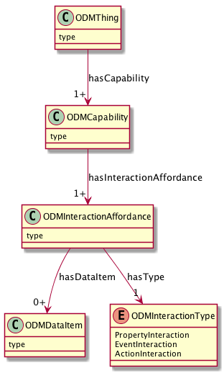
UML Model
Device Type and Constraints e.g. Thermostat, Light
Composable Capabilities e.g. onoff, level, temperature
Events, Actions, Properties
Data Types, Enums

Slide 6
ST Based Capabilities
{
"@id": "st:SwitchCapability",
"rdfs:subClassOf": "odm:Capability",
"rdfs:comment": "Basic On/Off Switch Capability",
"rdfs:label": "SmartThings Switch Capability",
"odm:hasInteractionAffordance": [
"st:Switch.valueProperty",
"st:Switch.onAction",
"st:Switch.offAction"
]
},
{
"@id": "st:SwitchLevelCapability",
"rdfs:subClassOf": "odm:Capability",
"rdfs:comment": "Capability to control the level",
"rdfs:label": "SmartThings SwitchLevel Capability",
"odm:hasInteractionAffordance": [
"st:SwitchLevel.levelProperty",
"st:SwitchLevel.setLevelAction"
]
}

Slide 7
Properties, Actions, Events
{
"@id": "st:SwitchLevel.levelProperty",
"rdfs:comment": "The current level setting",
"rdfs:label": "SwitchLevel levelProperty",
"@type": "odm.PropertyInteraction",
"rdfs:subClassOf": "odm:InteractionAffordance",
"odm:hasDataItem": "st:SwitchLevel.levelData"
},
{
"@id": "st:SwitchLevel.setLevelAction",
"rdfs:comment": "Action to set the level",
"rdfs:label": "SwitchLevel setLevelAction",
"@type": "odm:ActionInteraction",
"rdfs:subClassOf":"odm:InteractionAffordance",
"odm:hasDataItem": [
"st:SwitchLevel.levelData"
"st:SwitchLevel.rateData"
]
}

Slide 8
Data Items
{
"@id": "st:Switch.valueData",
"rdfs:comment": "value data for Switch (on/off string encoding)",
"rdfs:label": "SmartThings SwitchLevel.levelData",
"rdfs:subClassOf": "odm:DataItem",
"odm:DataItemType": "js:string",
"js:enum": ["on", "off"]
},
{
"@id": "st:SwitchLevel.levelData",
"rdfs:comment": "Level data for SwitchLevel",
"rdfs:label": "SmartThings SwitchLevel.levelData",
"rdfs:subClassOf": "odm:DataItem",
"odm:DataItemType": "js:integer",
"js:minimum": 0,
"js:maximum": 100
},
{
"@id": "st:SwitchLevel.rateData",
"rdfs:comment": "Rate time data for setLevelAction",
"rdfs:label": "SmartThings SwitchLevel.rateData",
"rdfs:subClassOf": "odm:DataItem",
"odm:DataItemType": "js:integer",
"js:minimum": 0,
"js:maximum": 65535
}

Slide 9
OCF Definition with annotations
"title": "Binary Switch",
"version": "v1.1.0-20160519",
"license": {
"name": "copyright 2016-2017 Open Connectivity Foundation, Inc. All rights reserved.",
}
},
"@type": "ocf:BinarySwitchCapability",
"schemes": ["http"],
"consumes": ["application/json"],
"produces": ["application/json"],
"paths": {
"/BinarySwitchResURI" : {
"@type": [
"ocf:BinarySwitch.valueProperty",
"ocf:BinarySwitch.OnAction",
"ocf:BinarySwitch.OffAction"
],

Slide 10
OCF Definition with annotated paths and operations
"paths": {
"/BinarySwitchResURI" : {
"@type": [
"ocf:BinarySwitch.valueProperty",
"ocf:BinarySwitch.OnAction",
"ocf:BinarySwitch.OffAction"
],
"get": {
"@type": "ocf:BinarySwitch.valueProperty",
}
"post": {
"@type": [
"ocf:BinarySwitch.valueProperty",
"ocf:BinarySwitch.OnAction",
"ocf:BinarySwitch.OffAction"
],
}

Slide 11
OCF Definition with data annotations
(...)
"minItems": 1,
"readOnly": true,
"type": "array"
},
"value" :
{
"@type": [
"ocf:BinarySwitch.valueData",
"ocf:BinarySwitch.OnValueData",
"ocf:BinarySwitch.OffValueData"
],
"description": "Status of the switch",
"type": "boolean"
},

Slide 12
Schema.org integration
Contribution to schema.org based on our prototype definition ontology (the terms need work)
Capability, InteractionAffordance, Event, Action, Property, DataItem classes
ProvidesInteractionPattern, AcceptsInputData, ProvidesOutputData property types
DataItem constraints using PropertyValueConstraint or other suitable vocabilaries (e.g. JSON Schema)
FoI property types
The definitions can be in external namespaces, only the core model needs to be accepted to start

Slide 13
schema.org IoT Extension Core Model
schema:thing
providesOutputData
providesInteractionPattern
acceptsInputData
Capability
InteractionPattern
DataItem
schema:PropertyValue
Action
Event
Property
schema:PropertyValueSpec.
rdfs:subclassOf
schema:Property
iotschema Class
Reused Class

Slide 14
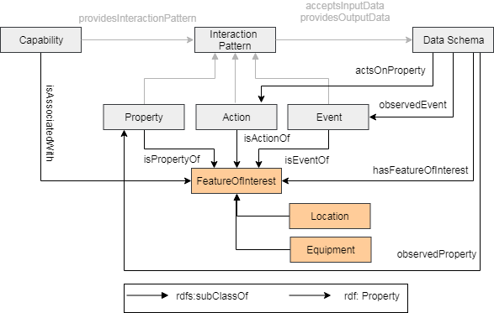
Feature of Interest Properties

Slide 15
Schema.org integration
Drive it through issues and discussion on our iotschema-collab github organization and in the new CG
At some key point, create issues on the schema.org github organization

Slide 16
Issue #54 Data Types
Currently we intend to define a semantic category for DataItems that we apply application-specific terms to, e.g. a TemperatureData type as defined for use in a TemperatureCapability
Applications can associate TemperatureData with the TemperatureCapability (concrete or abstract)
We define relations that can associate TemperatureData with Features of Interest
The intention is to be able to relate TemperatureData to concepts like Phenomenon and Observation

Slide 17
What is needed for this use case?

Slide 18
Other Business?
AOB
Adjourn

Slide 19
Technical Plan – Schema.org Integration
Develop the existing ontology to be suitable for integration into schema.org
Terminology needs broad agreement
Develop the references and browser navigation hooks to definitions in external namespaces

Slide 20
Technical Plan – Definitions
Create example definition sets from existing ecosystems – Annotation and Feature Extraction
ZCL/dotdot, OCF, LWM2M, SmartThings
Create a Developer Guideline for new definitions and for using existing definitions
Collect useful tools and scripts
New classes
Data classes
Capability sets for common Thing types?
Definitions for common Enumerations?

Slide 21
Technical Plan – Web Interface
Add Shapes Constraints to the definitions
Develop the browser navigation hooks
Determine namespace references from schema.org

Slide 22
Technical Plan – Feature of Interest
Develop integrations for external FoI ontologies
Automotive (VSS Schema)
Buildings (Brick Schema)
Sensor data and geospatial (W3C, OGC)
Industrial (IIC collaboration?)
Examples of annotations including domain-specific FoI definitions

