Slide 1
iot.schema.org
Community Teleconference
June 28, 2018

Slide 2
Agenda
Review agenda
Mapping Haystack and Brick Ontology
Feature of Interest in iot.schema.org
Review introductory materials and tools
Review the W3C CG Charter and organization
Upcoming events and conferences
AOB

Slide 3
(Mapping Haystack and Brick) (Feature of Interest Modeling)

Slide 4
Tools and infrastructure
Work in progess: definitions using RDF shapes
Flexible structure and value constraints
Augment the RDFS structural constraints
Alternative to PropertyValueSpecification for data types
Way forward for browsing definitions in HTML
Constructor tool to populate WoT Thing Descriptions from iot.schema.org capability definitions
Working on the roadmap to converge/merge with schema.org

Slide 5
iot.schema.org one pager
What is it?
An extension to schema.org and a meta-model for the semantics of interacting with connected things
Open, public definitions for connected things and their context, in a reusable and protocol-agnostic format
What problems does it solve?
The difficulty for domain experts and system developers to create and use formal semantic descriptions
The lack of common semantic vocabularies and conceptual models
Interoperability across diverse application domains
How does it solve these problems?
Common meta-model with categories of Capability, Interaction, and Data, that can be associated with Features of interest. Interaction types of Event, Action, and Property align with existing devices – (UML Diagram)
Enable multiple domain-specific vocabularies that can re-use the common categories and a core set of common definitions
What is the benefit of this approach?
Domain experts can focus on the high value semantic definitions that are important to them, without needing to become semantic web experts
Who it is for?
Developers of IoT systems, including connected things, applications, ecosystem bridges and translators
How do we get involved?
Use the public definitions in annotation of connected things in discovery and configuration of IoT applications
Create new definitions for capabilities that are not yet defined to expand the scope of semantic interoperability
Attend the teleconferences, join the W3C Community Group, or contribute as a member of schema.org

Slide 6
W3C WoT CG Charter
Subset of the iot.schema.org charter, for incubating contributions of definitions to iot.schema.org
Develop the process for achieving community consensus to publish agreed definitions
Contributor IPR regime is based on schema.org or W3C Community Group (either are OK)
Creative Commons CC-BY License
Ultimately expect to split off domain-specific community groups or use existing CG, for example automotive, based on this as a template

Slide 7
iotschema Common Pattern
schema:target
schema:EntryPoint
schema:thing
schema:PropertyValue
Capability
InteractionPattern
schema:PropertyValueSpec.
providesInteractionPattern
acceptsInputData
providesOutputData
rdfs:subclassOf
Action
schema:Property
Event
iotschema Class
Property
Reused Class

Slide 8
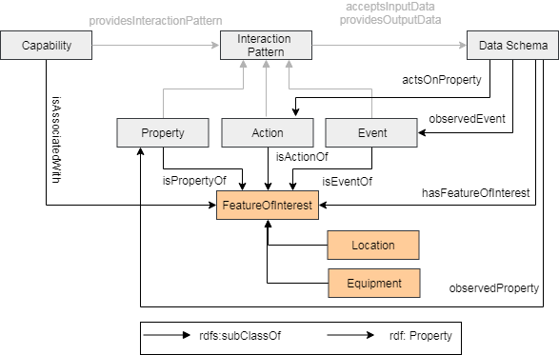
Feature Of Interest Pattern

Slide 9
Events and Conferences
W3C Web of Things face to face meeting in Korea
June 30-July 4th 2018
2 day Plugfest with
Using iot.schema.org annotation including FoI
WISHI at the IETF 102 hackathon
2 days; July 14th and 15th
Using iot.schema.org annotation with WoT framework
Research questions around semantic annotation and hypermedia integration

Slide 10
Other Business
Next teleconference back on the 3rd Thursday schedule – July 19th (During IETF 102 in Montreal)
Sorry for all the false notifications; having calendar integration issues… causing ghost appointments… trying to resolve

