Slide 1
iot.schema.org
WoT Status Review
October 26, 2018

Slide 2
Topics
Work on automating consumed and exposed APIs
SSN Workshop
Charter
Explainer and introductory slides
Integration with schema.org
Definition tools
Work on modeling target ecosystems
Developer-user tools
Going forward

Slide 3
iot.schema.org for Node-RED Semantic Interoperability
iot.schema.org embedded in Node-RED tool
Easies use of semantics for WoT developers
Simplify creation of applications with W3C WoT
Demonstrates semantic discovery and processing
Handsome tool for WoT PlugFests

Slide 4
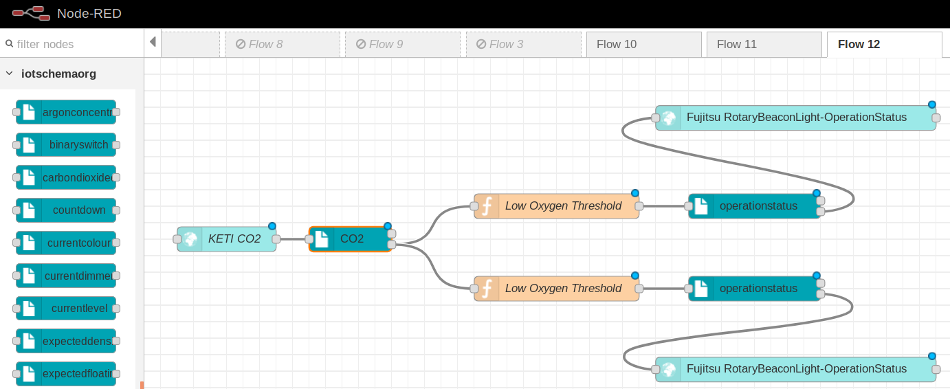
Example: Controlling Carbon Dioxide Node-RED Application with W3C WoT Things

Slide 5
Example: Controlling Carbon Dioxide Node-RED Application with W3C WoT Things

Slide 6
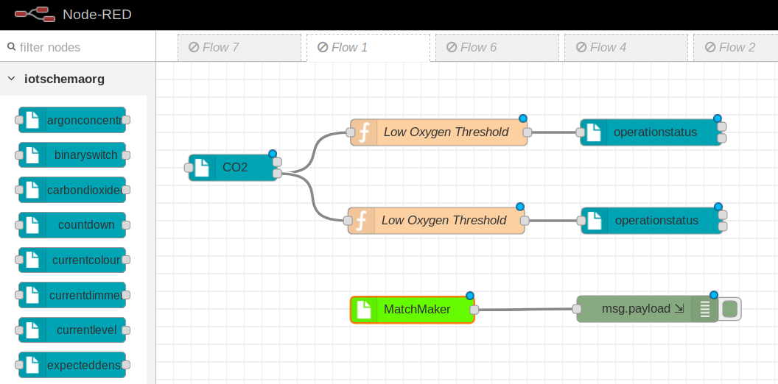
Semantic Recipe Reusable Flow Template
MatchMaker:
finds Things that can implement the Recipe
based on TD with iot.schema.org mark-ups

Slide 7
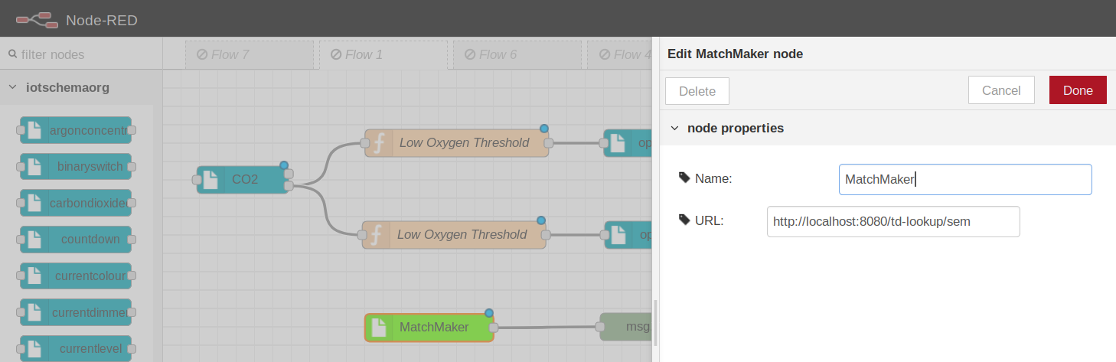
Configure Thing Description Directory

Slide 8
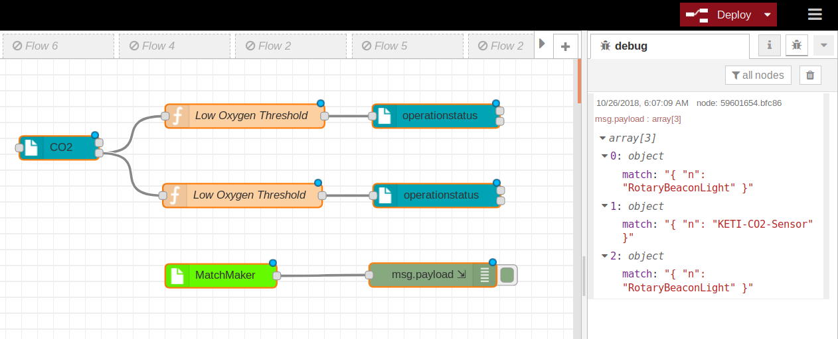
Semantic Discovery of Recipe Ingredients
Ingredients are Node-RED Nodes

Slide 9
Example: Controlling Carbon Dioxide Node-RED Application with W3C WoT Things
1
2
Wire discovered Node-RED nodes
3

Slide 10
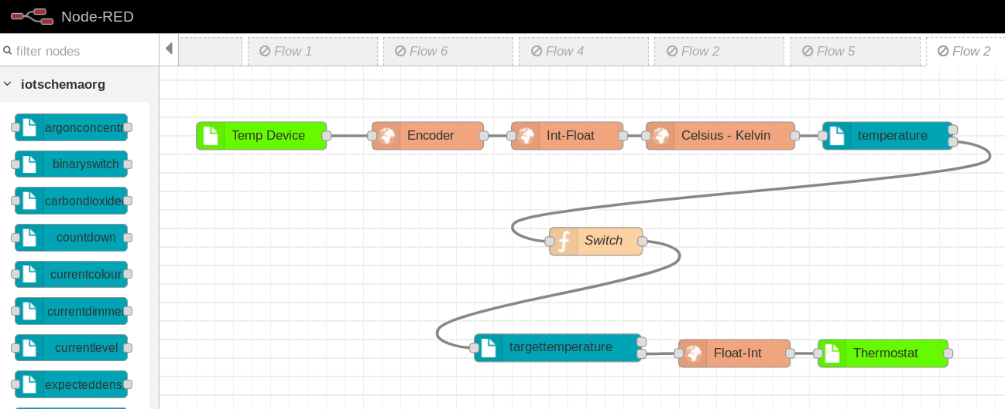
Semantic-Based Adapters

Slide 11
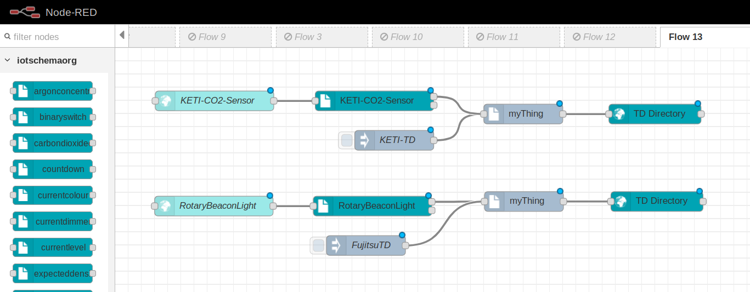
iot.schema.org: Semantic Mark-Up for W3C WoT Thing Description

Slide 12
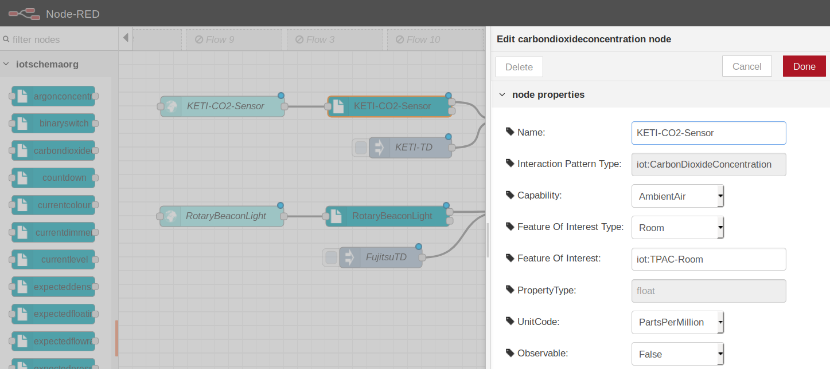
iot.schema.org: Semantic Mark-Up for W3C WoT Thing Description

Slide 13
SSN Workshop at ICSW2018
Presented iot.schema.org at the SSN Workshop last week
Presentation is in the teleconferences folder
Discussion:
Action, Event, Property terms are badly overloaded
When will the definitions be available on schema.org?
How do we create and use definitions?
What tools are available for definitions and annotation
How do we use definitions with existing device ecosystems?

Slide 14
SSN Workshop (contd)
Presentations on Automotive, Building Management, Home Care use cases
Clear focus on Feature of Interest concepts
Gap analysis for Semantic IoT
Taxonomy of Observable Properties
FoI Vocabularies
Sensor/Actuator Vocabulary
Vocabulary for processes and procedures

Slide 15
Organization
W3C CG Charter
Introductory materials
Explainer
Slide set for introduction
SSN workshop slides
Integration with schema.org
May not be a sub-domain, e.g. become part of schema.org
We need to enable the schema browser for iotschema definitions

Slide 16
Developer tools
How to create and maintain definitions
How to use definitions in deployed systems
How to apply definitions to existing device ecosystems and FoI definitions
OMA LWM2M
OCF
W3C WOT Thing Description
Genivi VSS
Haystack/Brick
What about Amazon Alexa, SmartThings, etc.
Other APIs using OAS/Swagger, HAL, JSON Hyperschema

Slide 17
Applying iot.schema.org definitions to existing ecosystems
Existing definitions in some machine-readable format
XML, JSON-Schema, JSON, others e.g. YAML
Annotate the definitions with Semantic terms to describe affordances
JSON-LD schema can be annotated as in WOT TD
Other annotation techniques (WISHI Research)
Use existing definition or create new definitions
Generate hypermedia controls from the annotated definitions
TD Generator
Other annotations of instances

Slide 18
Process
Rules and Templates
Discovery Result
TD Gen
Thing Description
Ecosystem Schema
Semantic Annotation

Slide 19
Annotation of a JSON Schema fragment using JSON-LD
{
"type": "object",
"properties": {
"name": "bri",
"@type": ["iot:LevelData" ],
"type": "integer",
"min": 0,
"max": 254
}
Annotated schema is used to generate hypermedia controls for instances
E.g. a link with a target attribute containing the annotation

Slide 20
Going Forward
Set up the CG
schema.org integration
Accept definitions for target ecosystems
LWM2M/IPSO (Ericsson), OCF, SmartThings
Would like to work with IIC to create testbeds for semantic interoperability

Slide 21
Upcoming Teleconferences
Dr. Amelie Gyrard – Semantic Web of Things
Industry-wide survey of existing definitions
Bruce Nordman – Lawrence Berkeley Laboratory
Device descriptions for energy monitoring

Slide 22
SSN Workshop Exit Keynote (condensed)
ISCW 2018
October 9, 2018

Slide 23
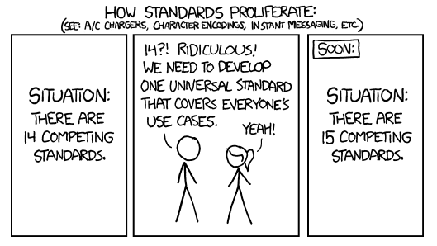
This is the Problem being solved:
Source: https://xkcd.com/927/

Slide 24
Problem being solved – Semantic Interoperability for IoT
Acknowledge the diversity of IoT device ecosystems
Not another device standard
Adaptive to diverse protocol, language, and data models
Distill the common and stable operational features
Second "narrow waist" for systems above IP networks
Address the ease of use of Semantic Web for IoT and use of IoT for Semantic Web
Not another IoT ontology
A conceptual layer that models connected things in relation to existing ontologies

Slide 25
Narrow Waist in System Design
App
App
App
App
Many Applications. Local and Remote
Web of Things
Semantic Interoperability (Software Adaptation)
Common Infrastructure
(Protocols, Formats, and Meta Models)
Internet of Things
IP Networks LAN/WAN (WiFi, Thread)
Fairhair
OCF
dotdot
LWM2M
Many Devices, Different Ecosystems

Slide 26
Diverse Devices and Applications, Common Protocols and Semantics
Diverse Applications
Applications
Interoperable Applications
Semantic Vocab
iot.schema.org
Web of Things
Narrow Waist
of Semantics
Thing Description
W3C Thing Description
Protocol Binding
Diverse Devices
Device Ecosystems
OCF, OMA, Zigbee, Fairhair
Protocols, Formats
IETF CoAP, CBOR, Link-Format
Internet of Things
Narrow Waist
of Protocols
Transport
UDP/TCP
Networks
WiFi, IPV6, Bluetooth

Slide 27
Integration with other Ontologies
Enables Well-Characterized interactions with Physical Entities
Feature of Interest, O&M Situation, Provenance
iot.schema.org Definition
Software Affordances
Quantities, Units, Shapes, Property Value Constraint

Slide 28
Connect things to the real world
"Lock Security Doors and Check" Action
DoorLock Capability
- ActuateLock Interaction
- ActuateUnlock Interaction
- GetState Interaction -> LockState Data
Door Lock
isAssociatedWith
iot.schema.org
Door
- Is A Front Door
- Opens To Outside
- Is A Security Door
other ontologies

