Slide 1
iot.schema.org
Community Teleconference
January 17, 2019

Slide 2
Agenda
Agenda and announcements
Integration of WoT Thing Directory discovery in the iotschema-node-red project
Updates
One Data Model Liaison Group
W3C Community Group for iot.schema.org
Roadmap for 2019
Other updates
AOB

Slide 3
iot.schema.org in Node-RED
Is there an easy way for a Web application developer to use iot.schema.org?
Our goal is to provide a tool that:
Does not require a developer to know RDF(S), JSON-LD, RDF Shapes etc.
Enables an easy configuration of things when using iot.schema.org
Avoids translations of serializations formats, data types, units etc.

Slide 4
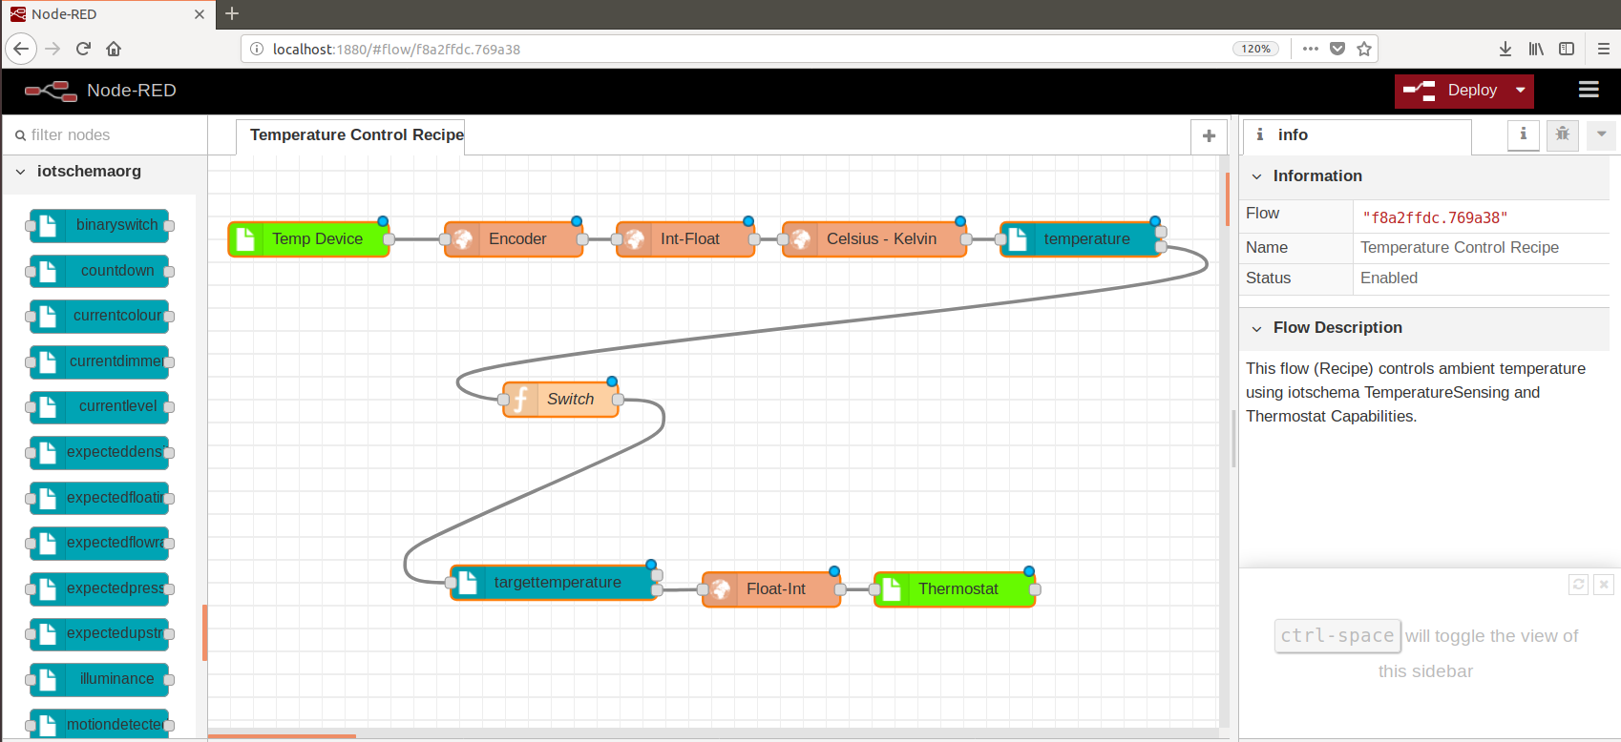
Example: Controlling Temperature Node-RED Application with iot.schema.org Nodes

Slide 5
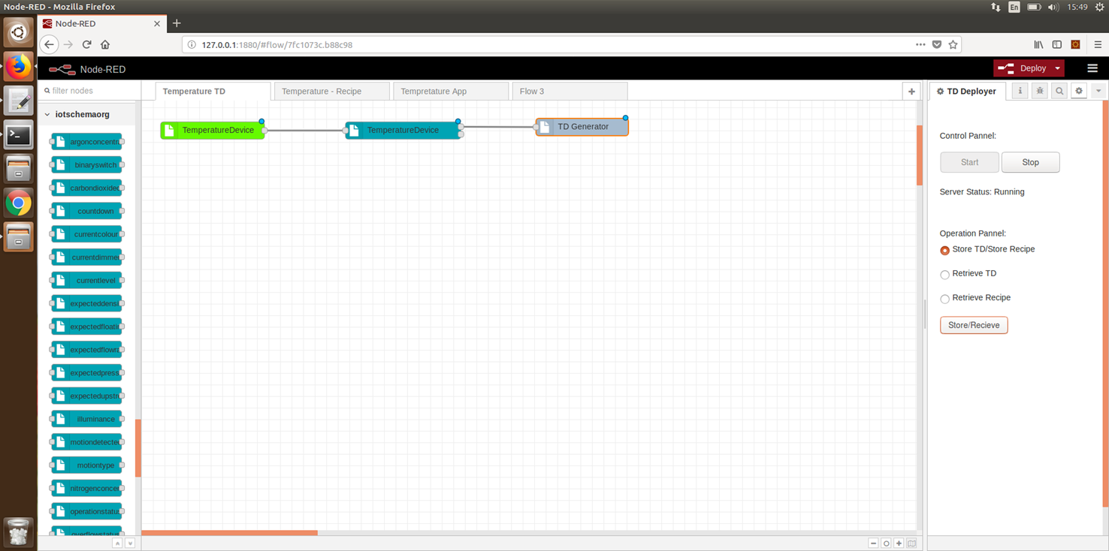
Integration of WoT Thing Directory in the iotschema-node-red Project

Slide 6

Integration of WoT Thing Directory in the iotschema-node-red Project

Slide 7
One Data Model Liaison Group
Outgrowth of "Hive", a well-attended meeting sponsored by the Zigbee Alliance in November
Address the device interoperability problem across SDOs, Vendors, Service Providers
Open membership, equal participation by company
Zigbee, OCF, OneM2M, GSMA, EnOcean
Google, Comcast, Schneider Electric, Honeywell, Ericsson, Qualcomm, NXP, Orange, Cable Labs, Silicon Labs, Samsung, Huawei, Haier, many others

Slide 8
One Data Model Liaison Group
Administratively hosted by OCF
Skip Ashton (SiLabs, Zigbee) is Chair
Weekly meetings; the third was January 16th 2019
Scope and Priorities are being discussed
Presentations are being given on existing models and approaches
January 4 – iot.schema.org
January 16 – Nest/Weave
Exploratory phase, gathering input and opinions

Slide 9
W3C Community Group
We have proposed a new W3C CG for IoT Extensions to schema.org
https://www.w3.org/community/blog/2019/01/17/proposed-group-schema-extensions-for-iot-community-group/
The charter will be our current charter (see the github repository)
Four additional supporting members are required to start the group
https://www.w3.org/community/groups/proposed/
Schema Extensions for IoT

Slide 10
W3C Community Group
Keep and extend the current charter
Provide a better venue for the group to operate
Mailing list
Work with related groups in W3C; Automotive, Spatial Data, Sensors, WoT
Potential transition to higher status in W3C, e.g. "Evergreen standard"
https://www.w3.org/community/groups/proposed/
Schema Extensions for IoT

Slide 11
2019 Roadmap
Start up the W3C Community Group
Develop and document pattern, practices, and tools for creating and using definitions
Web interface to browse definitions
Schema.org integration
Publish initial definition sets from contributors
Identify future enhancements
semantic categories and classes
behaviors, rules, scenes

Slide 12
Roadmap for 2019
Review the current iot.schema.org model
Integration of schema.org-like model with RDF Data Shapes
Support for extended scenarios based on querying, reasoning, and validation
Integration of Project Haystack & Brick with iot.schema.org
Continuation of the work on model mappings
Extension of iot.schema.org for industrial domain
Currently the focus is on smart home/building

Slide 13
Roadmap for 2019 Cont’d
Extension of iot.schema.org with Feature of Interest (FoI)
Continuation of the work on FoI model
Integration of existing FoI with iot.schema.org, e.g., W3C Linked Building Data
First proposal for Semantic API with iot.schema.org
Continuation of iotschema-node-red Project
Better integration of discovery, Semantic API…

