Slide 1
iot.schema.org
iot.schema.org Model - Revisited
Darko Anicic
Aparna Thuluva

Slide 2
Review of the Roadmap for 2019
Among other tasks:
Review the current iot.schema.org model
Navigation for Capabilities on our prototype web site: iotschema.org

Slide 3
Motivation for changes
iot.schema.org Model

Slide 4
Avoid Mixing Classes and Instances See Issue #2
iot.schema.org Example:
Temperature
InteractionPattern
subClassOf
providesOutputData
InteractionPattern
domainIncludes
Temperature is a class!
Temperature
MotionDetected
OperationStatus
TemperatureData
StateData
StatusData
providesOutputData
Temperature appears to be an instance!- which is not correct

Slide 5
Proposal: Using RDF Shapes in iot.schema.org
Temperature
MotionDetected
OperationStatus
TemperatureData
StateData
StatusData
providesOutputData
TemperatureShape
TemperatureDataShape
providesOutputData
Shape path
Shape

Slide 6
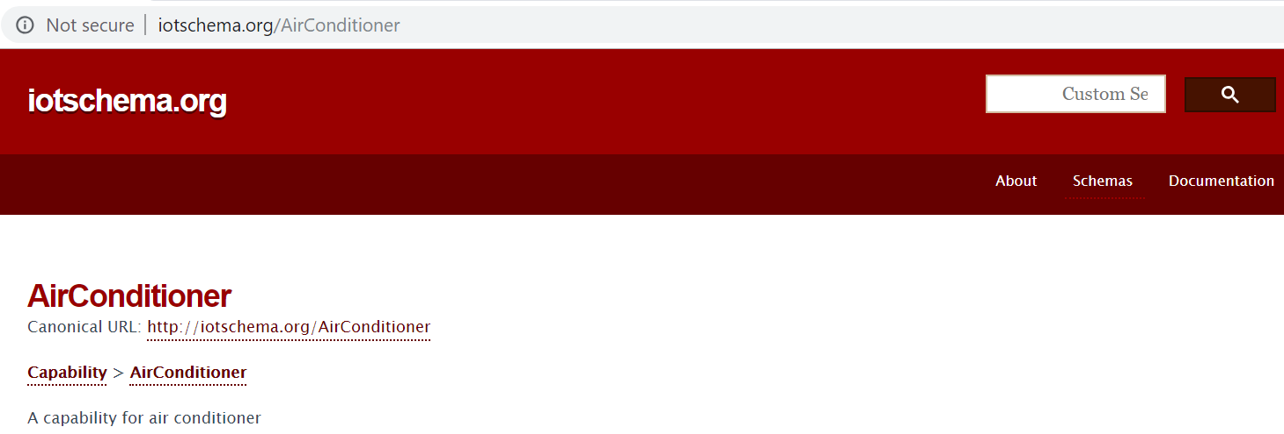
Incomplete Content of Schema

Slide 7
Updated Model
iot.schema.org

Slide 8
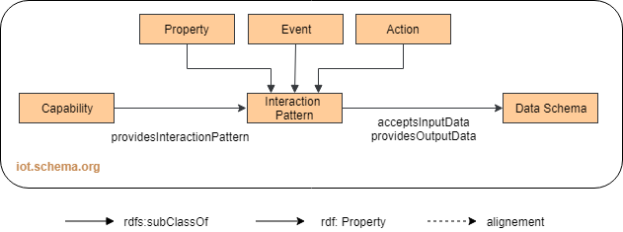
Current Capability Model iot.schema.org

Slide 9
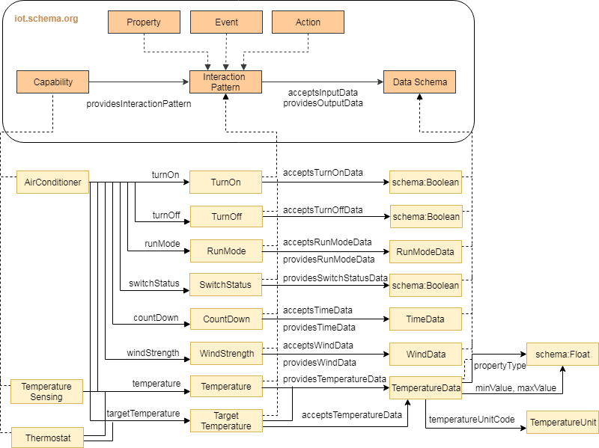
Updated Model

Slide 10
Next Steps
Review the updated model
Apply changes to the current schema
Update our prototype web site: iotschema.org
Review the iotschema SHACL Shapes

Slide 11
Thank You!
Questions please…

