Slide 1
IoT Extensions for schema.org
Community Teleconference
April 18, 2019

Slide 2
Agenda
Updates
schema.org integration proposal
One Data Model Update – Simple Definition Format
AOB

Slide 3
Brief Updates
Community Group
Need to elect chairs and create the mail list
Other updates?

Slide 4
iot.schema.org
iot.schema.org Model - Revisited
Darko Anicic
Aparna Thuluva

Slide 5
Review of the Roadmap for 2019
Among other tasks:
Review the current iot.schema.org model
Navigation for Capabilities on our prototype web site: iotschema.org

Slide 6
Motivation for changes
iot.schema.org Model

Slide 7
Avoid Mixing Classes and Instances See Issue #2
iot.schema.org Example:
Temperature
InteractionPattern
subClassOf
providesOutputData
InteractionPattern
domainIncludes
Temperature is a class!
Temperature
MotionDetected
OperationStatus
TemperatureData
StateData
StatusData
providesOutputData
Temperature appears to be an instance!- which is not correct

Slide 8
Proposal: Using RDF Shapes in iot.schema.org
Temperature
MotionDetected
OperationStatus
TemperatureData
StateData
StatusData
providesOutputData
TemperatureShape
TemperatureDataShape
providesOutputData
Shape path
Shape

Slide 9
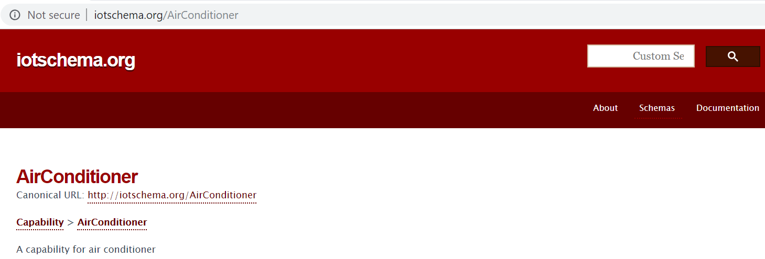
Incomplete Content of Schema

Slide 10
Updated Model
iot.schema.org

Slide 11
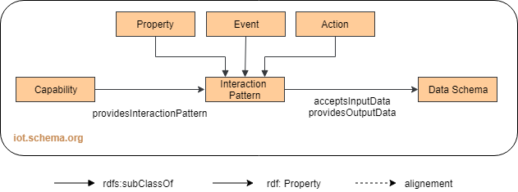
Current Capability Model iot.schema.org

Slide 12
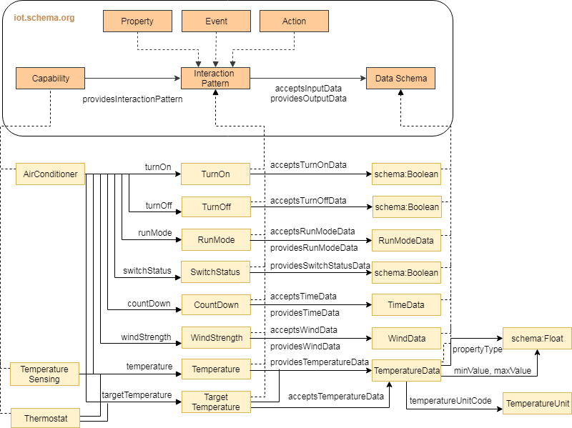
Updated Model

Slide 13
Next Steps
Review the updated model
Apply changes to the current schema
Update our prototype web site: iotschema.org
Review the iotschema SHACL Shapes

Slide 14
Thank You!
Questions please…

Slide 15
One Data Model
Harmonize device models across industry
High level semantic model that is aligned with the pattern we have been using for the prototype definitions
"Objects" with Event, Action, Property classes
Data class without any directionality
Objects compose into things and products

Slide 16
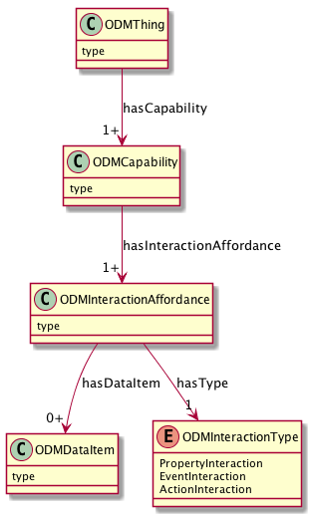
UML Model
Device Type and Constraints e.g. Thermostat, Light
Composable Objects e.g. onoff, level, temperature
Events, Actions, Properties
Data Types, Enums

Slide 17
Problems to solve
Process is to select the "best" from a wide variety of existing models the various orgs have built
Need to represent the abstract concepts from many design sources
High level representation that domain experts can use without getting bogged down in the tools
Methodology and tools
Simple Definition Format

Slide 18
Support This Pattern
Abstract Definitions
Events, Actions, Properties
Data Definitions
Feature Extraction
Protocol Binding
ZCL/dotdot Models
XML + XSD
OCF Models
OAS/Swagger

Slide 19
Simple Definition Format
JSON based DSL for making definitions
Distill the text down to high information content
Focus on definitions of objects with events, actions, and properties with semantic data types
Provide for extensions and constraints that can be applied earlier or later in the life cycle

Slide 20
SDF Example
https://github.com/mjkoster/ODM-Examples/SDF2.json
{
"info": {
"title": "Example file for ODM Simple JSON Definition Format",
"version": "20190404",
"copyright": "Copyright 2019 Example Corp. All rights reserved.",
"license": "http://example.com/license"
},
"namespace": {
"st": "http://smartthings.example.com/capability/odm"
},
"defaultNamespace": "st",
"object": {
"Switch": {}
},
"property": {
"Switch.value": {
"type": "string",
"enum": ["on", "off"]
}
},
"action": {
"Switch.on": {},
"Switch.off": {}
}
}

Slide 21
Simple example – Header Part
keywords
File Information
"info": {
"title": "Example file for ODM Simple JSON Definition Format",
"version": "20190404",
"copyright": "Copyright 2019 Xcorp, Inc. All rights reserved.",
"license": "http://example.com/license"
},
curies resolved
"namespace": {
"ocf": "http://openconnectivity.example.org/vocab/odm",
"st": "http://smartthings.example.com/capability/odm"
},
"defaultNamespace": "st",

Slide 22
Definitions
Definitions in the Default Namespace
"object": {
"Switch": {}
},
"property": {
"Switch.value": {
"type": "string",
"enum": ["on", "off"]
}
},
"action": {
"Switch.on": {},
"Switch.off": {}
},
"event": {},
"data": {}
}
SDF keywords

Slide 23
Definitions
A definition consists of a defined term and a map of it's defined qualities
"Switch.value": {
"type": "string",
"enum": ["on", "off"]
}

Slide 24
Identifier resolution precedence
1 - Explicit namespace prefix ( e.g. "st:Switch" )
2 - SDF Keywords:
https://github.com/mjkoster/ODM-Examples/blob/master/SDF2-Schema.json
3 – defaultNamespace
4 – Context of the definition (Object), local identifiers

Slide 25
SDF top level Keywords
info
title, version, copyright, license
namespace, defaultNamespace
object, property, action, event, data (definitions)

Slide 26
Object qualities + common qualities
"description": {
"type": "string"
},
"title": {
"type": "string"
},
"id": {
"type": "string"
},
"name": {
"type": "string"
},
"type": {
"type": "string"
},
"optional": {
"type": boolean"
{
"extends": {
"type": "string"
},
"refines": {
"type": "string"
},
"includes": {
"type": "string"
},

Slide 27
Property Qualities
All of the Object Qualities
All of the Data Qualities
"units": {
"type": "string"
},
"scaleMinimum": {
"type": "number"
},
"scaleMaximum": {
"type": "number"
},
"observable": {
"type": "boolean"
},
"nullable": {
"type": "boolean"
},
"encoding": {
"type": "object",
"properties": {
"widthInBits": {
"type": "number"
}
}
},
"contentFormat": {
"type": "string"
}

Slide 28
Data Qualities (JSON Schema)
"type": {
"type": "string",
"enum": [ "number", "string", "boolean", "integer", "array", "object" ]
},
"enum": {
"type": "array"
},
"const": {
"type": { "oneOf" : [ "number", "string", "boolean", "array", "object", "null" ] }
},
"default": {
"type": { "oneOf" : [ "number", "string", "boolean", "array", "object", "null" ] }
},
"pattern": {
"type": "string"
},
"minimum": {
"type": "number"
},
"maximum": {
"type": "number"
},
"multipleOf": {
"type": "number"
},
"maxLength": {
"type": "number"
},
"minLength": {
"type": "number"
},

Slide 29
Structured Data
"contains": {
"oneOf": [
{ "type": "array" },
{ "type": "object" }
]
},
"minItems": {
"type": "number"
},
"maxItems": {
"type": "number"
},
"properties": {
"type": "object"
},
"readOnly": {
"type": "boolean"
},
"writeOnly": {
"type": "boolean"
}
"oneOf": {
"type": "array",
"minItems": 1
},
"anyOf": {
"type": "array",
"minItems": 1
},
"allOf": {
"type": "array",
"minItems": 1
},
"items": {
"oneOf": [
{ "type": "array" },
{ "type": "object" }
]
},

Slide 30
SDF Example Definition
https://github.com/mjkoster/ODM-Examples/blob/master/SDF2-SwitchLevel.json
"object": {
"SwitchLevel": {}
},
"property": {
"SwitchLevel.level": {
"type": "SwitchLevel.levelData",
"readOnly": false
}
},
"action": {
"SwitchLevel.setLevel:": {
"data": [
"SwitchLevel.levelData",
"SwitchLevel.rateData"
]
}
},
"data": {
"SwitchLevel.levelData": {
"type": "number",
"minimum": 0,
"maximum": 100,
"multipleOf": 1
},
"SwitchLevel.rateData": {
"type": "number",
"minimum": 0,
"maximum": 65535,
"multipleOf": 1
}
}

Slide 31
Example JSON-LD Result
{
"@id": "st:SwitchLevel.level",
"rdfs:comment": "The current level setting",
"rdfs:label": "SwitchLevel level Property",
"@type": "odm:PropertyInteraction",
"rdfs:subClassOf": "odm:InteractionAffordance",
"odm:hasDataItem": "st:SwitchLevel.levelData"
},
{
"@id": "st:SwitchLevel.setLevel",
"rdfs:comment": "Action to set the level",
"rdfs:label": "SwitchLevel setLevelAction",
"@type": "odm:ActionInteraction",
"rdfs:subClassOf":"odm:InteractionAffordance",
"odm:hasDataItem": [
"st:SwitchLevel.levelData"
"st:SwitchLevel.rateData"
]
}

Slide 32
Opportunity
Share the definition format and tools between schema.org IoT extensions and One Data Model
Provide domain expert friendly tools for creating and managing definitions
ODM sourced definitions can be processed into schema.org extensions
Schema.org IoT sourced definitions can use SDF tools and can become ODM definitions
Models and definitions can be created within the domain expert venues

Slide 33
Other Business?
AOB
Adjourn

