Slide 1
MLP-Mixer: An all-MLP Architecture for Vision Ilya Tolstikhin*, Neil Houlsby*, Alexander Kolesnikov*, Lucas Beyer*, Xiaohua Zhai, Thomas Unterthiner, Jessica Yung, Daniel Keysers, Jakob Uszkoreit, Mario Lucic, Alexey Dosovitskiy *Equal contribution Google Research, brain team
Presenter: Daniela Campisi 1000011488

Slide 2
Motivation
Authors of this paper introduce the MLP-Mixer (“Mixer” for short ) model to show that convolutions and attention are not necessary for computer vision purposes.
In fact, until now CNNs and attention-based networks, such as the Vision Transformer, are the go-to models for computer vision.
Mixer is a competitive but conceptually and technically simple alternative, that does not use convolutions or self-attention.
Instead, Mixer’s architecture is based entirely on multi-layer perceptrons (MLPs) that are repeatedly applied across either spatial locations or feature channels.

Slide 3
Contribution
Despite its simplicity, Mixer attains competitive results on image classification benchmarks:
When pre-trained on large datasets (i.e., ∼100M images), it reaches near state-of-the-art performance, previously claimed by CNNs and Transformers, in terms of the accuracy/cost trade-off. This includes 87.94% validation accuracy on “ImageNet”.
When pre-trained on data of more modest scale (i.e., ∼1– 10M images), coupled with modern regularization techniques, Mixer also achieves strong performance.

Slide 4
State of the art
Mixer is a new architecture for computer vision that differs from previous successful architectures because it uses neither convolutional nor self-attention layers. Nevertheless, the design choices can be traced back to ideas from the literature on CNNs and Transformers.
CNN:
CNNs have been the de facto standard in computer vision field since the AlexNet model [1] surpassed prevailing approaches based on hand-crafted image features;
He et al. [2] introduced skip-connections together with the batch normalization layer, which enabled training of very deep neural networks with hundreds of layers and further improved performance;
A prominent line of research has investigated the benefits of using sparse convolutions, such as grouped [3] or depth-wise [4, 5] variants;
Finally, Hu et al. [6] and Wang et al. [7] propose to augment convolutional networks with non-local operations to partially alleviate the constraint of local processing from CNNs.
[1]. A. Krizhevsky, I. Sutskever, and G. E. Hinton. ImageNet classification with deep convolutional neural networks. In NeurIPS, 2012.
[2]. K. He, X. Zhang, S. Ren, and J. Sun. Deep residual learning for image recognition. In CVPR, 2016.
[3]. S. Xie, R. Girshick, P. Dollár, Z. Tu, and K. He. Aggregated residual transformations for deep neural networks. arXiv preprint arXiv:1611.05431, 2016.
[4] . F. Chollet. Xception: Deep learning with depthwise separable convolutions. In CVPR, 2017.
[5]. A. G. Howard, M. Zhu, B. Chen, D. Kalenichenko, W. Wang, T. Weyand, M. Andreetto, and H. Adam. Mobilenets: Efficient convolutional neural networks for mobile vision applications. arXiv preprint arXiv:1704.04861, 2017.
[6]. J. Hu, L. Shen, and G. Sun. Squeeze-and-excitation networks. In CVPR, 2018.
[7]. X. Wang, R. Girshick, A. Gupta, and K. He. Non-local neural networks. In CVPR, 2018.

Slide 5
State of the art
Transformers:
The value of self-attention based Transformer architectures for image recognition was demonstrated later, albeit in combination with a convolution-like locality bias [8], or on very low-resolution images [9];
Recently, Dosovitskiy et al. [10] introduced ViT, a pure transformer model that has fewer locality. Touvron et al. [11] showed that ViT can be trained effectively on smaller datasets using extensive regularization.
Mixer:
The idea of converting images to a sequence of patches and then directly processing embeddings of these patches originates in Dosovitskiy et al. [12];
Similar to Mixer, many recent works strive to design more effective architectures for vision. For example, Ramachandran et al. [13], Li et al. [14], and Bello [15] design networks that work well with new attention-like mechanisms. Mixer can be seen as a step in an orthogonal direction, without reliance on locality bias and attention mechanisms.
[8]. P. Ramachandran, N. Parmar, A. Vaswani, I. Bello, A. Levskaya, and J. Shlens. Stand-alone self-attention in vision models.
In NeurIPS, 2019.
[9]. J.-B. Cordonnier, A. Loukas, and M. Jaggi. On the relationship between self-attention and convolutional layers. In ICLR, 2020.
[10]. A. Dosovitskiy, L. Beyer, A. Kolesnikov, D. Weissenborn, X. Zhai, T. Unterthiner, M. Dehghani, M. Minderer, G. Heigold, S. Gelly, J. Uszkoreit, and N. Houlsby. An image is worth 16x16 words: Transformers for image recognition at scale. In ICLR, 2021.
[11] . H. Touvron, M. Cord, M. Douze, F. Massa, A. Sablayrolles, and H. Jégou. Training data-efficient image transformers & distillation through attention. arXiv preprint arXiv:2012.12877, 2020.
[12]. A. Dosovitskiy, L. Beyer, A. Kolesnikov, D. Weissenborn, X. Zhai, T. Unterthiner, M. Dehghani, M. Minderer, G. Heigold, S. Gelly, J. Uszkoreit, and N. Houlsby. An image is worth 16x16 words: Transformers for image recognition at scale. In ICLR, 2021.
[13]. P. Ramachandran, N. Parmar, A. Vaswani, I. Bello, A. Levskaya, and J. Shlens. Stand-alone self-attention in vision models. In NeurIPS, 2019.
[14]. D. Li, J. Hu, C. Wang, X. Li, Q. She, L. Zhu, T. Zhang, and Q. Chen. Involution: Inverting the inherence of convolution for visual recognition. CVPR, 2021.
[15]. I. Bello. LambdaNetworks: Modeling long-range interactions without attention. arXiv preprint arXiv:2102.08602, 2021.

Slide 6
Proposed approach The overall idea
The idea behind the Mixer architecture is to separate the per-location (channel-mixing) operations and the cross-location (token-mixing) operations. Both operations are implemented with MLPs.
Modern deep vision architectures consist of layers that mix features at a given spatial location, between different spatial locations – e.g. in CNNs this is implemented with N × N convolutions and pooling-, or both at once.
The main advantage of only using MLPs (which are basically matrix multiplications) is the simplicity of the architecture and the speed of computation.

Slide 7
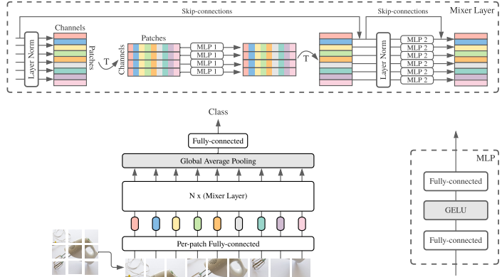
Proposed approach Model’s architecture

Slide 8
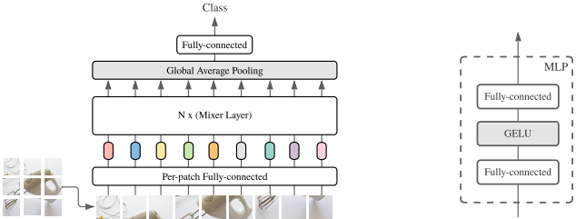
Proposed approach Model’s architecture
Mixer accepts a sequence of linearly projected image patches (tokens) shaped as a “patches × channels” table (X).
Mixer consists of multiple layers of identical size, and each layer consists of two MLP blocks:
Token-mixing MLP block (Per-patch);
Channel-mixing MLP block (Mixer Layer):
Each MLP block contains two fully-connected layers and a non-linearity (GELU) applied independently to each row of its input data tensor.
Finally, it has a linear classifier.

Slide 9
Proposed approach Model’s architecture
Token-mixing MLP block (Per-patch) → it acts on columns of X (i.e. it is applied to a transposed input table) and is shared across all columns, allowing communication between different spatial locations – tokens. We can think of this as encoding the image: this is a widely used compression trick in NNs to reduce the dimensionality of the image and only keep the most crucial features.
Channel-mixing MLP block (Mixer Layer) →it acts on rows of X and is shared across all rows (so, it operates on independent patches of the image, allowing communication between their channels). Mixer tries to find the best way to mix & encode the channels and patches of the image into a meaningful output.

Slide 10
Experimental Results Datasets
MLP-Mixer models are pre-trained with medium- to large-scale dataset:
ImageNet → 1.3M images and 1k classes. Since 2010 this public dataset is used in the ImageNet Large Scale Visual Recognition Challenge (ILSVRC), a benchmark in image classification and object detection.
ImageNet-21k → a superset of ImageNet containing 14M images and 21k classes;
JFT-300M → a proprietary dataset with 300M images and 18k classes. This is an internal Google dataset used for training image classification models. Images are labeled using an algorithm that uses complex mixture of raw web signals, connections between web-pages and user feedback. This results in over one billion labels for the 300M images (a single image can have multiple labels).

Slide 11
Experimental Results Datasets
The performance of that models are evaluated on a range of small and mid-sized downstream classification task, related to the following datasets:
Oxford Flowers-102 → 2k images and 102 classes;
Oxford-IIIT Pets → 3.7k images and 36 classes;
CIFAR-10 → 50k images and 10 classes;
CIFAR-100 → 50k images and 100 classes;
ImageNet → 1.3M images and 1k classes.

Slide 12
Experimental Results Metrics
Accuracy on the downstream task;
Total computational cost of pre-training, which is important when training the model from scratch on the upstream dataset;
Throughput at inference time in images/sec/core, which is important to people that have to deploy the models: number of processed images per second per core.
The highest throughput for each model is reported.
To access the quality of the model, we focus on top-1 downstream accuracy after fine-tuning.

Slide 13
Experimental Results Training Procedure
All models are pre-trained using:
Adam as the optimizer, with the hyper parameters β1 = 0.9, β2 = 0.999: the higher, the better, in fact setting them below 0.5 result in drastic decreases as the number of training steps/batches increases;
Batch size of 4096;
Resolution of images equal to 224;
Weight decay, and gradient clipping at global norm 1.
For JFT-300M, images are pre-processed by applying the cropping technique in addition to random horizontal flipping.
For ImageNet and ImageNet-21k, additional data augmentation and regularization techniques are employed: RandAugment, mixup, dropout and stochastic depth.

Slide 14
Experimental Results Training Procedure
Data are fine-tuned as follows:
SGD optimizer with momentum;
Batch size of 512;
Gradient clipping at global norm 1;
Resolution of images is higher than the one used at pre-training time;
Weight decay is not used when fine-tuning.

Slide 15
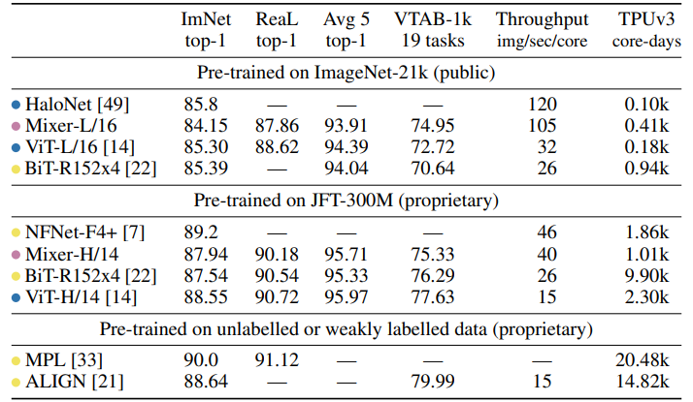
Experimental Results Results
This table presents comparison of the largest Mixer models to state-of-the-art models from the literature.
“ImNet” and “ReaL” columns refer to the original ImageNet validation labels and cleaned-up ReaL labels.
“Avg. 5” stands for the average performance across all five downstream tasks (ImageNet, CIFAR-10, CIFAR-100, Pets, Flowers).

Slide 16
Experimental Results Results
This table highlights the fact that the performance of the Mixer is quite similar to other architectures, however, it’s quite faster. In fact, it has a “throughput” of 105 image/sec/core compared to 32 for the Vision transformer.

Slide 17
Experimental Results Results
When the size of the upstream dataset increases, Mixer’s performance improves significantly. In particular, Mixer-H/14 achieves 87.94% top-1 accuracy on ImageNet, w.r.t. the previous value of 84.15%. Furthermore, Mixer-H/14 runs 2.5 times faster than ViT-H/14.

Slide 18
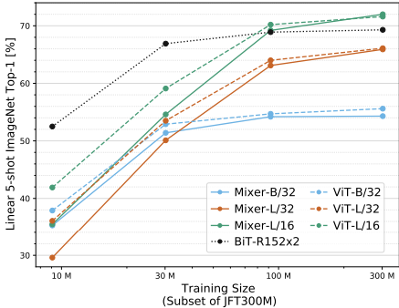
Experimental Results Results
Mixer (solid) catches or exceeds BiT (dotted) and ViT (dashed) as the data size grows.
Every point on a curve uses the same pre-training compute; they correspond to pre-training on 3%, 10%, 30%, and 100% of JFT-300M for 233, 70, 23, and 7 epochs, respectively.
Mixer improves more rapidly with data than ResNets, or even ViT, and the gap between large scale Mixer and ViT models shrinks until the performance is matched on the entire dataset.

Slide 19
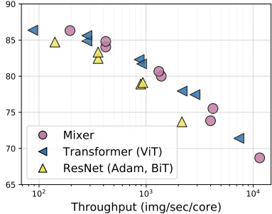

Experimental Results Results
In this case all models are pre-trained on JFT-300M.
We can see that increasing the number of processed images per second per core, we would obtain worst accuracy performances.

Slide 20
Conclusions
The authors describe a very simple architecture for vision.
Their experiments demonstrate that it is as good as existing state-of-the-art methods in terms of the trade-off between accuracy and computational resources required for training and inference.

Slide 21
Conclusions
They believe these results open many questions:
On the practical side, it may be useful to study the features learned by the model and identify the main differences (if any) from those learned by CNNs and Transformers;
On the theoretical side, we would like to understand the inductive biases hidden in these various features and eventually their role in generalization.

Slide 22
Conclusions
Most of all, they hope that their results spark further research, beyond the realms of established models based on convolutions and self-attention.

Slide 23
Thank you for your attention!
MLP-Mixer: An all-MLP Architecture for Vision
Presenter: Daniela Campisi 1000011488

