Slide 1
AIOps
Guardian Pro
AI-assisted investigation for SRE
and cloud operations teams
Presented By : Dani Chakiath Varghese
Capstone project
Notes:
Good morning, everyone. Today I’m presenting my capstone project, AIOps Guardian Pro, an AI-assisted investigation platform for SRE and cloud operations teams.
The project grew beyond my initial scope, but I kept the additional components to demonstrate a realistic SRE workflow. I’ll briefly cover the use case, technology stack, architecture, and a demo.
Source: Presenter-provided shortened capstone script.

Slide 2
Checkout incident use case
Checkout requests fail
after a deployment
Evidence to inspect
Metrics
Logs
An engineer needs evidence
to narrow the cause.
Deployment history
Runbooks
Guardian retains context and asks clarifying questions.
02
Notes:
Imagine an on-call engineer receives an alert that checkout requests are failing after a deployment. Finding the cause requires gathering evidence from metrics, logs, deployment history, and runbooks.
I designed Guardian to support that investigation through a conversational interface. It reviews available evidence, asks clarifying questions, and suggests the next useful check.
Source: Presenter-provided shortened capstone script.

Slide 3
Technology stack
Responsibility | Technology
User interface | React
Backend APIs | Python and FastAPI
Agent coordination and tools | LangGraph and MCP
Records and knowledge retrieval | PostgreSQL and FAISS
Conversational reasoning | Qwen through Ollama
Observability and runtime | Prometheus, Grafana and Kubernetes
03
Notes:
For the technology stack, I use React for the frontend and Python with FastAPI for the backend. LangGraph coordinates specialist agents, while MCP connects them to operational tools.
PostgreSQL stores operational records and conversations, and FAISS supports knowledge retrieval. A local Qwen model through Ollama supports conversational reasoning. I use Prometheus and Grafana for monitoring and visualization, with the application running in Kubernetes.
Source: Presenter-provided shortened capstone script.

Slide 4
Investigation architecture
01
Scope
Identify the application, environment and namespace.
02
Collect
Gather available evidence through specialist tools.
03
Reason
Explain findings using evidence and conversation history.
04
Clarify
Ask for missing details and retain the engineer’s answers.
04
Notes:
Architecturally, the flow starts with an engineer’s question. Guardian identifies the application and environment, gathers relevant evidence, and uses the conversation context to explain findings or request more information.
[Pause briefly to trace the four stages.]
Source: Presenter-provided shortened capstone script.

Slide 5
Human control and verification
Reasoning layer
Guardrail layer
Interprets the available evidence
Suggests the next useful check
Keeps uncertainty visible
Applies deterministic policy
Requires review for risky actions
Keeps approval separate from execution
Executed actions require health verification and an audit record.
05
Notes:
I kept the guardrail layer separate from the reasoning layer. The model can recommend an action, but risky changes require human approval. Any executed action must also be verified and recorded.
[If showing the approval queue, explain that a request does not mean execution.]
Source: Presenter-provided shortened capstone script.

Slide 6
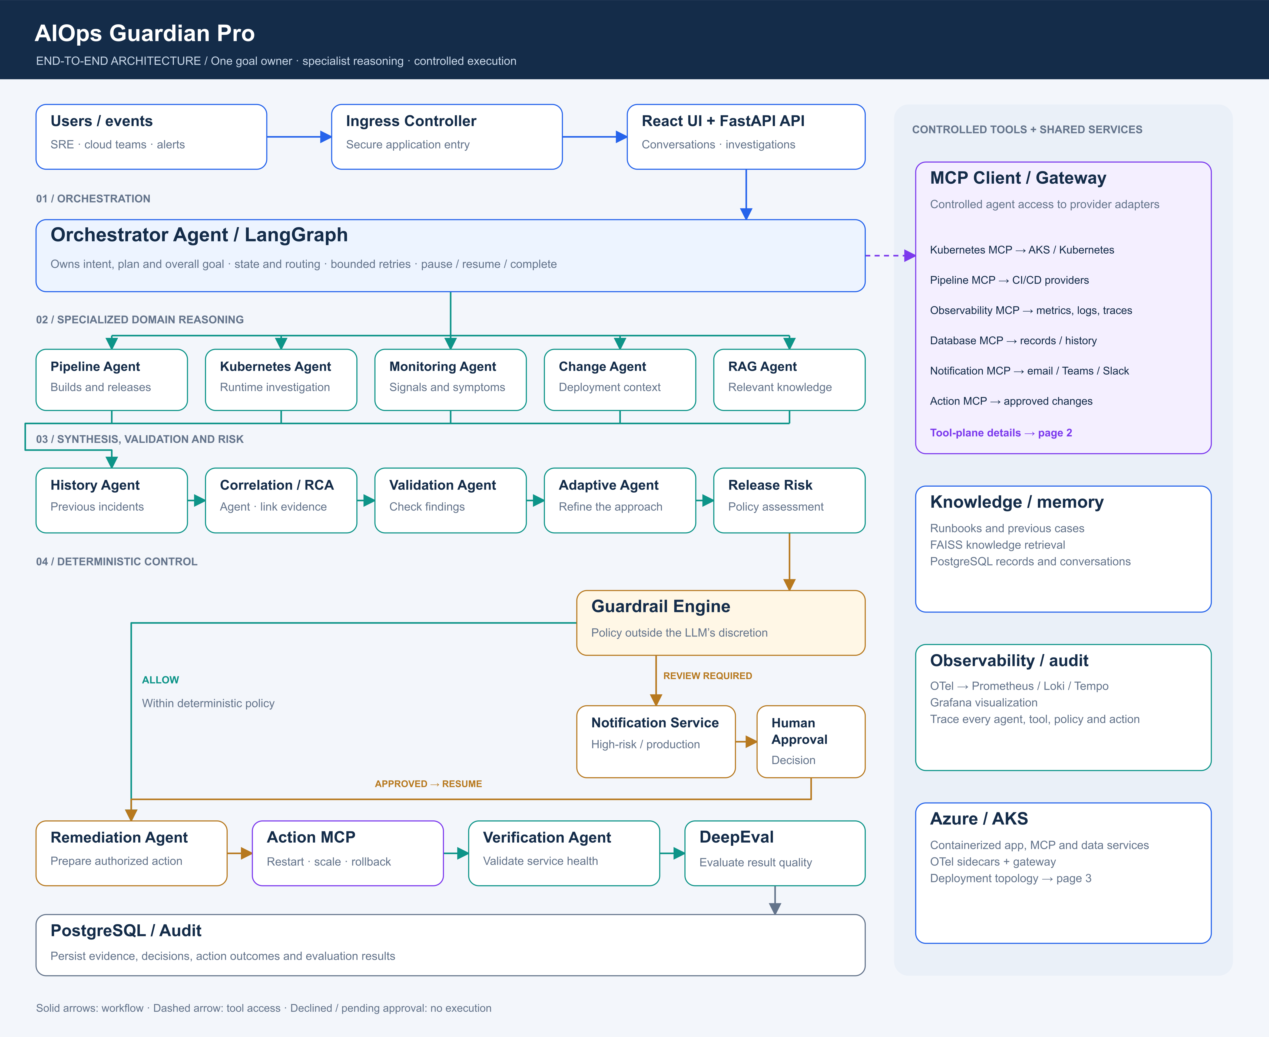

Slide 7
Demonstration scope
Live measurement
Simulated scenario
Local checkout application
Prometheus health metrics
Evidence may leave the cause unconfirmed
Controlled memory failure
Knowledge retrieval example
Human approval policy
Checkout incident walkthrough
06
Notes:
For this demonstration, I use a local checkout application with live Prometheus measurements. I’ll also show a clearly labelled simulated memory-failure scenario to illustrate knowledge retrieval and approval policies.
The goal is to help engineers investigate more efficiently while keeping uncertainty visible and operational decisions under human control.
With that overview, I’ll now walk through the checkout incident.
[Open the local Guardian interface. Keep live measurements separate from simulated evidence.]
Source: Presenter-provided shortened capstone script.

