Slide 1
Game Recommendations on Steam
Using Play/Purchase data to generate a predictive game recommendation model

Slide 2
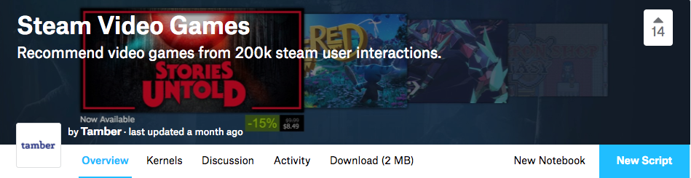
What data have you gathered, and how did you gather it?
I used an open sourced project on Kaggle to find data. With a Kaggle account, it is easy to access data- data science projects and datasets
https://www.kaggle.com/tamber/steam-video-games

Slide 3

Downloading the Data was a little weird...
Downloaded as a zip file
When attempted to unzip, file would become .zip.cpgz, then zip again
Trick to this is using command line “unzip + file extension”

Slide 4
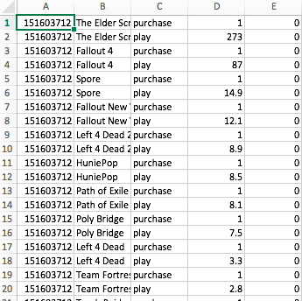
Which areas of the data have been cleaned, and which areas still need cleaning?
The data is a “list of user behaviors”
Columns: user-id, game-title, behavior-name, value. The behaviors included in this data are 'purchase' and 'play' where play is set to the time played, and purchase is always set to 1 to mean yes, it has been purchased (or downloaded in the case for free games
As is, the columns aren’t particularly helpful and they need to be moved around a bit. I wanted play and purchase in the same row.

Slide 5
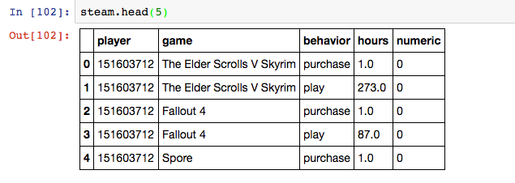
Opening the df in ipython/jupyter

Slide 6
What steps have been taken to explore the data? What insights have been gained from the exploration?
Shape- 200000, 5
Numeric column always = 0 (not useful) I need to remove these columns
Having a play column and purchase column doubles the rows needed. I decided I wanted them both in a single row
Need to make a ‘play’ df and ‘purchase’ df to create a new df
I will probably use KNN and/or clustering in data model to find and predict trends in gaming. (will be based on play hours) I think I can use this data to answer the initial question of trends and predictions in gaming

Slide 7
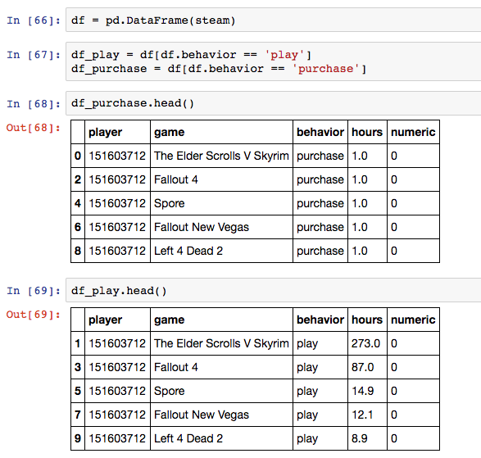
Play/Purchase
Separating out from one df to two- one with play data, and one with purchase data
View of both df.head()

Slide 8
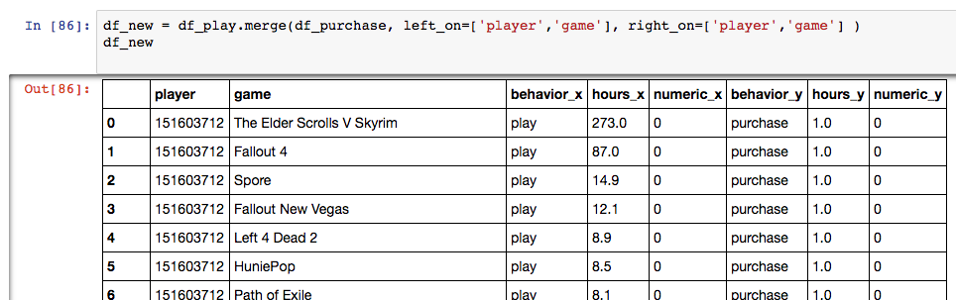
Making the new df
Next, creating one df_new with df_play and df_purchase

Slide 9
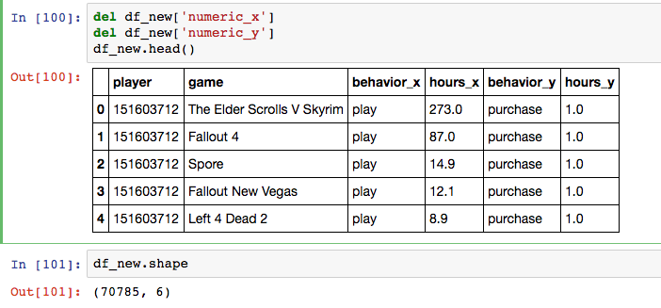
Dropping non-useful ‘numeric’ values

