Slide 1

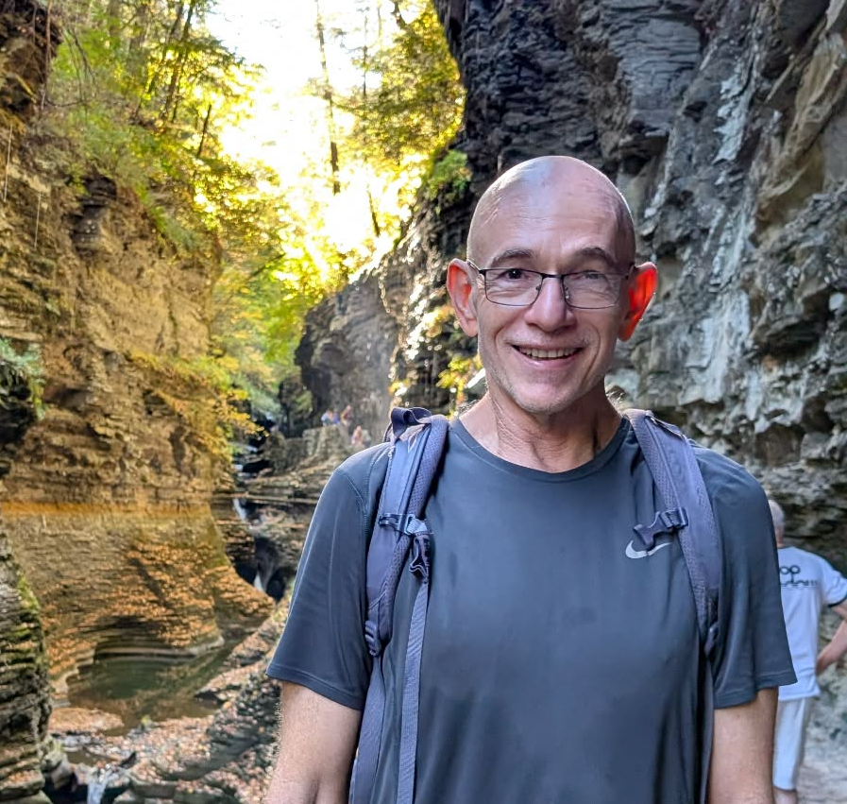
Improved Tree Sparsifiers in Near-Linear Time
Dani Dorfman
Max Planck Institute for Informatics
Daniel Agassy Haim Kaplan
TAU
TAU

Slide 2
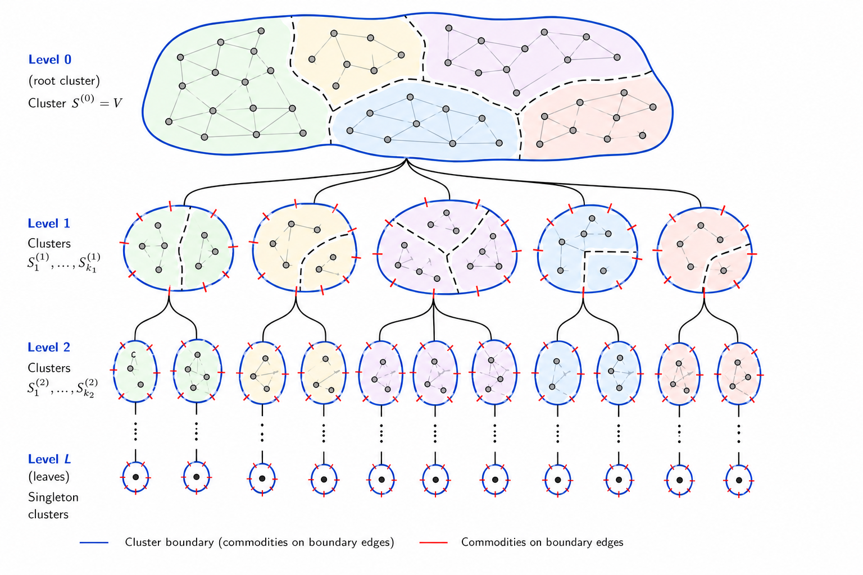
Outline
Cut sparsifiers
Hierarchical trees
Refinement primitive
Improved construction

Slide 3









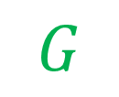

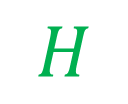





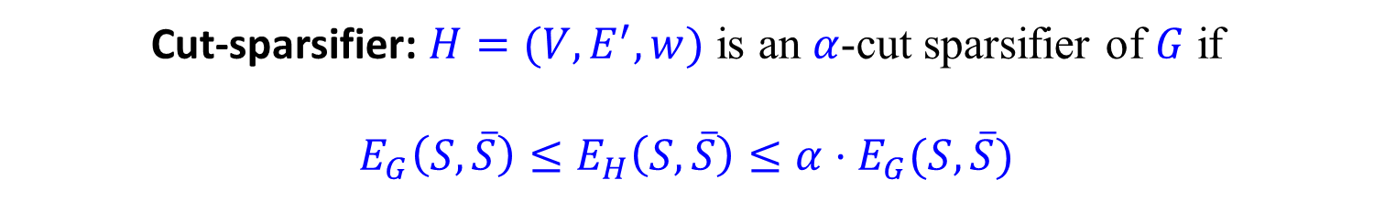



Cut Sparsifiers
$G=(V,E)$ undirected, unweighted graph.
Cut-sparsifier: $H=(V,E^{′},w)$ is an $α$-cut sparsifier of $G$ if
$${E_{G}\left(S,\overline{S}\right)≤E}_{H}\left(S,\overline{S}\right)≤α⋅E_{G}(S,\overline{S})$$
$$∀S⊆V:$$
$$G$$
$$H$$
$$2$$
$$4$$
$$3$$
$$2$$
3
$$1$$
$$2$$
$$1$$
$$2$$
$$2$$
$$2$$
$$2$$
$$2$$
$$1$$
$$4$$
$$2$$
$$1$$
$$2$$
Notes:
Usually, $S$ is chosen s.t. $vol\left(S\right)<vol(\overline{S})$
This is not a cut-sparsifier (some cuts don’t work).

Slide 4
Cut Sparsifiers
$G=(V,E)$ undirected, unweighted graph.
Cut-sparsifier: $H=(V,E^{′},w)$ is an $α$-cut sparsifier of $G$ if
$${E_{G}\left(S,\overline{S}\right)≤E}_{H}\left(S,\overline{S}\right)≤α⋅E_{G}(S,\overline{S})$$
$$∀S⊆V:$$
$$G$$
$$H$$
$$2$$
$$4$$
$$3$$
$$2$$
3
$$1$$
$$2$$
$$1$$
$$2$$
$$2$$
$$2$$
$$2$$
$$2$$
$$1$$
$$4$$
$$2$$
$$1$$
$$2$$
Notes:
Usually, $S$ is chosen s.t. $vol\left(S\right)<vol(\overline{S})$.
This is not a cut-sparsifier (some cuts don’t work).

Slide 5
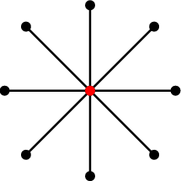











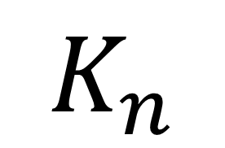







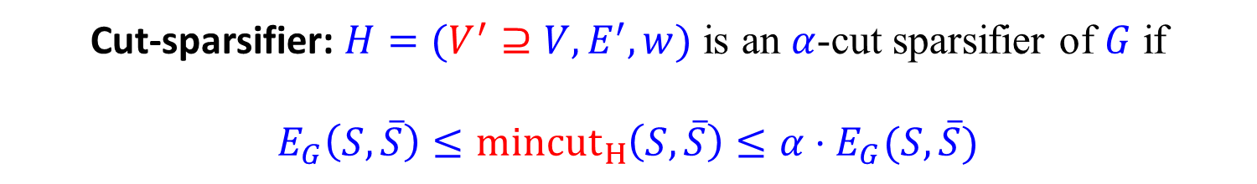



Cut Sparsifiers
$G=(V,E)$ undirected, unweighted graph.
Cut-sparsifier: $H=(V^{′}⊇V,E^{′},w)$ is an $α$-cut sparsifier of $G$ if
$$E_{G}\left(S,\overline{S}\right)≤{mincut}_{H}\left(S,\overline{S}\right)≤α⋅E_{G}(S,\overline{S})$$
$$∀S⊆V.$$
$$1$$
$$1$$
$$K_{n}$$
$$n$$
$$n$$
$$n$$
$$n$$
$$K_{n}$$
$$K_{n}$$
$$n$$
…
…
$$n$$
$$n$$
$$n$$
$$n$$
$$n$$
$$n$$
$$n$$
$$n$$
$$n$$
$$n$$
$$n$$
Notes:
$K_{n}$ is an example with $α=2$.
For the 2 cliques, I didn’t check. But note it is indeed a sparsifer.

Slide 6











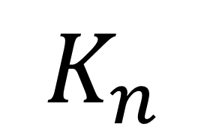







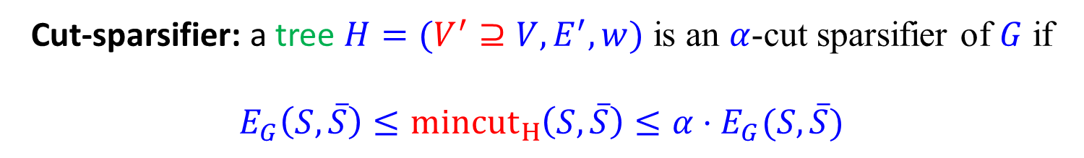



Tree Cut Sparsifier
$G=(V,E)$ undirected, unweighted graph.
Cut-sparsifier: a tree $H=(V^{′}⊇V,E^{′},w)$ is an $α$-cut sparsifier of $G$ if
$$E_{G}\left(S,\overline{S}\right)≤{mincut}_{H}\left(S,\overline{S}\right)≤α⋅E_{G}(S,\overline{S})$$
$$∀S⊆V.$$
$$1$$
$$1$$
$$K_{n}$$
$$n$$
$$n$$
$$n$$
$$n$$
$$K_{n}$$
$$K_{n}$$
$$n$$
…
…
$$n$$
$$n$$
$$n$$
$$n$$
$$n$$
$$n$$
$$n$$
$$n$$
$$n$$
$$n$$
$$n$$

Slide 7
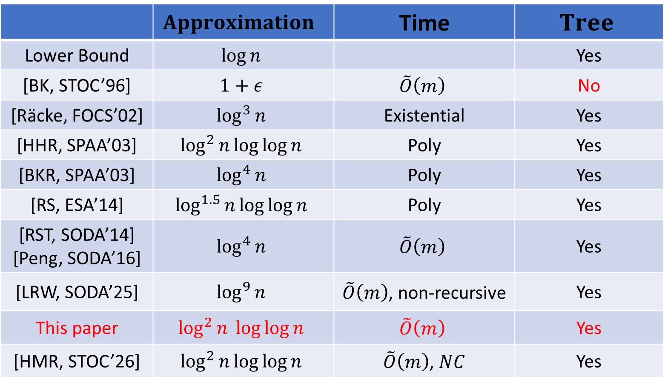
Cut Sparsifiers
 | $$Approximation$$ | Time | $$Tree$$
Lower Bound | $$\log{n}$$ |  | Yes
[BK, STOC’96] | $$1+ε$$ | $$\tilde{O}\left(m\right)$$ | No
[Räcke, FOCS’02] | $$\log^{3}{n}$$ | Existential | Yes
[HHR, SPAA’03] | $$\log^{2}{n}\log{\log{n}}$$ | Poly | Yes
[BKR, SPAA’03] | $$\log^{4}{n}$$ | Poly | Yes
[RS, ESA’14] | $$\log^{1.5}{n}\log{\log{n}}$$ | Poly | Yes
[RST, SODA’14] [Peng, SODA’16] | $$\log^{4}{n}$$ | $$\tilde{O}\left(m\right)$$ | Yes
[LRW, SODA’25] | $$\log^{9}{n}$$ | $\tilde{O}\left(m\right)$, non-recursive | Yes
This paper | $$\log^{2}{n \log{\log{n}}}$$ | $$\tilde{O}\left(m\right)$$ | Yes
[HMR, STOC’26] | $$\log^{2}{n}\log{\log{n}}$$ | $\tilde{O}\left(m\right)$, $NC$ | Yes
Notes:
BK = Benczúr, Karger – Cut sparsifier with near linear (in $n$) number of edges.
HHR = Harrelson, Hildrum, Rao
BKR = Bienkowski, Korzeniowski, Räcke
RS = Räcke, Shah
RST = Räcke, Shah, Täubig
LRW = Li, Rao, Wang
HMR = Henzinger, Münk, Räcke – Independent and concurrent result, they explain how to implement the construction in poly-log time with parallel computation. The algorithms use similar building blocks but operate using different flows. Their flow is more intricate while ours is simpler and more straightforward.

Slide 8
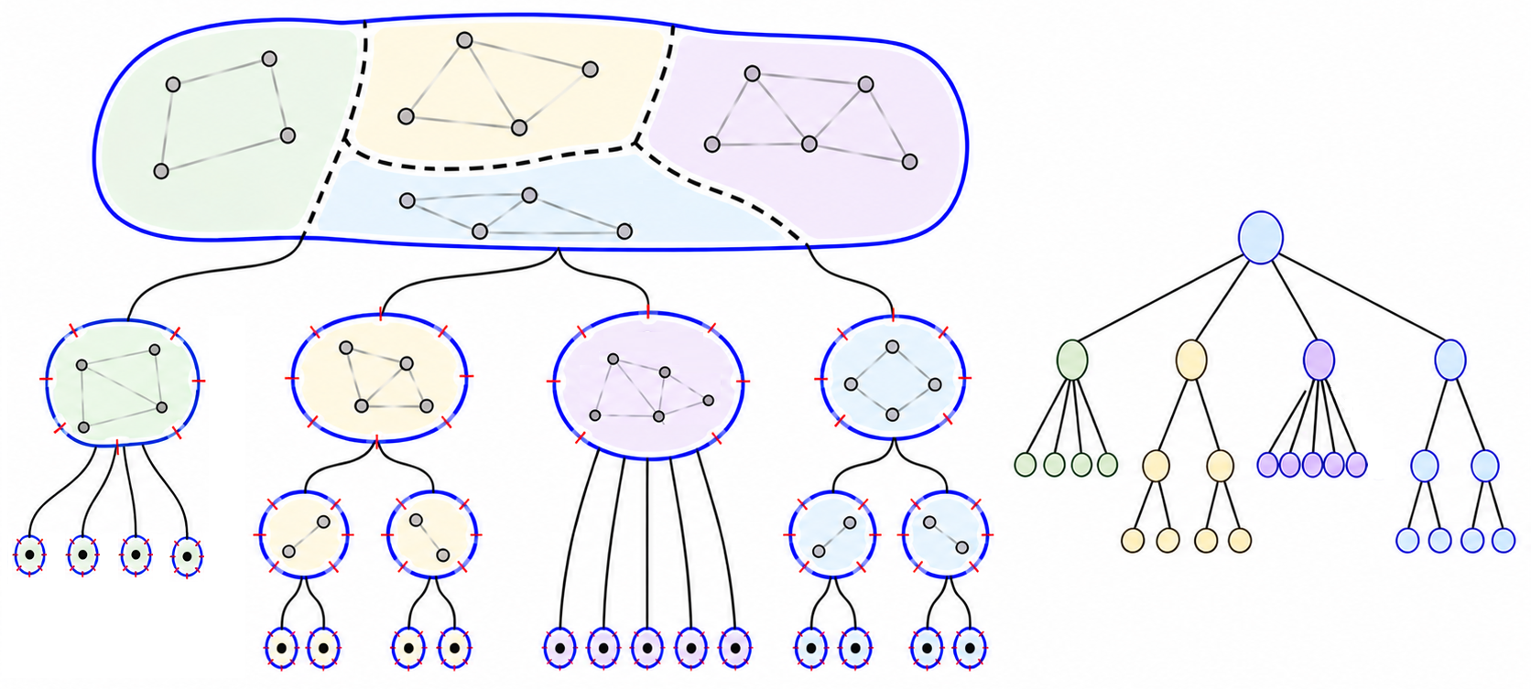
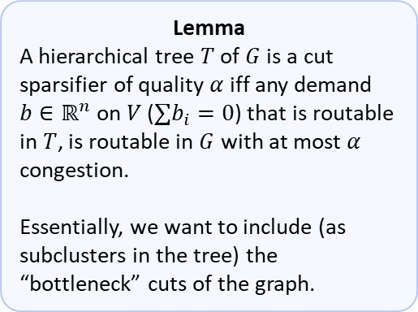
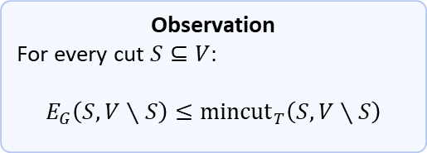

Hierarchical Trees
$G=(V,E)$ undirected, unweighted graph.
$T=\left(V^{′}⊇V,E^{′},w\right)$ is a Hierarchical Tree of $G$ if
$V′$ is a laminar partition $\{S_{i}\}$ of $V$.
$w\left(S,P(S)\right)=E_{G}(S, V∖S)$, for every $S∈V′$.
Observation
For every cut $S⊆V:$
$$E_{G}\left(S,V∖S\right)≤{mincut}_{T}\left(S,V∖S\right)$$
Lemma
A hierarchical tree $T$ of $G$ is a cut sparsifier of quality $α$ iff any demand $b∈ℝ^{n}$ on $V$ ($∑b_{i}=0$) that is routable in $T$, is routable in $G$ with at most $α$ congestion.
Essentially, we want to include (as subclusters in the tree) the “bottleneck” cuts of the graph.
Notes:
Observation proof:
Consider two vertices $u, v$. The weight of the edge between them is added to all tree edges on the path from $u$ to $v$ in $T$. Thus, because they are in different sides of the min-cut, the weight of the edge is counted in the mincut.

Slide 9
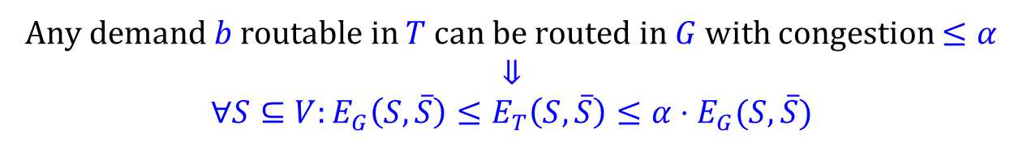

Lemma proof
Any demand $b$ routable in $T$ can be routed in $G$ with congestion $≤α$
$⇓$
$$∀S⊆V:{E_{G}\left(S,\overline{S}\right)≤E}_{T}\left(S,\overline{S}\right)≤α⋅E_{G}(S,\overline{S})$$
Fix a cut $S⊆V$.
Notes:
Proof (only the direction of being able to route -> cut sparsifier):

Slide 10





Lemma proof
Any demand $b$ routable in $T$ can be routed in $G$ with congestion $≤α$
$⇓$
$$∀S⊆V:{E_{G}\left(S,\overline{S}\right)≤E}_{T}\left(S,\overline{S}\right)≤α⋅E_{G}(S,\overline{S})$$
Fix a cut $S⊆V$.
Flow value $\left|f\right|={\text{mincut}}_{T}\left(S, \overline{S}\right)$
$$∞$$
$$∞$$
$$∞$$
$$∞$$
$$∞$$
$$∞$$
$$∞$$
$$∞$$
$$s$$
$$t$$
Notes:
Proof (only the direction of being able to route -> cut sparsifier):
Given $S, \overline{S}$ add a source and sink with $∞$ edges. See how much can be routed.
The value of the flow is the min-cut in the tree.

Slide 11






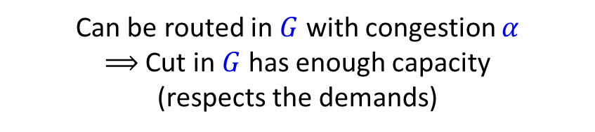


Lemma proof
Any demand $b$ routable in $T$ can be routed in $G$ with congestion $≤α$
$⇓$
$$∀S⊆V:{E_{G}\left(S,\overline{S}\right)≤E}_{T}\left(S,\overline{S}\right)≤α⋅E_{G}(S,\overline{S})$$
Fix a cut $S⊆V$.
Flow value $\left|f\right|={\text{mincut}}_{T}\left(S, \overline{S}\right)$
Can be routed in $G$ with congestion $α$ $⟹$ Cut in $G$ has enough capacity (respects the demands)
$$b_{2}$$
$${|b}_{6}|$$
$$b_{1}$$
$${|b}_{7}|$$
$$b_{3}$$
$${|b}_{5}|$$
The reverse direction is similar.
$$b_{4}$$
$${|b}_{8}|$$
$$s$$
$$t$$
Notes:
Proof (only the direction of being able to route -> cut sparsifier):
The value of the flow is the min-cut in the tree.
It can be routed in the graph, so the corresponding cut in the graph has enough capacity.

Slide 12
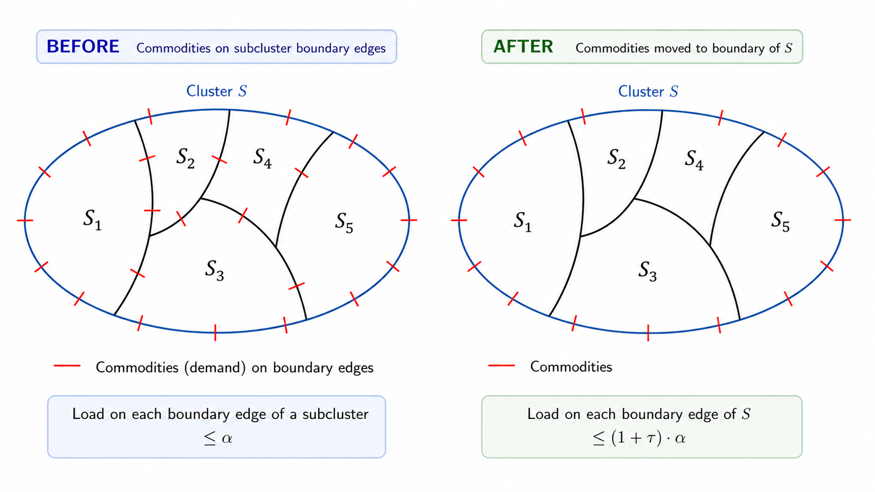
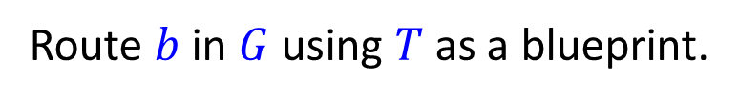
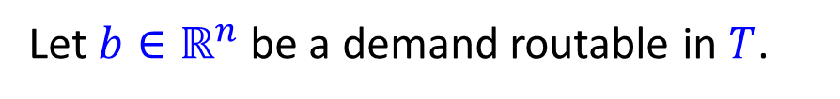


The Ideal Routing Picture
Assume we have a hierarchical decomposition with the property:
In every cluster $S$, there is an all-to-all multicommodity-flow routing on $F∪B.$
Let $b∈ℝ^{n}$ be a demand routable in $T$.
Respect the all-to-all flow
Route $b$ in $G$ using $T$ as a blueprint.
$B$: Boundary edges
$F$: inter-cluster edges
Notes:
Actually, we only need the all-to-all multi-commodity flow problem to be respected.
From now on, I will talk about it being routable, because it’s good for the intuition, but will in fact give the guarantees for respecting,

Slide 13
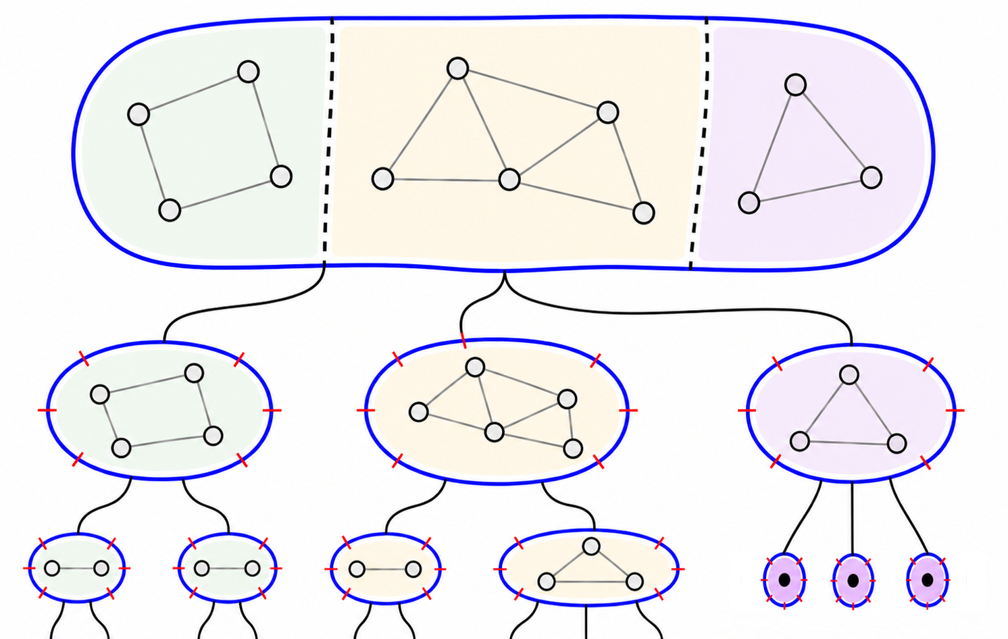













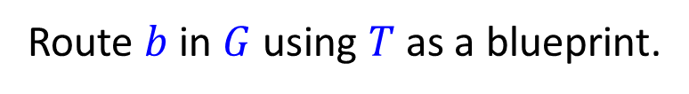


The Ideal Routing Picture
Route $b$ in $G$ using $T$ as a blueprint.
Shift the demand from nodes to edges
$$0$$
$$0$$
$$3$$
$$0$$
$$0$$
$$3$$
$$3$$
$$0$$
$$4$$
$$3$$
$$2$$
$$0$$
$$0$$
$$2$$
$$3$$
$$3$$
$$0$$
$$4$$
$$3$$
$$2$$
$$0$$
$$0$$
$$2$$
$$3$$

Slide 14














The Ideal Routing Picture
Route $b$ in $G$ using $T$ as a blueprint.
Shift the demand from nodes to edges
$$1$$
$$1$$
$$1$$
$$1$$
$$1$$
$$0$$
$$0$$
$$1$$
$$1$$
$$1$$
$$1$$
$$1$$
$$0$$
$$0$$
$$3$$
$$1$$
$$1$$
$$1$$
$$1$$
$$1$$
$$1$$
$$1$$
$$0$$
$$0$$
$$0$$
$$0$$
$$1$$
$$3$$
$$0$$
$$4$$
$$3$$
$$2$$
$$0$$
$$0$$
$$2$$
$$3$$

Slide 15






The Ideal Routing Picture
Route $b$ in $G$ using $T$ as a blueprint.
Shift the demand from nodes to edges
Use the all-to-all flow in order to cancel positive and negative demands and move the demands to the boundary
$$1$$
$$1$$
$$1$$
$$1$$
$$1$$
$$1$$
$$1$$
$$1$$
$$1$$
$$1$$
$$1$$
$$1$$
$$1$$
$$1$$
$$1$$
$$1$$
$$1$$
$$1$$
$$0$$
$$0$$
$$0$$
$$0$$
$$3$$
$$0$$
$$0$$
$$0$$
$$0$$
$$3$$
$$0$$
$$4$$
$$3$$
$$2$$
$$0$$
$$0$$
$$2$$
$$3$$

Slide 16












The Ideal Routing Picture
Route $b$ in $G$ using $T$ as a blueprint.
Shift the demand from nodes to edges
Use the all-to-all flow in order to cancel positive and negative demands and move the demands to the boundary
At most one unit of demand!
$$\frac{1}{2}$$
$$\frac{1}{2}$$
$$\frac{1}{2}$$
$$\frac{1}{2}$$
$$\frac{1}{2}$$
$$\frac{1}{2}$$
$$\frac{1}{2}$$
$$\frac{1}{2}$$
$$\frac{1}{6}$$
$$\frac{1}{6}$$
$$\frac{1}{6}$$
$$\frac{1}{6}$$
$$\frac{1}{2}$$
$$\frac{1}{2}$$
$$\frac{1}{6}$$
$$\frac{1}{6}$$
$$\frac{1}{6}$$
$$\frac{1}{6}$$
$$\frac{1}{2}$$
$$\frac{1}{2}$$
$$\frac{1}{6}$$
$$\frac{1}{6}$$
$$\frac{1}{6}$$
$$\frac{1}{6}$$
$$0$$
$$0$$
$$0$$
$$0$$
$$3$$
$$0$$
$$0$$
$$0$$
$$0$$
$$3$$
$$0$$
$$4$$
$$3$$
$$2$$
$$0$$
$$0$$
$$2$$
$$3$$
Notes:
Here we use that there is at most one unit on each boundary edge, because the total boundary weight is the weight of the corresponding edge in $T$, and the flow can be routed in $T$. After the uniform flow, the remaining flow on the boundary must leave (or enter) the sub-cluster.

Slide 17
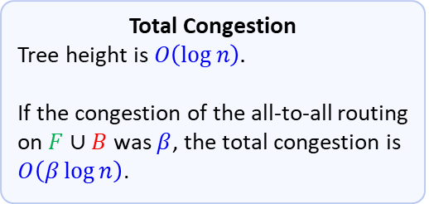


The Ideal Routing Picture
Route $b$ in $G$ using $T$ as a blueprint.
Shift the demand from nodes to edges
Use the all-to-all flow in order to cancel positive and negative demands and move the demands to the boundary
Total Congestion
Tree height is $O\left(\log{n}\right).$
If the congestion of the all-to-all routing on $F∪B$ was $β$, the total congestion is $O\left(β\log{n}\right)$.
At most one unit of demand!
$$\frac{1}{2}$$
$$\frac{1}{2}$$
$$\frac{1}{2}$$
$$\frac{1}{6}$$
$$\frac{1}{6}$$
$$\frac{1}{2}$$
$$\frac{1}{2}$$
$$\frac{1}{2}$$
$$\frac{1}{2}$$
$$\frac{1}{6}$$
$$\frac{1}{2}$$
$$\frac{1}{6}$$
$$\frac{1}{6}$$
$$\frac{1}{6}$$
$$\frac{1}{6}$$
$$\frac{1}{2}$$
$$\frac{1}{2}$$
$$\frac{1}{6}$$
$$\frac{1}{6}$$
$$\frac{1}{6}$$
$$\frac{1}{6}$$
$$\frac{1}{2}$$
$$\frac{1}{6}$$
$$\frac{1}{2}$$
$$0$$
$$0$$
$$0$$
$$0$$
$$3$$
$$0$$
$$0$$
$$0$$
$$0$$
$$3$$
$$0$$
$$4$$
$$3$$
$$2$$
$$0$$
$$0$$
$$2$$
$$3$$

Slide 18

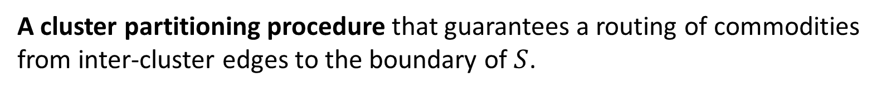
Räcke, Shah, Täubig SODA’14
A cluster partitioning procedure that guarantees a routing of commodities from inter-cluster edges to the boundary of $S$.
$\frac{α\log{n}}{ τ}$ Congestion
Notes:
Here we consider (our) cut variant of RST – they had $\frac{α\log^{2}{n}}{τ}$ congestion and were actually able to route.
The load on each boundary edge is not necessarily $1$, because we did not cancel all internal demands in the cluster.

Slide 19
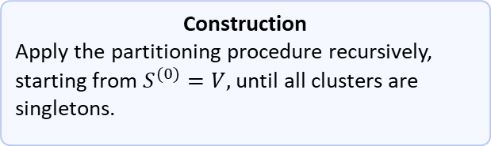
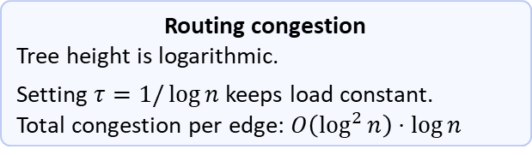
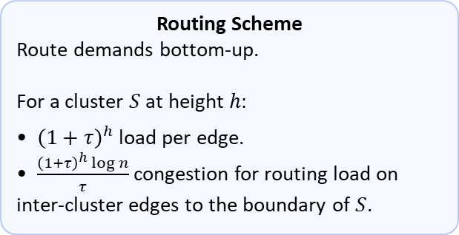
Räcke, Shah, Täubig SODA’14
Construction
Apply the partitioning procedure recursively, starting from $S^{(0)}=V,$ until all clusters are singletons.
Routing Scheme
Route demands bottom-up.
For a cluster $S$ at height $h:$
• ${\left(1+τ\right)}^{h}$ load per edge.
• $\frac{{\left(1+τ\right)}^{h}\log{n}}{τ}$ congestion for routing load on inter-cluster edges to the boundary of $S$.
Routing congestion
Tree height is logarithmic.
Setting $τ=1/\log{n}$ keeps load constant.
Total congestion per edge: $O\left(\log^{2}{n}\right)⋅\log{n}$
Single cluster
Tree height

Slide 20
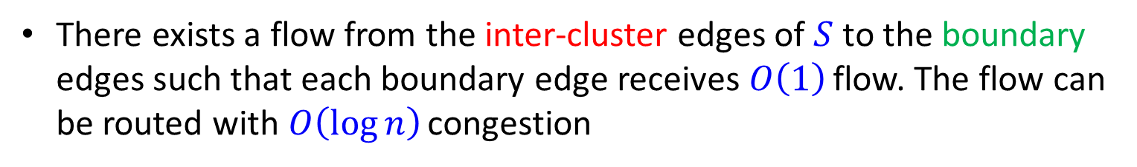
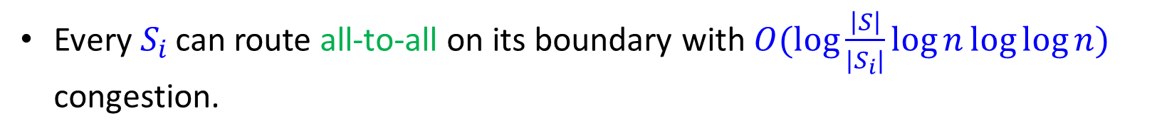
A Refinement Phase
Can we avoid the $1+τ$ load blow up factor?
Yes, if we are able to route all-to-all on the boundary
Theorem
Let $S⊆V.$ We can partition $S$ in $\tilde{O}(m)$ into subclusters ${\left\{S_{i}\right\}}_{i}$ such that:
Every $S_{i}$ can route all-to-all on its boundary with $O(\log{\frac{\left|S\right|}{|S_{i}|}}\log{n}\log{\log{n}})$ congestion.
Respect* the all-to-all flow
There exists a flow from the inter-cluster edges of $S$ to the boundary edges such that each boundary edge receives $O\left(1\right)$ flow. The flow can be routed with $O\left(\log{n}\right)$ congestion

Slide 21










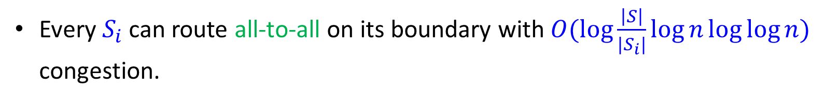


A Refinement Phase
Theorem
Let $S⊆V.$ We can partition $S$ in $\tilde{O}(m)$ into subclusters ${\left\{S_{i}\right\}}_{i}$ such that:
Every $S_{i}$ can route all-to-all on its boundary with $O(\log{\frac{\left|S\right|}{|S_{i}|}}\log{n}\log{\log{n}})$ congestion.
Seymour’s trick
There exists a flow from the inter-cluster edges of $S$ to the boundary edges such that each boundary edge receives $O\left(1\right)$ flow. The flow can be routed with $O\left(\log{n}\right)$ congestion.
$$S_{2}$$
$$S_{4}$$
$$S_{2}$$
$$S_{4}$$
$$S_{1}$$
$$S_{5}$$
$$S_{1}$$
$$S_{5}$$
$$S_{3}$$
$\log{n}$ Congestion
$$S_{3}$$
Notes:
Again, we mean respecting the all to all flow.
About Seymour’s trick – essentially, we say that when the cluster $S_{i}$ is much smaller than $S$, we allow for a weaker guarantee.

Slide 22
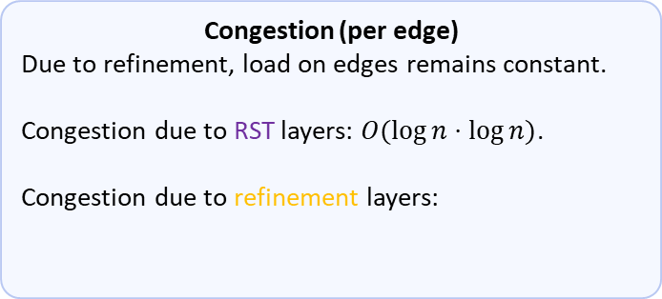

Alternating Construction
Alternate between RST and Refinement
Congestion (per edge)
Due to refinement, load on edges remains constant.
Congestion due to RST layers: $O(\log{n⋅\log{n})}$.
Congestion due to refinement layers:
$$\sum{\log{\frac{\left|S_{i}\right|}{|S_{i+1}|}}\log{n}\log{\log{n}}}=\log^{2}{n}\log{\log{n}}$$
…
…
…
…
…
…
…
…
…
…
Notes:
I’m talking about congestion per edge

Slide 23
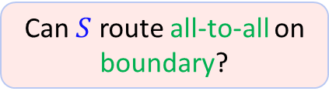

Implementing refinement
Iteratively check whether boundary can route all-to-all.
If not, find a (balanced) cut that certifies impossibility.
recur on both sides.
Can $S$ route all-to-all on boundary?
No, certificate cut
$$S$$

Slide 24


Implementing refinement
Iteratively check whether boundary can route all-to-all.
If not, find a (balanced) cut that certifies impossibility.
recur on both sides.
Can $S$ route all-to-all on boundary?
No, certificate cut
$$S_{1}$$
$$S_{2}$$

Slide 25
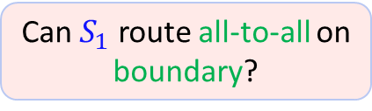
Implementing refinement
Iteratively check whether boundary can route all-to-all.
If not, find a (balanced) cut that certifies impossibility.
recur on both sides.
Can $S_{1}$ route all-to-all on boundary?
Yes
$$S_{1}$$
$$S_{2}$$

Slide 26


Implementing refinement
Iteratively check whether boundary can route all-to-all.
If not, find a (balanced) cut that certifies impossibility.
recur on both sides.
$$S_{2}$$
$$S_{1}$$
$$S_{3}$$

Slide 27


Implementing refinement
Iteratively check whether boundary can route all-to-all.
If not, find a (balanced) cut that certifies impossibility.
recur on both sides.
What about flow from inter-cluster-edges to the boundary?
$$S_{2}$$
$$S_{4}$$
$$S_{1}$$
$$S_{5}$$
By white-boxing the balanced cut algorithm we prove that it certifies flow
$$S_{3}$$

Slide 28
Implementing refinement
Iteratively check whether boundary can route all-to-all.
If not, find a (balanced) cut that certifies impossibility.
recur on both sides.
What about flow from inter-cluster-edges to the boundary?
Flow is sent from the cut to the boundary on the smaller side of the cut
$$S_{2}$$
By white-boxing the balanced cut algorithm we prove that it certifies flow
$$S_{1}$$

Slide 29
Implementing refinement
Iteratively check whether boundary can route all-to-all.
If not, find a (balanced) cut that certifies impossibility.
recur on both sides.
What about flow from inter-cluster-edges to the boundary?
Flow is sent from the cut to the boundary on the smaller side of the cut
$$S_{2}$$
By white-boxing the balanced cut algorithm we prove that it certifies flow
$$S_{1}$$
$$S_{3}$$

Slide 30
Implementing refinement
Iteratively check whether boundary can route all-to-all.
If not, find a (balanced) cut that certifies impossibility.
recur on both sides.
What about flow from inter-cluster-edges to the boundary?
Flow is sent from the cut to the boundary on the smaller side of the cut
$$S_{2}$$
$$S_{4}$$
By white-boxing the balanced cut algorithm we prove that it certifies flow
$$S_{1}$$
$$S_{3}$$

Slide 31
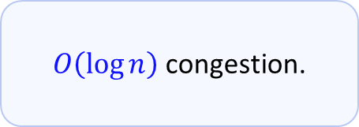
Implementing refinement
Iteratively check whether boundary can route all-to-all.
If not, find a (balanced) cut that certifies impossibility.
recur on both sides.
What about flow from inter-cluster-edges to the boundary?
Flow is sent from the cut to the boundary on the smaller side of the cut
$$S_{2}$$
$$S_{4}$$
$$S_{5}$$
$O\left(\log{n}\right)$ congestion.
By white-boxing the balanced cut algorithm we prove that it certifies flow
$$S_{1}$$
$$S_{3}$$

Slide 32

Future Work
A recent result achieved almost optimal expander decomposition in polynomial time. Can we get almost optimal tree cut-sparsifiers?
Almost linear time cut sparsifier with $\log^{1.5}{n}\log{\log{n}}$ quality (matching best polynomial time)?
Notes:
2) I mean using Sherman’s $O\left(\sqrt{\log{n}}\right)$ approx. sparse cut in almost linear time. Probably the hardest part is making Sherman return a balanced sparse cut (Sherman

Slide 33
Thank you for your attention!

