Slide 1


Improved Bounds for Strategy Improvement Algorithms for Energy Games
Dani Dorfman
MPI für Informatik
Haim Kaplan Uri Zwick
Notes:
Thesis based on a paper that is a joint work with…

Slide 2








Outline
Energy Games.
Strategy Improvement.
Layering.
$$2$$
$$−3$$
$$2$$
$$2$$
$$2$$
$$−2$$
$$−3$$
$$10$$

Slide 3









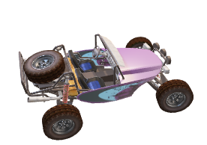







Energy Games
$$−2$$
$$3$$
$$1$$
$$1$$
$$−2$$
$$−2$$
-$1$
$$−2$$
$$3$$
$$0$$
$$0$$
$$3$$
$$−10$$
$$−10$$
$−$ player $0, minimizer$
$−$ player $1, maximizer$

Slide 4

Energy Games
$$−2$$
$$3$$
$$1$$
$$1$$
$$−2$$
$$−2$$
-$1$
$$−2$$
$$3$$
$$0$$
$$0$$
$$3$$
$$−10$$
$$−10$$
$−$ player $0, minimizer$
$−$ player $1, maximizer$

Slide 5
Energy Games
$$−2$$
$$3$$
$$1$$
$$1$$
$$−2$$
$$−2$$
-$1$
$$−2$$
$$3$$
$$0$$
$$0$$
$$3$$
$$−10$$
$$−10$$
$−$ player $0, minimizer$
$−$ player $1, maximizer$

Slide 6

Energy Games
$$−2$$
$$3$$
$$1$$
$$1$$
$$−2$$
$$−2$$
-$1$
$$−2$$
$$3$$
$$0$$
$$0$$
$$3$$
$$−10$$
$$−10$$
$−$ player $0, minimizer$
$−$ player $1, maximizer$

Slide 7


Energy Games
$$−2$$
$$3$$
$$1$$
$$1$$
$$−2$$
$$−2$$
-$1$
$$−2$$
$$3$$
$$0$$
$$0$$
$$3$$
$$−10$$
$$−10$$
$−$ player $0, minimizer$
$−$ player $1, maximizer$

Slide 8
Energy Games
$$−2$$
$$3$$
$$1$$
$$1$$
$$−2$$
$$−2$$
-$1$
$$−2$$
$$3$$
$$0$$
$$0$$
$$3$$
$$−10$$
$$−10$$
$−$ player $0, minimizer$
$−$ player $1, maximizer$

Slide 9
Energy Games
$$−2$$
$$3$$
$$1$$
$$1$$
$$−2$$
$$−2$$
-$1$
$$−2$$
$$3$$
$$0$$
$$0$$
$$3$$
$$−10$$
$$−10$$
$−$ player $0, minimizer$
$−$ player $1, maximizer$

Slide 10

Energy Games
$$−2$$
$$3$$
$$1$$
$$1$$
$$−2$$
$$−2$$
-$1$
$$−2$$
$$3$$
$$0$$
$$0$$
$$3$$
$$−10$$
$$−10$$
$−$ player $0, minimizer$
$−$ player $1, maximizer$

Slide 11

Energy Games
$$−2$$
$$3$$
$$1$$
$$1$$
$$−2$$
$$−2$$
-$1$
$$−2$$
$$3$$
$$0$$
$$0$$
$$3$$
$$−10$$
$$−10$$
$−$ player $0, minimizer$
$−$ player $1, maximizer$

Slide 12

Energy Games
$$−2$$
$$3$$
$$1$$
$$1$$
$$−2$$
$$−2$$
-$1$
$$−2$$
$$3$$
$$0$$
$$0$$
$$3$$
$$−10$$
$$−10$$
$−$ player $0, minimizer$
$−$ player $1, maximizer$

Slide 13
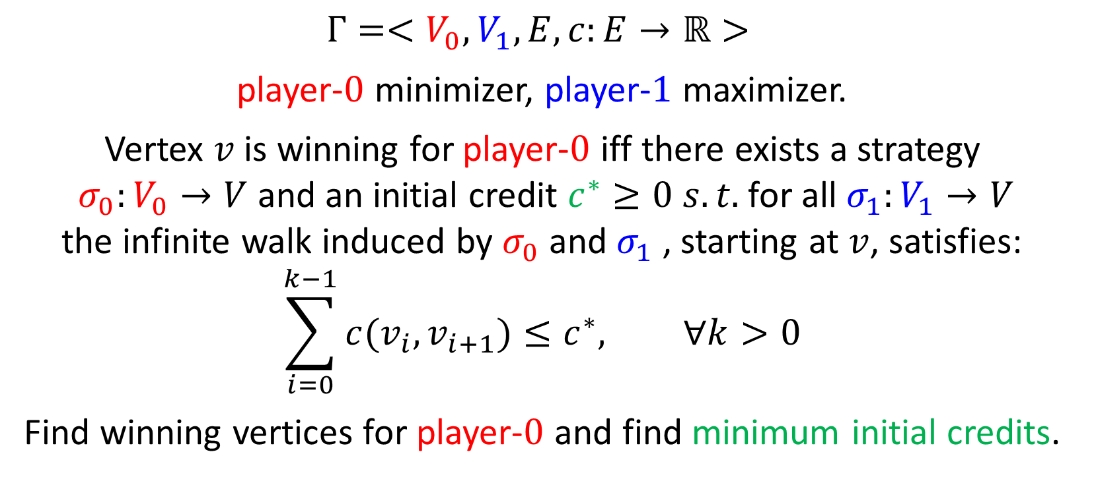
Energy Games
$$Γ=<V_{0},V_{1},E,c:E→ℝ>$$
player-$0$ minimizer, player-$1$ maximizer.
Vertex $v$ is winning for player-$0$ iff there exists a strategy $σ_{0}:V_{0}→V$ and an initial credit $c^{∗}≥0$ $s.t.$ for all $σ_{1}:V_{1}→V$ the infinite walk induced by $σ_{0}$ and $σ_{1}$ , starting at $v$, satisfies:
$$\sum_{i=0}^{k−1}{c(v_{i},v_{i+1})}≤c^{∗}, ∀k>0$$
Find winning vertices for player-$0$ and find minimum initial credits.

Slide 14






















Energy Games
Minimal initial Energies
$$−2$$
$$1$$
$$3$$
$$4$$
$$1$$
$$∞$$
$$1$$
$$3$$
$$−2$$
$$−2$$
$$−1$$
$$∞$$
$$−2$$
$$3$$
$$0$$
$$0$$
$$3$$
$$0$$
$$−10$$
$$∞$$
$$−10$$
$$∞$$
Energy Games admit optimal positional strategies for both players.

Slide 15
Energy Games
Minimal initial Energies
$$−2$$
$$1$$
$$3$$
$$4$$
$$1$$
$$∞$$
$$1$$
$$3$$
$$−2$$
$$−2$$
$$−1$$
$$∞$$
$$−2$$
$$3$$
$$0$$
$$0$$
$$3$$
$$0$$
$$−10$$
$$∞$$
$$−10$$
$$∞$$
Energy Games admit optimal positional strategies for both players.

Slide 16



Energy Games
Minimal initial Energies
$$−2$$
$$1$$
$$3$$
$$4$$
$$1$$
$$∞$$
$$1$$
$$3$$
$$−2$$
$$−2$$
$$−1$$
$$∞$$
$$−2$$
$$3$$
$$0$$
$$0$$
$$3$$
$$0$$
$$−10$$
$$∞$$
$$−10$$
$$∞$$
Energy Games admit optimal positional strategies for both players.

Slide 17
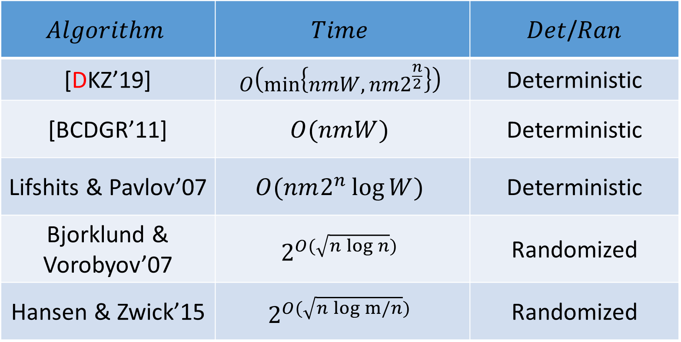

Previous Results
$$c:E→\{−W,…0,…,W\}$$
$$Algorithm$$ | $$Time$$ | $Det$/$Ran$
[DKZ’19] | $$O\left(\min\left\{nmW,nm2^{\frac{n}{2}}\right\}\right)$$ | Deterministic
[BCDGR’11] | $$O(nmW)$$ | Deterministic
Lifshits & Pavlov’07 | $$O(nm2^{n}\log{W})$$ | Deterministic
Bjorklund & Vorobyov’07 | $$2^{O(\sqrt{n\log{n}})}$$ | Randomized
Hansen & Zwick’15 | $$2^{O(\sqrt{n\log{m/n}})}$$ | Randomized
Notes:
Brim Chaloupka Doyen Gentilini Raskin

Slide 18
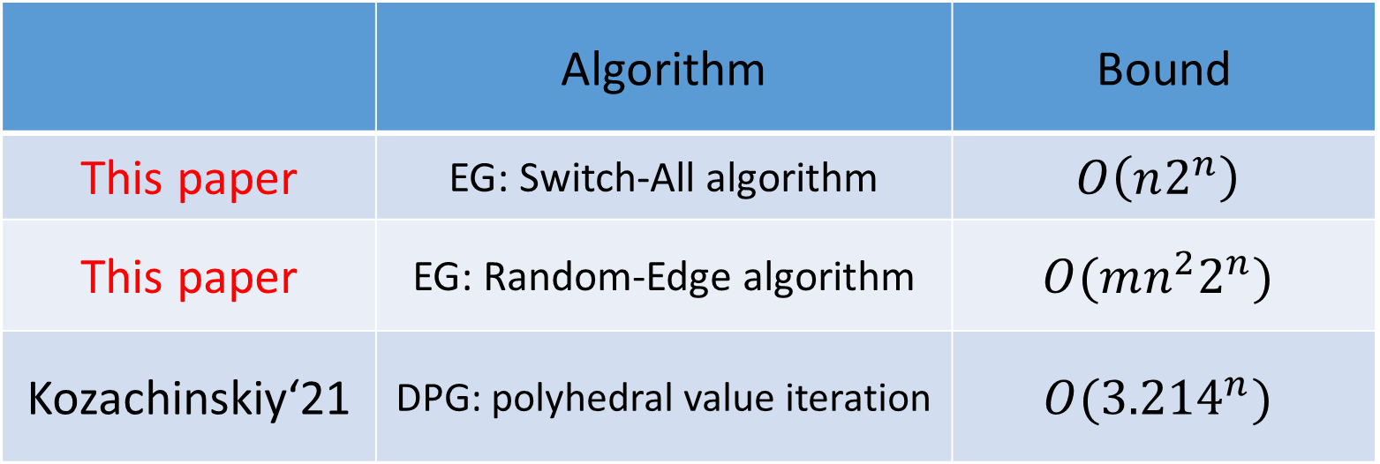
New Applications of the Layering Technique
 | Algorithm | Bound
This paper | EG: Switch-All algorithm | $$O\left(n2^{n}\right)$$
This paper | EG: Random-Edge algorithm | $$O(mn^{2}2^{n})$$
Kozachinskiy‘21 | DPG: polyhedral value iteration | $$O({3.214}^{n})$$

Slide 19



Valid Potential Functions
$f:V→ℝ_{≥0}$ is a $valid potential$ if for every $v∈V$:
If $u∈V_{0}$ then $∃\left(u,v\right)∈E. f\left(v\right)+c\left(u,v\right)≤f(u)$
If $u∈V_{1}$ then $∀\left(u,v\right)∈E. f\left(v\right)+c\left(u,v\right)≤f(u)$
We say that $v∈V$ is $valid$ with respect to $f$ if $v$ satisfies the above constraints. Otherwise $v$ is $invalid$.
Define the modified costs with respect to $f:V→ℝ_{≥0}$ $$c_{f}\left(u,v\right)=c\left(u,v\right)−f\left(u\right)+f(v)$$
Notes:
Energy progress measure is basically a partition of sufficient initial energies which is consistent within itself.

Slide 20


Valid Potential Functions
$f:V→ℝ_{≥0}$ is a $valid potential$ if for every $v∈V$:
If $u∈V_{0}$ then $∃\left(u,v\right)∈E. c_{f}\left(u,v\right)≤0$
If $u∈V_{1}$ then $∀\left(u,v\right)∈E. c_{f}\left(u,v\right)≤0$
We say that $v∈V$ is $valid$ with respect to $f$ if $v$ satisfies the above constraints. Otherwise $v$ is $invalid$.
Define the modified costs with respect to $f:V→ℝ_{≥0}$ $$c_{f}\left(u,v\right)=c\left(u,v\right)−f\left(u\right)+f(v)$$
Notes:
Energy progress measure is basically a partition of sufficient initial energies which is consistent within itself.

Slide 21
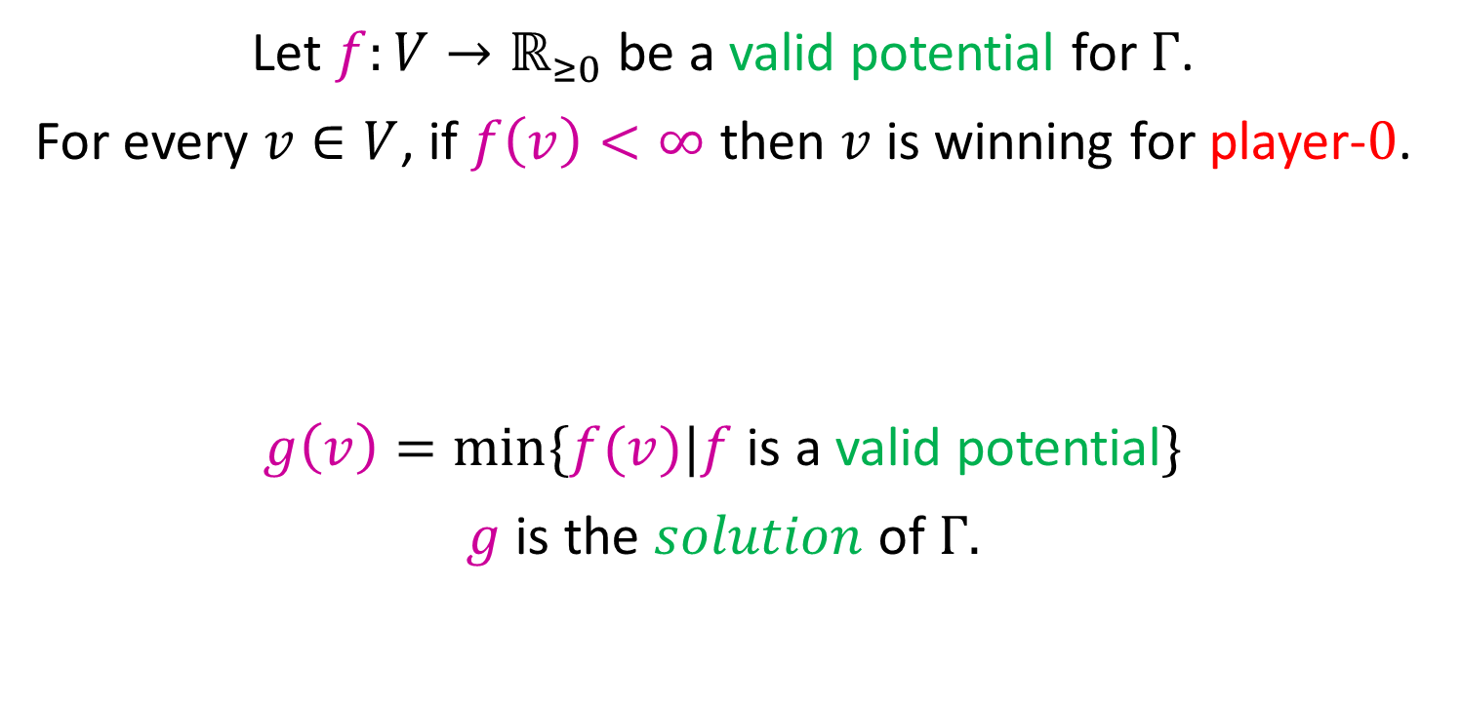
Optimality [BCDGR’11]
Let $f:V→ℝ_{≥0}$ be a valid potential for $Γ$.
For every $v∈V$, if $f\left(v\right)<∞$ then $v$ is winning for player-$0$.
$g\left(v\right)=min⁡\{f(v)|f$ is a valid potential$\}$
$g$ is the $solution$ of $Γ.$
Moreover,

Slide 22
Strategy Improvement
Let $π∈Σ_{1}$. A strategy-improvement step is:
Compute $σ∈Σ_{0},$ a best response strategy to $π.$
Build $π′$ by utilizing improving switches: For every $v∈V_{1}$, choose
$$π^{′}\left(v\right)∈\left\{π\left(v\right)\right\}∪\{\left(v,w\right)∣c\left(v,w\right)+val^{π,σ}\left(w\right)>val^{π,σ}\left(v\right)\}$$
Improving switches
$Theorem:$ For every $v∈V$, $val^{π,⋅}\left(v\right)≤val^{π^{′},⋅}\left(v\right)$.

Slide 23
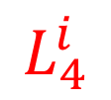
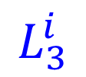
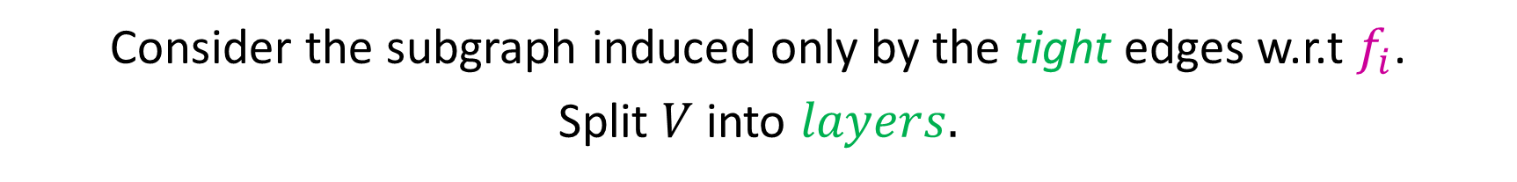
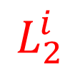
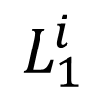


Layer Graph
$$c_{f_{i}}\left(u,v\right)=c\left(u,v\right)−f_{i}\left(u\right)+f_{i}(v)$$
$(u,v)$ is $f$-tight if $c_{f_{i}}\left(u,v\right)=0$
Let $π_{1},π_{2},…,π_{i},…$ be the strategies and let $f_{i}=val^{π_{i},⋅}$.
Consider the subgraph induced only by the tight edges w.r.t $f_{i}$.
Split $V$ into $layers.$
…
$$L_{1}^{i}$$
$$L_{2}^{i}$$
$$L_{3}^{i}$$
$$L_{4}^{i}$$

Slide 24

Layer Graph
$$c_{f_{i}}\left(u,v\right)=c\left(u,v\right)−f_{i}\left(u\right)+f_{i}(v)$$
$(u,v)$ is $f$-tight if $c_{f_{i}}\left(u,v\right)=0$
Let $π_{1},π_{2},…,π_{i},…$ be the strategies and let $f_{i}=val^{π_{i},⋅}$.
Consider the subgraph induced only by the tight edges w.r.t $f_{i}$.
Split $V$ into $layers.$
…
$$\{u|f_{i}\left(u\right)=0\}$$
$$L_{2}^{i}$$
$$L_{3}^{i}$$
$$L_{4}^{i}$$

Slide 25
Layer Graph
$$c_{f_{i}}\left(u,v\right)=c\left(u,v\right)−f_{i}\left(u\right)+f_{i}(v)$$
$(u,v)$ is $f$-tight if $c_{f_{i}}\left(u,v\right)=0$
Let $π_{1},π_{2},…,π_{i},…$ be the strategies and let $f_{i}=val^{π_{i},⋅}$.
Consider the subgraph induced only by the tight edges w.r.t $f_{i}$.
Split $V$ into $layers.$
…
$$\{u|f_{i}\left(u\right)=0\}$$
$$L_{3}^{i}$$
$$L_{4}^{i}$$

Slide 26
Layer Graph
$$c_{f_{i}}\left(u,v\right)=c\left(u,v\right)−f_{i}\left(u\right)+f_{i}(v)$$
$(u,v)$ is $f$-tight if $c_{f_{i}}\left(u,v\right)=0$
Let $π_{1},π_{2},…,π_{i},…$ be the strategies and let $f_{i}=val^{π_{i},⋅}$.
Consider the subgraph induced only by the tight edges w.r.t $f_{i}$.
Split $V$ into $layers.$
…
$$\{u|f_{i}\left(u\right)=0\}$$
$$L_{4}^{i}$$

Slide 27
Layer Graph
$$c_{f_{i}}\left(u,v\right)=c\left(u,v\right)−f_{i}\left(u\right)+f_{i}(v)$$
$(u,v)$ is $f$-tight if $c_{f_{i}}\left(u,v\right)=0$
Let $π_{1},π_{2},…,π_{i},…$ be the strategies and let $f_{i}=val^{π_{i},⋅}$.
Consider the subgraph induced only by the tight edges w.r.t $f_{i}$.
Split $V$ into $layers.$
…
$$\{u|f_{i}\left(u\right)=0\}$$

Slide 28


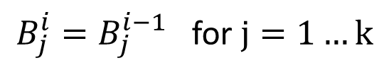
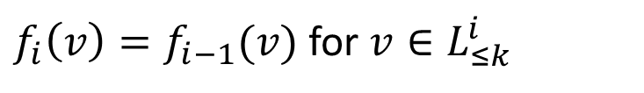

Static Layers
Definition: Layers $1$ to $k$ are static at iteration $i$ if
$f_{i}\left(v\right)=f_{i−1}(v)$ for $v∈L_{≤k}^{i}$
$B_{j}^{i}=B_{j}^{i−1}$ for $j=1…k$
$$k$$
…
$$\{u|f_{i}\left(u\right)=0\}$$

Slide 29

Main Lemma – Switch-All Improvement
Assume layers $1$ to $k$ are static at iteration $i$.
Let $ℓ≤k$ be the smallest such that $L_{ℓ}^{i}≠L_{ℓ}^{i}$, then:
If $ℓ$ is $odd$ then $L_{ℓ}^{i−1}⊊L_{ℓ}^{i}.$
If $ℓ$ is $even$ then $L_{ℓ}^{i−1}⊋L_{ℓ}^{i}.$
…
$$\{u|f_{i}\left(u\right)=0\}$$

Slide 30


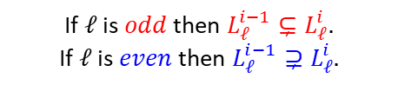









Switch-All Improvement - Analysis
If $ℓ$ is $odd$ then $L_{ℓ}^{i−1}⊊L_{ℓ}^{i}.$
If $ℓ$ is $even$ then $L_{ℓ}^{i−1}⊋L_{ℓ}^{i}.$
Let $k$ be maximal s.t layers $1$ to $k$ are static at iteration $i$.
Define the binary counter potential $b^{i}$.
Theorem: $b^{i+1}≥b^{i}$, $b^{i+n}>b^{i}$.
$$b^{i}=$$
$$1111111$$
$$00000$$
$$1111111$$
$$00000000$$
$$0000…00000$$
$$|L_{1}^{i}|$$
$$|L_{2}^{i}|$$
$$|L_{3}^{i}|$$
$$|L_{4}^{i}|$$
…
$$\{u|f_{i}\left(u\right)=0\}$$

Slide 31
Thank you for your attention!

