Slide 1
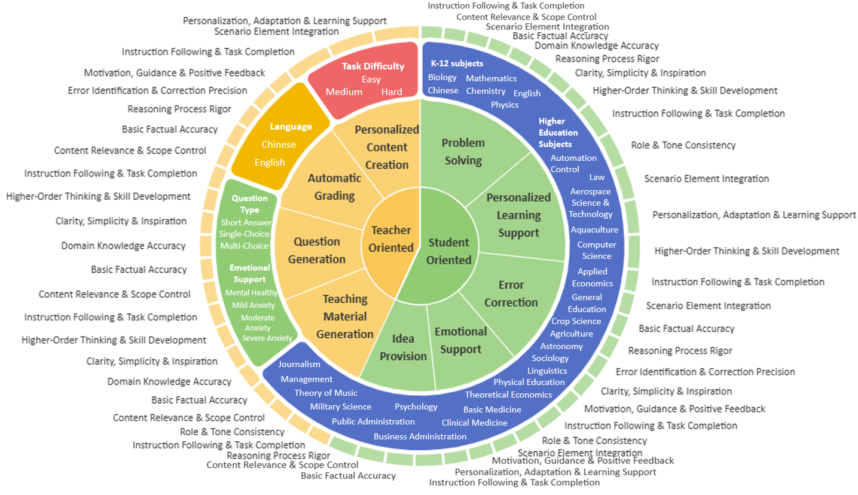
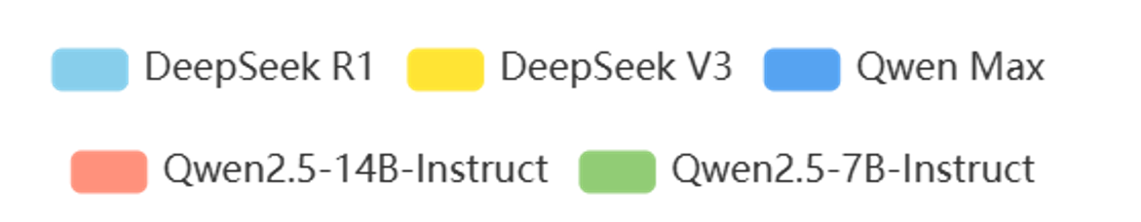
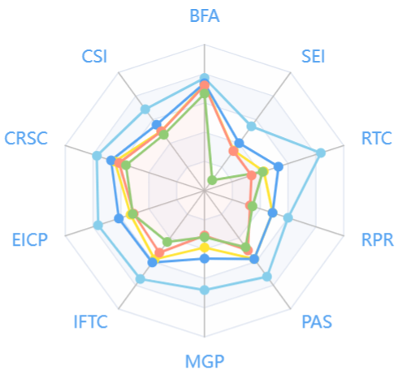
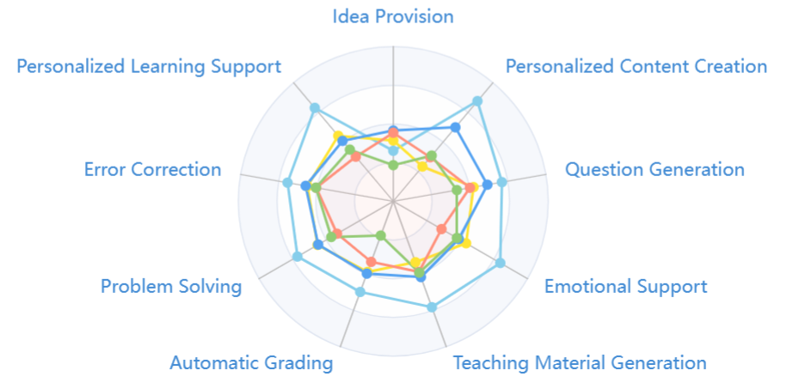
(
Teacher Oriented Domains
+
Student Oriented Domains
)
*
(
Chinese
+
English
)
*
(
Easy
+
Medium
+
Hard
)
*
(
K-12 Subjects
+
Higher Education Subjects
)
*
(
Short Answer
+
Single-Choice
+
Multi-Choice
)
=
4,019 contexts

