Slide 1
Personalized Content Creation
Teaching Material Generation
Problem Solving
Error Correction
Automatic Grading
Teacher Oriented
Student Oriented
Question Answering
Question Generation
Emotional Support
Personalized Learning Support

Slide 2
Task Difficulty
K-12 subjects
Easy
Geography
Chemistry
Medium
Chinese
English
Language
Biology
Chinese
Hard
History
Mathematics
English
Physics
Higher Education Subjects
Question Type
Teaching
Material
Generation
Personalized Content Creation
Problem Solving
Automation Control
Short Answer
Law
Single Choice
Error
Correction
Crop Science
Multiple Choice
Automatic
Grading
Aerospace Science & Technology
Teacher
Oriented
Student
Oriented
Emotional Support
Question
Answering
Agriculture
Question
Generation
Astronomy
Mental Healthy
Emotional
Support
Personalized
Aquaculture
Mild Anxiety
Learning
Computer Science
Moderate Anxiety
Support
Applied Economics
Severe Anxiety
General Education
Sociology
Physical Education
Theory of Music
Journalism
Theoretical Economics
Linguistics
Clinical Medicine
Basic Medicine
Military Science
Business Administration
Management
Public Administration
Psychology
Higher-Order Thinking & Skill Development
Instruction Following & Task Completion
Basic Factual Accuracy
Personalization, Adaptation & Learning Support
Role & Tone Consistency
Domain Knowledge Accuracy
Motivation, Guidance & Positive Feedback
Scenario Element Integration
Reasoning Process Rigor
Clarity, Simplicity & Inspiration
Content Relevance & Scope Control
Error Identification & Correction Precision

Slide 3
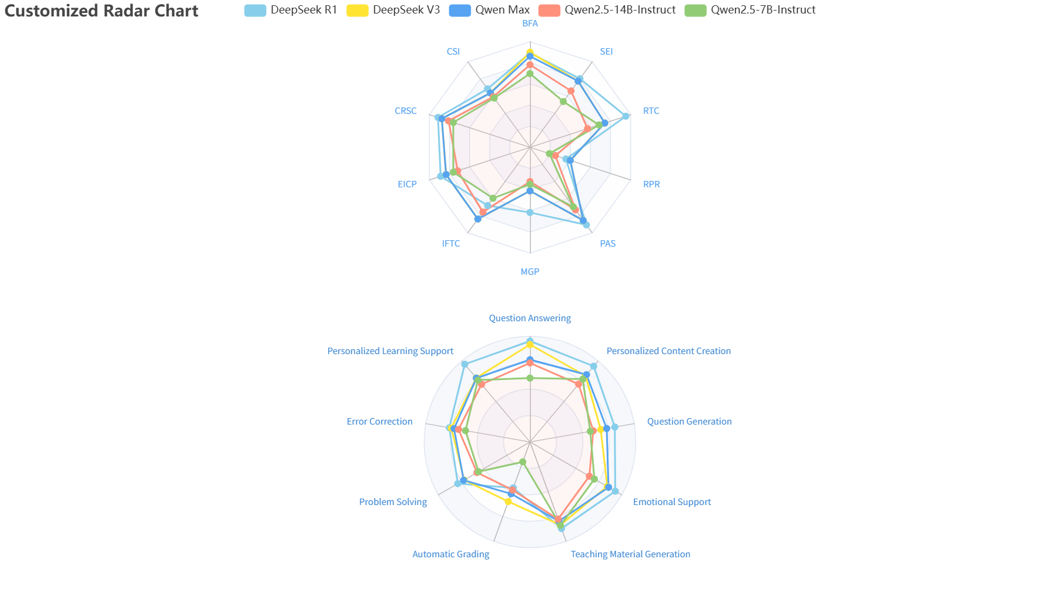
Task Difficulty
K-12 subjects
Easy
Geography
Chemistry
Medium
Chinese
English
Language
Biology
Chinese
Hard
History
Mathematics
English
Physics
Higher Education Subjects
Question Type
Personalized Content Creation
Problem Solving
Automation Control
Short Answer
Teaching
Material
Generation
Error
Correction
Law
Single-Choice
Crop Science
Multi-Choice
Teacher
Oriented
Aerospace Science & Technology
Emotional Support
Automatic
Grading
Student
Oriented
Question
Answering
Agriculture
Astronomy
Mental Healthy
Personalized
Aquaculture
Question
Generation
Personalized
Learning
Computer Science
Mild Anxiety
Support
Support
Moderate Anxiety
Emotional
Support
Applied Economics
Severe Anxiety
General Education
Sociology
Physical Education
Theory of Music
Journalism
Theoretical Economics
Linguistics
Clinical Medicine
Basic Medicine
Military Science
Business Administration
Management
Public Administration
Psychology
Higher-Order Thinking & Skill Development
Motivation, Guidance & Positive Feedback
Personalization, Adaptation & Learning Support
Clarity, Simplicity & Inspiration
Instruction Following & Task Completion
Scenario Element Integration
Role & Tone Consistency
Content Relevance & Scope Control
Basic Factual Accuracy
Reasoning Process Rigor
Domain Knowledge Accuracy
Error Identification & Correction Precision

Slide 4
Task Difficulty
K-12 subjects
Easy
Geography
Chemistry
Medium
Chinese
English
Language
Biology
Chinese
Hard
History
Mathematics
English
Physics
Higher Education Subjects
Question Type
Personalized Content Creation
Problem Solving
Automation Control
Teaching
Material
Generation
Law
Short Answer
Error
Correction
Crop Science
Single-Choice
Automatic
Grading
Teacher
Oriented
Aerospace Science & Technology
Multi-Choice
Student
Oriented
Question
Answering
Agriculture
Emotional Support
Astronomy
Mental Healthy
Question
Generation
Personalized
Aquaculture
Mild Anxiety
Learning
Computer Science
Emotional
Support
Moderate Anxiety
Support
Applied Economics
Severe Anxiety
General Education
Sociology
Physical Education
Theory of Music
Journalism
Theoretical Economics
Linguistics
Clinical Medicine
Basic Medicine
Military Science
Business Administration
Management
Public Administration
Psychology
Higher-Order Thinking & Skill Development
Motivation, Guidance & Positive Feedback
Personalization, Adaptation & Learning Support
Clarity, Simplicity & Inspiration
Instruction Following & Task Completion
Scenario Element Integration
Role & Tone Consistency
Content Relevance & Scope Control
Basic Factual Accuracy
Reasoning Process Rigor
Domain Knowledge Accuracy
Error Identification & Correction Precision

Slide 5
Task Difficulty
K-12 subjects
Easy
Geography
Chemistry
Medium
Chinese
English
Language
Biology
Chinese
Hard
History
Mathematics
English
Physics
Higher Education Subjects
Question Type
Personalized Content Creation
Problem Solving
Automation Control
Teaching
Material
Generation
Law
Short Answer
Error
Correction
Crop Science
Single Choice
Aerospace Science & Technology
Multiple Choice
Automatic
Grading
Teacher
Oriented
Student
Oriented
Emotional Support
Question
Answering
Agriculture
Astronomy
Mental Healthy
Question
Generation
Personalized
Learning
Support
Aquaculture
Mild Anxiety
Emotional
Support
Computer Science
Moderate Anxiety
Applied Economics
Severe Anxiety
General Education
Sociology
Physical Education
Theory of Music
Journalism
Theoretical Economics
Basic Factual Accuracy
Linguistics
Clinical Medicine
Basic Medicine
Military Science
Business Administration
Error Identification & Correction Precision
Management
Public Administration
Psychology
Higher-Order Thinking & Skill Development
Instruction Following & Task Completion
Basic Factual Accuracy
Personalization, Adaptation & Learning Support
Role & Tone Consistency
Domain Knowledge Accuracy
Motivation, Guidance & Positive Feedback
Scenario Element Integration
Reasoning Process Rigor
Clarity, Simplicity & Inspiration
Content Relevance & Scope Control
Error Identification & Correction Precision

Slide 6
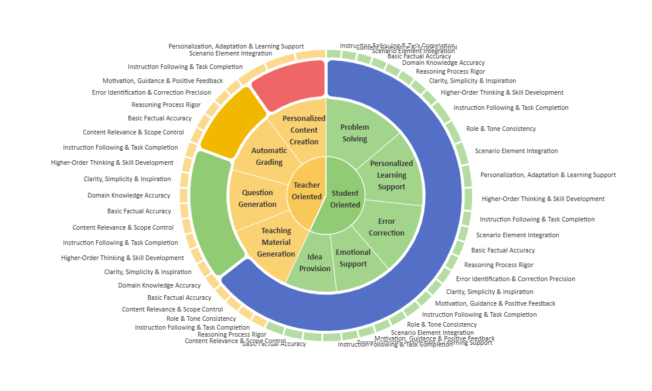




Task Difficulty
K-12 subjects
Easy
Biology
Mathematics
Medium
Hard
Chinese
Chemistry
English
Physics
Language
Higher Education Subjects
Chinese
English
Automation Control
Law
Question Type
Aerospace Science & Technology
Short Answer
Aquaculture
Single-Choice
Computer Science
Multi-Choice
Emotional Support
Applied Economics
Mental Healthy
General Education
Mild Anxiety
Moderate Anxiety
Crop Science
Severe Anxiety
Agriculture
Astronomy
Journalism
Sociology
Management
Linguistics
Theory of Music
Physical Education
Military Science
Theoretical Economics
Psychology
Basic Medicine
Public Administration
Clinical Medicine
Business Administration

Slide 7
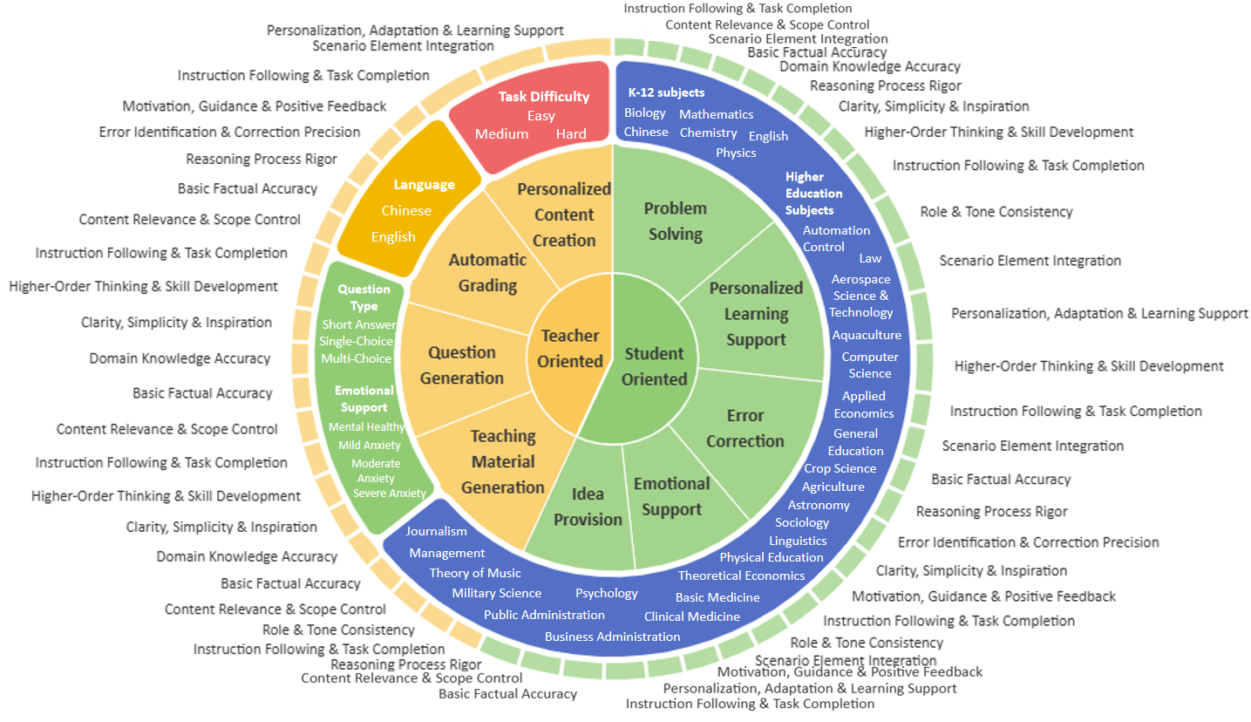
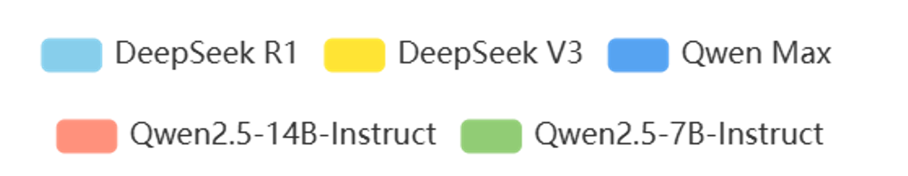
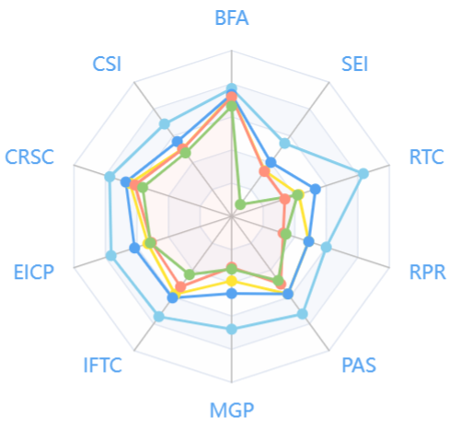
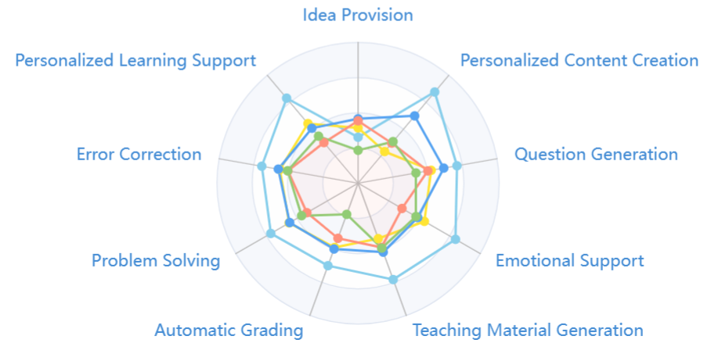
(
Teacher Oriented Domains
+
Student Oriented Domains
)
*
(
Chinese
+
English
)
*
(
Easy
+
Medium
+
Hard
)
*
(
K-12 Subjects
+
Higher Education Subjects
)
*
(
Short Answer
+
Single-Choice
+
Multi-Choice
)
=
4,019 contexts

