Slide 1
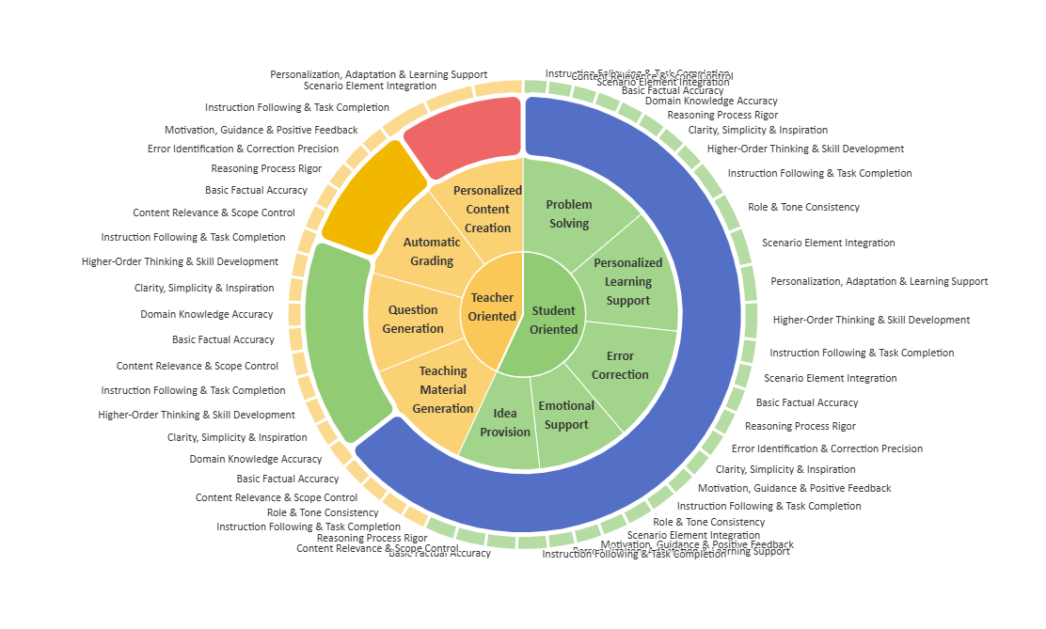




Task Difficulty
K-12 subjects
Easy
Biology
Mathematics
Medium
Hard
Chinese
Chemistry
English
Physics
Language
Higher Education Subjects
Chinese
English
Automation Control
Law
Question Type
Aerospace Science & Technology
Short Answer
Aquaculture
Single-Choice
Computer Science
Multi-Choice
Emotional Support
Applied Economics
Mental Healthy
General Education
Mild Anxiety
Moderate Anxiety
Crop Science
Severe Anxiety
Agriculture
Astronomy
Journalism
Sociology
Management
Linguistics
Theory of Music
Physical Education
Military Science
Theoretical Economics
Psychology
Basic Medicine
Public Administration
Clinical Medicine
Business Administration

