Slide 1
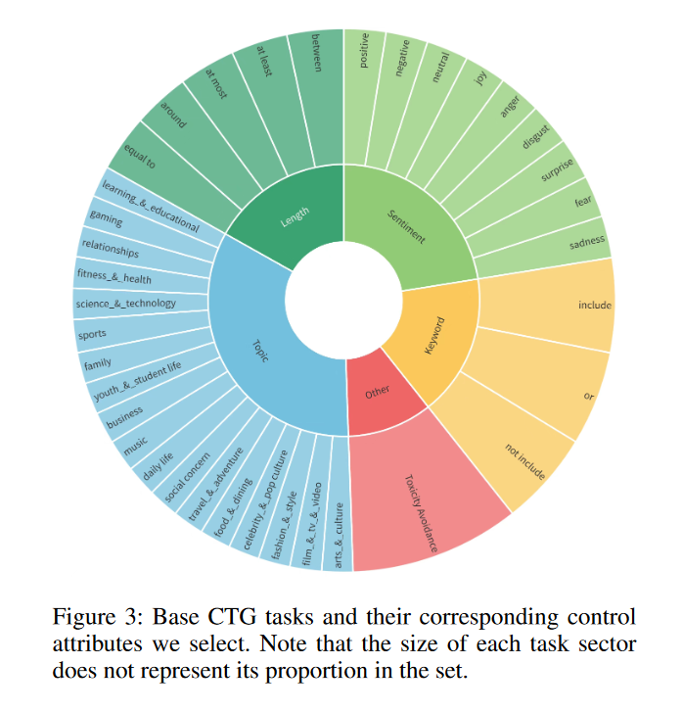
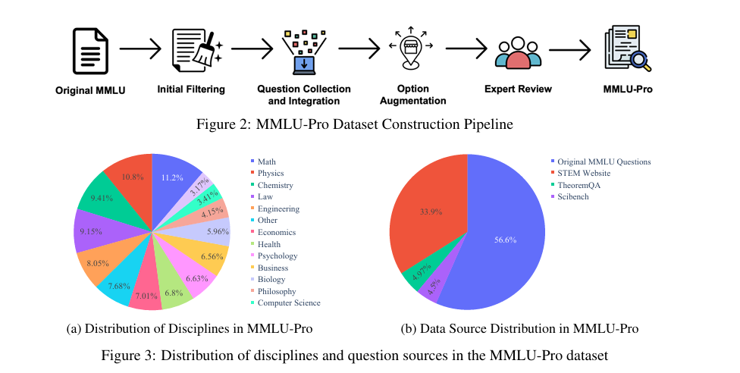

Slide 2
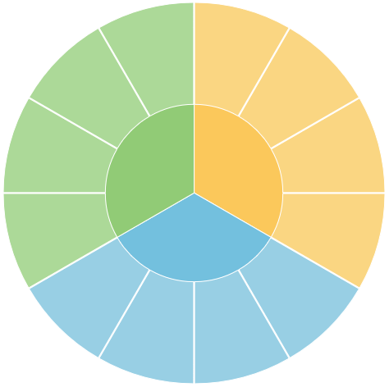
Higher-Order Thinking & Skill Development
Instruction Following & Task Completion
Personalization, Adaptation & Learning Support
Role & Tone Consistency
Motivation, Guidance & Positive Feedback
Content Relevance & Scope Control
Pedagogical Application
Scenario Adaptation
Clarity, Simplicity & Inspiration
Scenario Element Integration
Factual & Reasoning Accuracy
Error Identification & Correction Precision
Basic Factual Accuracy
Reasoning Process Rigor
Domain Knowledge Accuracy

Slide 3
Undergraduate/
Graduate/Doctoral

Slide 4
每个metric下面的context
#548235
#70AD47
#95CF7B
#C5E0B4
#E2F0D9
#C5E0B4
9×4个metrics
#95CF7B
9个领域
#70AD47
teacher
#73C0DE
#98CFE4
#BDD7EE

Slide 5
Personalized Content Creation
Teaching Material Generation
Problem Solving
Error Correction
Automatic Grading
Question Answering
Question Generation
Emotional Support
Personalized Learning Support

Slide 6
Sciences: Mathematics, Physics, Chemistry, Biology, Astronomy
Engineering: Computer Science, Automation Control, Aerospace Science and Technology
Agriculture: Aquaculture, Crop Science
Economics: Applied Economics, Theoretical Economics
Education: General Education, Physical Education
Management: Business Administration, Public Administration
Medicine: Basic Medicine, Clinical Medicine
Social Sciences and Humanities: Sociology, Psychology, History, Law, Management
Literature and Arts: Linguistics, Journalism, Theory of Music
Military Science
Higher-Order Thinking & Skill Development
Instruction Following & Task Completion
Basic Factual Accuracy
Personalization, Adaptation & Learning Support
Role & Tone Consistency
Domain Knowledge Accuracy
Motivation, Guidance & Positive Feedback
Scenario Element Integration
Reasoning Process Rigor
Clarity, Simplicity & Inspiration
Content Relevance & Scope Control
Error Identification & Correction Precision

Slide 7
Personalized Content Creation
Task Difficulty
K-12 subjects
Easy
Geography
Chemistry
Medium
Chinese
English
Language
Biology
Chinese
Hard
History
Mathematics
English
Physics
Higher Education Subjects
Question Type
Teaching
Material
Generation
Problem Solving
Automation Control
Short Answer
Error
Correction
Law
Crop Science
Single Choice
Automatic
Grading
Aerospace Science & Technology
Multiple Choice
Teacher
Oriented
Student
Oriented
Question
Answering
Emotional Support
Agriculture
Question
Generation
Astronomy
Mental Healthy
Aquaculture
Mild Anxiety
Emotional
Support
Computer Science
Moderate Anxiety
Applied Economics
Severe Anxiety
General Education
Sociology
Theoretical Economics
Theory of Music
Journalism
Physical Education
Linguistics
Clinical Medicine
Basic Medicine
Military Science
Business Administration
Management
Public Administration
Psychology
Personalized Learning Support
Higher-Order Thinking & Skill Development
Instruction Following & Task Completion
Basic Factual Accuracy
Personalization, Adaptation & Learning Support
Role & Tone Consistency
Domain Knowledge Accuracy
Motivation, Guidance & Positive Feedback
Scenario Element Integration
Reasoning Process Rigor
Clarity, Simplicity & Inspiration
Content Relevance & Scope Control
Error Identification & Correction Precision

