Slide 1
Java Web para Certificação
Capacitação do Porto Digital e Qualiti

Slide 2
Sobre o Instrutor
Thiago Burgo Belo (Ou somente Burgo)
10 anos de experiência com desenvolvimento de Software
Instrutor a 09 anos
Certificado Java e .NET
Trabalhando como Arquiteto de Software na Pitang
Odeio Formalidades e adoro discutir

Slide 3
Sobre o Curso
Informações Gerais
O que é nosso curso
Treinamento focado na Certificação 1Z0-899 (Java EE 6 Web Component Developer Certified Expert Exam)
O que não é nosso curso
Não é um “curso de mercado”

Slide 4
Visão Geral dos Módulos
Introduction to Java Servlets and HTML/HTTP
Introduction to Java Server Pages
Implementing an MVC Design
The servlet's environment
Container facilities for servlets and JSPs
More view facilities
Developing JSP pages
Developing JSP pages using custom tags
More Controller facilities
More options for the Model
Asynchronous web applications
Web application security

Slide 5
Conhecimentos que Você Deve Ter
Conhecimento profundo da Linguagem JAVA
Bom Conhecimento Sobre as principais APIs JAVA
Bom Conhecimento Sobre Internet (HTTP em especial), HTML (e tecnologias que circundam o html)

Slide 6
Introdução a Tecnologias Web
HTML over HTTP
Common Gateway Interface (CGI)
Servlets
JavaServer Pages (JSP) technology
JSP Standard Tag Library (JSTL)
XML
Struts
JavaServer Faces
etc...

Slide 7
JAVA EE
Java EE is the industry standard for developing portable, robust, scalable and secure server-side Java applications. Java EE is built on the solid foundation of Java Platform, Standard Edition (Java SE).
Java EE is a set of coordinated technologies which includes the following web application technologies:
Java Servlet (Java Specification Requests [JSR] 154)
JavaServer Pages (JSR 245)
JavaServer Pages Standard Tag Library (JSR 52)
JavaServer Faces (JSR 252)

Slide 8
Web Sites and Web Applications
A web site is a collection of static files, HTML pages, graphics, and various other files.
A web application is a web site with dynamic functionality on the server.
A web application run programs on the server, for example:
A browser makes a request, to the server, for an HTML form.
The server responds by sending the HTML form back to the browser in an HTTP request stream.
Next, the browser sends another request, with data from the HTML form, to the server.
The server passes the request and data to a program that responds by sending data back to the browser.

Slide 9
Execution of CGI Programs

Slide 10
Execution of CGI Programs II

Slide 11
Execution of Java Servlets

Slide 12
Execution of Java Servlets (continued)

Slide 13
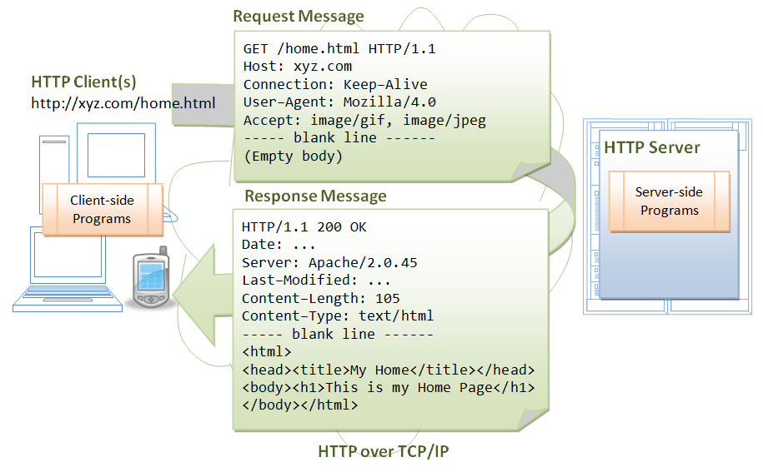
Ciclo de Vida de uma Requisição

Slide 14
Using Separate Processes or Using Threads
Advantages of running programs in separate processes over threads:
Programs can be written in a variety of languages
Web designers can easily reference programs that run in separate processes.
Advantages of running servlet programs in threads compared with other languages not in threads:
The CPU requirements are lower.
Java technologies separate processing code (business logic) from the HTML (presentation logic).
The Java language is robust and object-oriented.
The Java language is platform-independent.

Slide 15
Java Servlets
A servlet is a Java technology component that executes on the server.
Servlet programs perform the following:
Process HTTP requests
Generate dynamic HTTP responses
A web container is a special Java Virtual Machine (JVM™) tool interface that manages the servlets and a thread pool.

Slide 16
JavaServer Pages™ Technology
JSP pages are translated into Java servlet classes that are compiled and execute as servlets in the web container.
JSP pages should focus on the presentation logic, not on the business logic. This makes for a good design.
In JSP pages, custom tags and JSP Expression Language provide for reusable code and separation of concerns.
Java code can be embedded into JSP pages.
In a Java technology web application, JSP pages are often used in conjunction with servlets and business objects in a Model-View-Controller pattern.

Slide 17
Concerns When Using Servlets and JSP™ Technology
Advantages of JSP technology:
Provides high performance and scalability because threads are used
Is built on Java technology, so it is platformindependent.
Can take advantage of the object-oriented language and its APIs

Slide 18
Concerns When Using Servlets and JSP Technology (continued)
Disadvantages of JSP technology:
If JSP pages are used in isolation, then the scripting code that performs business and control logic can become cumbersome in the JSP pages. JSP pages are also difficult to debug.
There is separation of concerns into business logic and presentation logic.
There are concurrency issues.

Slide 19
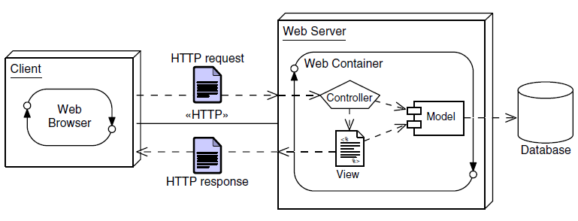
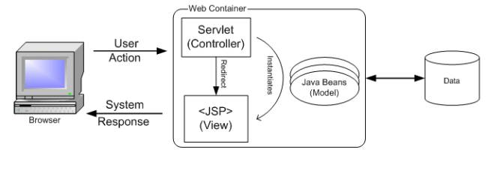
"Model 2 Architecture"

Slide 20
Alguns Frameworks da “Model 2 Architecture”
Frameworks are partial implementations on which you can build your components.
There are several Model 2 frameworks available:
Struts from the Jakarta group
JavaServer Faces technology from Sun/Oracle
Velocity from Apache
…

Slide 21
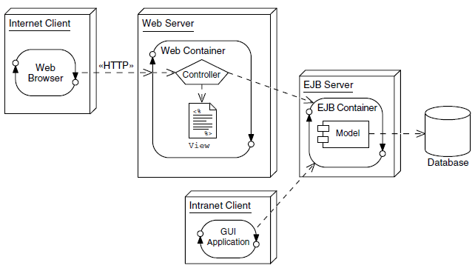
Java EE Containers
Modular design allows for easier modification of the business logic.
Enterprise components can use container-provided services such as presentation, security, transaction, persistence, and life cycle management.

Slide 22
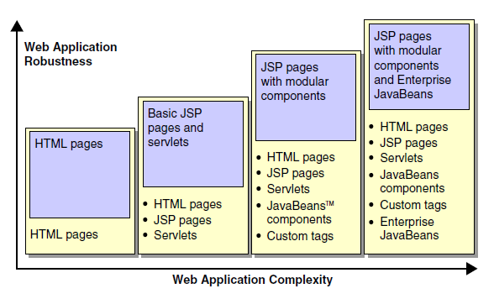
Robustez vs. Complexidade

Slide 23
Manipulando HTTP Requests e Responses com Servlets

Slide 24
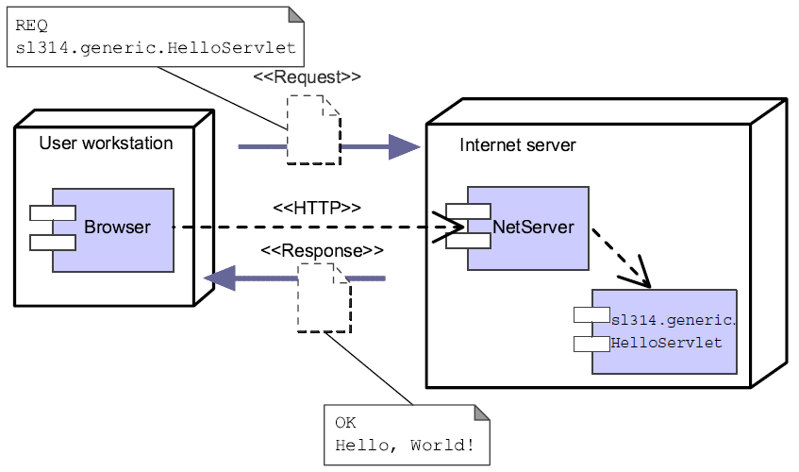
Generic Internet Services
The Java servlet API supports generic Internet services; that is, it supports services that are not dependent on the HTTP protocol.

Slide 25
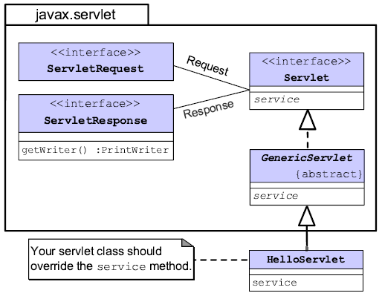
Estrutura de Objetos de um Servlet Genérico

Slide 26
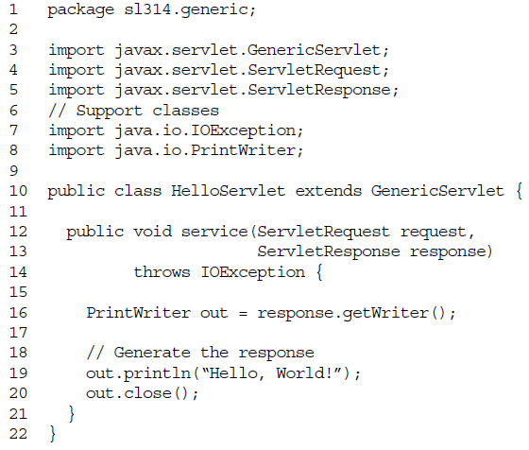
Exemplo

Slide 27
HTTP Servlets
Programado para manipular o protocolo HTTP
Métodos HTTP
HTTP Request
The request stream acts as an envelope to the request URL and message body of the HTTP client request
HTTP Response

Slide 28
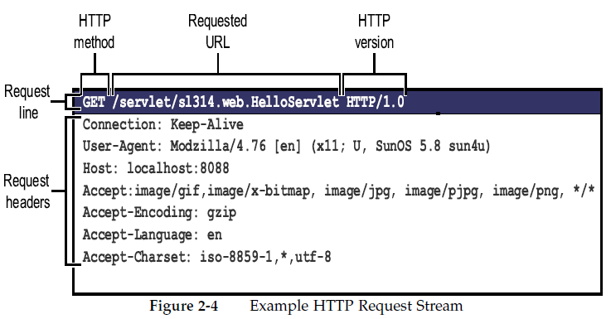
Exemplo de uma Requisição HTTP

Slide 29
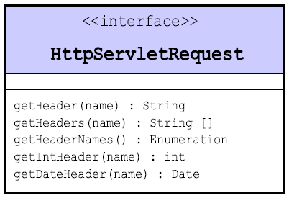
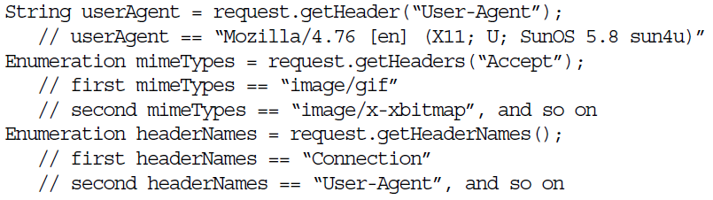
HttpServlet Interface

Slide 30
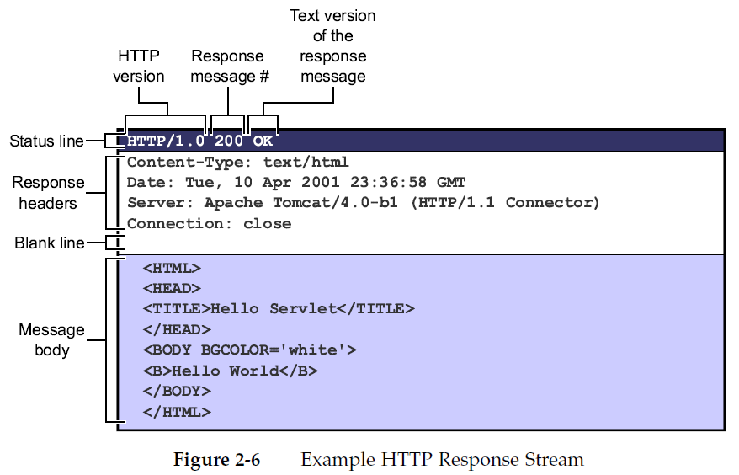
Exemplo de um Response HTTP

Slide 31
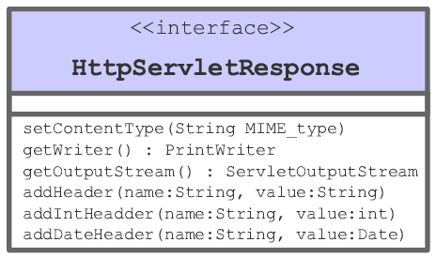

Interface HttpServletResponse

Slide 32
Demo
Criando um GenericServlet
Criando um HTTP Servlet

Slide 33
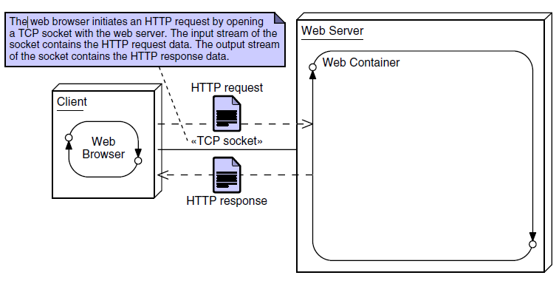
Request and Response Process

Slide 34
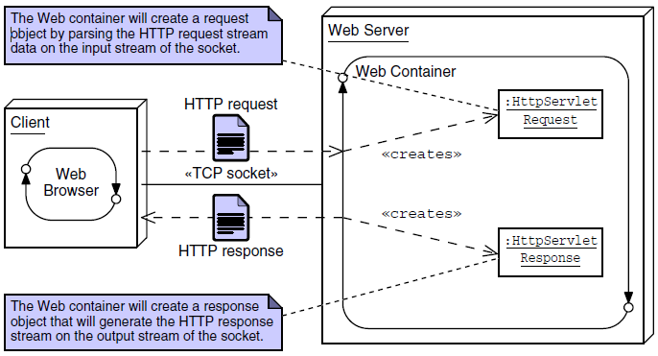
Request and Response Process (2)

Slide 35
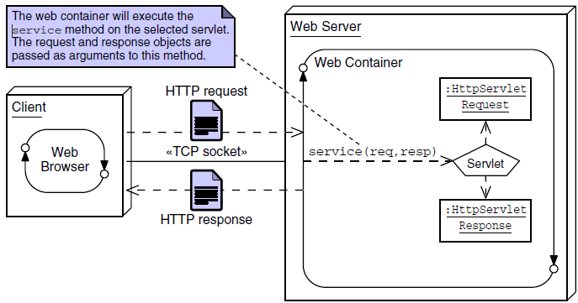
Request and Response Process (3)

Slide 36
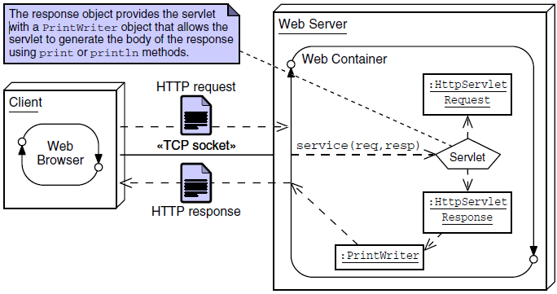
Request and Response Process (4)

Slide 37
Configure a Servlet Definition
web.xml is the file to configure our Servlet:
<servlet>
<servlet-name>ProductList</servlet-name>
<servlet-class>my.package.ProductListServlet</servlet-class>
</servlet>
<servlet-mapping>
<servlet-name>ProductList</servlet-name>
<url-pattern>/list_products.view</url-pattern>
</servlet-mapping>

Slide 38
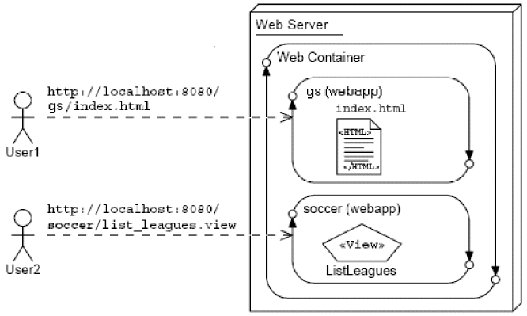
Web Application Context Root

Slide 39
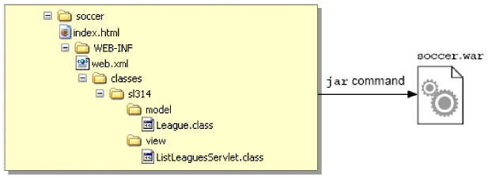
Application Deployment
WAR File Structure

Slide 40
Exercício
Discutir Tema
Criar Aplicação

