Slide 1
RequestDispatcher & Wrappers

Slide 2
RequestDispatcher

Slide 3
RequestDispatcher – Para que serve
The RequestDispacher interface provides the facility of dispatching the request to another resource it may be html, servlet or jsp.This interface can also be used to include the content of antoher resource also. It is one of the way of servlet collaboration.

Slide 4
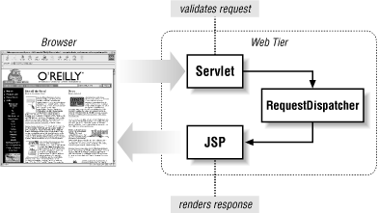
RequestDispatcher - Exemplo

Slide 5
RequestDispatcher - Como obter
ServletContext
getRequestDispatcher(String path)
getNamedDispatcher(String name)
ServletRequest
getRequestDispatcher(String path)

Slide 6
RequestDispatcher ServletContext.getRequestDispatcher
/**
* O getRequestDispacher deve receber o caminho relativo de um recurso
*/
protected void doGet(HttpServletRequest request,
HttpServletResponse response)
throws ServletException, IOException {
RequestDispatcher dispatcher =
getServletContext().getRequestDispatcher("/banner");
if (dispatcher != null){
dispatcher.include(request, response);
}
}

Slide 7
RequestDispatcher ServletContext.getNamedDispatcher
/**
* O getRequestDispacher deve receber um nome de dispatcher configurado.
* Ou seja, o nome de um servlet configurado no web.xml ou via annotation
*/
protected void doGet(HttpServletRequest request,
HttpServletResponse response)
throws ServletException, IOException {
RequestDispatcher dispatcher =
getServletContext().getNamedDispatcher("banner");
if (dispatcher != null){
dispatcher.forward(request, response);
}
}

Slide 8
RequestDispatcher ServletContext.getNamedDispatcher(Cont)
<servlet>
<servlet-name>banner</servlet-name>
<servlet-class>br.com.qualiti.BannerServlet</servlet-class>
</servlet>
Ou
@WebServlet(name="banner",
urlPatterns = { "/banner" })
public class BannerServlet extends HttpServlet {

Slide 9
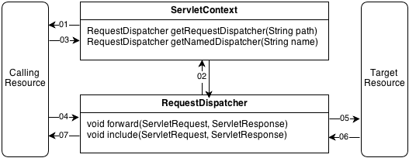
ServletContext X RequestDispacher

Slide 10
RequestDispatcher ServletRequest.getRequestDispatcher
/**
* O getRequestDispacher deve receber o caminho relativo de um recurso
*/
protected void doGet(HttpServletRequest request,
HttpServletResponse response)
throws ServletException, IOException {
RequestDispatcher dispatcher =
request.getRequestDispatcher("/banner");
if (dispatcher != null){
dispatcher.include(request, response);
}
}

Slide 11
RequestDispatcher – Métodos - forward
void forward(ServletRequest, ServletResponse)
Serve para transferir o controle para outro componente web (servlet/JSP).
Redireciona o request e response para o recurso indicado no getRequestDispatcher
Só pode ser chamado uma vez
Se alguma operação for feita após a chamada dele é levantada IllegalStateException, pois o controle não está mais no servlet atual
Redireciona para outro recurso

Slide 12
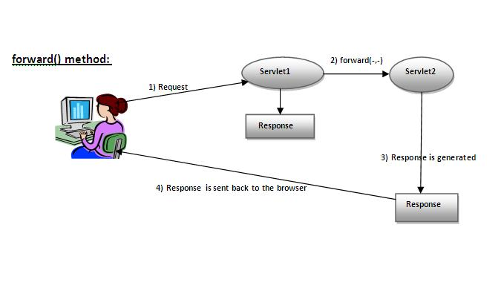
RequestDispatcher – Métodos - forward

Slide 13
RequestDispatcher – Métodos - forward
protected void doGet(HttpServletRequest request,
HttpServletResponse response)
throws ServletException, IOException {
RequestDispatcher dispatcher =
request.getRequestDispatcher("/teste.jsp");
dispatcher.forward(request, response);
}

Slide 14
RequestDispatcher – Métodos - include
void include(ServletRequest, ServletResponse)
Apenas inclui recursos no response atual
Pode ser chamado várias vezes
Não redireciona, apena inclui

Slide 15
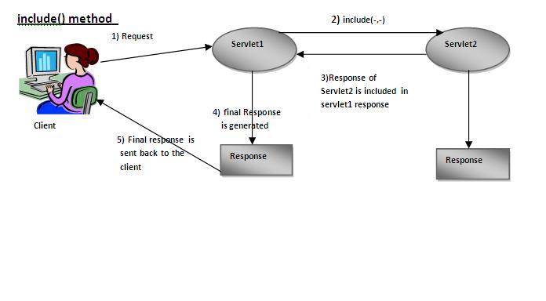
RequestDispatcher – Métodos - include

Slide 16
RequestDispatcher – Métodos - include
protected void doGet(HttpServletRequest request,
HttpServletResponse response)
throws ServletException, IOException {
RequestDispatcher dispatcher =
request.getRequestDispatcher("/util.js");
dispatcher.include(request, response);
dispatcher = request.getRequestDispatcher("/include.jsp");
dispatcher.include(request, response);
}

Slide 17
DEMO (Objetivo: mostrar o uso do forward e include)
Login
Index.html (input dos dados)
Login.java (Trata a requisição)
WelcomeServlet.java (Exibe a mensagem de boas vindas)

Slide 18
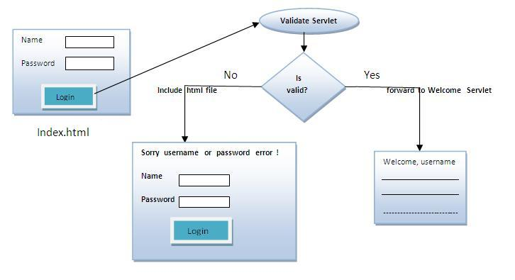
DEMO

Slide 19
Wrapping Requests and Responses

Slide 20
Request Wrappers

Slide 21
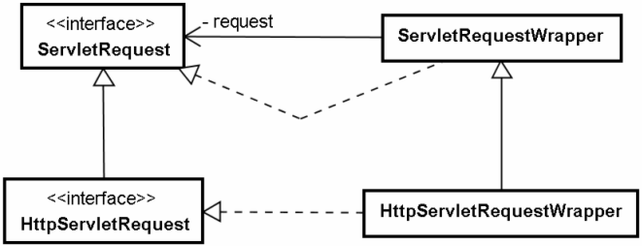
Request Wrappers

Slide 22
ServletRequestWrapper

Slide 23
ServletRequestWrapper
/**
* Provides a convenient implementation of the ServletRequest interface that can
* be subclassed by developers wishing to adapt the request to a Servlet. This
* class implements the Wrapper or Decorator pattern. Methods default to calling
* through to the wrapped request object.
*/
public class ServletRequestWrapper
implements ServletRequest {
private ServletRequest request;

Slide 24
ServletRequestWrapper
/**
* Creates a ServletRequest adaptor wrapping the given request object.
* Throws: java.lang.IllegalArgumentException if the request is null
*/
public ServletRequestWrapper(ServletRequest request) {
if (request == null) {
throw new IllegalArgumentException(
"Request cannot be null");
}
this.request = request;
}

Slide 25
ServletRequestWrapper
/**
* Return the wrapped request object.
*/
public ServletRequest getRequest() {
return request;
}
/**
* Sets the request object being wrapped.
* Throws:
* java.lang.IllegalArgumentException if the request is null
*/
public void setRequest(ServletRequest request) {
if (request == null) {
throw new IllegalArgumentException(
"Request cannot be null");
}
this.request = request;
}

Slide 26
HttpServletRequestWrapper

Slide 27
HttpServletRequestWrapper
/**
* Provides a convenient implementation of the HttpServletRequest interface that
* can be subclassed by developers wishing to adapt the request to a Servlet.
* This class implements the Wrapper or Decorator pattern. Methods default to
* calling through to the wrapped request object. *
*/
public class HttpServletRequestWrapper
extends ServletRequestWrapper
implements HttpServletRequest {

Slide 28
HttpServletRequestWrapper
/**
* Constructs a request object wrapping the given request.
* Throws: java.lang.IllegalArgumentException if the request is null
*/
public HttpServletRequestWrapper(HttpServletRequest request) {
super(request);
}

Slide 29
HttpServletRequestWrapper
/**
* Return the wrapped request object.
*/
private HttpServletRequest _getHttpServletRequest() {
return (HttpServletRequest) super.getRequest();
}

Slide 30
Response Wrappers

Slide 31
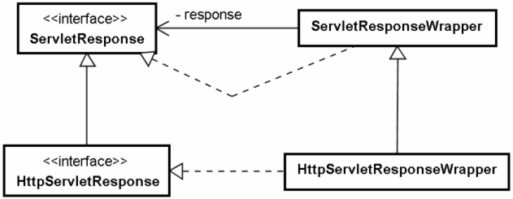
Response Wrappers

Slide 32
ServletResponseWrapper

Slide 33
ServletResponseWrapper
/**
* Provides a convenient implementation of the ServletResponse interface that can
* be subclassed by developers wishing to adapt the response from a Servlet. This
* class implements the Wrapper or Decorator pattern. Methods default to calling
* through to the wrapped response object.
*/
public class ServletResponseWrapper
implements ServletResponse {
private ServletResponse response;

Slide 34
ServletResponseWrapper
/**
* Creates a ServletResponse adaptor wrapping the given response object.
* Throws: java.lang.IllegalArgumentException if the response is null
*/
public ServletResponseWrapper(ServletResponse response) {
if (response == null) {
throw new IllegalArgumentException(
"Response cannot be null");
}
this.response = response;
}

Slide 35
ServletResponseWrapper
/**
* Return the wrapped response object.
*/
public ServletResponse getResponse() {
return response;
}
/**
* Sets the response object being wrapped.
* Throws:
* java.lang.IllegalArgumentException if the response is null
*/
public void setResponse(ServletResponse response) {
if (response == null) {
throw new IllegalArgumentException(
"Response cannot be null");
}
this.response = response;
}

Slide 36
HttpServletResponseWrapper

Slide 37
HttpServletResponseWrapper
/**
* Provides a convenient implementation of the HttpServletResponse interface that
* can be subclassed by developers wishing to adapt the response from a Servlet.
* This class implements the Wrapper or Decorator pattern. Methods default to
* calling through to the wrapped response object. *
*/
public class HttpServletResponseWrapper
extends ServletResponseWrapper
implements HttpServletResponse {

Slide 38
HttpServletResponseWrapper
/**
* Constructs a response object wrapping the given response.
* Throws: java.lang.IllegalArgumentException if the response is null
*/
public HttpServletResponseWrapper(
HttpServletResponse response) {
super(response);
}

Slide 39
HttpServletResponseWrapper
/**
* Return the wrapped response object.
*/
private HttpServletResponse _getHttpServletResponse() {
return (HttpServletResponse) super.getResponse();
}

Slide 40
Wrappers and RequestDispatchers

Slide 41
DEMO
Wrappers and RequestDispatchers

