Slide 1

Treinamento JAVA
Módulo 01 – Introdução ao JAVA

Slide 2
Breve História do JAVA
Criada por James Gosling
Iniciada em 1991 (projeto Green) e lançada oficialmente em 1995 pela Sun Microsystems
Baseada em C++
Pensada inicialmente para rodar em “consumer-eletronic devices”
Batizada em uma cafeteria pela equipe da Sun
Notes:
Microprocessors are having a profound impact in intelligent consumer-electronic devices. Recognizing this, Sun Microsystems in 1991 funded an internal corporate research project code-named Green, which resulted in the development of a C++-based language that its creator, James Gosling, called Oak after an oak tree outside his window at Sun. It was later discovered that there already was a computer language called Oak. When a group of Sun people visited a local coffee shop, the name Java was suggested, and it stuck.
The Green project ran into some difficulties. The marketplace for intelligent consumer-electronic devices was not developing in the early 1990s as quickly as Sun had anticipated. The project was in danger of being canceled. By sheer good fortune, the World Wide Web exploded in popularity in 1993, and Sun people saw the immediate potential of using Java to add dynamic content, such as interactivity and animations, to Web pages. This breathed new life into the project.
Sun formally announced Java at a major conference in May 1995. Java garnered the attention of the business community because of the phenomenal interest in the World Wide Web. Java is now used to develop large-scale enterprise applications, to enhance the functionality of Web servers (the computers that provide the content we see in our Web browsers), to provide applications for consumer devices (e.g., cell phones, pagers and personal digital assistants) and for many other purposes.
<number>

Slide 3
Principais Características
orientada a objetos e familiar
Distribuida
Simples
Multi-threaded
Robusta e segura
Portável (Cross Platform )
“Write once, run anywhere!”

Slide 4
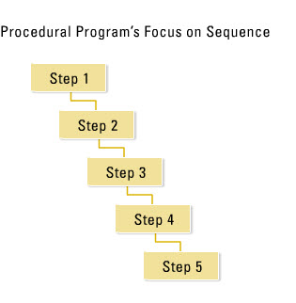
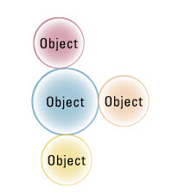
POO vs Procedural
Procedural: Foco nos passos (linear)
OO: Objetos tem estado, atributos e operações
Notes:
Java was designed to be:
1. Object Oriented: Java programming language was designed from beginning to be object oriented. wht is object-oriented? To know about that, we shall go back to an era when procedural programming was used.
Procedural: Programs in the past were using procedural process for development where a program performed in series of steps , in a linear fashion and the focus was on steps as shown below:
Object oriented: In object-oriented, focus is on real world objects which interact with each other. Objects in turn have state, attributes & operations.
<number>

Slide 5
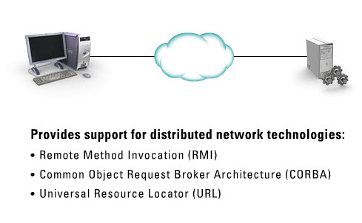
Distribuída
Notes:
Distributed: Unlike programs of the past, where all the pieces of the program had to be available at the beginning of the execution of the program. A java program can have its pieces scattered all over the place, even all over internet. And as it executes, it brings all the pieces together as it needs them.
This is achieved using:
Remote Method Invocation (RMI)
Common object request broker architecture (CORBA)
Universal resource locator (URL)
<number>

Slide 6
Simples
Desenhada para ser simples quando comparada com c ou c++. Das seguintes maneiras:
Referências ao invés de ponteiros – cuida do endereçamento interno de memória.
Garbage collectors – não é necessário desalocar memória.
Herança simples .
Tipo Boolean –assume true ou false ( não assume 0 ou 1).

Slide 7
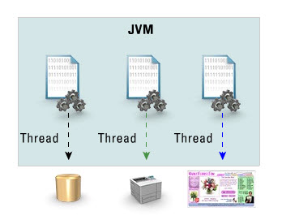
Multi-threaded
Basicamente significa que um programa java pode fazer muitas coisas ao mesmo tempo.
Notes:
Multi-threaded: Another consideration was that, Java programming language should support multi-threading. What is multi-threading? Basically, its a means for a Java program to do many things at the same time. For ex, one thread is accessing database, another is printing through printer, another is updating UI
<number>

Slide 8
Segura
Um programa Java é executado na JVM (Java Virtual Machine).
A JVM interpreta o código Java & executa ele
A JVM assegura que o código não tenha nada inseguro nele
Ex.: JVM não permite o código manipular memória diretamente, também não permite um applet ler ou escrever no seu disco rígido

Slide 9
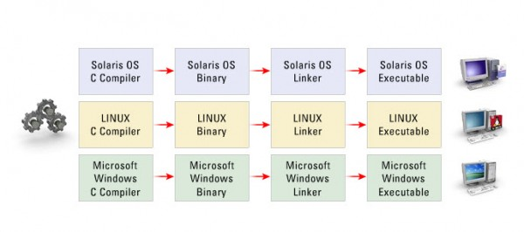
Portável
Ao contrário de linguagens como o C, na figura:
Notes:
6. Platform – independant: Another feature is platform independance. Its a most important design feature. To understand this feature better, we shall first see how programs in past have been compiled & executed. Previously, you would take your source code, run it thro’ a compiler, and that complier had to be for a specific platform. That compiler would give out a binary file, it would again be platform dependant and before executing the binary it had to run thro’ the linker which was again platform dependant. That linker would take binary files and libraries to give an .exe file. It can be then run only on a specific platform. For ex: win exe on a windows workstation.
<number>

Slide 10
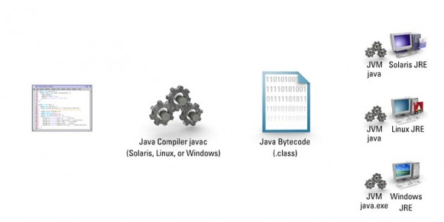
Portável
O java pode executar em vários ambientes sem uma nova compilação:
Notes:
Unlike languages like C, java program language provides platform independance using which you can write once, compile once, & execute on variety of platforms. All you need to do is to take your source code, run it thro’ a java compiler whose output is platform-independant intermediatary bytecode. This bytecode gets interpreted by JVM. JVM is specific to given platform so a bytecode can be run on different platform as desired.
<number>

Slide 11
Principais Divisões da Tecnologia
A tecnologia Java é, basicamente, dividida em:
Java Standard Edition (J2SE)
Core: base do desenvolvimento Java
Java Enterprise Edition (J2EE)
Aplicações corporativas, distribuídas
Java Micro Edition (J2ME)
Aplicações para dispositivos móveis
Notes:
Using java technology, you can build wide range of applications. But in order to do that, you need to know which Java technology product group to download & install.
J2SE - Java 2 Standard Edition – This edition is used to build desktop solutions, such as stand-alone applications, like your word processor or spread-sheet, and distributed applications. For ex: Applet.
J2EE - Java 2 Enterprise Edition - This edition is used to build powerful multi-tier enterprise applications such as e-commerce sites. Many popular sites are built using J2EE.
J2ME – Java 2 Micro Edition – This edition is used to write programs with small memory foot print. For ex: cellphone, pda etc.
<number>

Slide 12
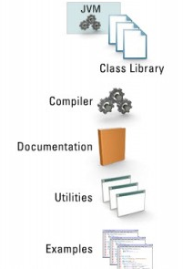
JAVA 2 Platform, Standard Edition (J2SE), Componentes do JDK
Java runtime environment (JRE)
Java Virtual Machine (JVM) java.exe
Biblioteca de classes java
Java Compiler – javac.exe
Documentação das bibliotecas de classe (baixada separadamente)
Utilitários adcionais (assinatura digital, criação de jar)
Exemplos de Programas
Notes:
J2SE – This is also known as the development kit. This allows to write stand alone applications & distributed applications such as applets. It contains the following:
1. JRE - Java Runtime Environment – This environment allows to run java programs. It includes JVM & java class libraries. Its also available as a seperate download, so that you can just download this alone if you want to just run java programs.
JVM
Java class libraries
2. Java compiler – This is available as a binary file called javac.exe - This command allows to write & compile java programs.
3. Class library documentation (downloaded seperately) – This is documentation that has been generated from the class libraries available. Its also referred to as API (Application Programming Interface). This can be best used as a reference to learn more about the class libraries.
4. Additional utilities – There are other utilities also available in this package.
5. Program examples – There are readily available java examples.
<number>

Slide 13
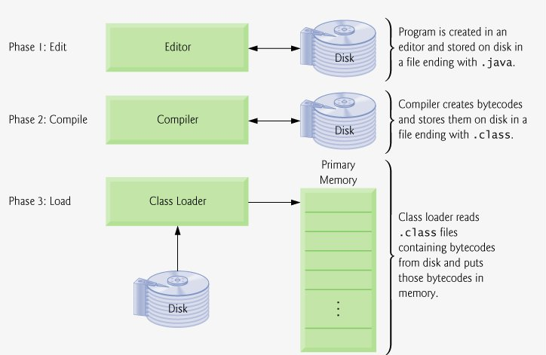
Criação e Execução
Notes:
Phase 1: Creating a Program
Phase 1 consists of editing a file with an editor program (normally known simply as an editor). You type a Java program (typically referred to as source code) using the editor, make any necessary corrections and save the program on a secondary storage device, such as your hard drive. Java source-code file names end with the .java extension, which indicates that a file contains Java source code. We assume that the reader knows how to edit a file.
Two editors widely used on UNIX/Linux systems are vi and emacs. On Windows, a simple editing program like Windows Notepad will suffice. Many freeware and shareware editors are also available for download from the Internet on sites like www.download.com.
For organizations that develop substantial information systems, integrated development environments (IDEs) are available from many major software suppliers, including Sun Microsystems. IDEs provide many tools that support the software development process, including editors for writing and editing programs and debuggers for locating logic errors in programs.
[Page 14] Several popular IDEs are NetBeans (www.netbeans.org), jEdit (www.jedit.org), Eclipse (www.eclipse.org), JBuilder (www.borland.com), JCreator (www.jcreator.com), BlueJ (www.blueJ.org) and jGRASP (www.jgrasp.org). Sun Microsystems has the Sun Java Studio (wwws.sun.com/software/sundev/jde/), which is an enhanced version of Net-Beans. [Note: NetBeans v. 3.6, jEdit v. 4.1, jGRASP v. 1.7 and BlueJ v. 1.3.5 are included on the CD that accompanies this book. These IDEs are designed to execute on most major platforms. Our example programs should operate properly with any Java integrated development environment that supports the JDK 5.0. We also provide free Dive Into™ guides for various IDEs on our Web site at www.deitel.com/books/jHTP6/index.html.]
Phase 2: Compiling a Java Program into Bytecodes
In Phase 2, the programmer uses the command javac (the Java compiler) to compile a program. For example, to compile a program called Welcome.java, you would type
javac Welcome.java
in the command window of your system (i.e., the MS-DOS prompt in Windows 95/98/ ME, the Command Prompt in Windows NT/2000/XP, the shell prompt in UNIX/Linux or the Terminal application in Mac OS X). If the program compiles, the compiler produces a .class file called Welcome.class that contains the compiled version of the program.
The Java compiler translates the Java source code into bytecodes that represent the tasks to be performed during the execution phase (Phase 5). Bytecodes are executed by the Java Virtual Machine (JVM)a part of the JDK and the foundation of the Java platform. A virtual machine(VM) is a software application that simulates a computer, but hides the underlying operating system and hardware from the programs that interact with the VM. If the same VM is implemented on many computer platforms, applications that it executes can be used on all those platforms. The JVM is one of the most widely used virtual machines.
Unlike machine language, which is dependent on specific computer hardware, byte-codes are platform-independent instructionsthey are not dependent on a particular hardware platform. So Java's bytecodes are portablethat is, the same bytecodes can execute on any platform containing a JVM that understands the version of Java in which the bytecodes were compiled. The JVM is invoked by the java command. For example, to execute a Java application called Welcome, you would type the command
java Welcome
in a command window to invoke the JVM, which would then initiate the steps necessary to execute the application. This begins Phase 3.
Phase 3: Loading a Program into Memory
In Phase 3, the program must be placed in memory before it can executea process known as loading. The class loader takes the .class files containing the program's bytecodes and transfers them to primary memory. The class loader also loads any of the .class files provided by Java that your program uses. The .class files can be loaded from a disk on your system or over a network (e.g., your local college or company network, or the Internet).
<number>

Slide 14
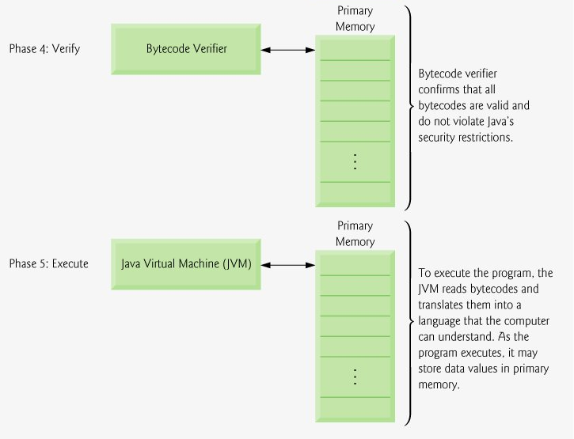
Notes:
Phase 4: Bytecode Verification
In Phase 4, as the classes are loaded, the bytecode verifier examines their bytecodes to ensure that they are valid and do not violate Java's security restrictions. Java enforces strong security, to make sure that Java programs arriving over the network do not damage your files or your system (as computer viruses and worms might).
Phase 5: Execution
In Phase 5, the JVM executes the program's bytecodes, thus performing the actions specified by the program. In early Java versions, the JVM was simply an interpreter for Java bytecodes. This caused most Java programs to execute slowly because the JVM would interpret and execute one bytecode at a time. Today's JVMs typically execute bytecodes using a combination of interpretation and so-called just-in-time (JIT) compilation. In this process, The JVM analyzes the bytecodes as they are interpreted, searching for hot spotsparts of the bytecodes that execute frequently. For these parts, a just-in-time (JIT) compilerknown as the Java HotSpot compilertranslates the bytecodes into the underlying computer's machine language. When the JVM encounters these compiled parts again, the faster machine-language code executes. Thus Java programs actually go through two compilation phasesone in which source code is translated into bytecodes (for portability across JVMs on different computer platforms) and a second in which, during execution, the bytecodes are translated into machine language for the actual computer on which the program executes.
<number>

Slide 15
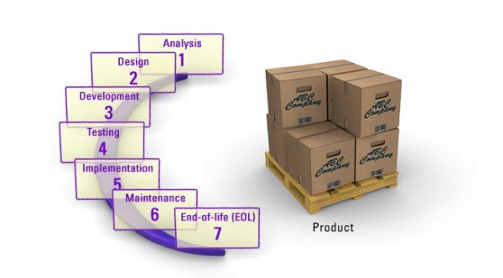
Ciclo de Vida de um Produto
Existem 7 estágios do ciclo de vida de um produto

Slide 16
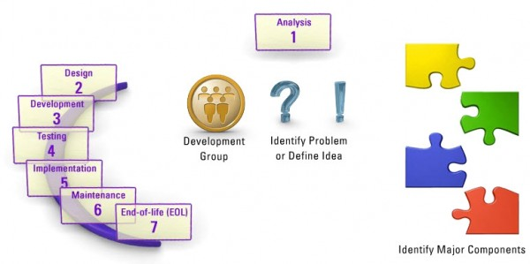
1. Análise
Notes:
Analysis stage:
In this stage, the development team will be responsible for identifying an already existing problem which needs to be solved or finding a new idea for an application. Once that problem or idea has been identified, the development team need to determine the scope of the problem or its boundary. Once the scope or boundary is identified, they can then identify the key major components that fall within the boundary / scope & within the project scope.
<number>

Slide 17
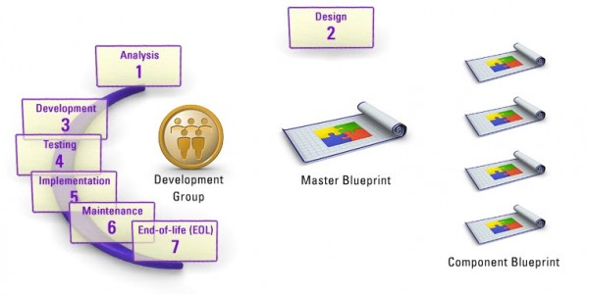
2. Design (Arquitetura)
Notes:
Design stage:
In the design phase, the development team will determine how the components will fit together to solve the problem or to create the idea. Once that is done, individual components can be designed & thier specification / blue-print can be created.
<number>

Slide 18
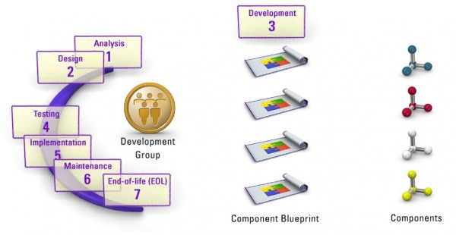
3. Desenvolvimento
Notes:
Development stage:
In the development stage, the development team will take indvidual blue-print & create each individual component. This is where java programming is applicable. Its when the product is actually created.
<number>

Slide 19
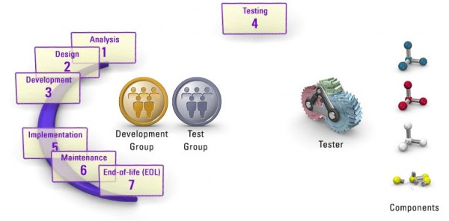
4. Testes
Notes:
Testing stage:
In the testing phase, a new group comes into action and this group is known as the testing group. And the testers in the testing group’s job is to take each of the component & run them thro’ variety of tests to see if the component makes it or breakes it.
<number>

Slide 20
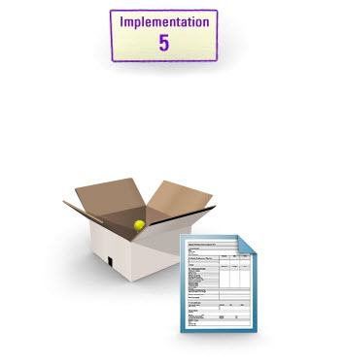
5. Implementação/Deployment
Notes:
Implementation stage:
In the Implementation stage, the development and testing of the product is assumed to be complete and this is when the product is taken to the end users or customers.
<number>

Slide 21
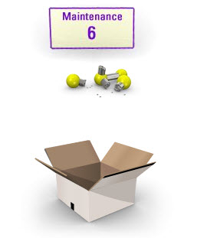
Manutenção
Notes:
Maintainence stage:
In the Maintainence stage, as the product has been out there for a while with the customers / end users, we may find not everything works in the way it should. In that case, the broken things are fixed.
<number>

Slide 22
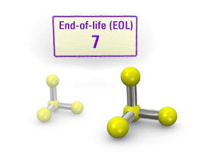
Fim de Vida
Notes:
7. End of life stage:
If the product becomes old or outdated & if there can be better enhancements to it, a newer product will be emereged. It replaces the old version with the new version. This is end of life for the old product.
<number>

