Slide 1
Document Parsing
Daniel Acuna
acuna.io

Slide 2
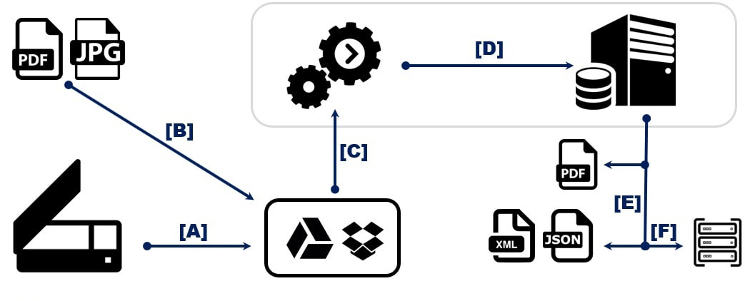
Document parsing

Slide 3
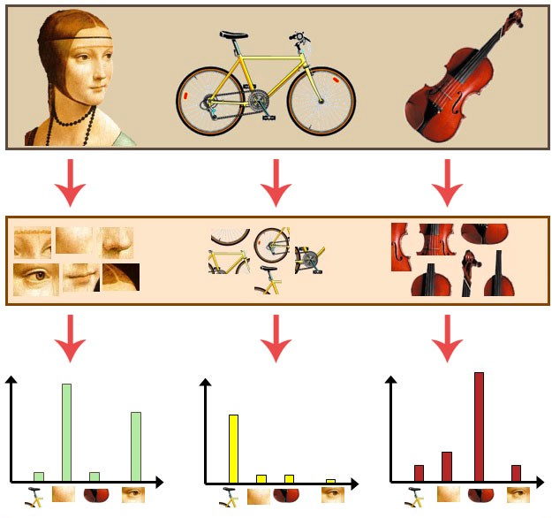
Traditional approaches from Computer Vision
Bag-of-visual words

Slide 4
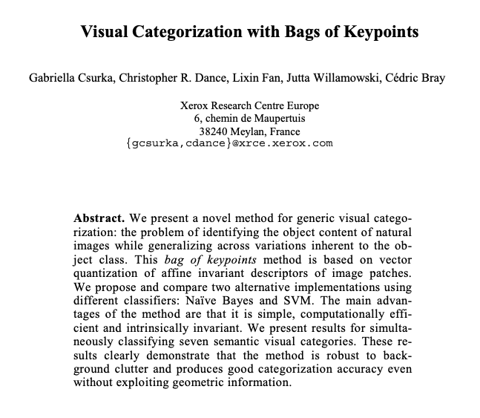
Csurka, G., Dance, C., Fan, L., Willamowski, J., & Bray, C. (2004, May). Visual categorization with bags of keypoints. In Workshop on statistical learning in computer vision, ECCV (Vol. 1, No. 1-22, pp. 1-2).

Slide 5
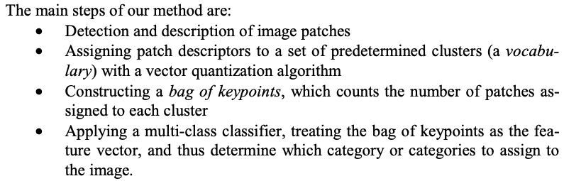
Visual categorization with with bags of keypoints

Slide 6
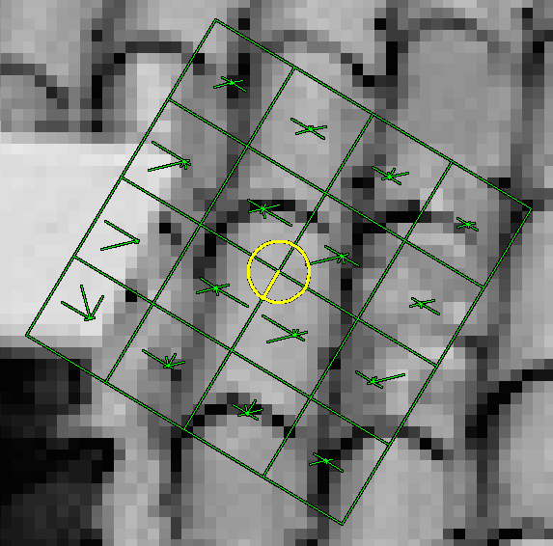
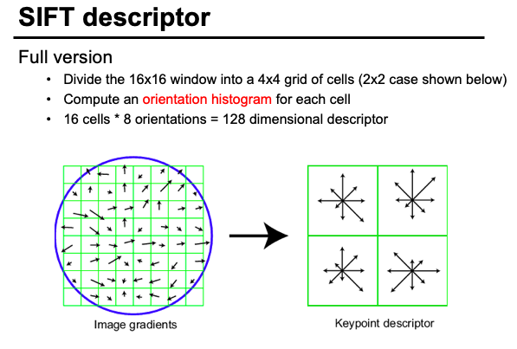
SIFT descriptors
Keypoint detection and description

Slide 7
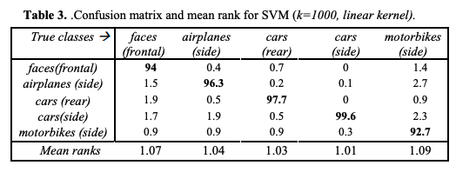

Slide 8
Problems with bag-of-visual features
Heavily relies on features used by the model
Ignores spatial relationship among patches

Slide 9
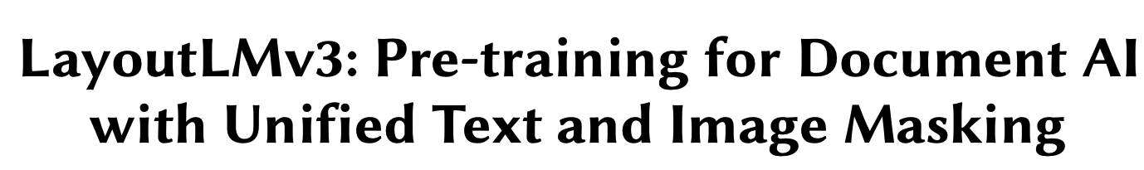
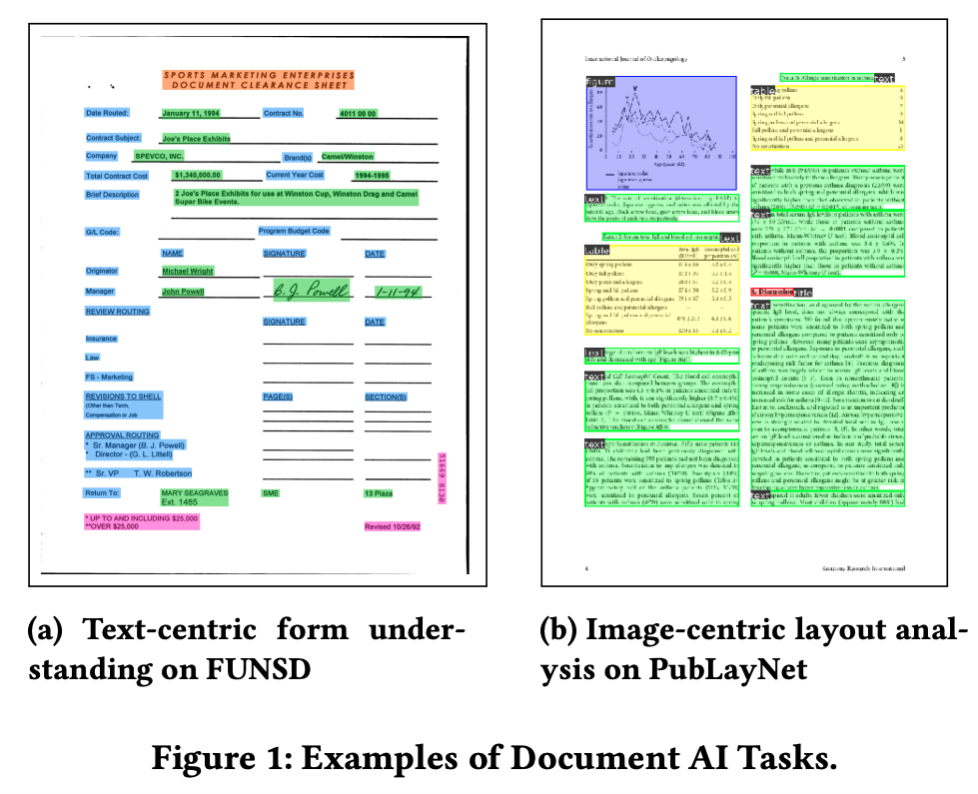
Deep learning

Slide 10
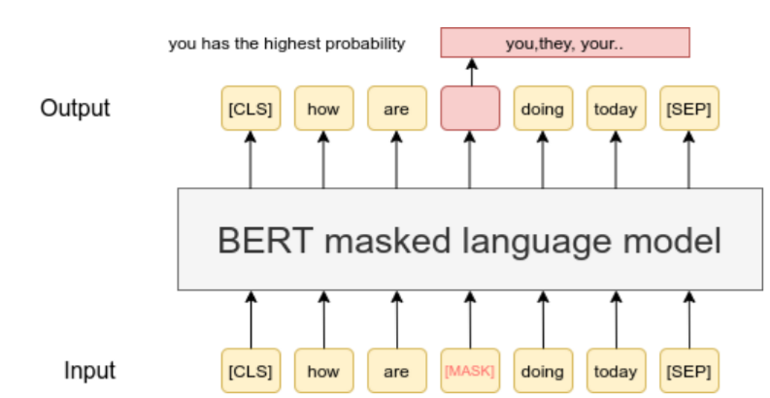
Self learning and multi-modal models
Self-training (unsupervised training)
BERT training: MLM (Masked-Language modeling) task

Slide 11
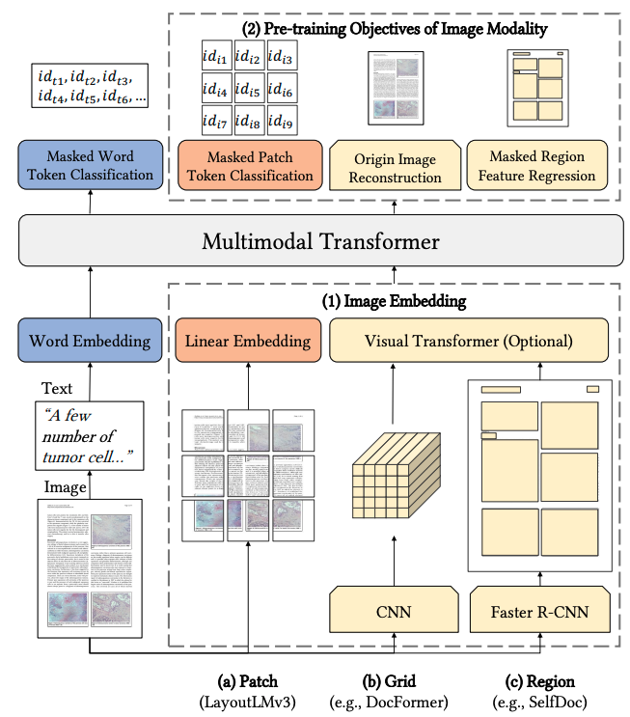
Self learning and multi-modal models
Train a model on multiple tasks simultaneously
Text model
Image model

Slide 12
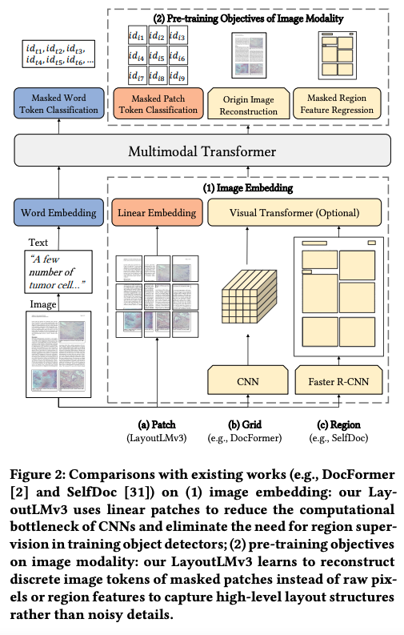
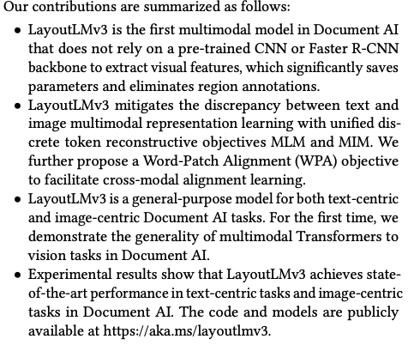

Slide 13
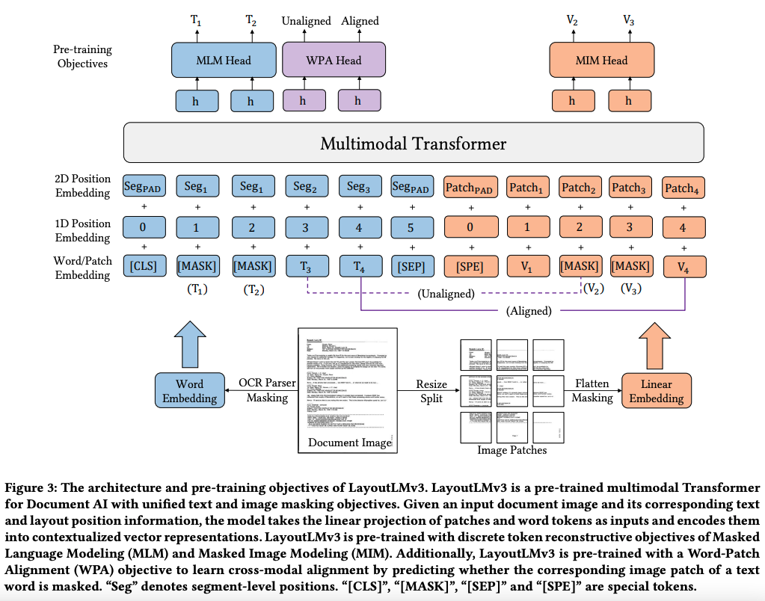
Model inputs

Slide 14
Text embeddings (MLM)
Word embeddings from RoBERTA
1D sentence positional embedding
2D document positional embedding

Slide 15
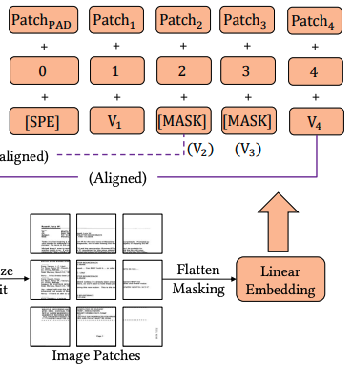
Image embedding (MIM)
Unlike previous methods that extract information using CNNs, this architecture does a simple linear transformation of patches

Slide 16
Word-patch alignment (WPA)
Whether a word embedding corresponds to an image patch

Slide 17
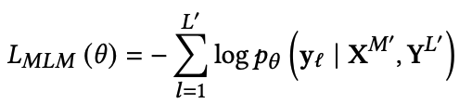
Training objective
MLM: They mask a varying number of tokens in the text and predict their presence based on word (X^K) and image embeddings (X^M)

Slide 18
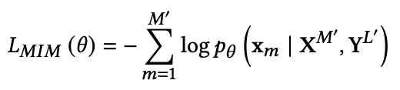
Training objective
MIM: Mask 40% of the image blocks and predict image “tokens” (tokenization of image patches is based on another process). Use both text and image embeddings to predict the missing tokens

Slide 19

Training objective
WPA: Predict whether the text embedding corresponding to an image patch is masked (linking image and text masking tasks). The only use “unmasked” tokens --- they only care about predicting what is not unmasked.

Slide 20
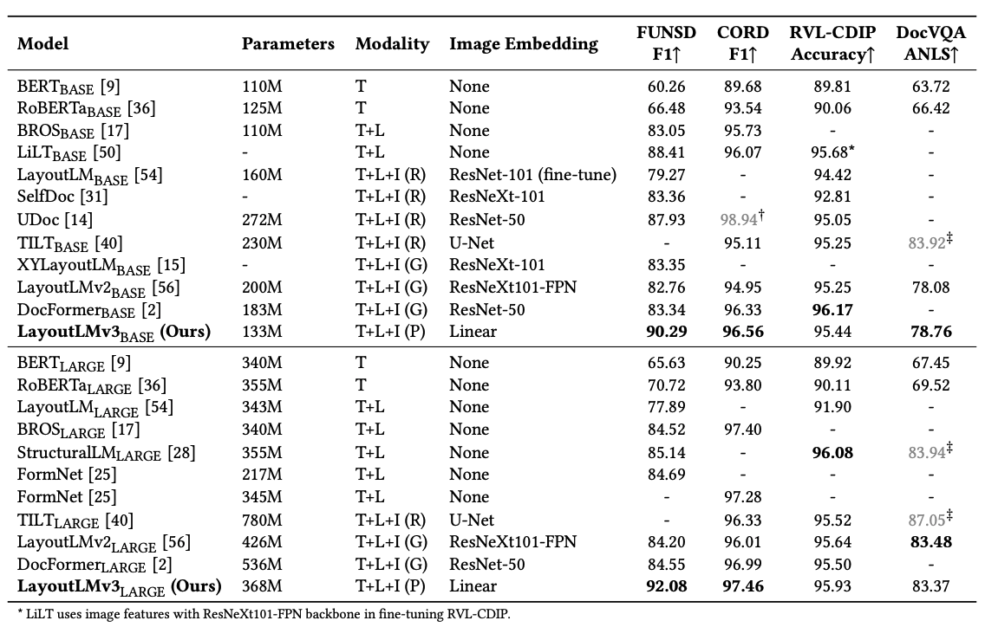

Slide 21
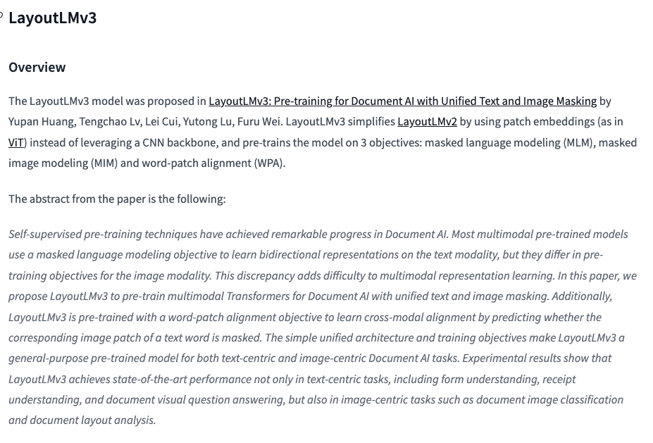


Slide 22
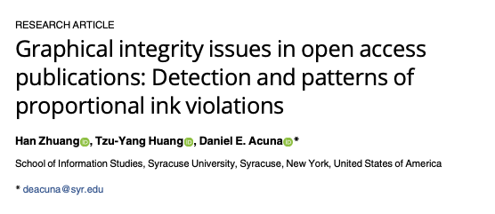
Application for AI in Science: Detecting proportional ink violations

Slide 23
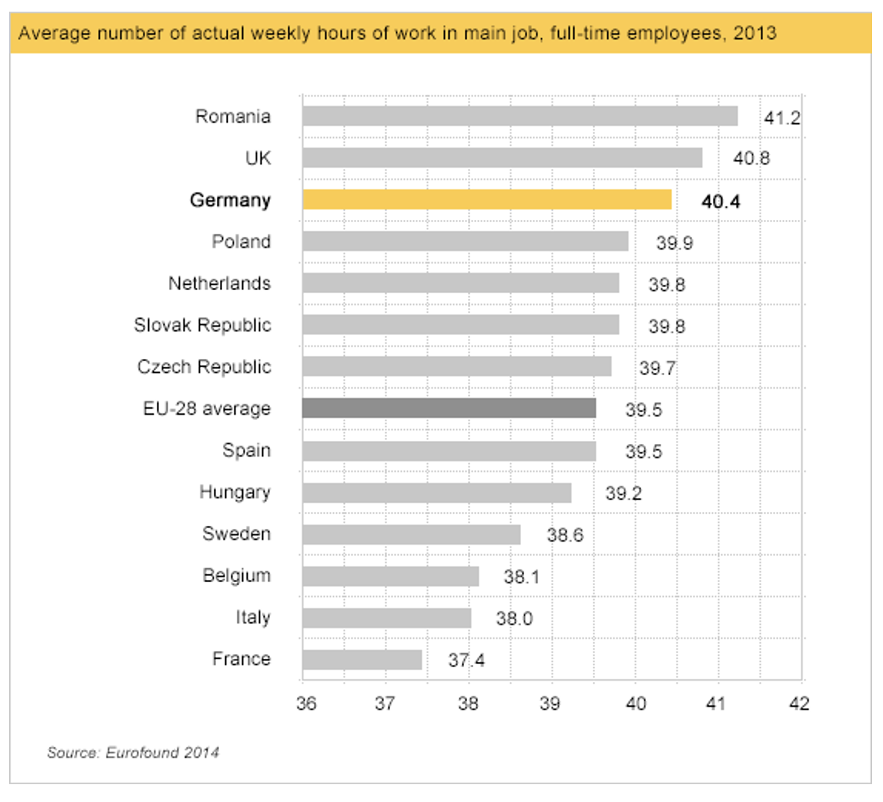

Proportional ink violation analysis

Slide 24
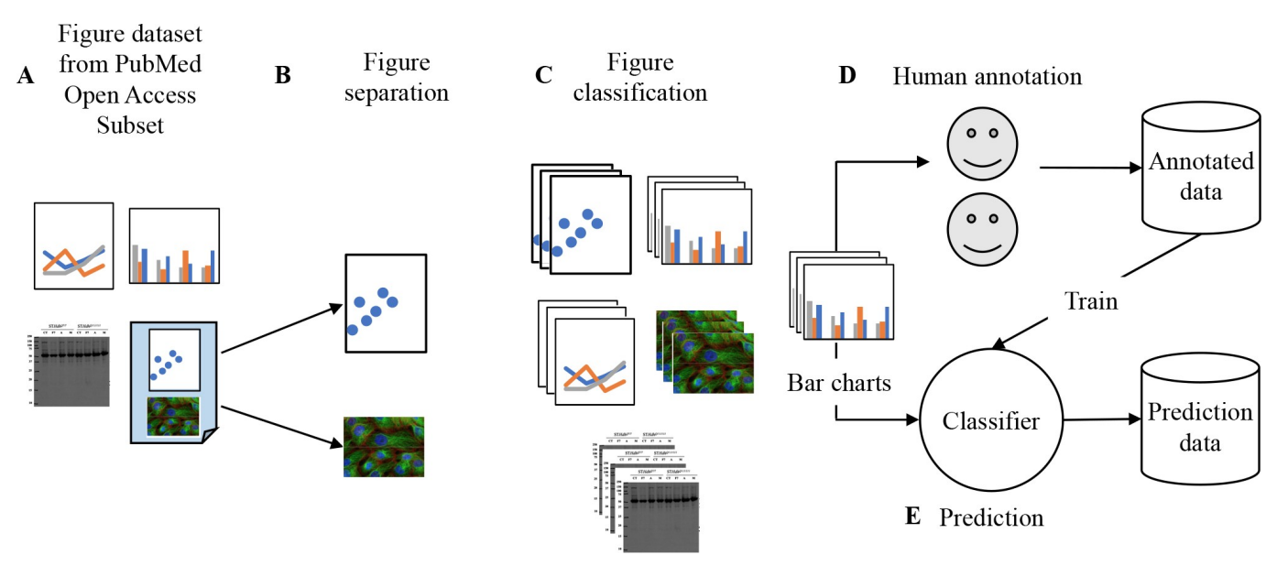
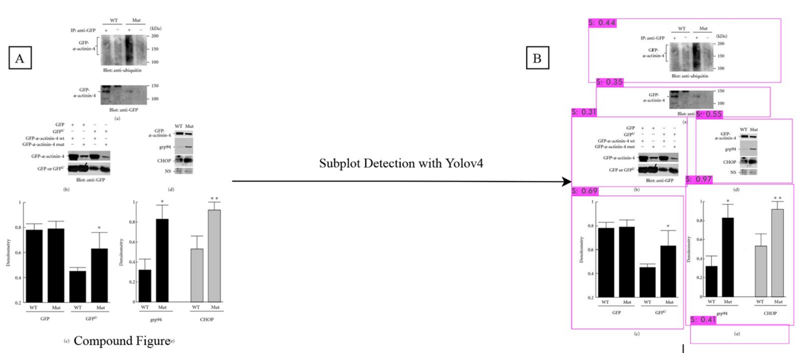

Proportional ink violation analysis
Zhuang, H., Huang, T. Y., & Acuna, D. E. (2021) PLoS CB, 17(12), e1009650.

Slide 25
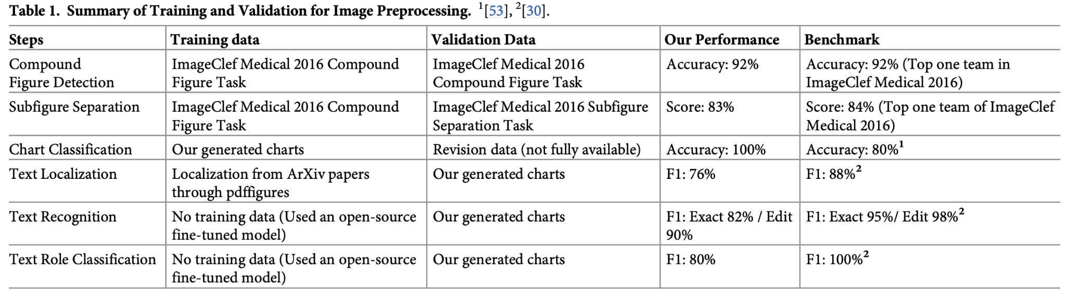
Proportional ink violation analysis
Zhuang, H., Huang, T. Y., & Acuna, D. E. (2021) PLoS CB, 17(12), e1009650.
Notes:
Our method had multiple steps, but were on par with the performance of others

Slide 26
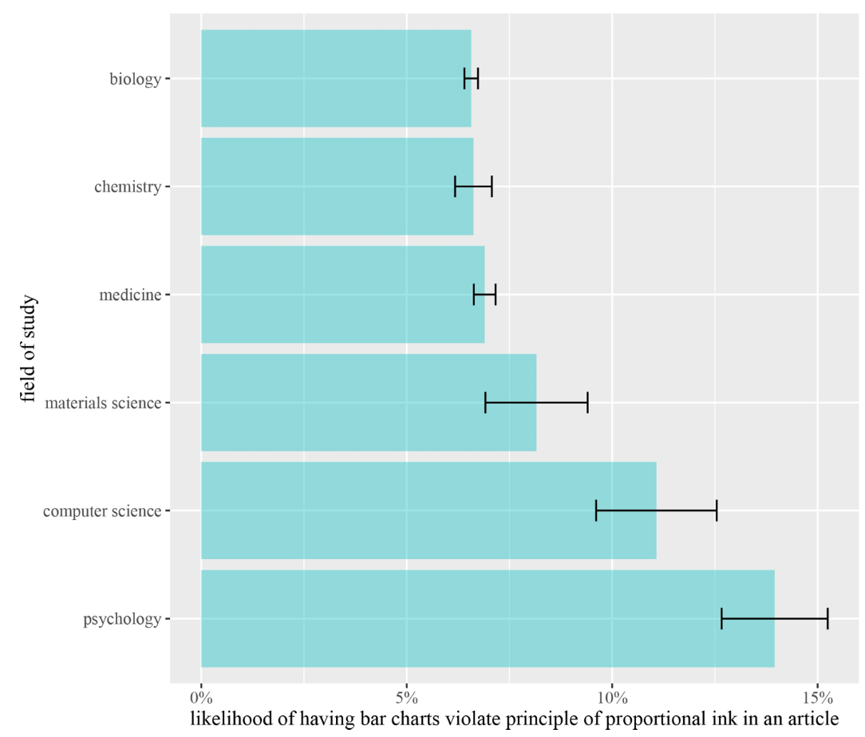
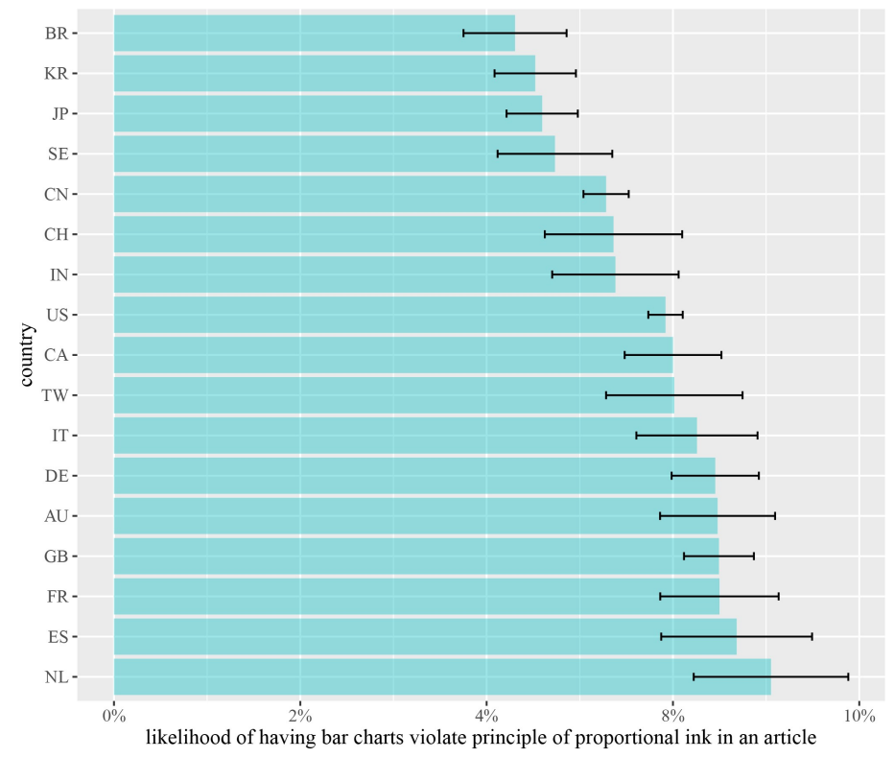
Results
We estimate that around 5.5% of publications contain proportional ink violations
We did not find seniority, institution, and impact factor effects
Notes:
We found that around 5.5% of publications have proportional ink violations
We tried to find many factors that may be related to this but only found field specific and country specific variations

