Slide 1
Optimal Reviewer Assignment
Daniel Acuna
acuna.io

Slide 2
Motivation
http://blog.mrtz.org/2014/12/15/the-nips-experiment.html
http://inverseprobability.com/talks/notes/the-neurips-experiment.html

Slide 3
Naive assignment

Slide 4
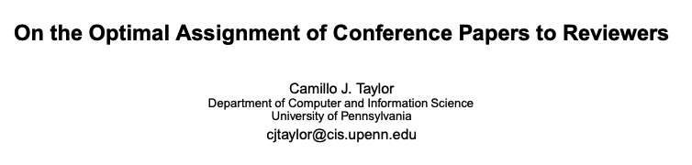
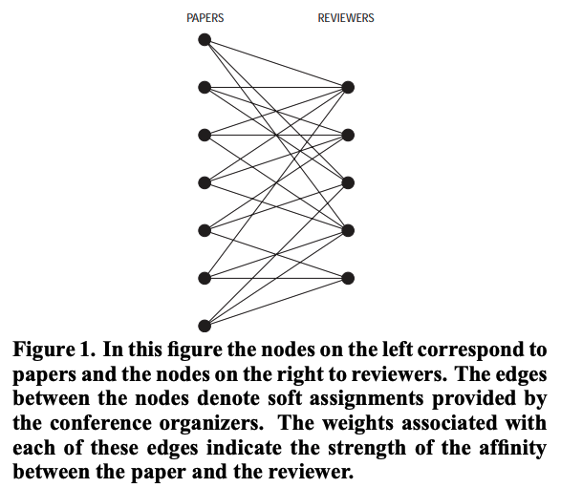

Slide 5
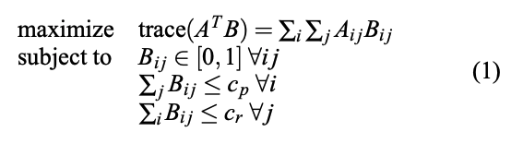
A is the affinity matrix
B is the assignment
C_p is number of papers per review
And c_r is number of reviewers per paper
https://www.cis.upenn.edu/~cjtaylor/PUBLICATIONS/pdfs/TaylorTR08.pdf

Slide 6
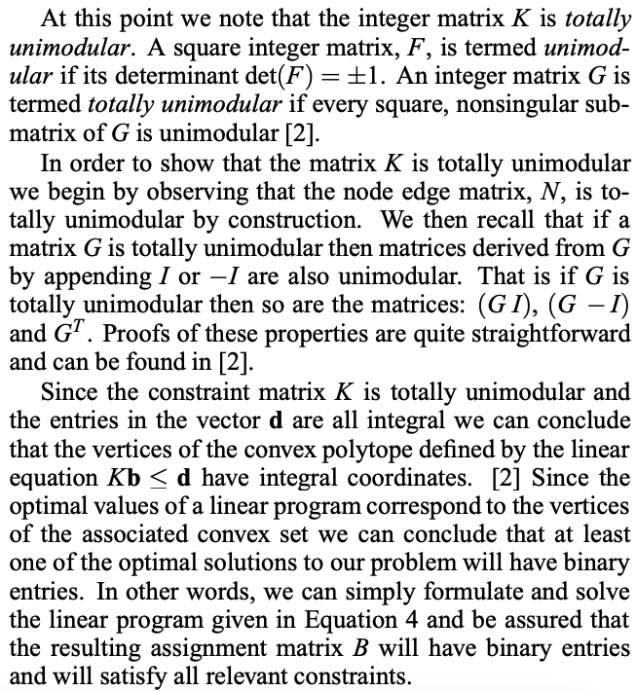
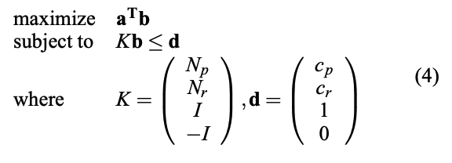

Slide 7
A review of Bayesian statistics and decision theory

Slide 8
Bias and variance in assignment

Slide 9





The challenge of scoring manuscripts
Grumpy reviewer
Unfairly low score
Great manuscript
“Nice” reviewer
Unfairly high score
Bad manuscript

Slide 10


But we need to estimate from data: given average articles

Slide 11
But we need to estimate from data: given average articles

Slide 12
But we need to estimate from data: credit reviewers

Slide 13
But we need to estimate from data: given average reviewers

Slide 14
But we need to estimate from data: credit papers

Slide 15

How can we control for these effects?
Scientific articles for review
Potential reviewers
?

Slide 16
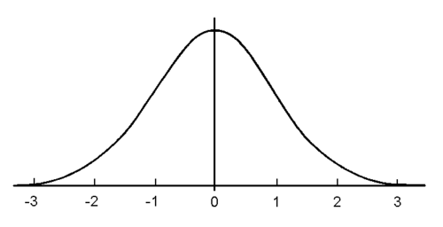
Bayesian score estimation
Reviewer’s central tendency
Article deviation

Slide 17


Bayesian score estimation: Random effects model
Reviewer’s central tendency
Article deviation

Slide 18



Bayesian score estimation: Random effects model
Bayesian estimation
Measurements of interests:
: estimated score of article k
: estimated uncertainty about score k

Slide 19
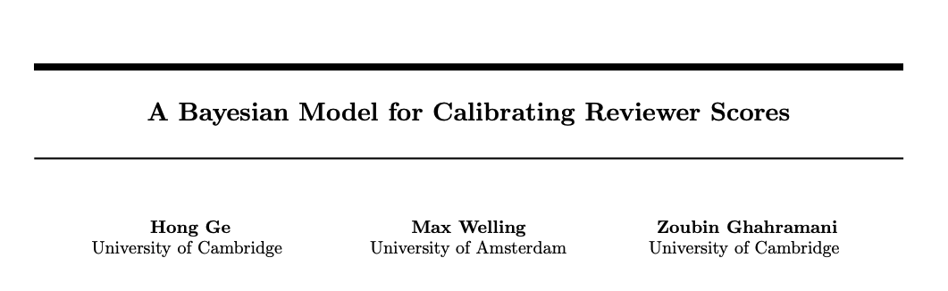

Slide 20
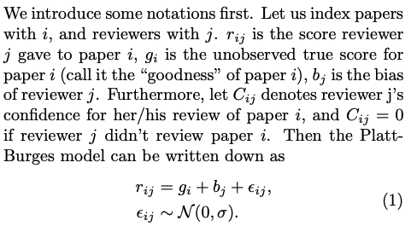

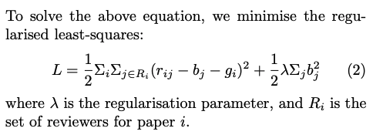

Slide 21
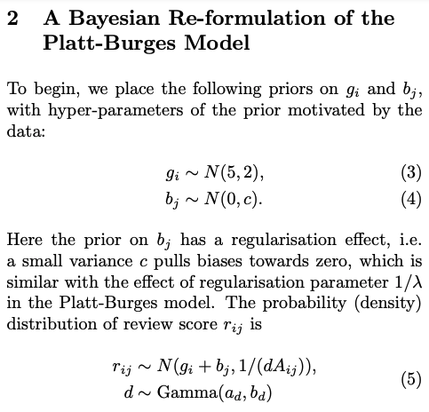
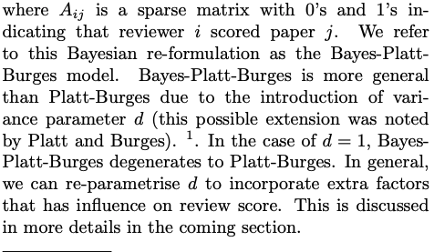

Slide 22
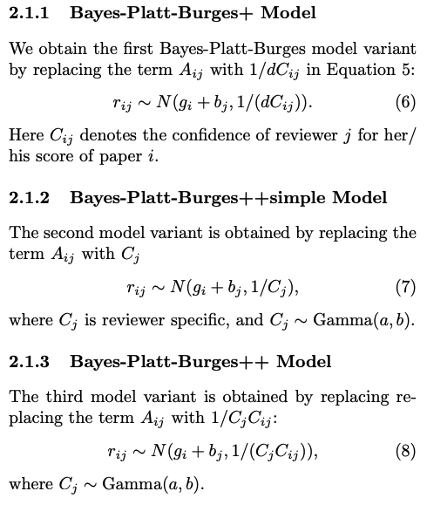
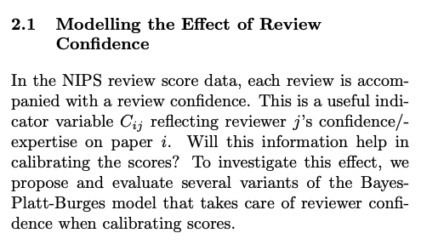

Slide 23
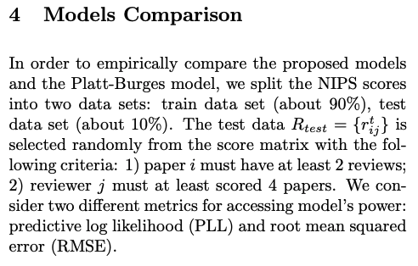
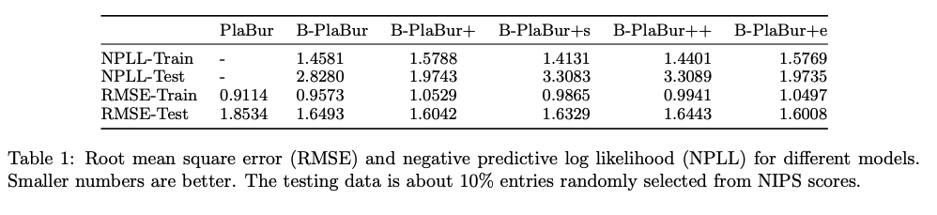

Slide 24
Who will agree to review a paper?

Slide 25
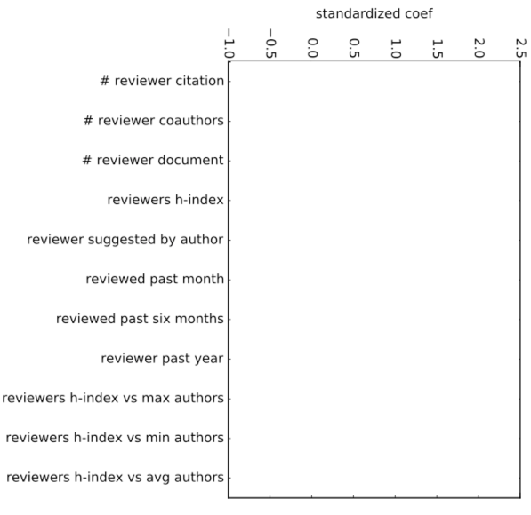
Predicting who will agree to review

Slide 26
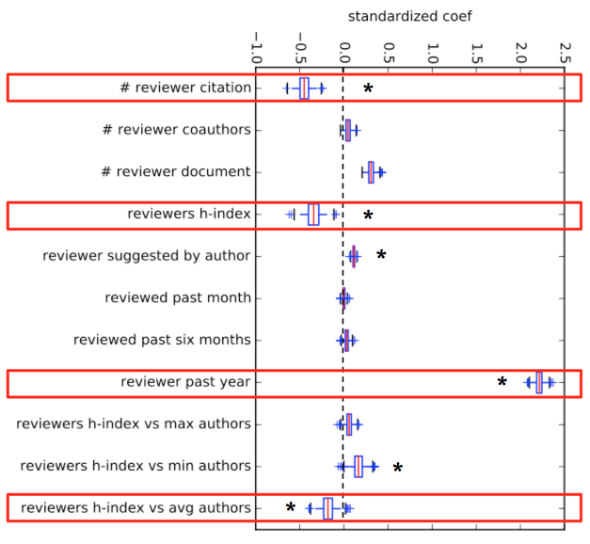
Predicting who will agree to review

Slide 27
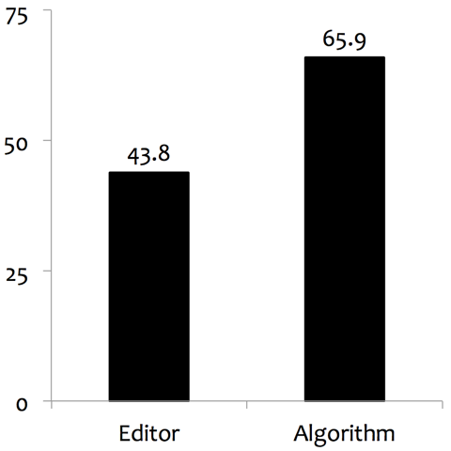
Invitation acceptance rate

Slide 28
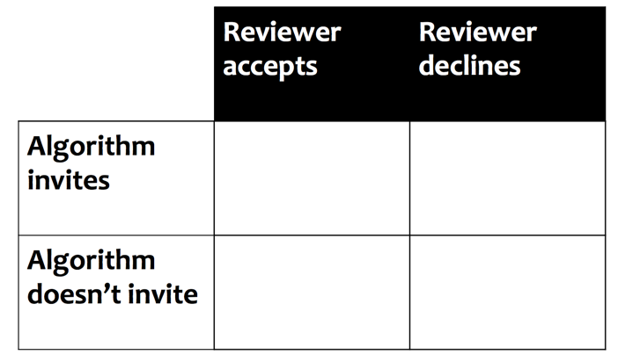
Decision theory

Slide 29
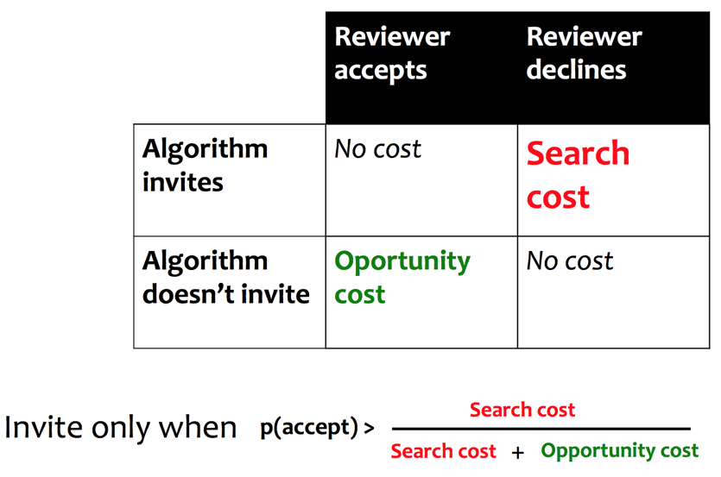
Decision theory

Slide 30
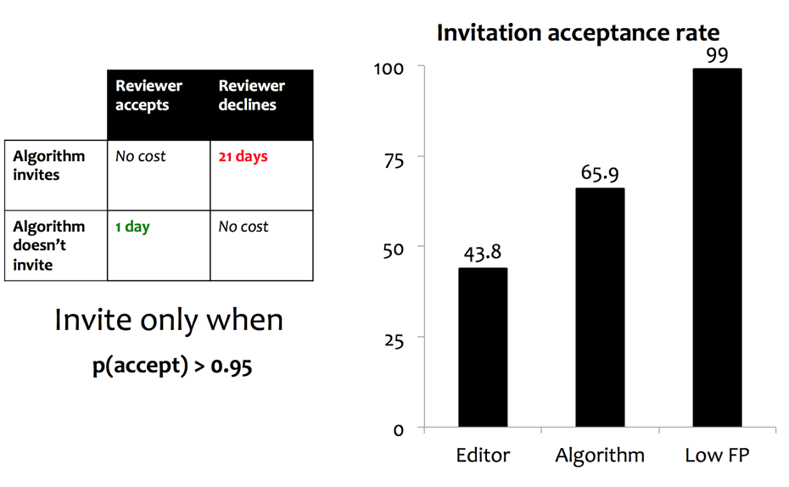
Decision theory

Slide 31
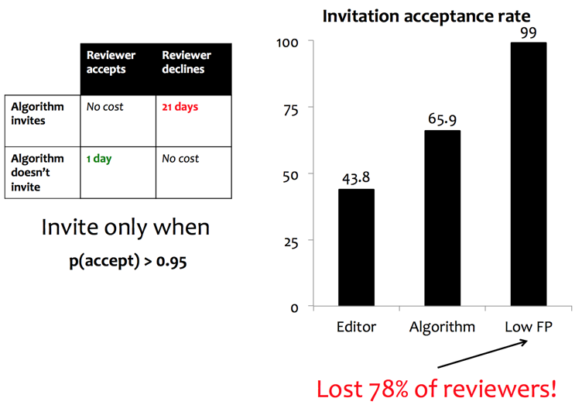
Decision theory

Slide 32
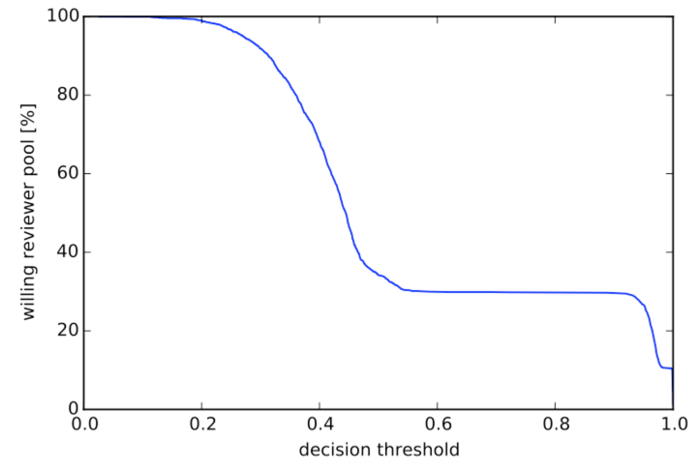
Decision theory

Slide 33
Ideal reviewer
Invite reviewers with:
Many publications
Few citations
Not so senior
But more senior than authors
Postdoctoral researcher?

