Slide 1
Using and Accessing OpenAlex
Daniel Acuna
Computer Science at CU Boulder
CSCI 7000: AI for Science
Fall 2022
kindly shared by Lizhen Liang
Syracuse University

Slide 2
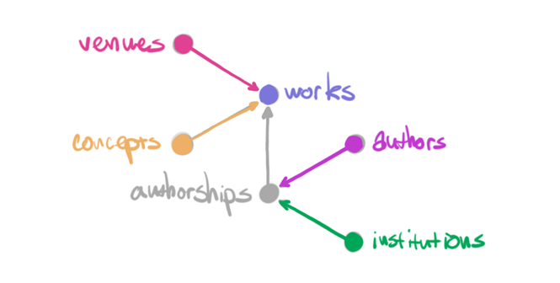

Slide 3
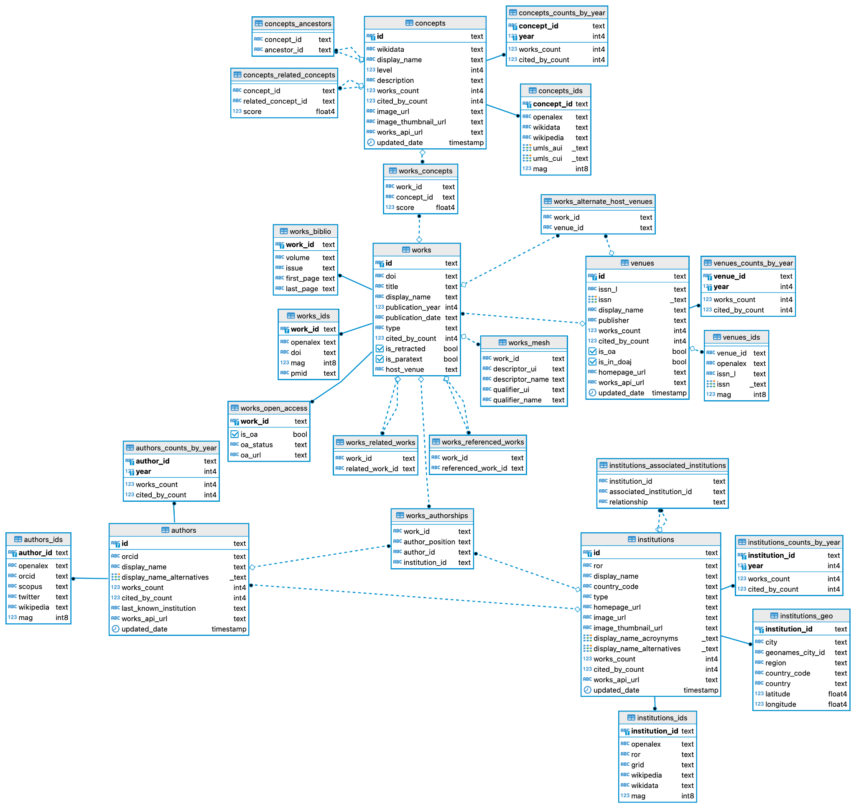

Slide 4
“Works”
Papers, books, datasets, etc; they cite other works

Slide 5
Supported Identifiers for “works”
OpenAlex ID
DOI
Microsoft Academic Graph ID (PaperId)
Pubmed Identifier (pmid)
Pubmed Central Identifier (pmcid)

Slide 6
“Authors”
People who create works

Slide 7
Supported Identifiers for “Authors”
OpenAlex ID
orcid (ORCID ID)
Microsoft Academic Graph ID (AuthorId)
twitter (Twitter handle)
wikipedia (Author’s Wikipedia page URL)
scopus (Author’s Scopus author ID)

Slide 8
“Venues”
Where works are hosted

Slide 9
Supported Identifiers for “venues”
OpenAlex ID
Issn_l (the venue’s ISSN-L)
Microsoft Academic Graph ID (JournalId / ConferenceSeriesId)
issn (a list of this venue’s ISSNs)

Slide 10
“Institutions”
Organizations to which authors claim affiliations

Slide 11
Supported Identifiers for “institutions”
OpenAlex ID
ror (The institution’s Research Organization Registry ID)
Microsoft Academic Graph ID (AffiliationId)
grid (The institution’s GRID ID)
Wikipedia (This institution's Wikipedia page URL)
Wikidata (This institution's Wikidata ID)

Slide 12
“Concepts”
Abstract ideas that works are about

Slide 13
Supported Identifiers for “Concepts”
OpenAlex ID
Microsoft Academic Graph ID (AffiliationId)
umls_aui (this concept's Unified Medical Language System Atom Unique Identifiers)
umls_cui (this concept's Unified Medical Language System Concept Unique Identifiers)
Wikipedia (This concept's Wikipedia page URL)
Wikidata (This concept's Wikidata ID)

