Slide 1
Sales & Repeat Purchase Analysis
Prepared by: Daniel Agblevor
Date: 2nd June, 2025

Slide 2
Dataset Overview
No. of Orders: 300 orders
Time Range: 1st January, 2023 to 31st December, 2023
Key Columns:
Product, Category
Quantity, Unit Price
Customer Region, Order Date
Purchased Again (Yes/No)

Slide 3
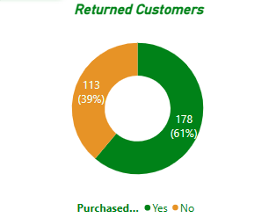
Key Metrics
Total Revenue: GHS 411,300
Total Orders: 7,296
Repeat Purchase Rate: 61%
Avg Order Quantity: 27 units
Avg Unit Price: GHS 57.74

Slide 4
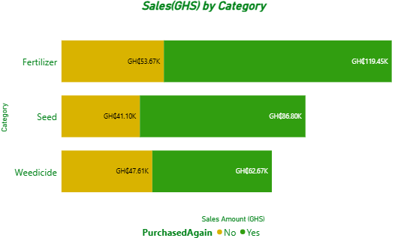
Sales & Repeat Behavior
Fertilizers lead in total revenue share.
Fertilizers also have the highest repeat purchase rate.

Slide 5
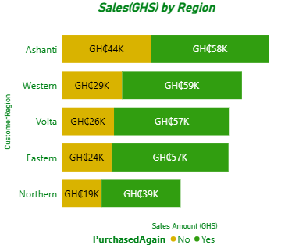
Regional and Time-Based Trends
Ashanti region has highest sales, Western region leads leads in loyalty.

Slide 6
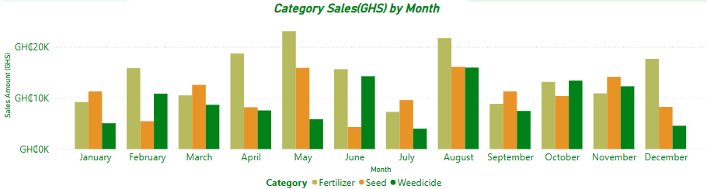
Regional and Time-Based Trends
Seasonal peak in May and August.

Slide 7
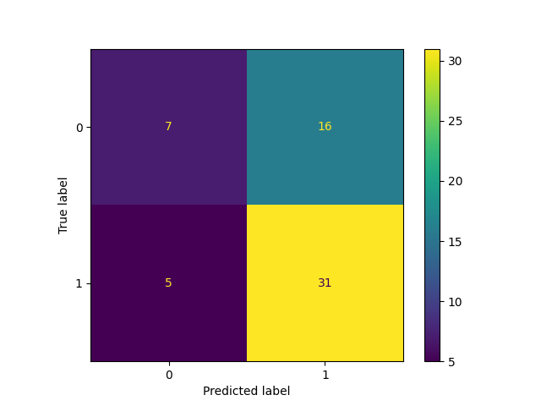
Predictive Modeling & Recommendations
Logistic Regression model for PurchasedAgain prediction.
Model accuracy and precision are 64% and 66% respectively.
Key Features: Quantity, Price, Category, Region, Month.
Recommendations:
Target high-repeat regions and categories.
Align inventory with peak months.
Optimize price for volume orders.

Slide 8
Thank You!

