Slide 1

WP4
Daniel Campa

Slide 2

Purpose
How to use git-filter-repo
Tool for removing history from git repository
Motivation
git tracks all history
Sensitive data (passwords)
Large files

Slide 3
Audience
Those with a background in Computer Science
Minimal git experience
Basic Linux commands

Slide 4
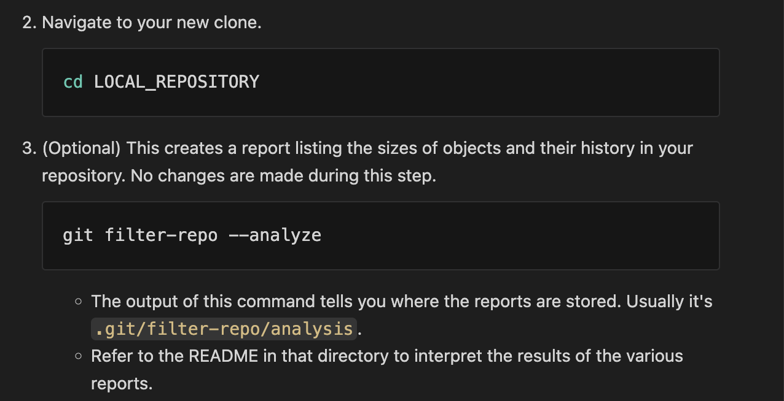
Conventions
Webpage
Created using markdown
Markdown Pros
Easy to create
Scales automatically for split screen
Industry standard

Slide 5
Usability Test
Tester
Computer Science student
Matched target audience well
Conditions
My laptop
Artificial scenario
Lessons
Don’t imply or assume anything
More verifying steps

Slide 6
