Slide 1
SDLC Automation
Daniel Enríquez Barrera

Slide 2
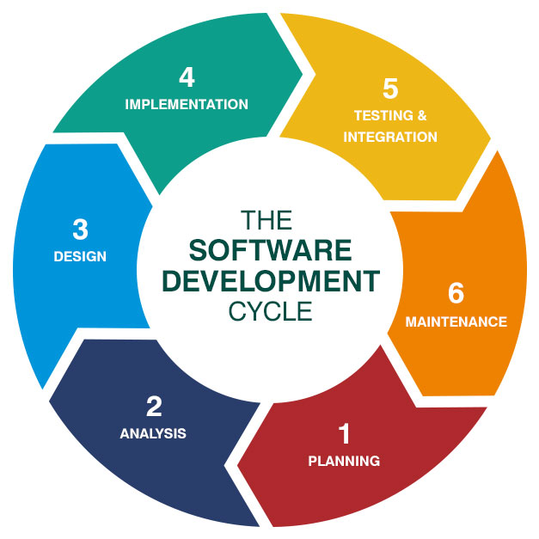
Table of contents
Continuous Integration
Continuous Delivery/Deployment
CI/CD Tools
Infrastructure as Code
Demo

Slide 3
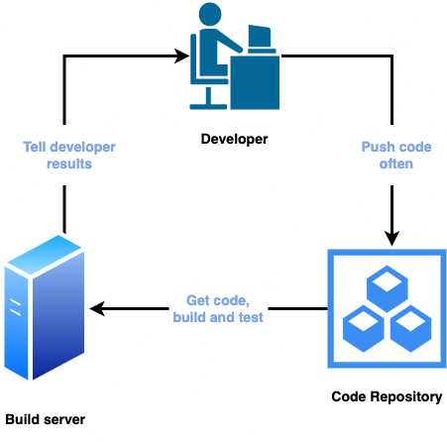
Continuous Integration
Notes:
1. Developers push the code to a code repository often (GitHub / CodeCommit / Bitbucket / etc…)
2. A testing / build server checks the code as soon as it’s pushed (CodeBuild / Jenkins CI / etc…)
3. The developer gets feedback about the tests and checks that have passed / failed
Pros
Find bugs early, fix bugs
Deliver faster as the code is tested
Deploy often

Slide 4
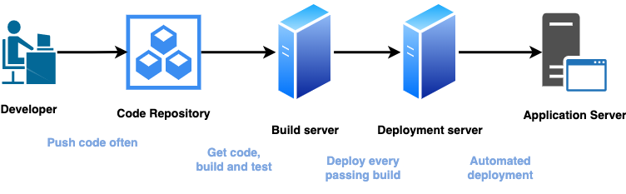
Continuous Delivery/Deployment
Notes:
Ensure that the software can be released reliably whenever needed.
Ensures deployments happen often and are quick
Shift away from “one release every 3 months” to ”5 releases a day”
Continuous Delivery:
• May involve a manual step to “approve” a deployment
Continuous Deployment:
• Full automation, every code change is deployed all the way to production
• No manual intervention of approvals

Slide 5
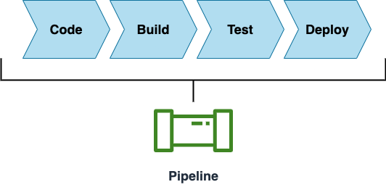
CI/CD Tools
Notes:
<<<<Explain the image>>>>

Slide 6

CodeCommit
Notes:
Version control is the ability to understand the various changes that happened to the code over time (and possibly roll back).
Benefits are:
• Collaborate with other developers
• Make sure the code is backed-up somewhere
• Make sure it’s fully viewable and auditable
CodeCommit
• private Git repositories
• No size limit on repositories (scale seamlessly)
• Fully managed, highly available
• Code only in AWS Cloud account => increased security and compliance
• Secure (encrypted, access control, etc…)
• Integrated with Jenkins / CodeBuild / other CI tools

Slide 7

CodeBuild
Notes:
Fully managed build service
• Alternative to other build tools such as Jenkins
• Continuous scaling (no servers to manage or provision – no build queue)
• Pay for usage: the time it takes to complete the builds
• Leverages Docker under the hood for reproducible builds
• Possibility to extend capabilities leveraging our own base Docker images
• Source Code from GitHub / CodeCommit / CodePipeline / S3…
• Build instructions can be defined in code (buildspec.yml file)
• Output logs to Amazon S3 & AWS CloudWatch Logs
• Metrics to monitor CodeBuild statistics
• Use CloudWatch Events to detect failed builds and trigger notifications
• Use CloudWatch Alarms to notify if you need “thresholds” for failures
• CloudWatch Events / AWS Lambda as a Glue
• SNS notifications

Slide 8

CodeDeploy
Notes:
Fully managed deployment service that automates software deployments to a variety of compute services such as:
- EC2
- AWS Fargate
- AWS Lambda
- On-premises servers
Benefits
- makes it easier to rapidly release new features
- helps you avoid downtime during application deployment

Slide 9

CodePipeline
Notes:
Fully managed continuous delivery service that helps you automate your release pipelines for fast and reliable application and infrastructure updates based on the release model you define.
• Made of stages
• Each stage can have sequential actions and / or parallel actions
• Stages examples: Build / Test / Deploy / Load Test / etc…
• Manual approval can be defined at any stage
Pros
This enables you to rapidly and reliably deliver features and updates
You can easily integrate AWS CodePipeline with third-party services such as GitHub or with your own custom plugin.
pay for what you use.

Slide 10


Infrastructure as Code
Notes:
Infrastructure as Code (IaC) is the managing and provisioning of infrastructure through code instead of through manual processes.
With IaC, configuration files are created that contain your infrastructure specifications, which makes it easier to edit and distribute configurations.
Pros
No resources are manually created, which is excellent for control
The code can be version controlled for example using git
Changes to the infrastructure are reviewed through code
Each resources within the stack is stagged with an identifier so you can easily see how much a stack costs you
Savings strategy: In Dev, you could automation deletion of templates at 5 PM and

Slide 11
Demo Time

Slide 12
Any questions?

Slide 13
Thanks!

