Slide 1
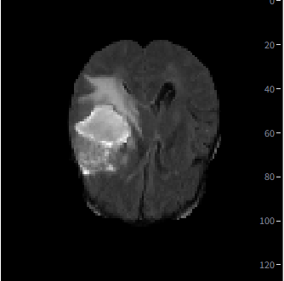
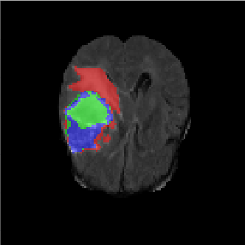
3D UNET GBM Auto Segmentation
DS18 – Chervin Daniel.

Slide 2
Intro
Automatic glioblastoma multiforme (GBM) segmentation refers to the use of computer algorithms—most often deep-learning models—to identify and delineate tumor regions in magnetic resonance imaging (MRI) scans without manual intervention.
Precision in Treatment Planning: Automatic GBM segmentation provides consistent, voxel-level delineation of tumor subregions (enhancing tumor, edema, necrosis(.
Efficiency & Scalability: Automated methods drastically reduce the time and labor of manual contouring.
Reproducibility & Objectivity: By minimizing inter- and intra-observer variability inherent to manual annotation.
Quantitative Monitoring: Enables robust quantification of tumor volume changes over time, supporting early assessment of treatment response and facilitating adaptive therapy strategies.

Slide 3
Datasets & repositories
Healthy Brain full scans in nifty format.
IXI dataset https://brain-development.org/ixi-dataset/
Brain full scans with GBM + labels (segmentation) nifty format.
BRATS dataset https://www.cancerimagingarchive.net/collection/ucsd-ptgbm/
Github repo
https://github.com/daniel-chervin/DS18_FinalProject/tree/main
Streamlit app
https://ds18finalproject-danielc.streamlit.app/

Slide 4
Two Strategies tested
Unsupervised (private interest)
Train Autoencoders on healthy brain MRI scans (IXI).
Inference on Brain scan with tumor and analyze reconstruction anomalies.
Does not require a labeled dataset, advantage.
Spoiler… not accurate enough segmentation, disadvantage.
Supervised
Train a 3D UNET CNN on MRI scans with GBM + labels dataset.
Evaluate on a ground truth scans with labels.

Slide 5
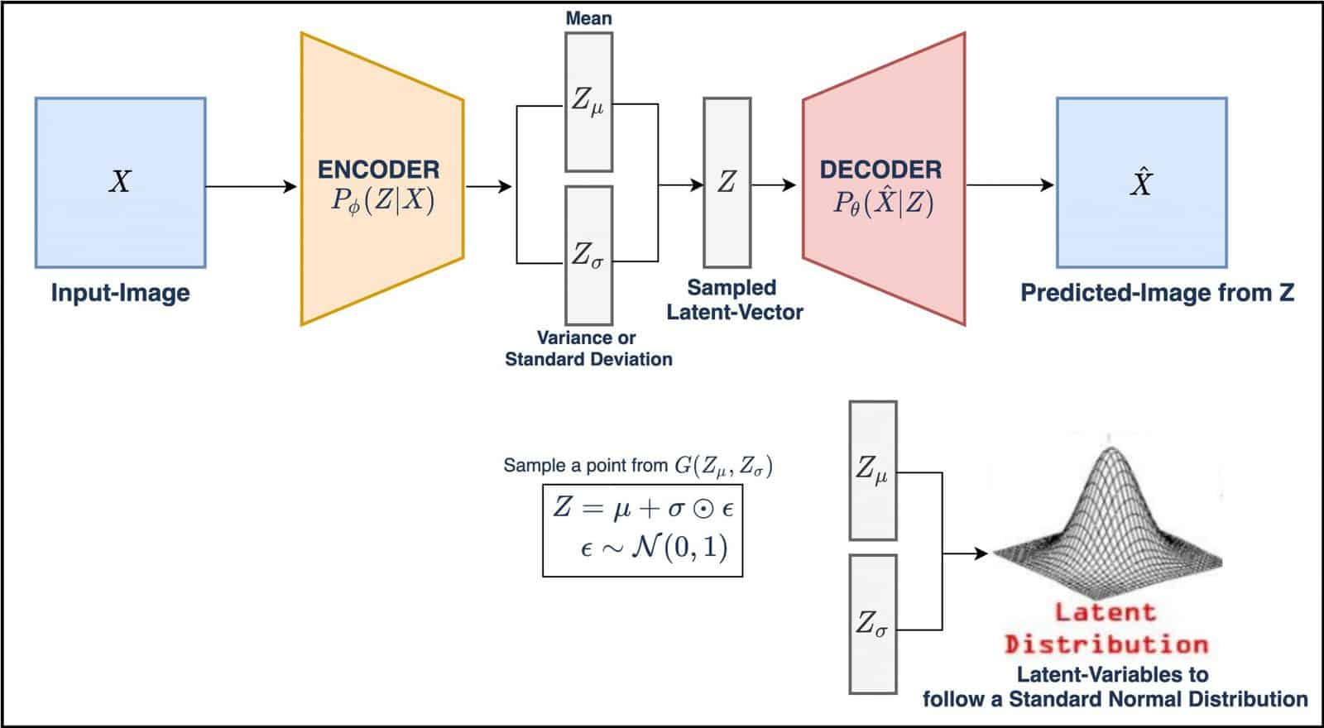
Unsupevised – VAE with MB Conv

Slide 6
Unsupevised – VAE with MB Conv
Input volume: A 3D scan enters the encoder.
Encoder path:
Series of MBConv3D blocks that expand channels and down-sample via stride.
Global average pooling yields a single feature vector.
Two linear layers produce μ and log σ² for the latent distribution.
Latent space (z): Sampling occurs via the reparameterization trick.
Decoder path:
Project z back to a small feature map.
Three rounds of ConvTranspose3D up-sampling followed by MBConv3D refinement.
Final 1×1×1 convolution reconstructs the single-channel volume.

Slide 7
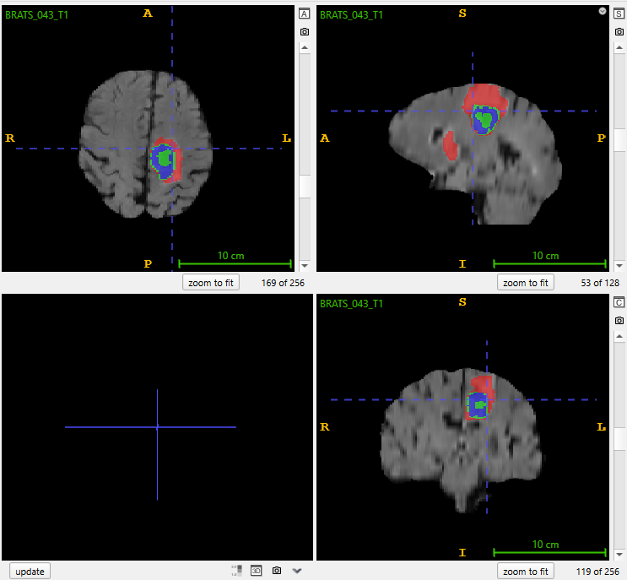
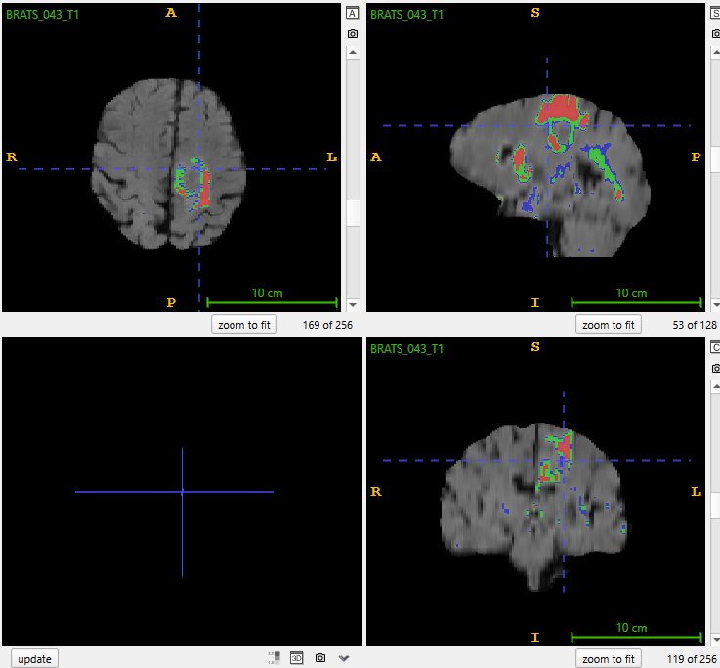
VAE MBConv results

Slide 8
VAE MBConv conclussions
VAE + MBConv model is consistently picking up the high-contrast core of the tumor
Under-segmentation, misses central and peripheral regions.
Spurious false positives, small, scattered green/blue islands in regions where the ground truth has none.
Shape irregularity, jagged output, holes…
Next steps (post DS18 ;)
Increase latent capacity.
Morphological post-processing, eliminate spurious islands and fill holes.
Etc…
Overall
Catches the tumor but requires more investigation and refinement of the architecture to segment the full region and handle false positives.

Slide 9
Supervised - 3D UNET
U-Net is a CNN architecture originally designed for biomedical image segmentation, featuring a symmetric “U-shaped” encoder–decoder.
The encoder (contracting path) repeatedly applies convolutional blocks and down-sampling to capture context and extract deep features.
The decoder (expansive path) uses transposed convolutions to up-sample feature maps and gradually recover spatial resolution.
Skip connections link each encoder layer to its corresponding decoder layer, concatenating feature maps to preserve fine-grained localization.
With its efficient use of data and strong localization ability, U-Net has become a foundational model for medical and semantic segmentation tasks.

Slide 10
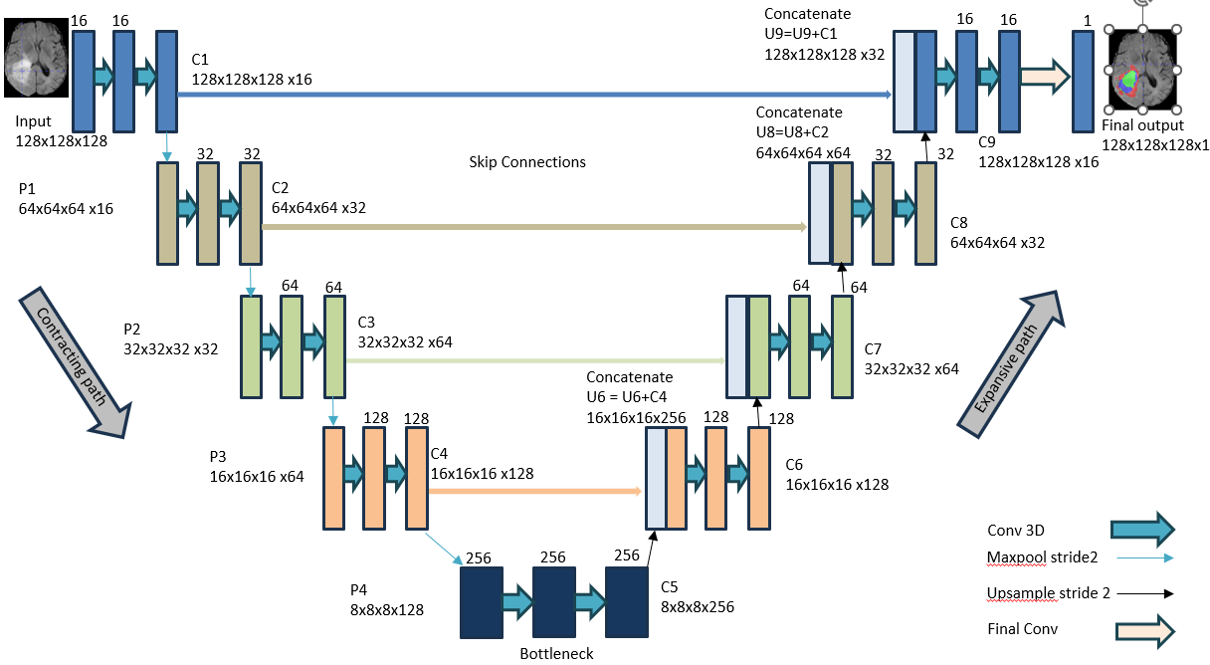
Supevised – 3D UNET Architecture

Slide 11
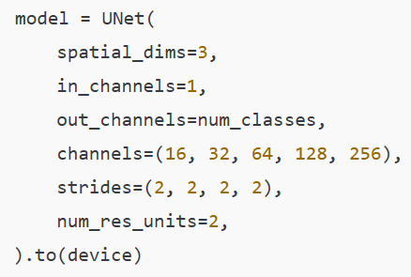
3D UNET with Monai
Encoder:
Input → 2×ResUnit @16 → ↓
16 → 2×ResUnit @32 → ↓
32 → 2×ResUnit @64 → ↓
64 → 2×ResUnit @128 → ↓
Bottleneck :
2×ResUnit @256
Decoder:
↑ 2×ResUnit @128 ← Skip from step 4
↑ 2×ResUnit @64 ← Skip from step 3
↑ 2×ResUnit @32 ← Skip from step 2
↑ 2×ResUnit @16 ← Skip from step 1
Final:
1×1×1 Conv → num_classes (=4) channel output

Slide 12
3D UNET with Monai
Input: A 128×128×128 MRI volume.
Contracting (“Encoder”) Path
C1: two 3×3×3 Conv → ReLU layers producing 16 channels.
P1: 2×2×2 max-pool reduces to 64³.
C2: 2xResUnit(Conv+ReLU) → 32 channels; P2 → 32³.
C3: 2xResUnit(Conv+ReLU) → 64 channels; P3 → 16³.
C4: 2xResUnit(Conv+ReLU) → 128 channels; P4 → 8³.
Bottleneck (C5): Conv block → 256 channels at 8³.
Expansive (“Decoder”) Path
U6: 2× up-sampling from 8³→16³, concatenate with C4 features (skip), then Conv block →128 channels.
U7: up-sample 16³→32³ + C3 skip → 2xResUnit(DeConv+ReLU) →64 channels.
U8: up-sample 32³→64³ + C2 skip → 2xResUnit(DeConv+ReLU) →32 channels.
U9: up-sample 64³→128³ + C1 skip → 2xResUnit(DeConv+ReLU) →16 channels.
Final Output
A 1×1×1 Conv projects the 16-channel map to a single segmentation mask (128³×1).
Key Points
Symmetry: encoder and decoder mirror each other in depth and channel counts.
Skip Connections: direct concatenation of encoder features restores fine spatial detail.
3D Conv & Pool/Upsample: all operations are volumetric, preserving the 3D context.

Slide 13
3D UNET Packages & libraries
PyTorch:
Library for tensor operations and GPU acceleration.
Dataset, DataLoader: abstractions to wrap your data and batch/shuffle it efficiently during training.
nn: PyTorch’s module for building neural‐network layers and models.
optim: Provides optimizers (e.g. Adam), to update model weights via backpropagation (nn.CrossEntropyLoss).
SimpleITK (sitk): Utility for reading, writing, and preprocessing medical‐image volumes (e.g. NIfTI).
Scikit-learn:
train_test_split: helper to split file lists or arrays into training and validation sets.
UNet (from MONAI):
Off‐the‐shelf 3D U-Net implementation tailored for medical segmentation.
DiceLoss: A segmentation loss function that maximizes overlap (Dice coefficient) between prediction and ground truth

Slide 14
Monai 3D UNET Batch Inefrence
Setup directories for tumor or healthy test scans and their corresponding output folders, creating them if needed.
Load the trained model once from checkpoint_path and switch to evaluation mode.
Loop over all *-T1.nii.gz files in input_dir, stripping the suffix to build each output filename.
Read each volume with SimpleITK, convert to a NumPy array, and z-score normalize it.
Convert the array to a 1×1×D×H×W PyTorch tensor on the chosen device and run inference under torch.no_grad().
Compute the segmentation by taking argmax over the softmax channels.
Reconstruct a NIfTI from the label map (preserving original spacing/origin) and write it to output_dir, logging each save.

Slide 15
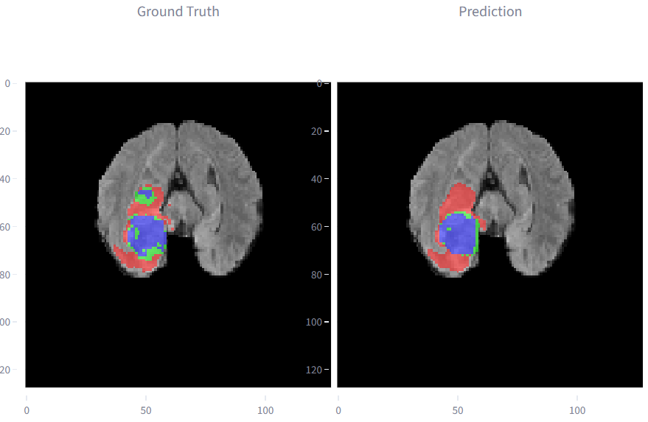
Monai 3D UNET Batch Inference

Slide 16
Monai 3D UNET Streamlit Demo
Batch inference ran in 3D_UNet_Brain_Tumor_Segmentation_multiclass_complete.ipynb notebook.
Inference ran on scans with tumors and healthy scans for reference.
Files for testing (Brain MRI, ground_truth & predicted segmentations) uploaded to GitHub then cached into Streamlit session memory on app startup (faster but heavier on resources, tricky).
Browse through:
Different cases/scans.
Different planed (axial, saggital & coronal)
Slide different slices.
Each case shows 4 views, MRI with overlayed segmentations (ground truth, predicted & combined) and MRI without overlays.
HelperFunftions.py
compute_segmentation_metrics - compares ground truth and predicted segmentations.
analyze_metrics_with_gpt – prompts openai and retrieves a readable analysis report.

Slide 17

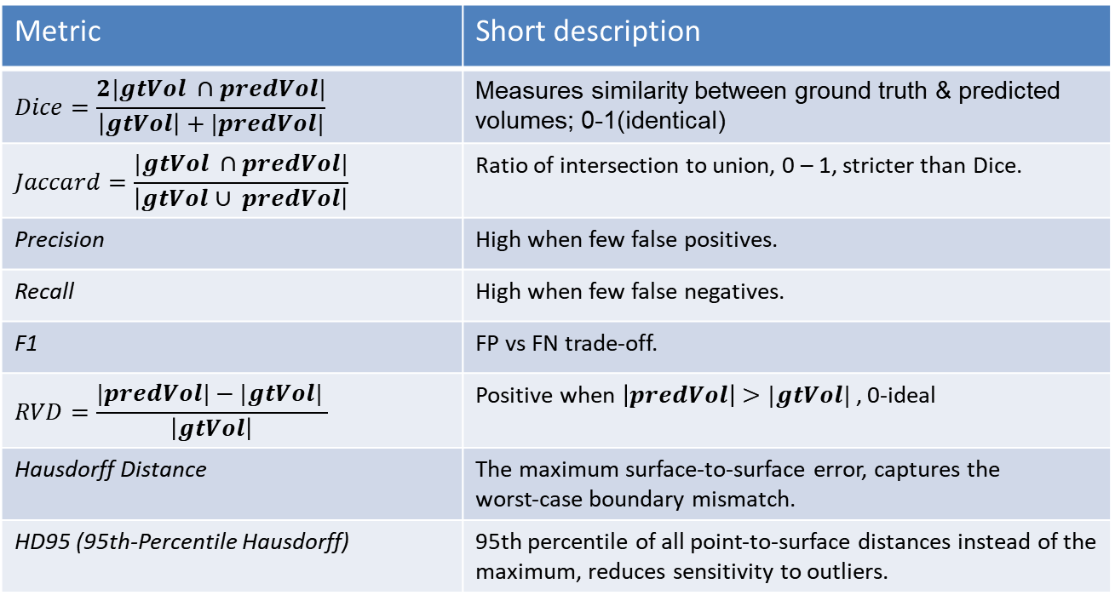
Monai 3D UNET Segmentation Metrics
Metric | Short description
$$Dice=\frac{2|gtVol ∩predVol|}{\left|gtVol\right|+|predVol|}$$ | Measures similarity between ground truth & predicted volumes; 0-1(identical)
$$Jaccard=\frac{|gtVol ∩predVol|}{\left|gtVol∪ predVol\right|}$$ | Ratio of intersection to union, 0 – 1, stricter than Dice.
Precision | High when few false positives.
Recall | High when few false negatives.
F1 | FP vs FN trade-off.
$$RVD=\frac{|predVol|−|gtVol| }{\left|gtVol\right|}$$ | Positive when $\left|predVol\right|>|gtVol|$, 0-ideal
Hausdorff Distance | The maximum surface-to-surface error, captures the worst‐case boundary mismatch.
HD95 (95th-Percentile Hausdorff) | 95th percentile of all point‐to‐surface distances instead of the maximum, reduces sensitivity to outliers.

Slide 18
3D UNET GBM Auto Segmentation
Next steps:
Continue investigation on unsupervised strategies & models.
Continue development & productization with 3D UNET automatic segmentation.

Slide 19
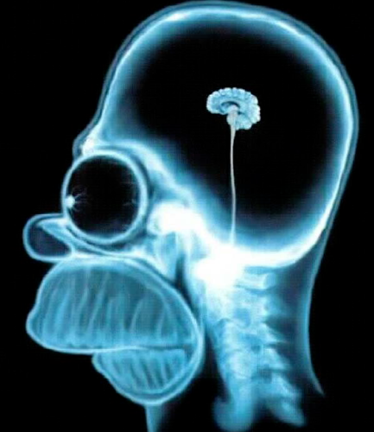
This is just the beginning…
Thank you!

Slide 20
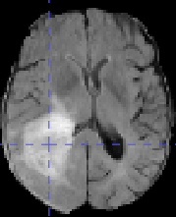
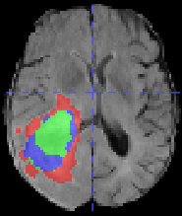
16
16
Concatenate
U9=U9+C1
128x128x128 x32
16
16
1
C1
128x128x128 x16
Input
128x128x128
Concatenate
U8=U8+C2
64x64x64 x64
Final output
128x128x128x1
32
32
32
32
C9
128x128x128 x16
Skip Connections
P1
64x64x64 x16
C2
64x64x64 x32
C8
64x64x64 x32
64
64
64
64
P2
32x32x32 x32
C3
32x32x32 x64
C7
32x32x32 x64
Expansive path
Contracting path
Concatenate
U6 = U6+C4
16x16x16x256
128
128
128
128
P3
16x16x16 x64
C4
16x16x16 x128
C6
16x16x16 x128
Conv 3D
256
256
256
Maxpool stride2
P4
8x8x8x128
C5
8x8x8x256
Upsample stride 2
Final Conv
Bottleneck

