Slide 1
Project report
Opportunistic Cellular Network
Federico Casu, Daniel Deiana, Erica Raffa

Slide 2
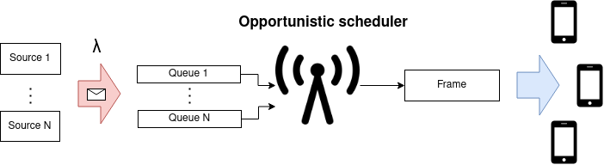
Introduction and Model
Objectives: We want to analyze the perfomance of an opportunistic cellular network using the following KPIs:
User perfomance
Throughput as number of bytes served per timeslot
Response time
Perceived fairness
Notes:
Erica

Slide 3
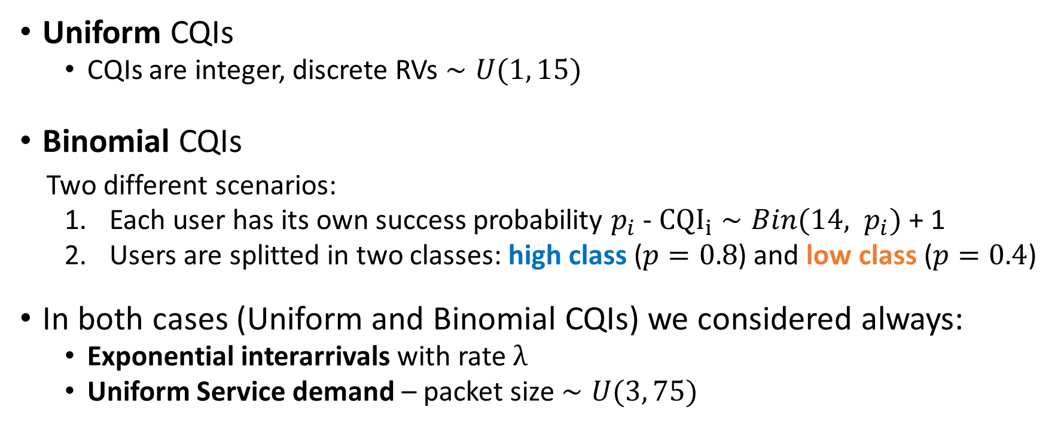
Scenarios
Uniform CQIs
CQIs are integer, discrete RVs $∼U(1, 15)$
Binomial CQIs
Two different scenarios:
Each user has its own success probability $p_{i}$ - ${CQI}_{i}∼Bin(14, p_{i})$ + 1
Users are splitted in two classes: high class ($p=0.8$) and low class ($p=0.4$)
In both cases (Uniform and Binomial CQIs) we considered always:
Exponential interarrivals with rate $λ$
Uniform Service demand – packet size $∼U(3, 75)$
Notes:
Erica

Slide 4
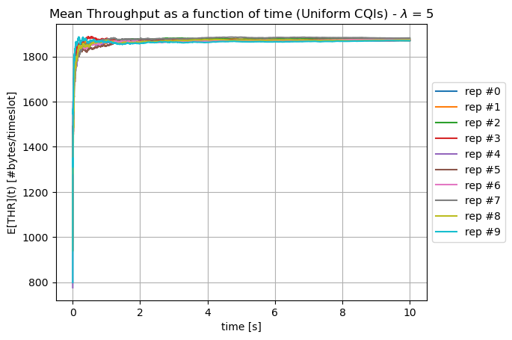
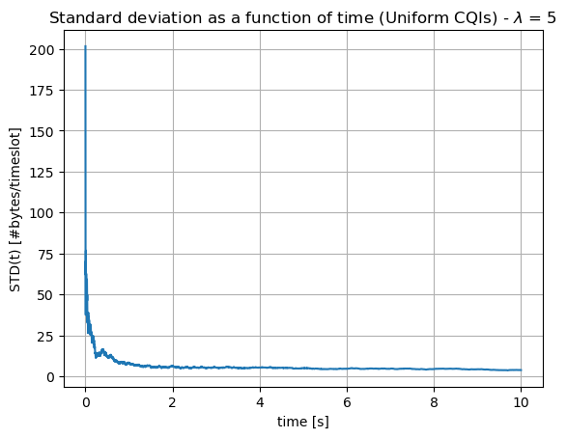
Warmup period and simulation time
Reference: Antenna slotted throughput
Warm-up time: 2 s
We observed the trajectory of the mean throughput, for 10 different repetitions, to see when the transitory has passed.
Simulation time: 10 s
We observed the trajectory of the sample standard deviation among different repetitions.
In both cases we considered the worst-case scenario, and we used them for all simulations.
Notes:
Federico

Slide 5
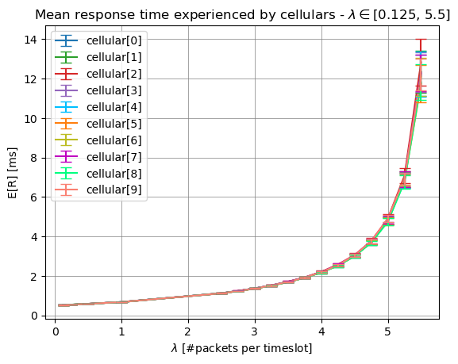
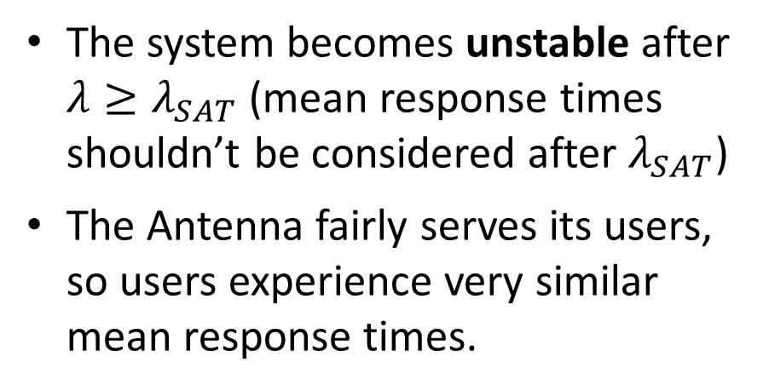
Response time analysis (Uniform)
The system becomes unstable after $λ≥λ_{SAT}$ (mean response times shouldn’t be considered after $λ_{SAT}$)
The Antenna fairly serves its users, so users experience very similar mean response times.
Notes:
Federico

Slide 6
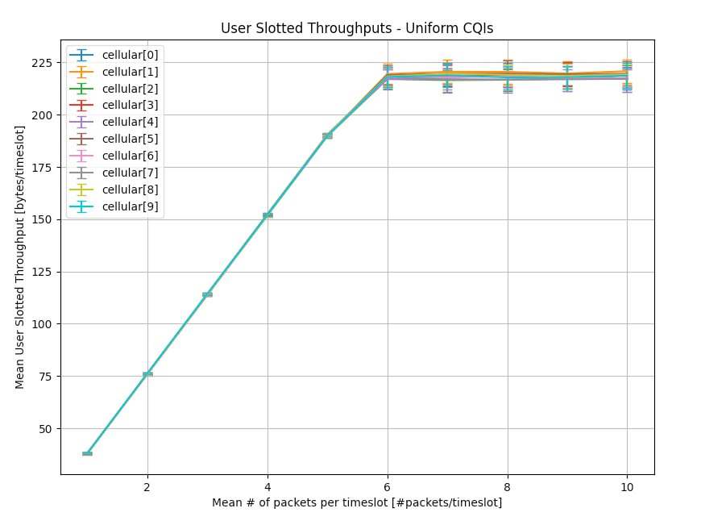
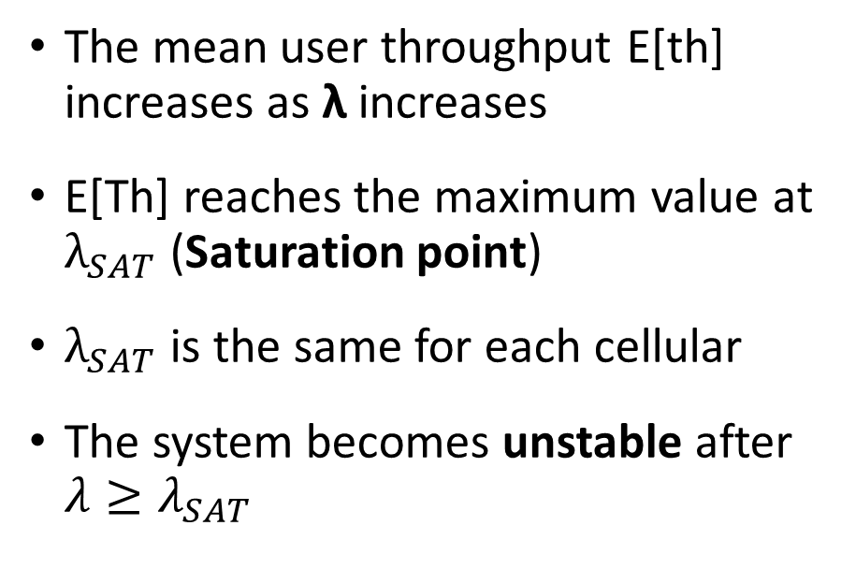
Throughput Analysis (Uniform)
The mean user throughput E[th] increases as λ increases
E[Th] reaches the maximum value at $λ_{SAT}$ (Saturation point)
$λ_{SAT}$ is the same for each cellular
The system becomes unstable after $λ≥λ_{SAT}$
Notes:
Erica

Slide 7
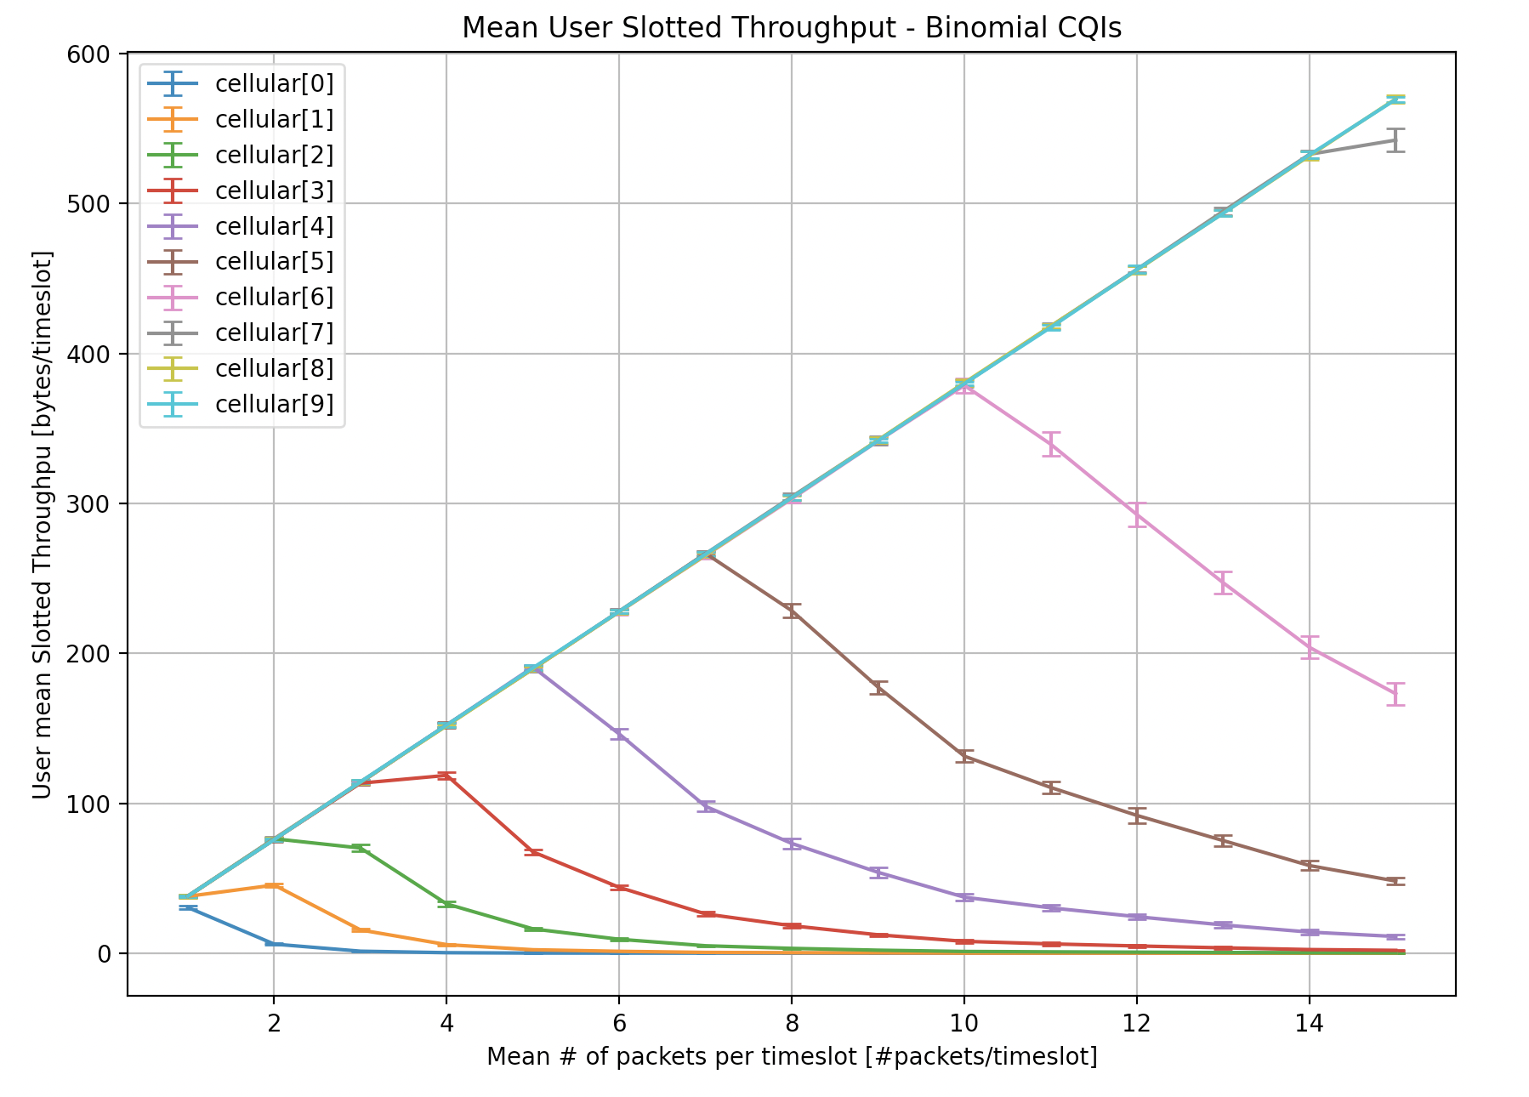
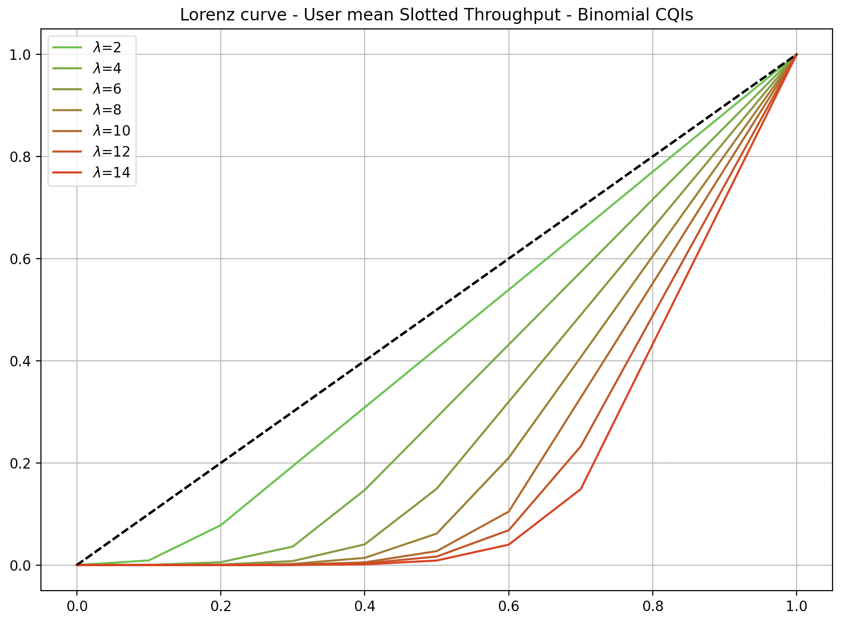
Throughput Analysis (Binomial)
Low CQI users tend to be excluded as the workload increases (their throughput eventually tends to 0).
System fairness is heavily affected by workload.
Notes:
Daniel

Slide 8
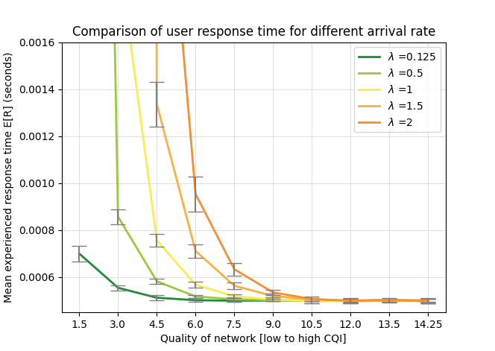
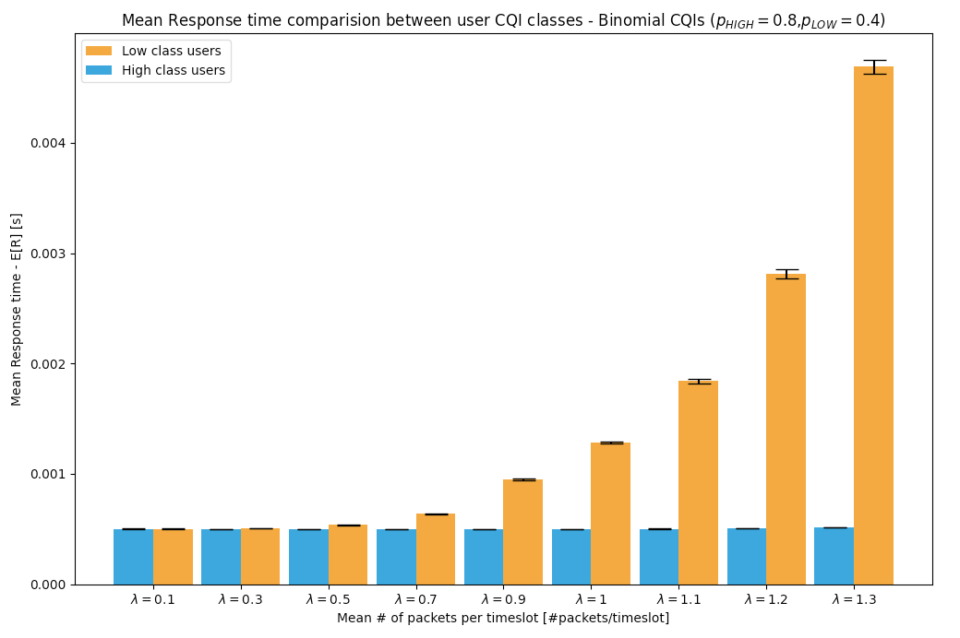
Response time analysis (Binomial)
Another point of view:
"High" and "low" class of users
The Antenna prioritizes the high-class users
Low CQI class experiences worse response times respect to high CQI class starting from λ ≥ 0.3
Increases of λ results in the evident rise of the mean response time E[R]
The lower CQIs' performance are strongly more affected
Notes:
Federico

Slide 9
Conclusions
The opportunistic scheduling policy, in general, prioritize users which experience a better quality of network.
The scheduling policy aims to maximize throughput.
What is the purpose of having an opportunistic scheduling policy?
Building a network which advantages the users depending on their perceived network quality.
This type of scheduling policy shouldn’t be used when is required a minimum QoS, if the perceived network quality among all users is heterogeneous.
Notes:
Daniel

Slide 10
Questions?

