Slide 1
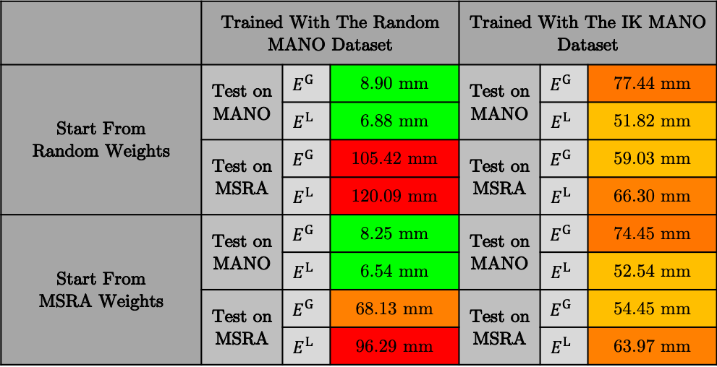
 | Trained With The Random MANO Dataset |  |  | Trained With The IK MANO Dataset
Start From Random Weights | Test on MANO | $$E^{G}$$ | 8.90 mm | Test on MANO | $$E^{G}$$ | 77.44 mm
 |  | $$E^{L}$$ | 6.88 mm |  | $$E^{L}$$ | 51.82 mm
 | Test on MSRA | $$E^{G}$$ | 105.42 mm | Test on MSRA | $$E^{G}$$ | 59.03 mm
 |  | $$E^{L}$$ | 120.09 mm |  | $$E^{L}$$ | 66.30 mm
Start From MSRA Weights | Test on MANO | $$E^{G}$$ | 8.25 mm | Test on MANO | $$E^{G}$$ | 74.45 mm
 |  | $$E^{L}$$ | 6.54 mm |  | $$E^{L}$$ | 52.54 mm
 | Test on MSRA | $$E^{G}$$ | 68.13 mm | Test on MSRA | $$E^{G}$$ | 54.45 mm
 |  | $$E^{L}$$ | 96.29 mm |  | $$E^{L}$$ | 63.97 mm

